Slide 1
How to build RGB Light Stips for your Micro:bit

Slide 2
Materials
Soldering Iron Kit – Not necessary if you already own one + solder.
RGB LED strip – WS2812B type
Alligator Clips Test Lead Set

Slide 3
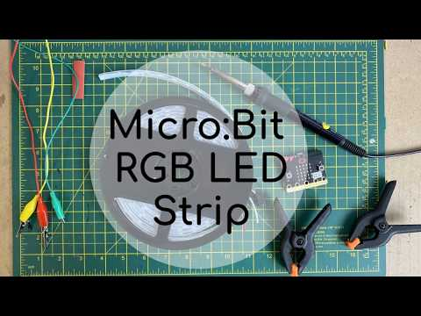

Slide 4
Instructions are also available through this link.
Credit: AlwaysComputing

Slide 5
Note: Make sure when soldering that you only solder to the left of how data is transferred through the strip.

Slide 6
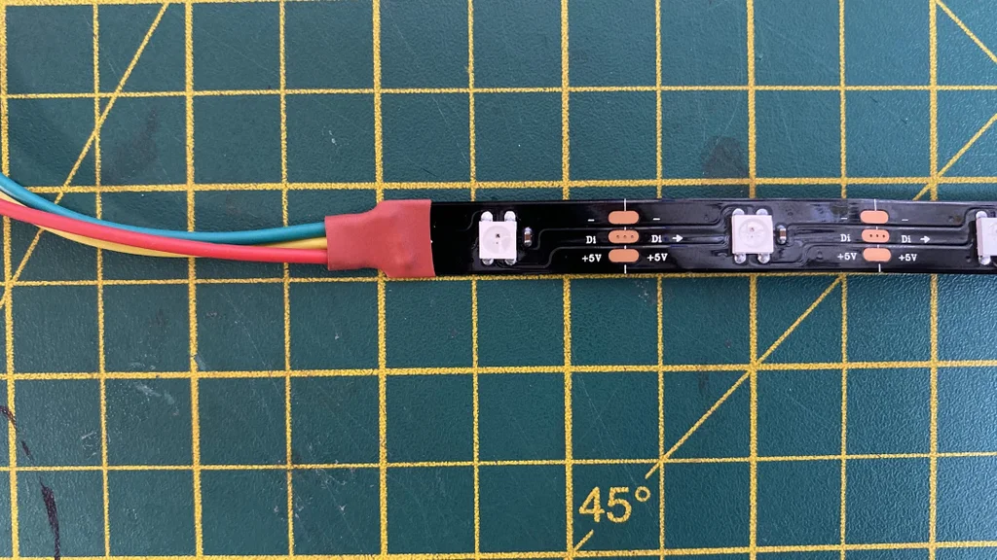
This arrow indicates the direction of data.
L

Slide 7
