Slide 1

Exploring outputs with an RGB light Strip

Slide 2
Objectives
Understand the principles of light and color codes in computer science
Adjust, sequence, and control an RGB light strip as an output for a computational artifact.

Slide 3
Pair-Programming Reminder
Driver will work on the computer importing or downloading block code and modifying code.
Navigator will wire the microcontroller and sensors and coach the coding.

Slide 4
Opening Questions
How does a computer show color?
What does color indicate to us as a user?

Slide 5
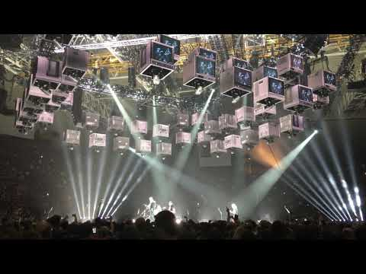

Slide 6
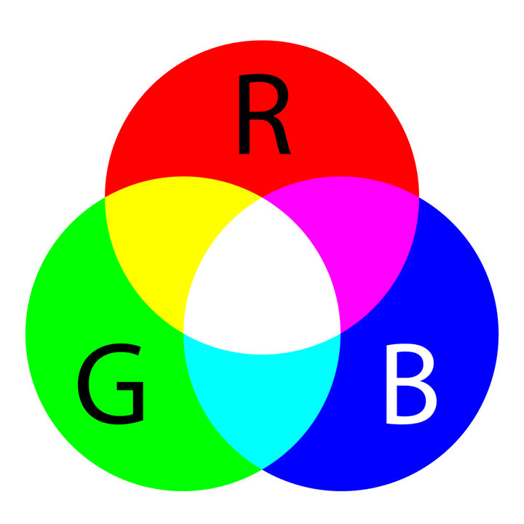
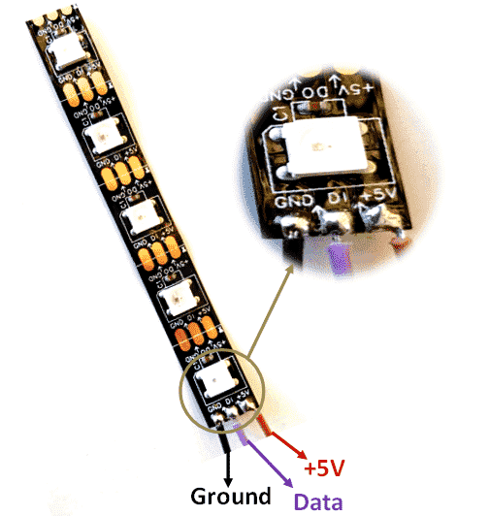
What is a RGB LED Strip?
https://www.google.com/search?q=color+picker
Notes:
RGB LED Strip: An LED strip light is a flexible circuit board populated by surface mounted light-emitting diodes (SMD LEDs) and other components that usually comes with an adhesive backing. Traditionally, strip lights had been used solely in accent lighting, backlighting, task lighting, and decorative lighting applications. Increased luminous efficacy and higher-power SMDs have allowed LED strip lights to be used in applications such as high brightness task lighting, fluorescent and halogen lighting fixture replacements, indirect lighting applications, Ultra Violet inspection during manufacturing processes, set and costume design, and even growing plants.
RGB Color Wheel: The RGB color model is an additive color model in which red, green, and blue light are added together in various ways to reproduce a broad array of colors.
Source: Wikipedia

Slide 7
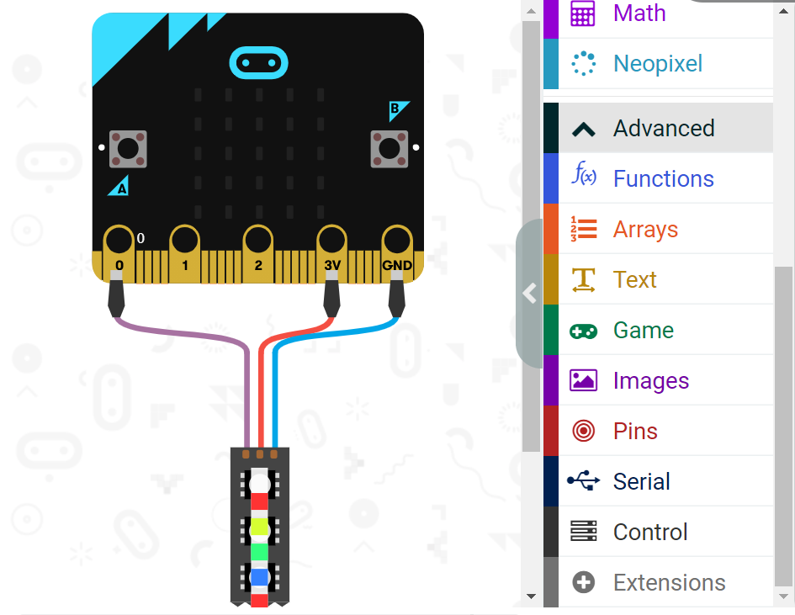
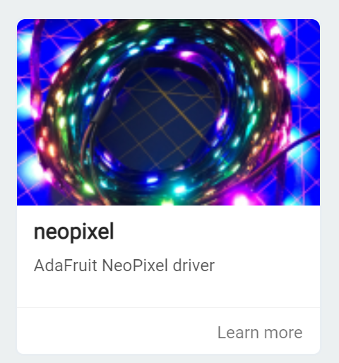
How to Control an RGB LED Light Strip

Slide 8
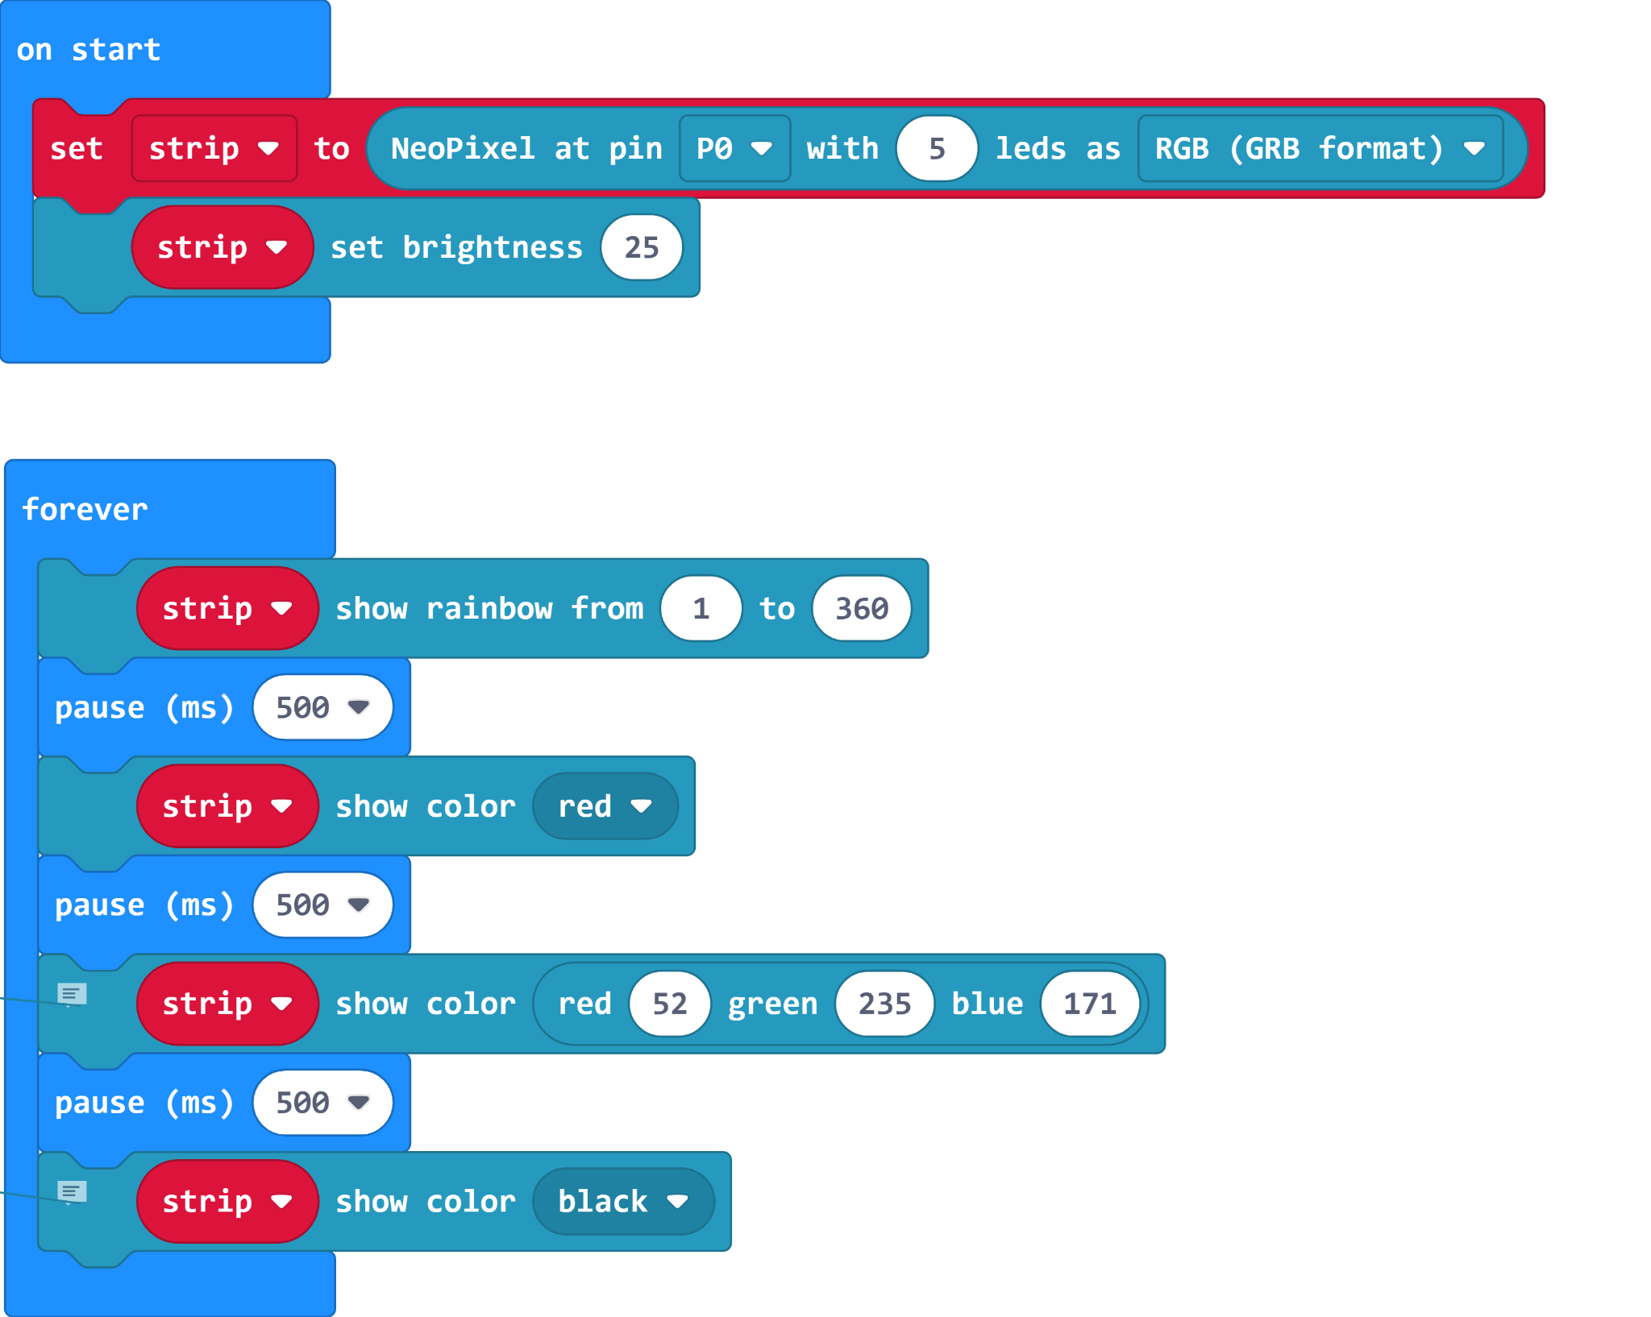
Make Code Example
What does this program do?

Slide 9
Exploration
What are the possibilities of this output component?
Note: The LED’s are quite bright make sure to set their brightness to 25 on start.

Slide 10
Challenge
Work with another student to create a new lighting effect for a concert that is going to be coming to town. Your client has set the criteria for what they want.
Button A - sequencing light pattern
Button B - Flashing light effect
Button A + B - A unique RGB color is shown (Use https://www.google.com/search?q=color+picker)
Shake - The grand finally (This is up to you and your partner to decide what happens)

