Slide 1
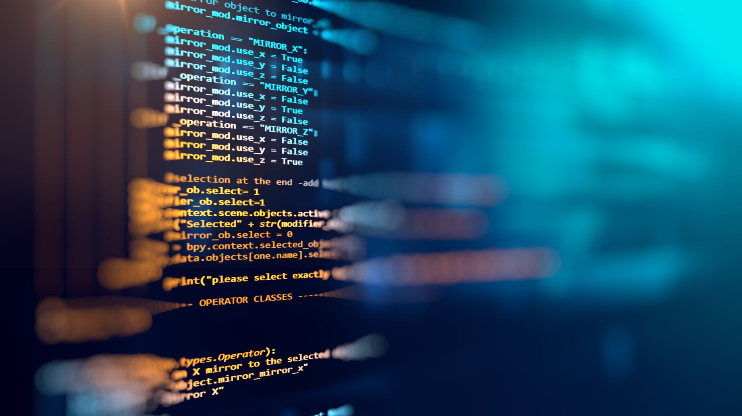
Introduction to Programming a MicroBit

Slide 2
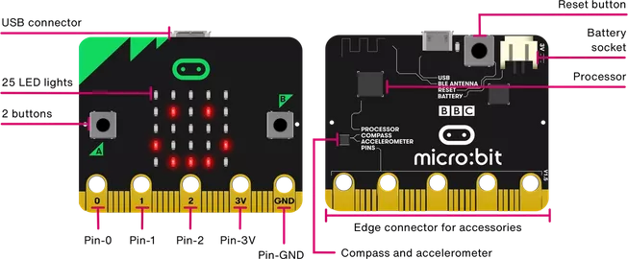
Computing Systems
Receive input (stimulus) from the world
Process input / information
Respond to input / information
Generate output (response) to the world
Foundations of Computing Systems
Main Operations
Cross-Disciplinary Connections
Let’s dive in to see what the processor (the brain) can do!
Programmers / Programming: Use Existing Instructions to Control Processor/Brains
Computer Scientist / Science: Create New Instructions / Optimize Instructions …

Slide 3
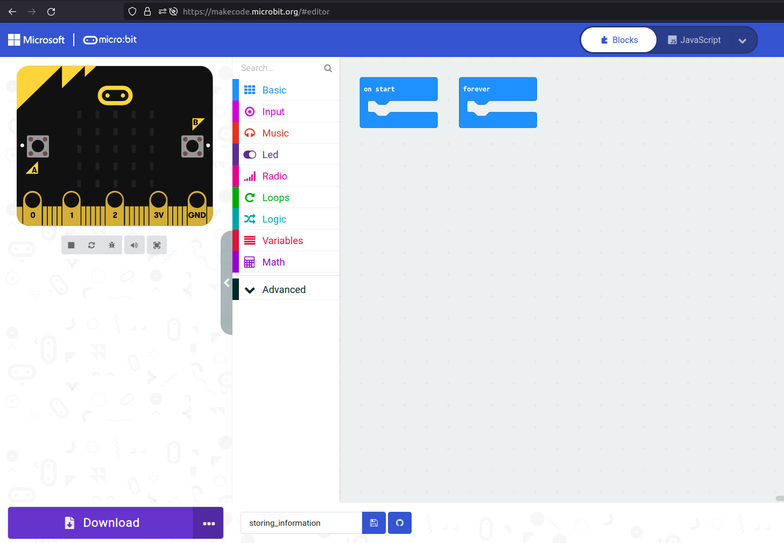
First a tour of our environment
makecode.microbit.org
Simulator
Tool/
Func.
Pallet
Programming area
“Deployment”

