Slide 1
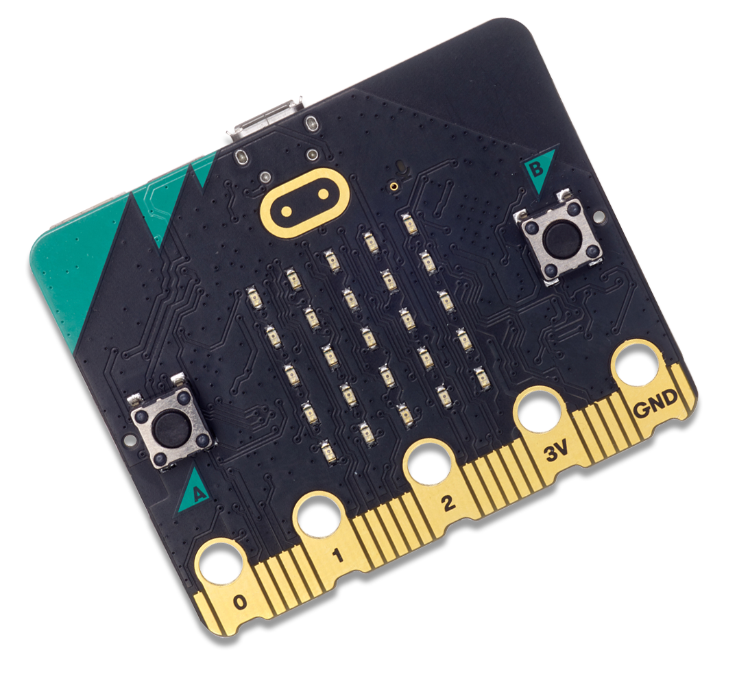
Introduction to Micro:bits!
Let’s have some fun learning!

Slide 2
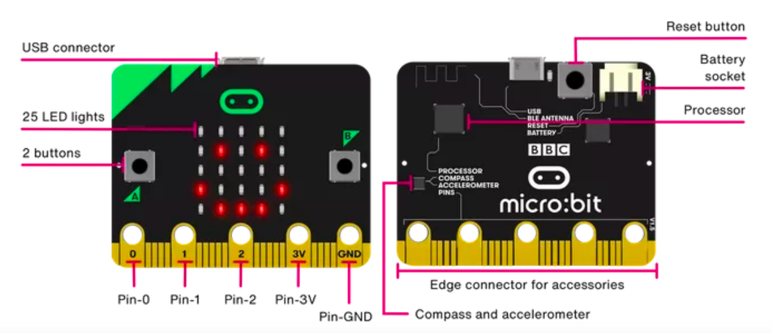
The Micro:bit!

Slide 3

The Basics: Buttons

Slide 4

The Basics: LEDs

Slide 5

The Basics: Radio

Slide 6

The Basics: Pins

Slide 7
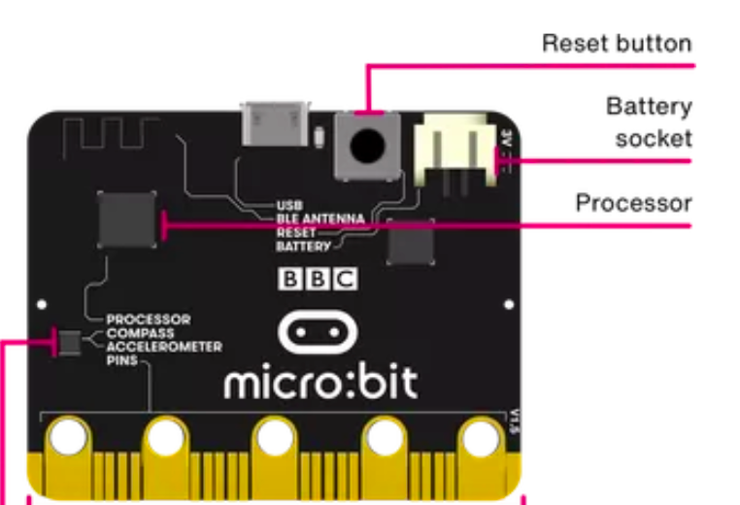
The Basics: Reset Button
Restart your micro:bit programs with the reset button.

Slide 8
The Basics: Battery
Instead of powering your micro:bit from the USB socket, you can unplug it from your computer and use a battery pack instead. This is really useful if you want to take your micro:bit outside, wear it or play games with it. It can run for a long time using just two AAA batteries.

Slide 9
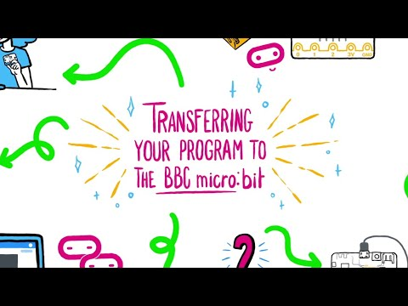
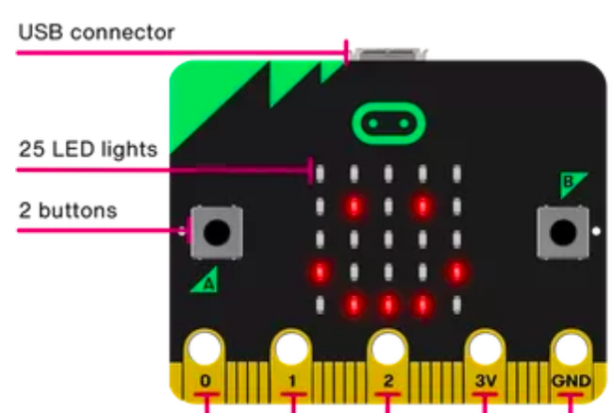
The Basics: Micro USB Socket & Downloading
The USB connector will be used to connect a cable from the micro:bit to your device with the USB port to download your program to the micro:bit.

Slide 10
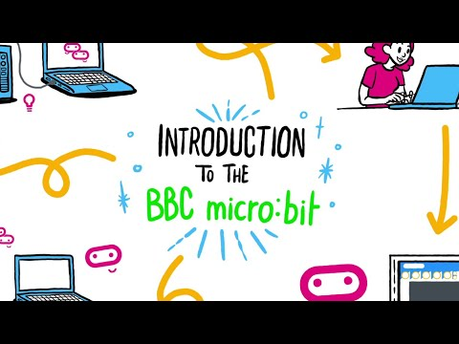
The Basics: Coding

Slide 11
Flashing Heart
https://microbit.org/projects/make-it-code-it/heart/

