Slide 1
What is a computer?
What is computer science?
#1

Slide 2



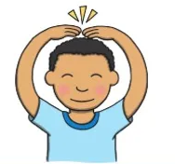
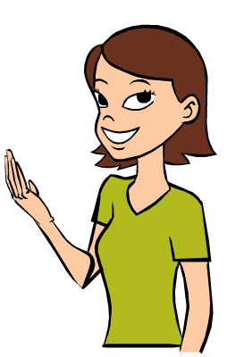
Computer Science
Computer science is
using the power of computers
to solve our problems
and express ourselves!

Slide 3
WHAT IS A COMPUTER?

Slide 4
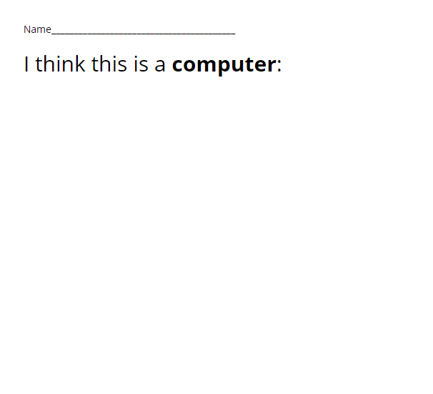
What is a computer?

Slide 5
Look at your computer...
How does your computer work? Do you press buttons or talk to it?
Does it solve a problem for someone?
Can we express our feelings or ideas using your computer?

Slide 6
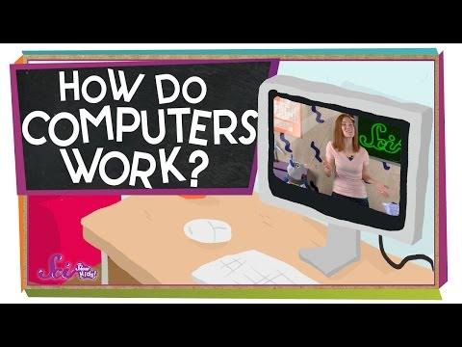
A little more information...

Slide 7
Next...
We are going to learn two new words:
INPUT
OUTPUT
Home

