Slide 1
That Could Be A Computer!
Learning Input and Output
#2

Slide 2



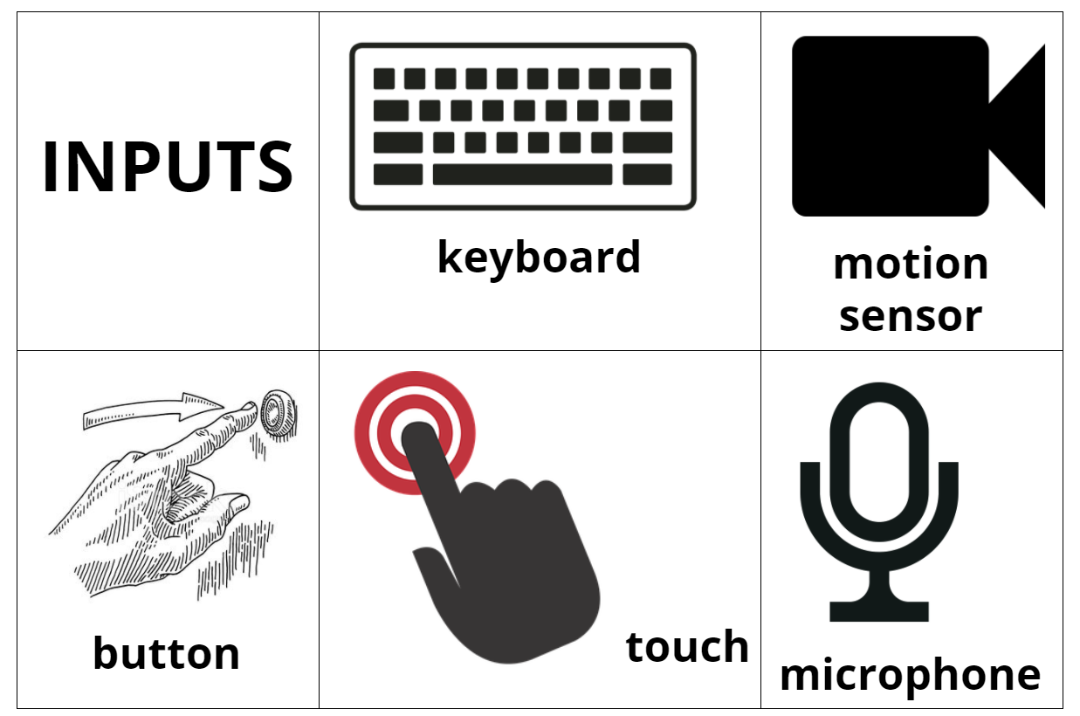



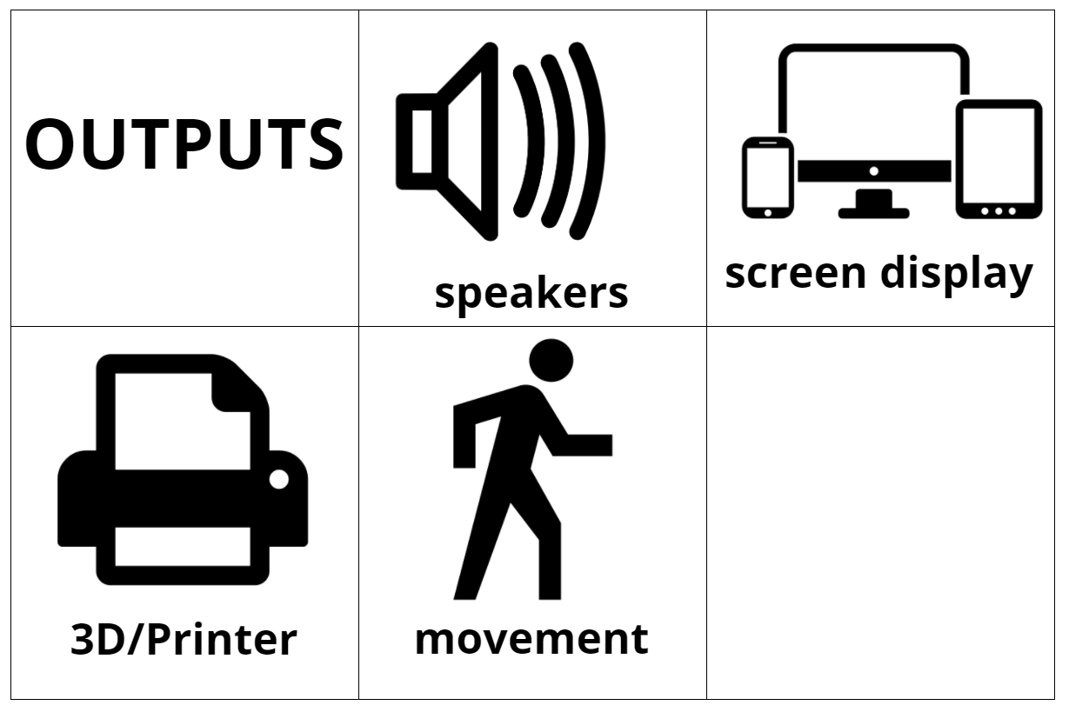

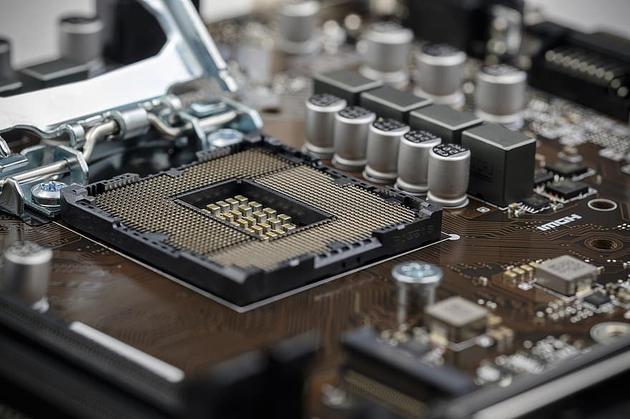
Big FANCY words...
Computer Science
Hardware

Slide 3
Input is what PEOPLE do!
People press keys or talk to a device or press a button. Can you think of other inputs?

Slide 4
Output is what the COMPUTER does.
Computers give information with pictures, words, sounds, printer papers. Can you think of other outputs?

Slide 5
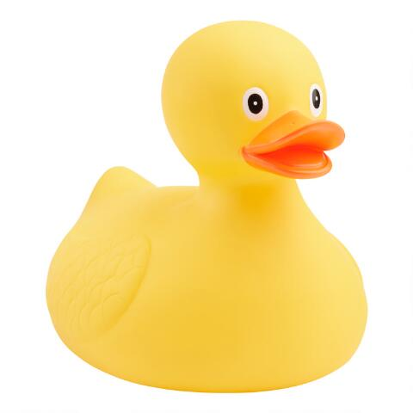
Is this a computer?
It could be...

Slide 6
It could be a computer if...
...I added a special button that when I press the button the duck quacks twice and says, “Today is Wednesday.” The input is a button. The output is the quacks and date.

Slide 7
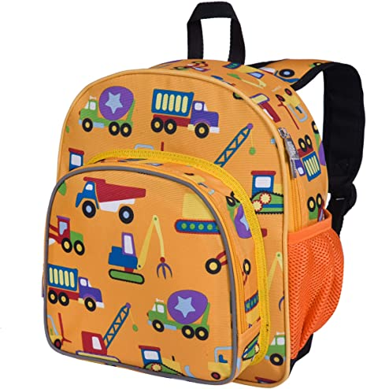
Is this a computer?
It could be...

Slide 8
It could be a computer if...
...I added a special piece to the handle so when I picked it up it would remind me to get my lunch box. The input is the handle. The output is the reminder.

Slide 9

Let’s play:
This is not a __________, it’s a computer that ___________________.
The input is ____________.
The output is _____________.

Slide 10
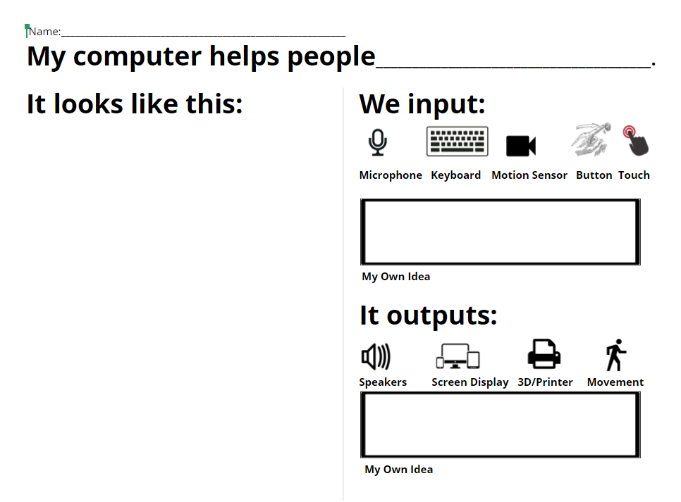
Try it yourself...

Slide 12
If you finish early you can color.

Slide 13
Next time...
In our next lesson, we’re going to be thinking like a computer by
SEQUENCING
Home

Slide 14

Free templates for all your presentation needs
For PowerPoint and Google Slides
100% free for personal or commercial use
Ready to use, professional and customizable
Blow your audience away with attractive visuals

