Slide 1
Secret Handshake Sequencing
#3
What is a sequence?

Slide 2

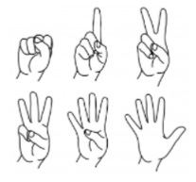
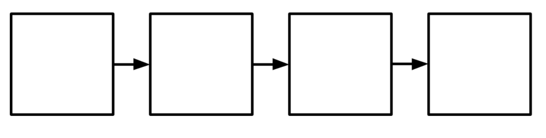
Big fancy words...
Computer Science
Sequence

Slide 3
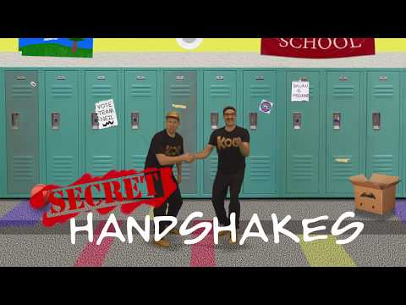
A cool way to say hello!

Slide 4

What order did they teach us the moves?

Slide 5
What order did they do the secret handshake?

Slide 6
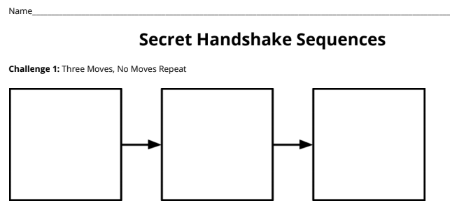
Challenge 1: Make a sequence using our three moves in any order you want.

Slide 7
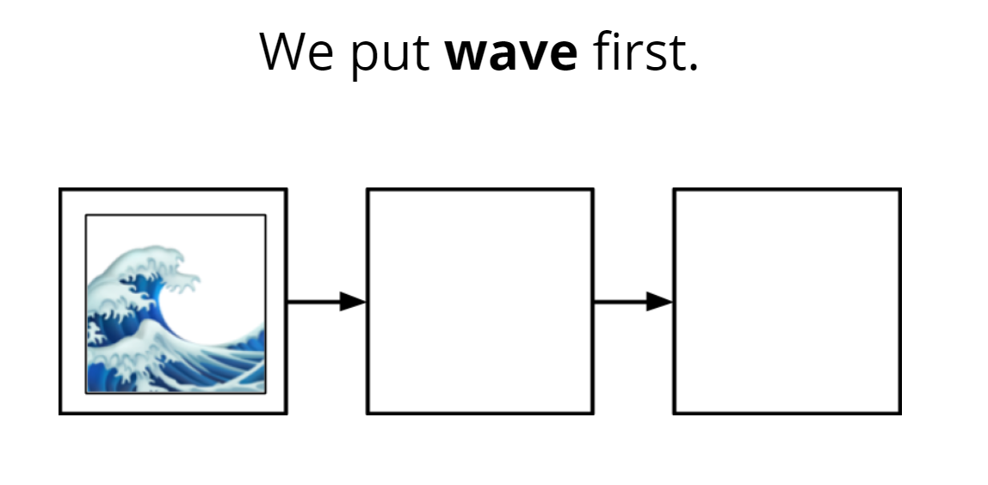
Stand up if...

Slide 8
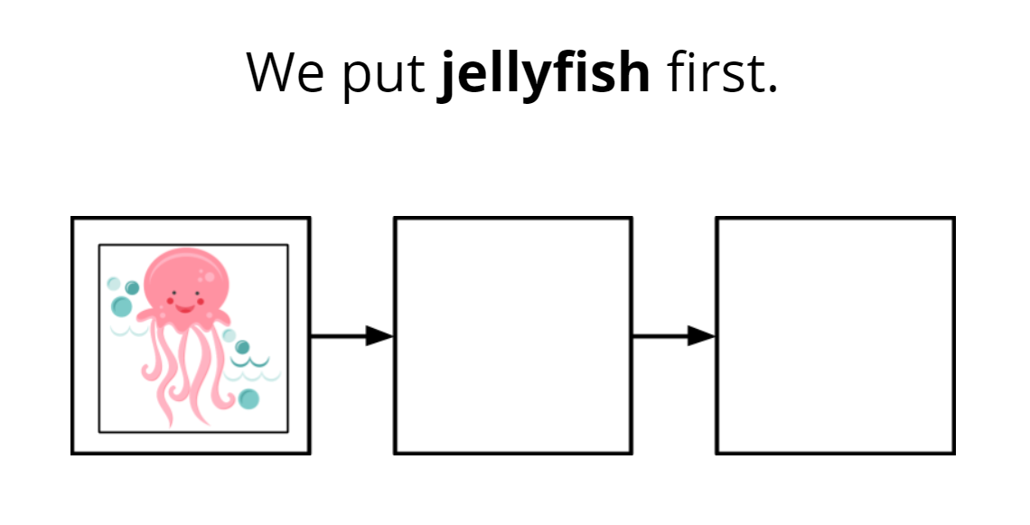
Stand up if...

Slide 9
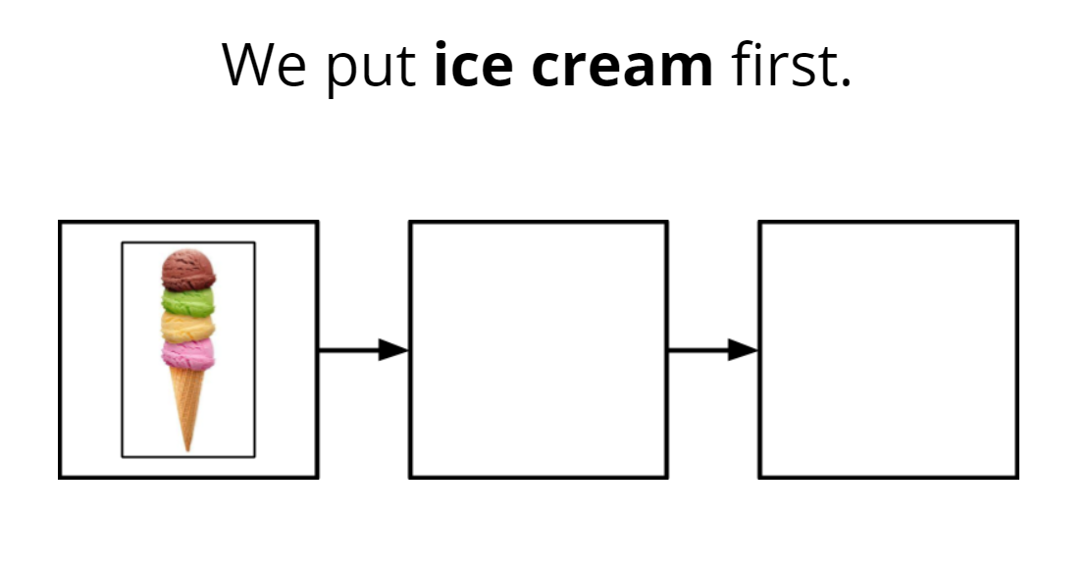
Stand up if...

Slide 10
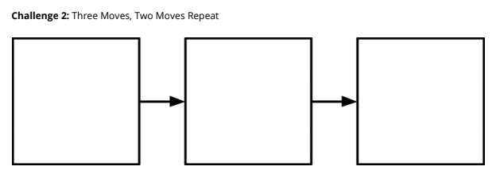
Challege 2 - SPICY - Make a sequence that uses only two moves but you do one twice.

Slide 11
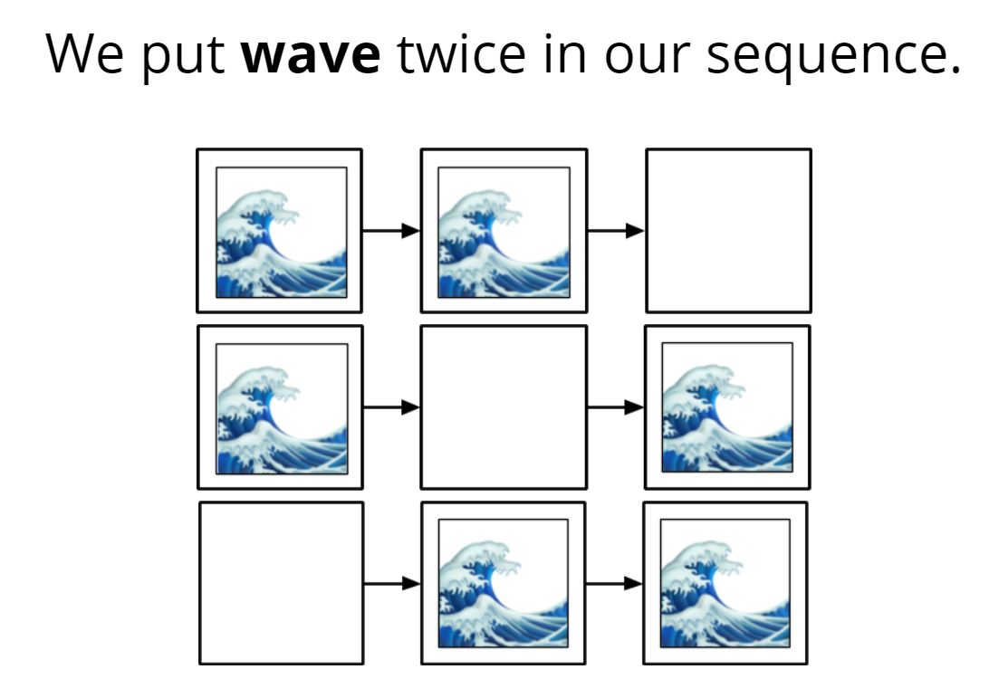
Stand up if...

Slide 12
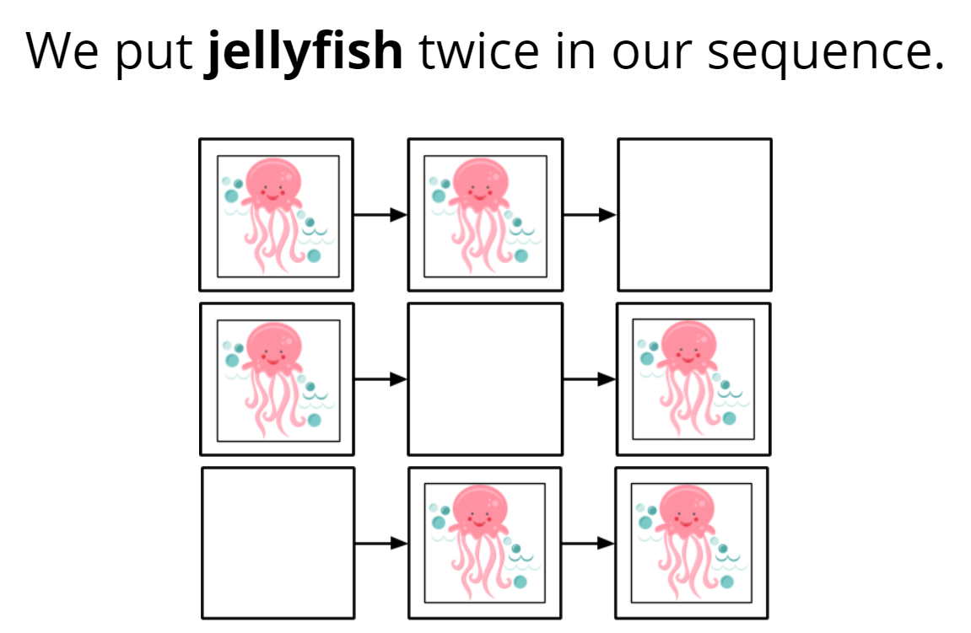
Stand up if...

Slide 13
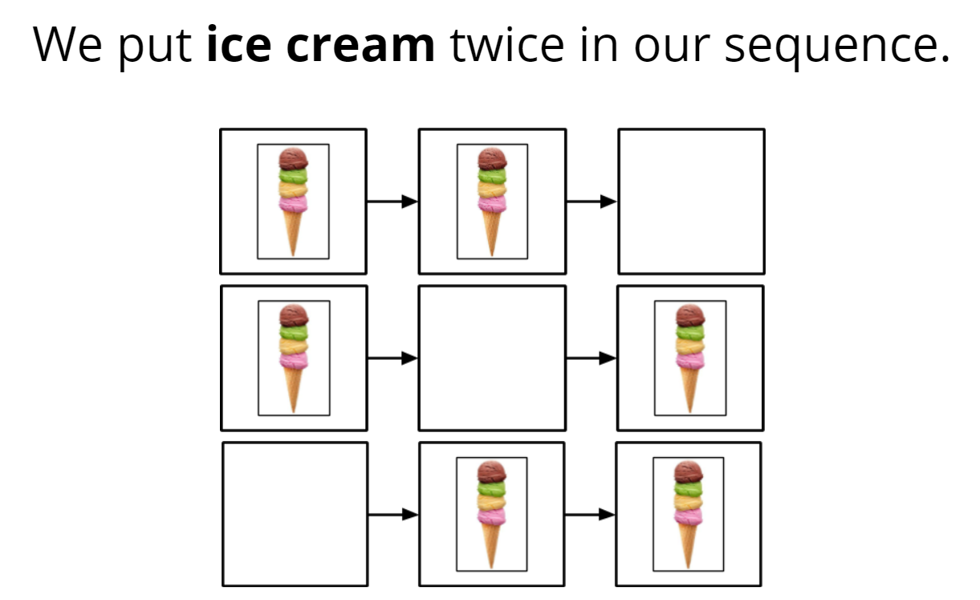
Stand up if...

Slide 14
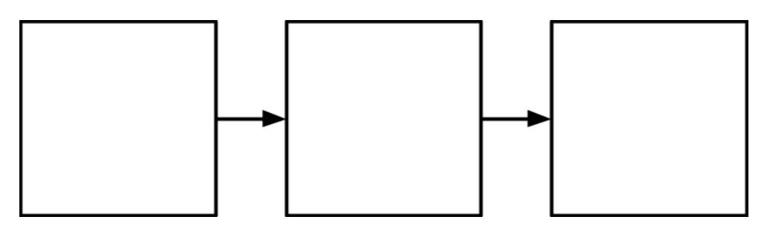
Challenge 3 - SPICIER - Pick two images to glue onto your sequence, then draw your own image.

Slide 15
Challenge 4 - SPICIEST - Make up FOUR of your very own moves for your sequence.

Slide 16
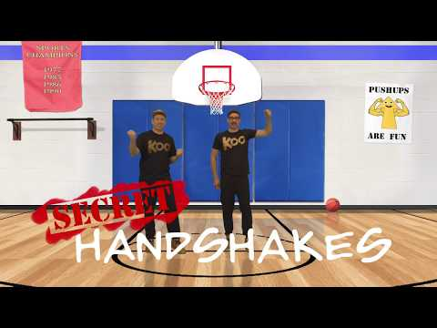
Just for fun!

Slide 17
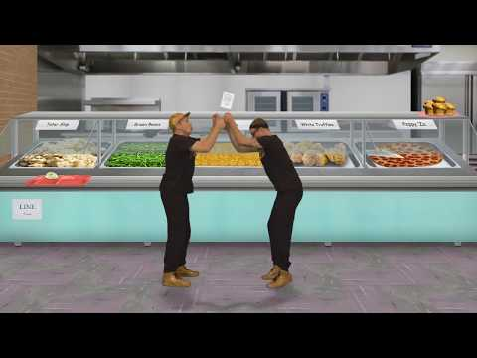
Try this...

Slide 18
Next...
We are going to do more thinking like a computer by looking for
PATTERNS
Home

