Slide 1
ages 9-11
Barefoot meets micro:bit
Litter Hunt - Lesson 1

Slide 2
Learning objectives
I can explain what the buttons and sensors on the micro:bit do
I can program sensors and buttons using the MakeCode editor
I can store data with variables using the MakeCode editor

Slide 3
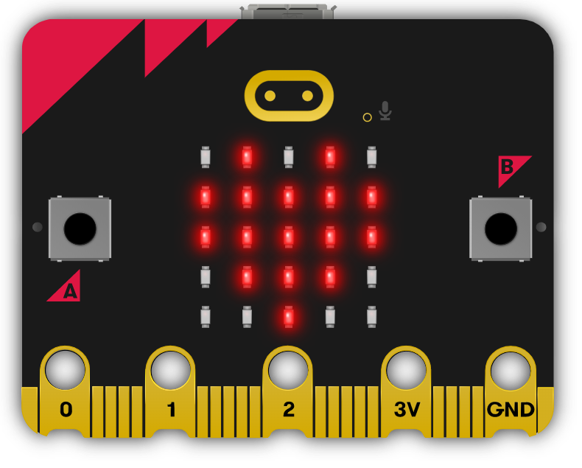
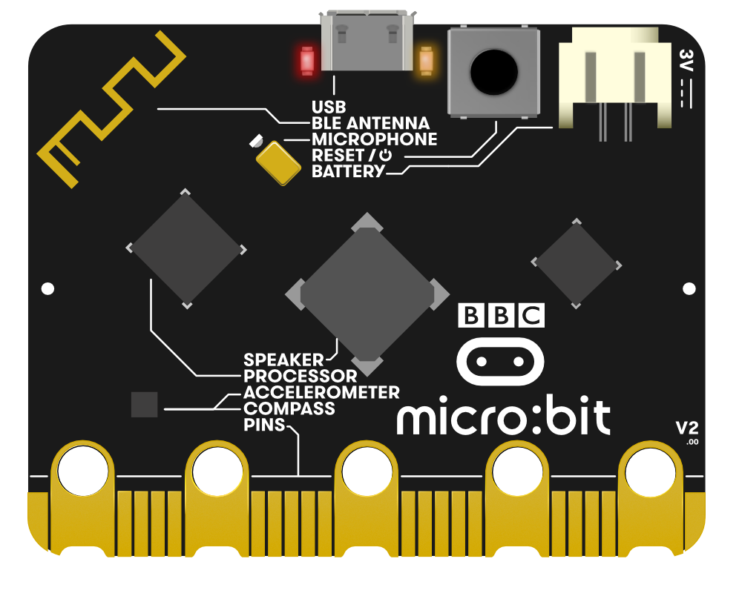
micro:bit
Can you find these parts?
LEDs
USB connector
Buttons
Accelerometer
Are the LEDs inputs or outputs?
What about the buttons and the accelerometer?
What other parts can you find and what do they do?
Notes:
Image © Micro:bit Educational Foundation

Slide 4
Can you remember?
We’ll be using the MakeCode programming environment - makecode.microbit.org
How do we?
Create a new project
Place “show icon” blocks into the programming area
Download the program
Transfer the program file to micro:bit

Slide 5
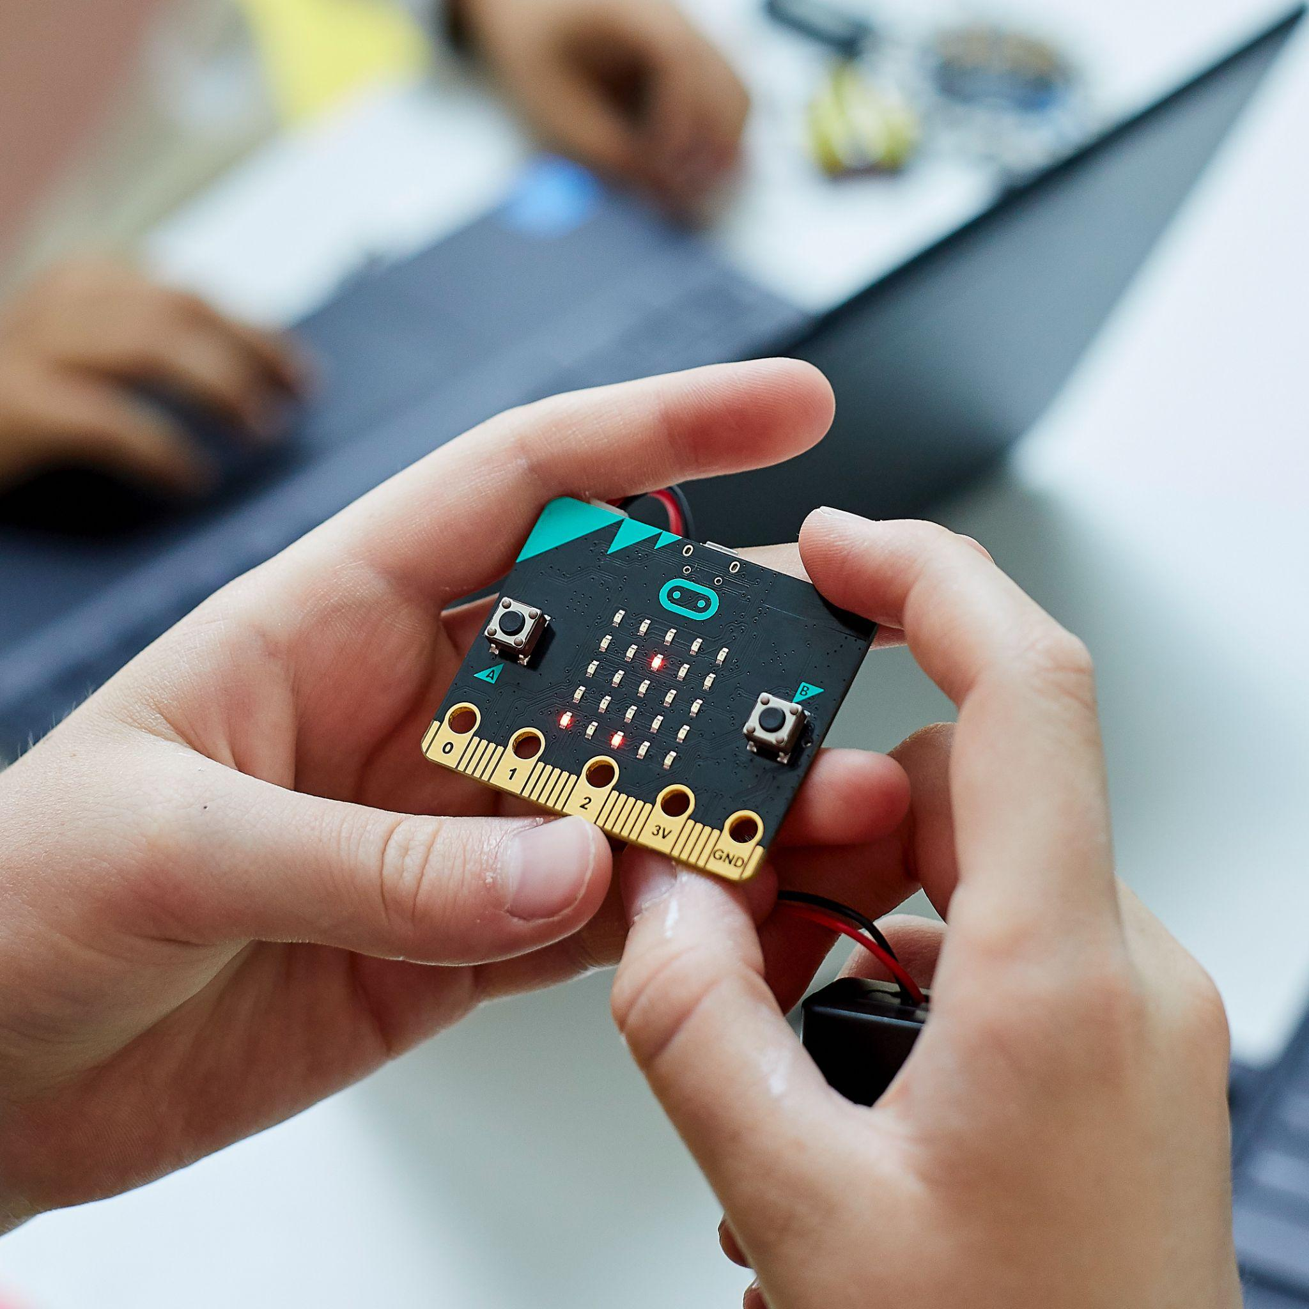
Keeping safe
Hold the micro:bit carefully by the edges
Avoid touching the components
Keep liquids away from the micro:bit
Notes:
Image © Micro:bit Educational Foundation

Slide 6
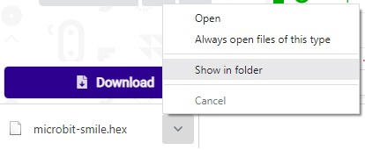
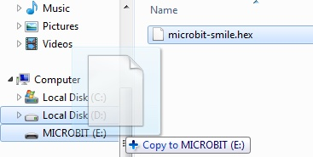
Transferring a program
Download the program, then select ‘Show in folder’
Drag the file from the ‘Downloads’ folder onto the micro:bit

Slide 7
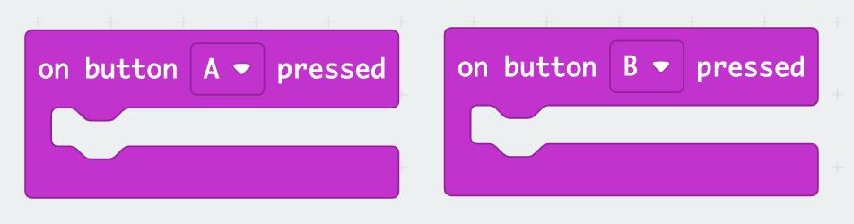
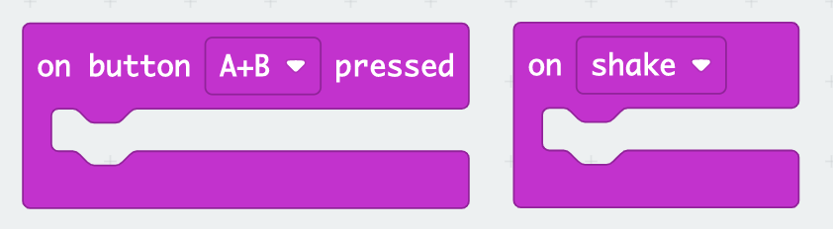
Buttons and sensors
Can you match the code block to the correct button or sensor?
Notes:
Image © Micro:bit Educational Foundation

Slide 8
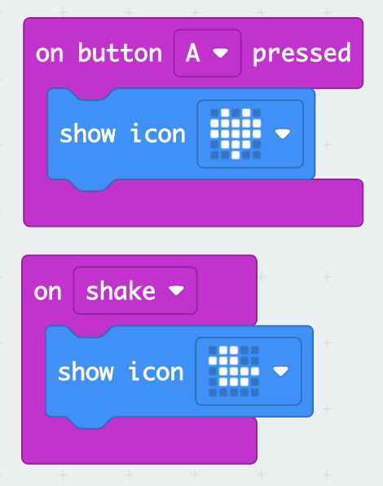
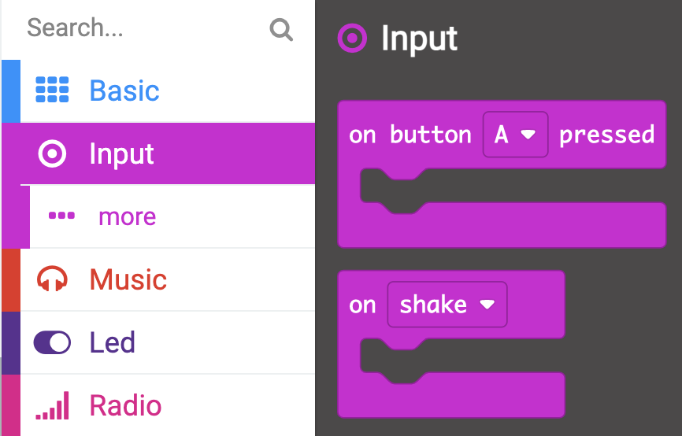
Buttons and sensors

Slide 9
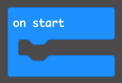
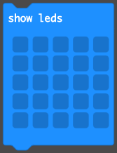

Your turn!
Create your own program to display different images when button A is pressed and the micro:bit is shaken.
Once you have made your program, tinker with the blocks on screen, to:
Make button B display text on the LEDs
Make both an image and text display when you press buttons A and B together
Make an image display when the program starts
Combine instructions you’ve previously used for different buttons and sensors

Slide 10
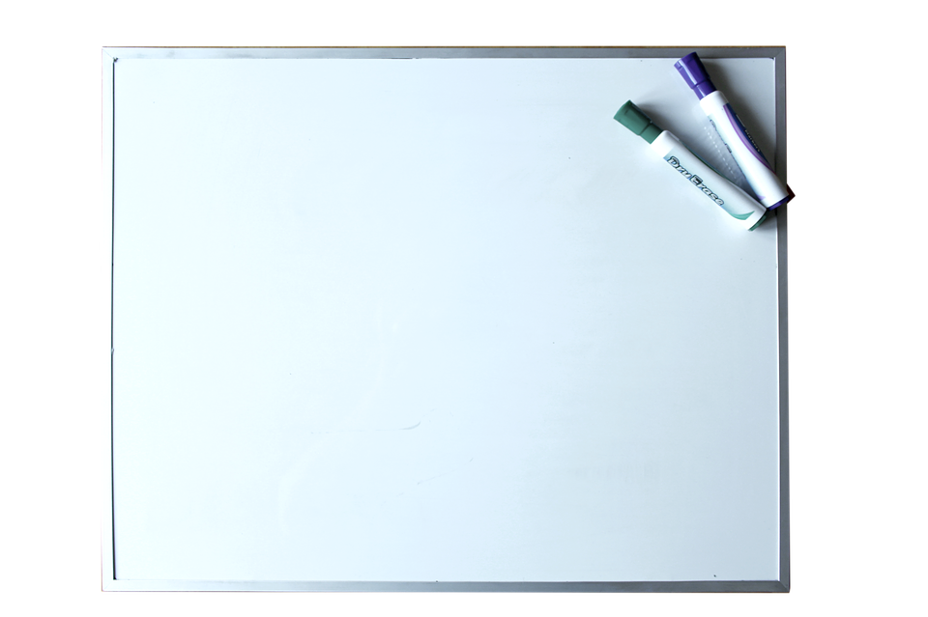
Introducing variables
We are going to use the micro:bit to store data.
We can do this using a variable, which is a named space in the micro:bit’s memory.
We will first record how many times button A is pressed.
We will name our variable “counterA”, so we remember what it is storing.
counterA

Slide 11
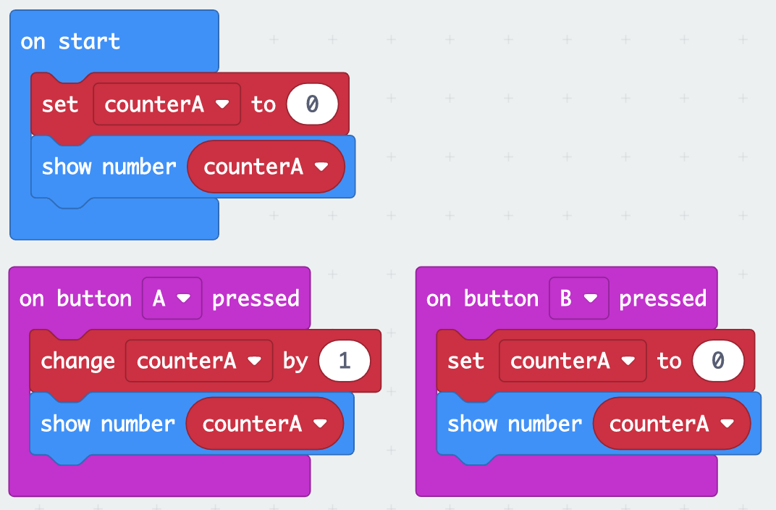
Introducing variables

Slide 12
Introducing variables
Which blocks initialise the value of counterA?
Which blocks display the value of counterA on the LEDs?
Which block increases the value of counterA by 1?
Which block resets the value of counterA to 0?

Slide 13
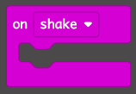
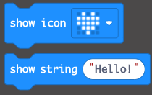

Your turn!
Create your own program to change and display the value of a variable.
Once you have made your program, tinker with these blocks to:
Make counterA increase by 10 when you shake the micro:bit
Show a smiley face when counterA is set to 0
Add some text to your program, such as a welcome message

Slide 14
Time for a race
We’re going to make a game to see who can press the button the most times in 20 seconds. The program should function in the following way:
When the program starts, set counterA and counterB to be zero
When button A is pressed, increase counterA by 1
When button B is pressed, increase counterB by 1
When the micro:bit is shaken, display the following:
“Button A”, followed by the value of counterA
Pause for 1 second
“Button B”, followed by the value of counterB
When playing your game, make sure both players hold the micro:bit with two hands

Slide 15
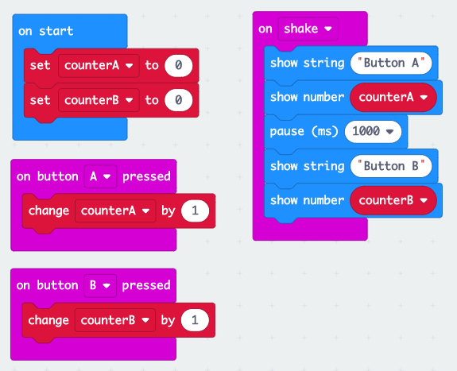
When playing your game, make sure both players hold the micro:bit with two hands

Slide 16
Plenary
Can you remember what we use a variable for in programming?
How could you improve your program?

