Slide 1
Modeling Lunar Phases

Slide 2
What is Computer Science?
PROBLEM SOLVING!!
(use steps to solve large problems)

Slide 3
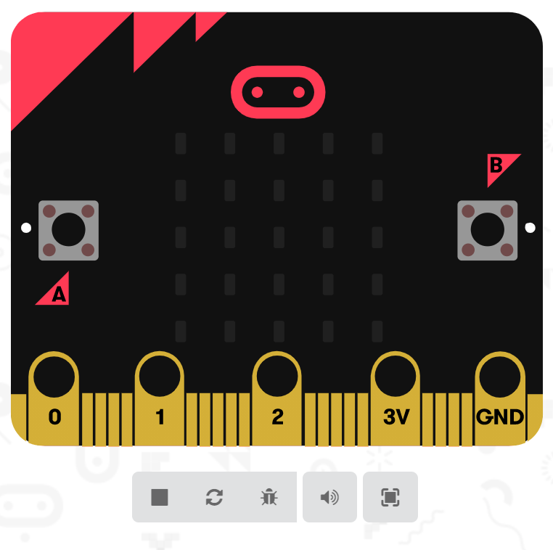
Mini Computer

Slide 4
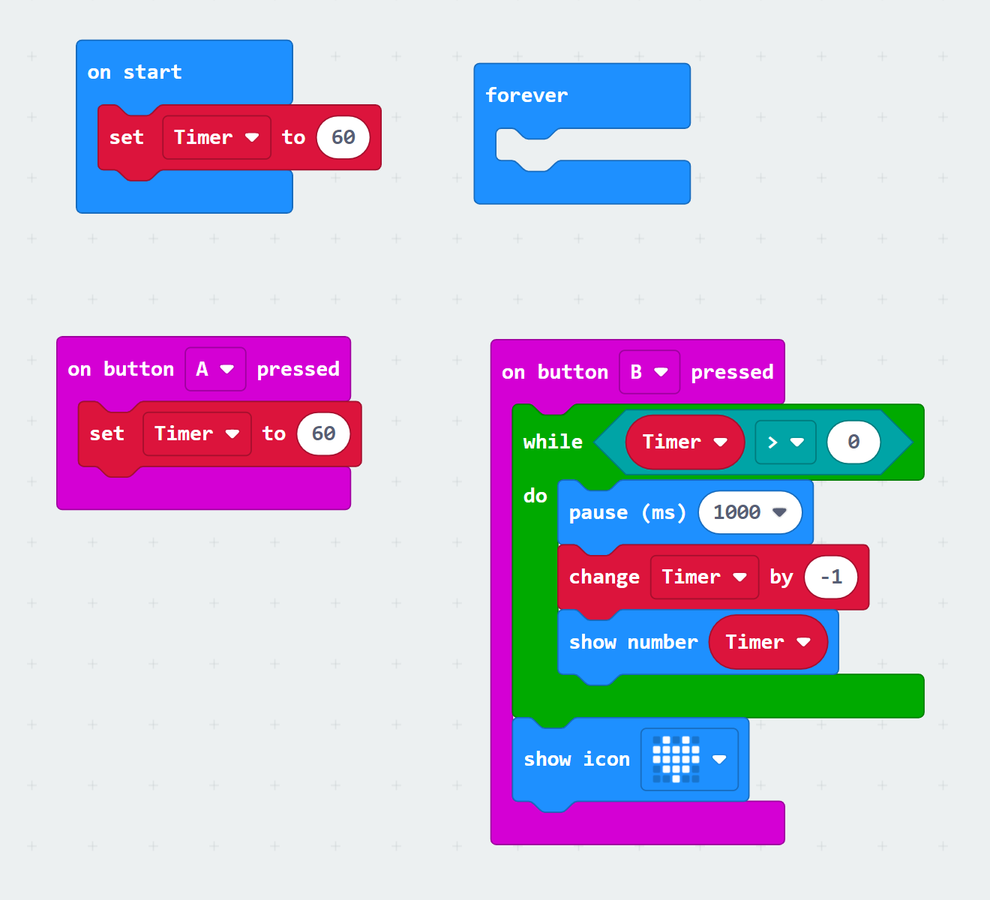
Algorithms
Computers follow steps
These steps are called algorithms

Slide 5
Problem?
We need to model lunar phases as we see them on Earth!

Slide 6

Turn and Talk
Share your ideas with your table partner
How many lunar phases are there?
Do some phases last longer than other phases? If so, which ones?

Slide 7
Problem?
We need to model lunar phases as we see them on Earth- with some phases slowly building on a continuum

Slide 8
Your challenge today:
Tell the computer what steps to do by programming the computer to create a lunar phase model that:
Shows the moon from Earth
Starts with a New Moon
Includes all the lunar phases in order
Gradually progresses through the phases
Repeats the whole cycle

Slide 9
Brainstorm
What steps (algorithms) would be needed to show a lunar phase?
How could you show a phase transitioning into another phase?
Notes:
Examples: way to start timer, countdown, way to know when timer is done, and way to reset timer

Slide 10
Sun- Earth – Moon Model
Draw/ cut out the Sun
Draw/ cut out Earth
Download your program onto your Micro:bit
Create your Sun-Earth-Moon model

Slide 11
Sun- Earth – Moon Model
1. What are the strengths of this model?
2. What are some weaknesses of this model?

