Slide 1
Nature Art
Merging Nature, Algorithms, and Programming in an inclusive environment
Complete lesson plan with slides and handouts. This assignment has been modified and customized.

Slide 2
STUDENTS
I am so proud you are interested in this and wanting to learn more on your own.
You are impressive!
Complete lesson plan with slides and handouts. This assignment has been modified and customized.

Slide 3
Table of contents
01
02
03
04
Representing Nature
Art Algorithms
Digital Nature
Representation
Programming and evaluating representations

Slide 4
US CSTA Core Standards:
1B-CS-01 - Describe how internal and external parts of computing devices function to form a system.
1B-CS-02 - Model how computer hardware and software work together as a system to accomplish tasks
1B-CS-03 - Determine potential solutions to solve simple hardware and software problems using common troubleshooting strategies.
1B-AP-08 - Compare and refine multiple algorithms for the same task and determine which is the most appropriate.
1B-AP-15 - Test and debug (identify and fix errors) a program or algorithm to ensure it runs as intended.

Slide 5
This lesson is an introduction to computational thinking and the BBC micro:bit. Students learn how to create nature abstractions by observing nature,, using art materials and then using the LEDs on micro:bit.
They'll develop an understanding of several key computational thinking concepts, including logical reasoning, abstraction, algorithms and evaluation.
Students then develop their programming and debugging skills and are introduced to working with outputs.
Lesson Description

Slide 6
STUDENTS
can understand and apply the fundamental principles and concepts of computer science, including abstraction, logic, algorithms and data representation
can analyse problems in computational terms, and have repeated practical experience of writing computer programs in order to solve such problems
can evaluate and apply information technology, including new or unfamiliar technologies, analytically to solve problems
are responsible, competent, confident and creative users of information and communication technology
Measurable Objectives

Slide 7
Creating artistic representations
●Select an image from nature that you find interesting.
Explore how the image can be represented using the materials
●Can you represent the image by representing part of the image that is strongly associated with that plant/animal?
01
Representing Nature

Slide 8
Abstraction
●Abstraction is when we select the most important detail(s) and leave out information that is not required.
●What information would you abstract if you were representing a flower, a dog, a tree?
●Abstraction is useful when solving problems as it helps us to focus on the important information and ignore the details we don’t need.
Draw a representation of the nature you picked.
Identify one aspect you are pleased with and one aspect you would like to improve.
01
Representing Nature

Slide 9
What is an Algorithm?
●Set of sequenced instructions, steps or rules to solve a problem or complete a task.
●Written for humans to follow.
●We are going to write an algorithm for someone to follow to create a representation of something from a nature walk.
STUDENT CHOICE-we can do this together or in small groups or by yourself!
02
Art Algorithms

Slide 10
Creating an Algorithm
●Discuss with a partner any steps we took that enabled us to create our representations.
●Record these steps on your sheet of paper.
●How could we turn these steps into instructions to give to another person?
02
Art Algorithms

Slide 11
Debugging Algorithms
●When we create algorithms, we need to check that we have given the instructions in the correct order and that the instructions are accurate and easy to understand.
●If they are any mistakes we need to change these to allow the people that follow the instructions to complete the task.
●This process of find and fixing errors in called debugging.

Slide 12
Constructing Algorithms
●Working in pairs, construct an algorithm that would allow other people to create a representation of wildlife from a nature walk.
●Remember to debug your algorithm as you go along.
02
Art Algorithms

Slide 13
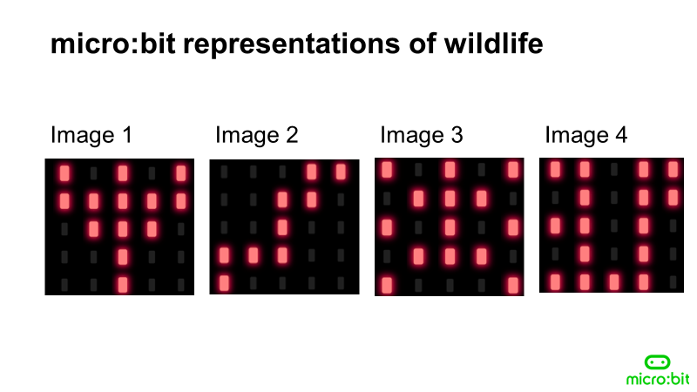
03
Can you guess what each image represents?
Digital Nature
Representation

Slide 14
03
Image 1 is a flower with the stem, petals and the stamen represented.
Image 2 ia a worm with the wiggly shape of the body represented.
Image 3 is a spider with eight legs represented by sharing LEDs
Image 4 is a squirrel with its bushy tail represented
Digital Nature
Representation

Slide 15
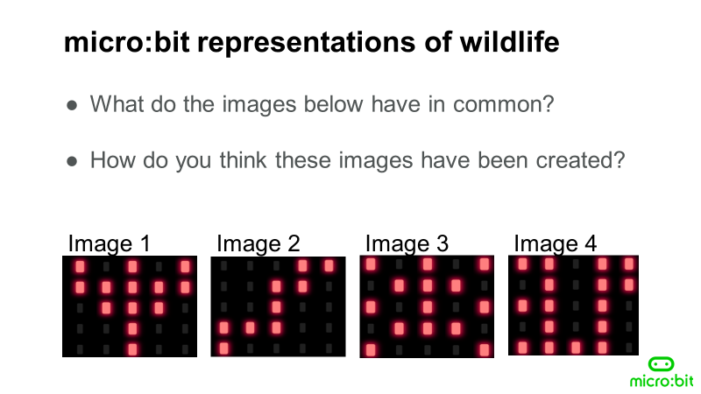
03
Digital Nature
Representation

Slide 16
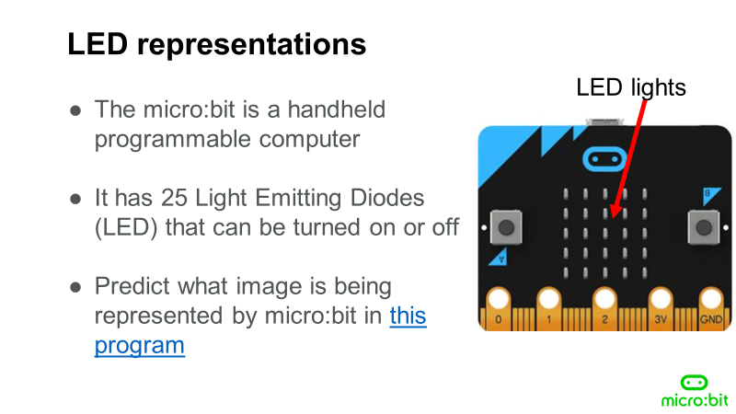
03
Use the simple images hex file contained in the folder to program a micro:bit and show images to the class or use the program with the simulator using the link
Digital Nature
Representation

Slide 17
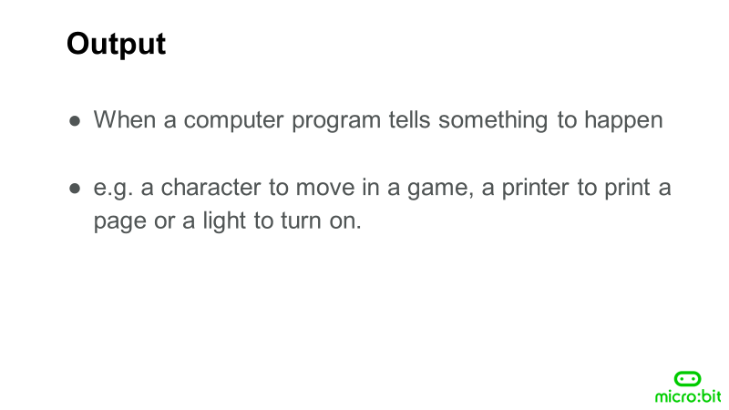
03
Digital Nature
Representation

Slide 18
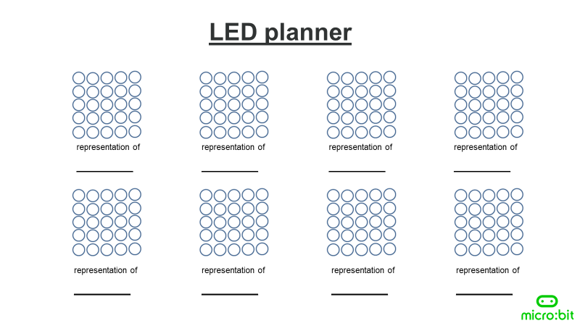
03
Digital Nature
Representation

Slide 19
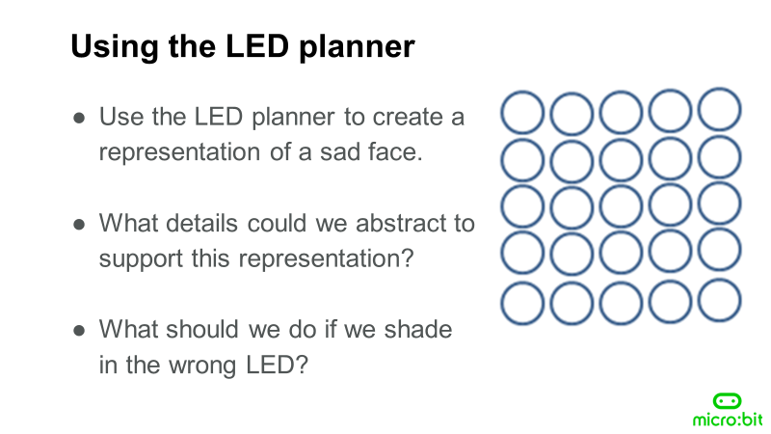
03
Digital Nature
Representation

Slide 20
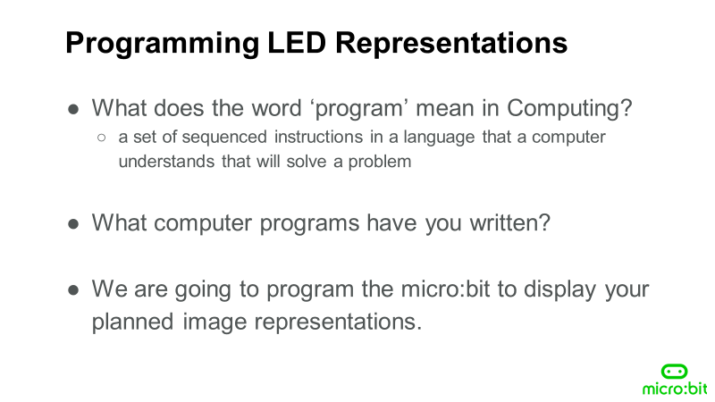
03
Digital Nature
Representation

Slide 21
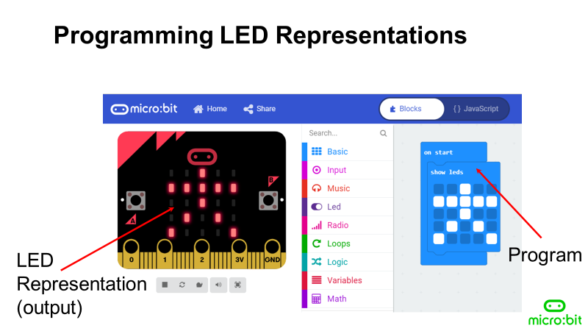
03
Digital Nature
Representation

Slide 22
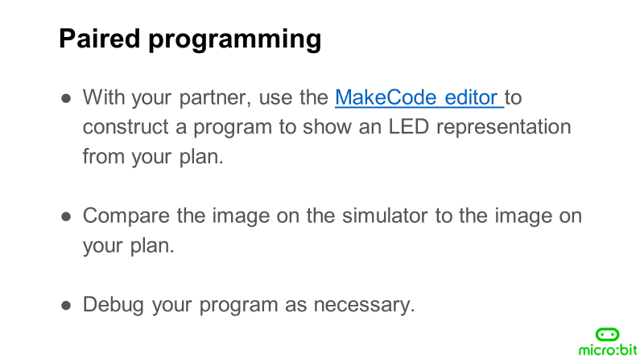
Digital Nature
Representation

Slide 23
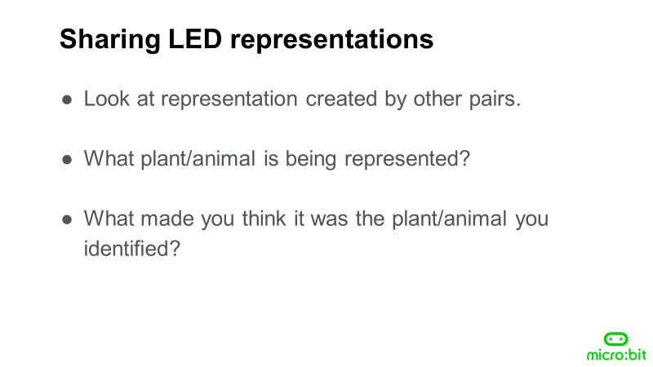
Digital Nature
Representation

Slide 24
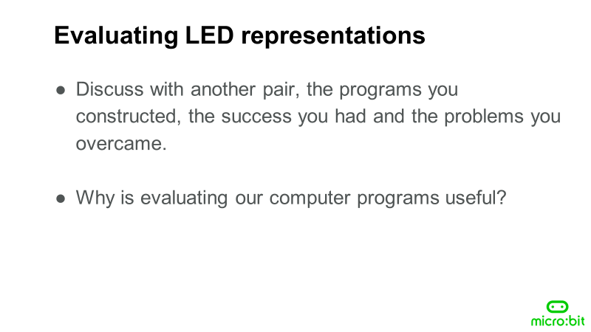
Digital Nature
Representation

Slide 25
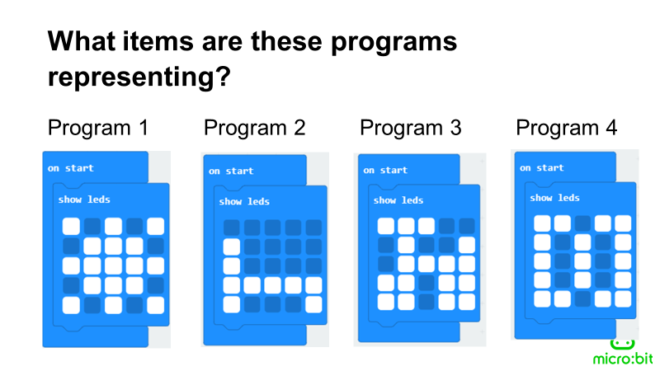
04
Programming and evaluating representations

Slide 26
04
Program 1 represents a star.
Program 2 represents a bed.
Program 3 represents a bicycle.
Program 4 represents a elephant. This image provides an opportunity to revisit abstraction. What detail has been included? - Ears and the trunk Is this enough detail to provide a accurate representation of an elephant?
Programming and evaluating representations

Slide 27
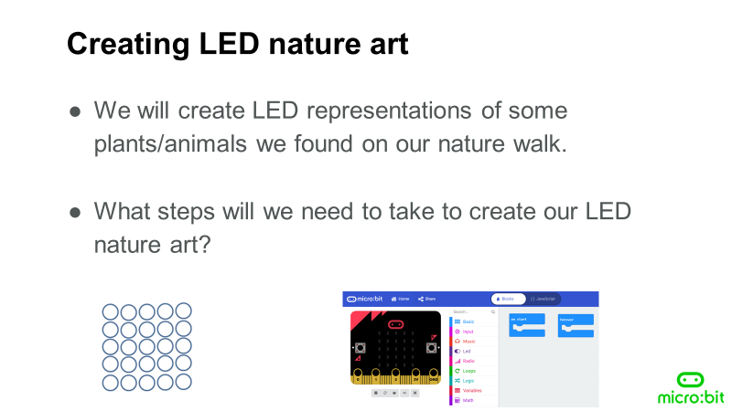
04
Programming and evaluating representations

Slide 28
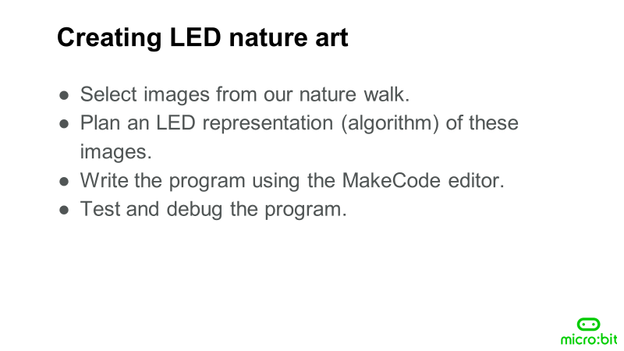
04
Programming and evaluating representations

Slide 29
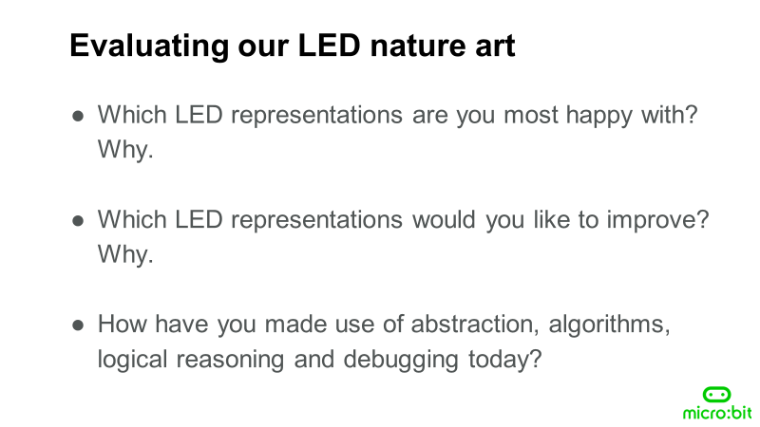
04
Programming and evaluating representations

Slide 30
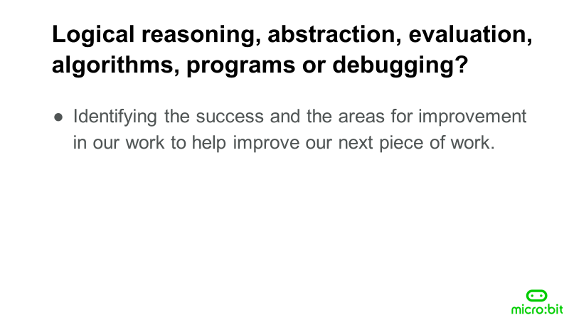
04
Programming and evaluating representations

Slide 31
Congratulations!
You have learned so much information.
Please CLICK HERE to evaluate your learning!

Slide 32


Slide 33
What we are working on
Mars
Venus
Mercury
Despite being red, Mars is a cold place
Venus is the second planet from the Sun
It’s the closest planet to the Sun

Slide 34
Now
Venus has a beautiful name and is the second planet from the Sun. It’s terribly hot—even hotter than Mercury—and its atmosphere is extremely poisonous

Slide 35
01
Name of your section
You can enter a subtitle
here if you need it

