Slide 1
“O” is for Outlaw
By Ms. Cline 4th grade Rawlins Elementary

Slide 2
Background Builder about Outlaws
Now that we’ve learned about the Oregon Trail and the Railroad coming out west and through Wyoming, it’s time to learn about famous Outlaws and Lawmen of Wyoming.
Let’s brainstorm!
Why do you think there were more Outlaws after the Oregon Trail and Railroad coming through Wyoming? Pair share with a partner!
https://www.historyhit.com/notorious-outlaws-of-the-wild-west/

Slide 3
Outlaws
Sometimes more people, can lead to more problems. As more people made it out west, there wasn’t much for law and order or law enforcement for that matter. This allowed for more crimes to happen because they had a pretty good chance of getting away with it.
We’ll be reading about famous outlaws and lawmen in our Wyoming History book, but here’s a few others that are quite famous.
https://www.historyhit.com/notorious-outlaws-of-the-wild-west/

Slide 4
Your mission
You will choose an outlaw or someone from law enforcement to research.
You will need to collect information about the person you choose.

Slide 5
Communication in the 1840’s-1850’s
Now that your research is done, let’s brainstorm about the types of communication and technology there was back in the 1840’s-1850’s. Pair share with a partner
-

Slide 6
What if???? Big Nose George had a Facebook Page?
Technology has changed so much, that can you imagine if the outlaws or lawmen you studied had a Facebook, Instagram, or Snapchat account?
What would they have put on their account? We have to be careful what information we share that should be kept more private.
I mean The Hole in the Wall Gang wouldn’t put their exact address on their Facebook site after they committed a robbery, right?

Slide 7
Create a Facebook Profile for the Outlaw or Lawman you Studied
On the next page is an example of a Facebook page, I will be sending a link so you can create your own Facebook page for your outlaw or lawman. I would challenge you to do two, one that is more cybersafe and one that is VERY OBVIOUS about what your next move is. You can share your page with others so they can comment if you choose to.
***When you get the link, you’ll have to make a copy of it, so you’re not writing on my original.***
https://docs.google.com/presentation/d/1XRz9Jpi4_kyU4eml0WMMmpkgXusVt0Y4wZN5sK7lbbI/edit?usp=sharing

Slide 8
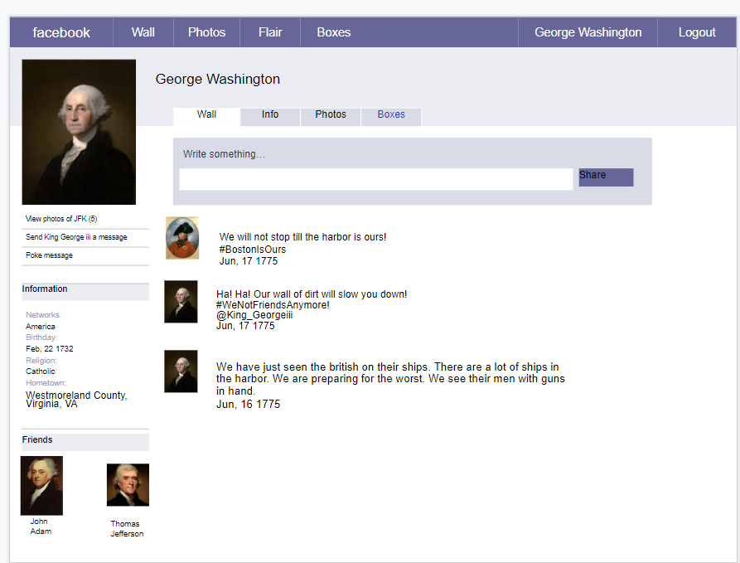
Example:

Slide 9
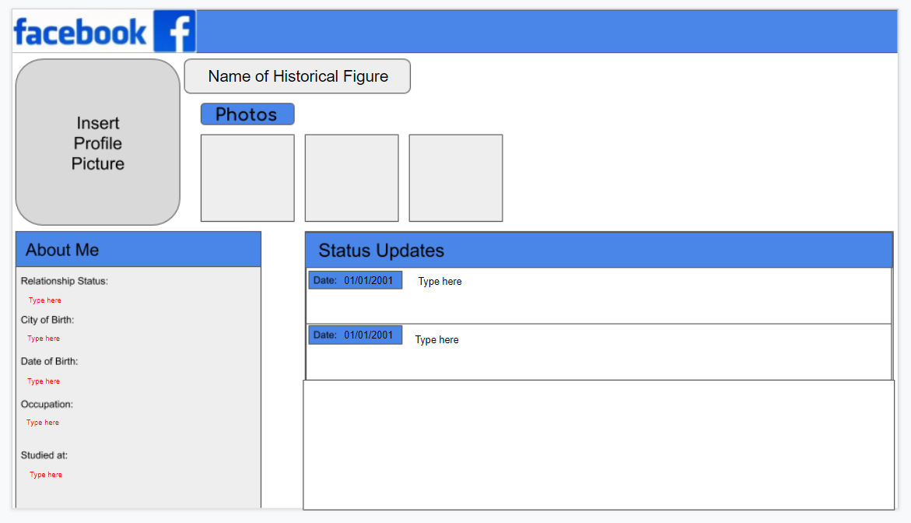

Slide 10
Closing Task
You will need to share your Facebook page with the class, you can choose the more cybersafe one or the one that is cyber “obvious.”
Closing: Just a reminder that as you get to have your own social media accounts that you need to keep them Cybersafe. What does that look like?

Slide 11
Game-If you finish early……
https://www.thinkuknow.co.uk/8_10/

