Slide 1






Sea Turtle Safe Beach Lights

Slide 2
Discovering sea turtles
What do you know about sea turtles?
What can you find out about them?
Where do sea turtles live?
What kinds are there?
Why are they so important to marine ecosystems?
What fascinating facts can you find out about sea turtles?

Slide 3
Sea turtles in trouble
What is happening to sea turtles?
Why are they in danger?
What are the biggest threats to sea turtles?

Slide 4
How can we help sea turtles?
What is being done to help sea turtles?
How are threats being reduced?
What specific examples and projects can you find?

Slide 5
Helping sea turtle hatchlings
What have you found out so far about hatchlings?
What help do hatchlings need?
What is the issue with hatchlings and beach lighting?
How could technology help?
How could micro:bit help?

Slide 6
A sea turtle safe beach light using micro:bit
Creates turtle-safe lighting for beach paths, so hatchlings retain the instinct to move toward the sea (and the moon/start light reflected from the water)
Low-wattage light comes from LEDs
Should automatically turn on at dusk and stay on until dawn
LEDs should show a turtle shape as a fun way of lighting the path

Slide 7
A sea turtle safe beach light using micro:bit
Algorithm starter:
IF it's night time
turn on LEDs (in turtle pattern)
Sample code here

Slide 8
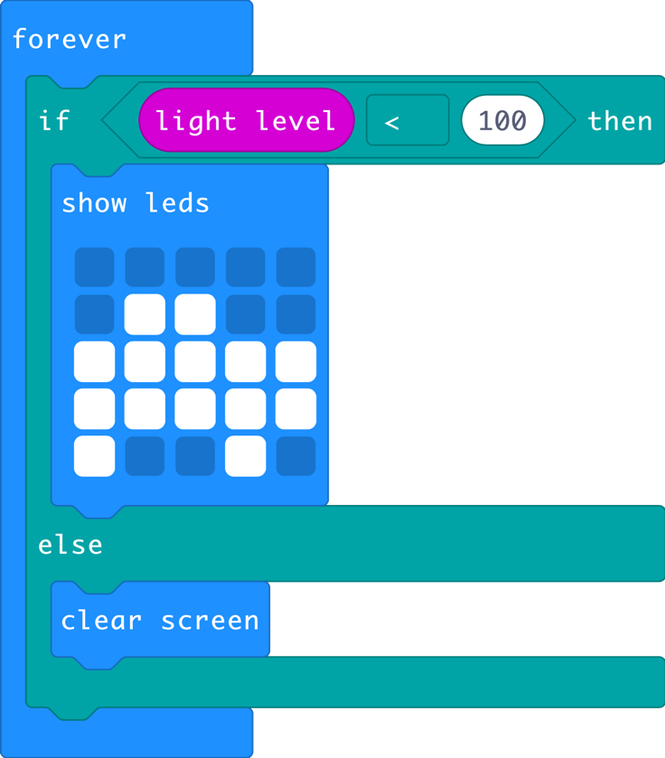
A sea turtle safe beach light using micro:bit
Sample code here

Slide 9
Learning review so far...
What have you learnt about sea turtles?
How can your prototype help?
What works well?
What needs to be improved?

Slide 10
Licensing information
Published by the Micro:bit Educational Foundation microbit.org under the following Creative Commons licence:
Attribution-ShareAlike 4.0 International (CC BY-SA 4.0)
https://creativecommons.org/licenses/by-sa/4.0/
https://microbit.org/do-your-bit/

