Slide 1
Understanding Pseudocode

Slide 2
What is pseudocode?
Pseudocode is a technique used to describe the distinct steps of an algorithm in a manner that is easy to understand for anyone with basic programming knowledge.

Slide 3
Why should we use pseudocode?
Better Readability
Easing of code construction
A good middle point between flowchart and code
Act as a starting point for documentation
Easier bug detection and fixing

Slide 4
Part 1 - Statements
A statement is defined as an instruction that directs the computer to perform a specific action.
In writing pseudocode, we will refer to singular instructions as statements.

Slide 5
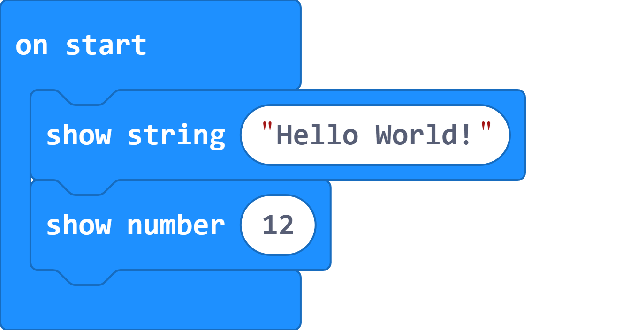
Part 1 - Statements
In pseudocode you would write the algorithm as follows.
On Start
Show string “Hello World!”
Show number 12

Slide 6
Part 1 - Statements
Indentation is important whenever you need to show “dependency”.
On Start
Show string “Hello World!”
Show number 12
Notes:
Dependency is the control structure throughout the algorithm. I.E - event handlers; Loops: forever,for, while; if statements

Slide 7
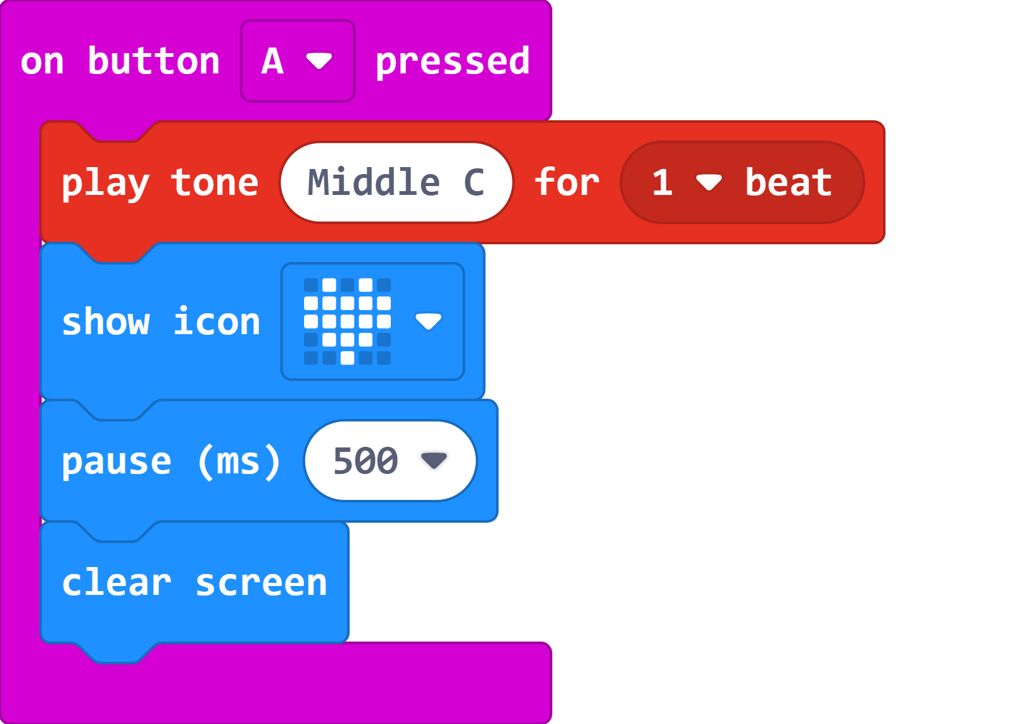
Part 1 - Statements
What would the pseudocode look like for this algorithm?
On button A pressed
Play tone MIDDLE C - 1 beat
Show icon HEART
Pause 500 ms
Clear Screen

Slide 8
Part 2 - Conditionals
During algorithm development, we need statements which evaluate expressions and execute instructions depending on whether the expression evaluated to True or False.

Slide 9
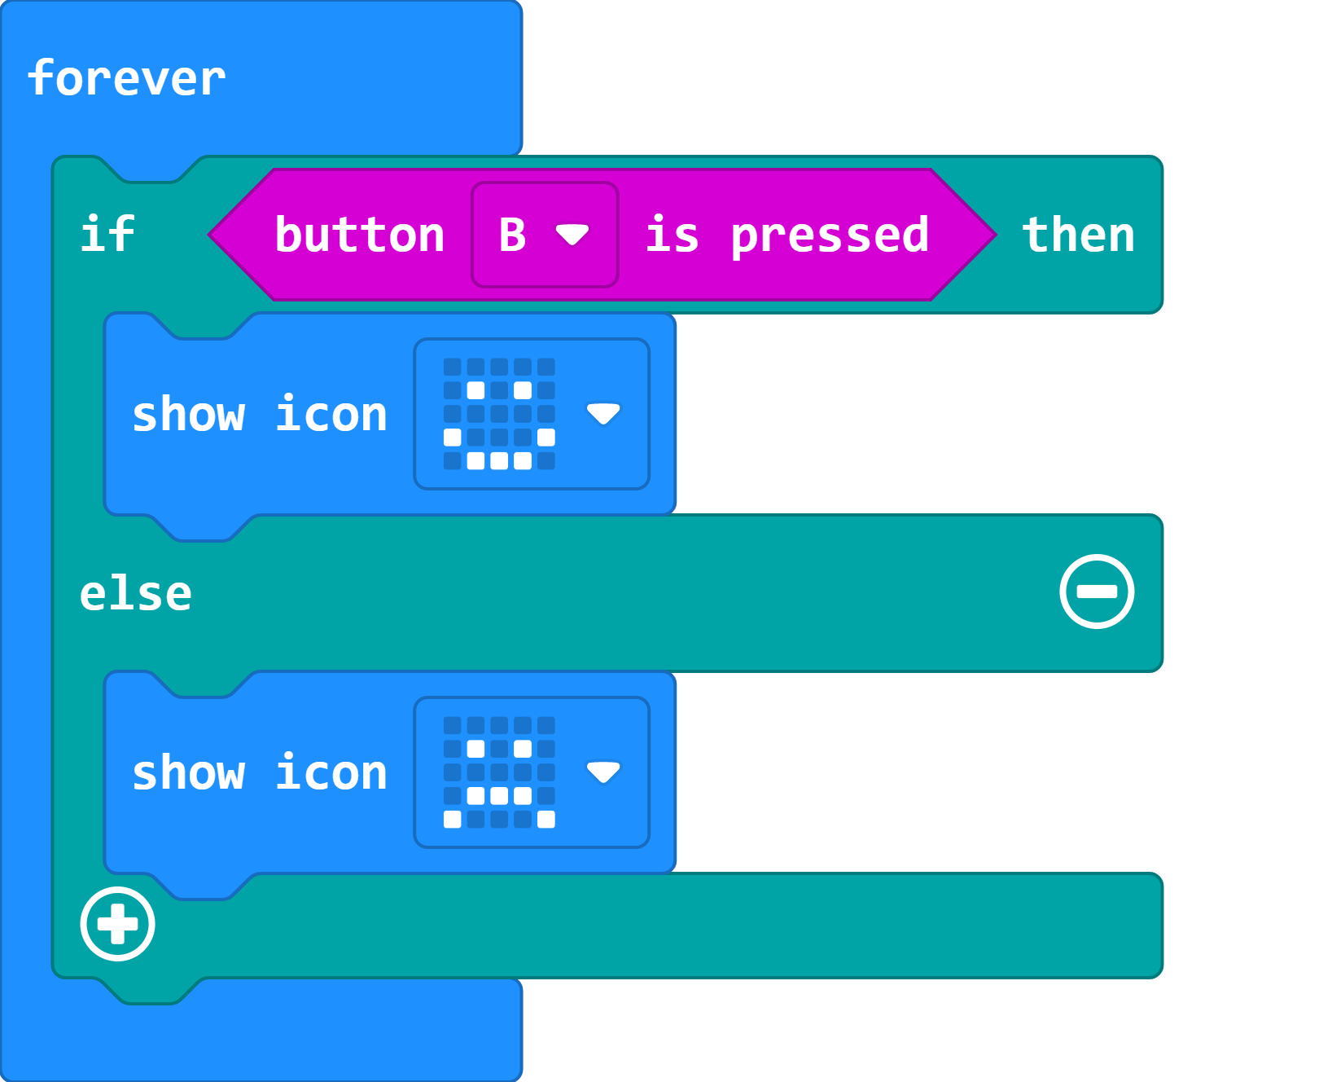
Part 2 - Conditionals
Once again indentation is needed to show dependency.
Forever
If Button B Pressed
Show icon SMILE
Else
Show icon SAD

Slide 10
Part 2 - Conditionals
Once again indentation is needed to show dependency.
Forever
If Button B Pressed
Show icon SMILE
Else
Show icon SAD

Slide 11
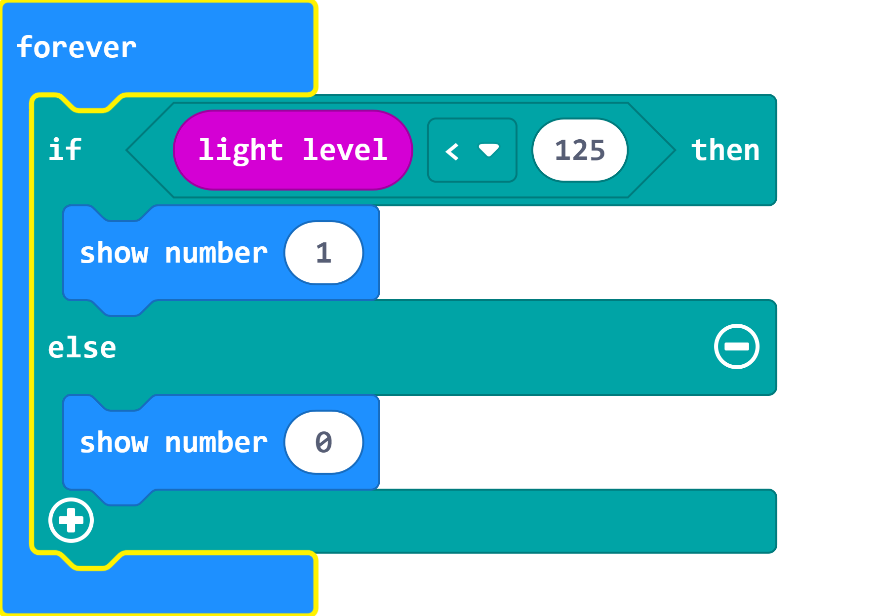
Part 2 - Conditionals
What would the pseudocode look like when a comparison statement is used?
Forever
If (light Level < 125)
Show number 1
Else
Show number 0

Slide 12
Part 3 - Iteration
To iterate is to repeat a set of instructions in order to generate a sequence of outcomes. We iterate so that we can achieve a certain goal.

Slide 13
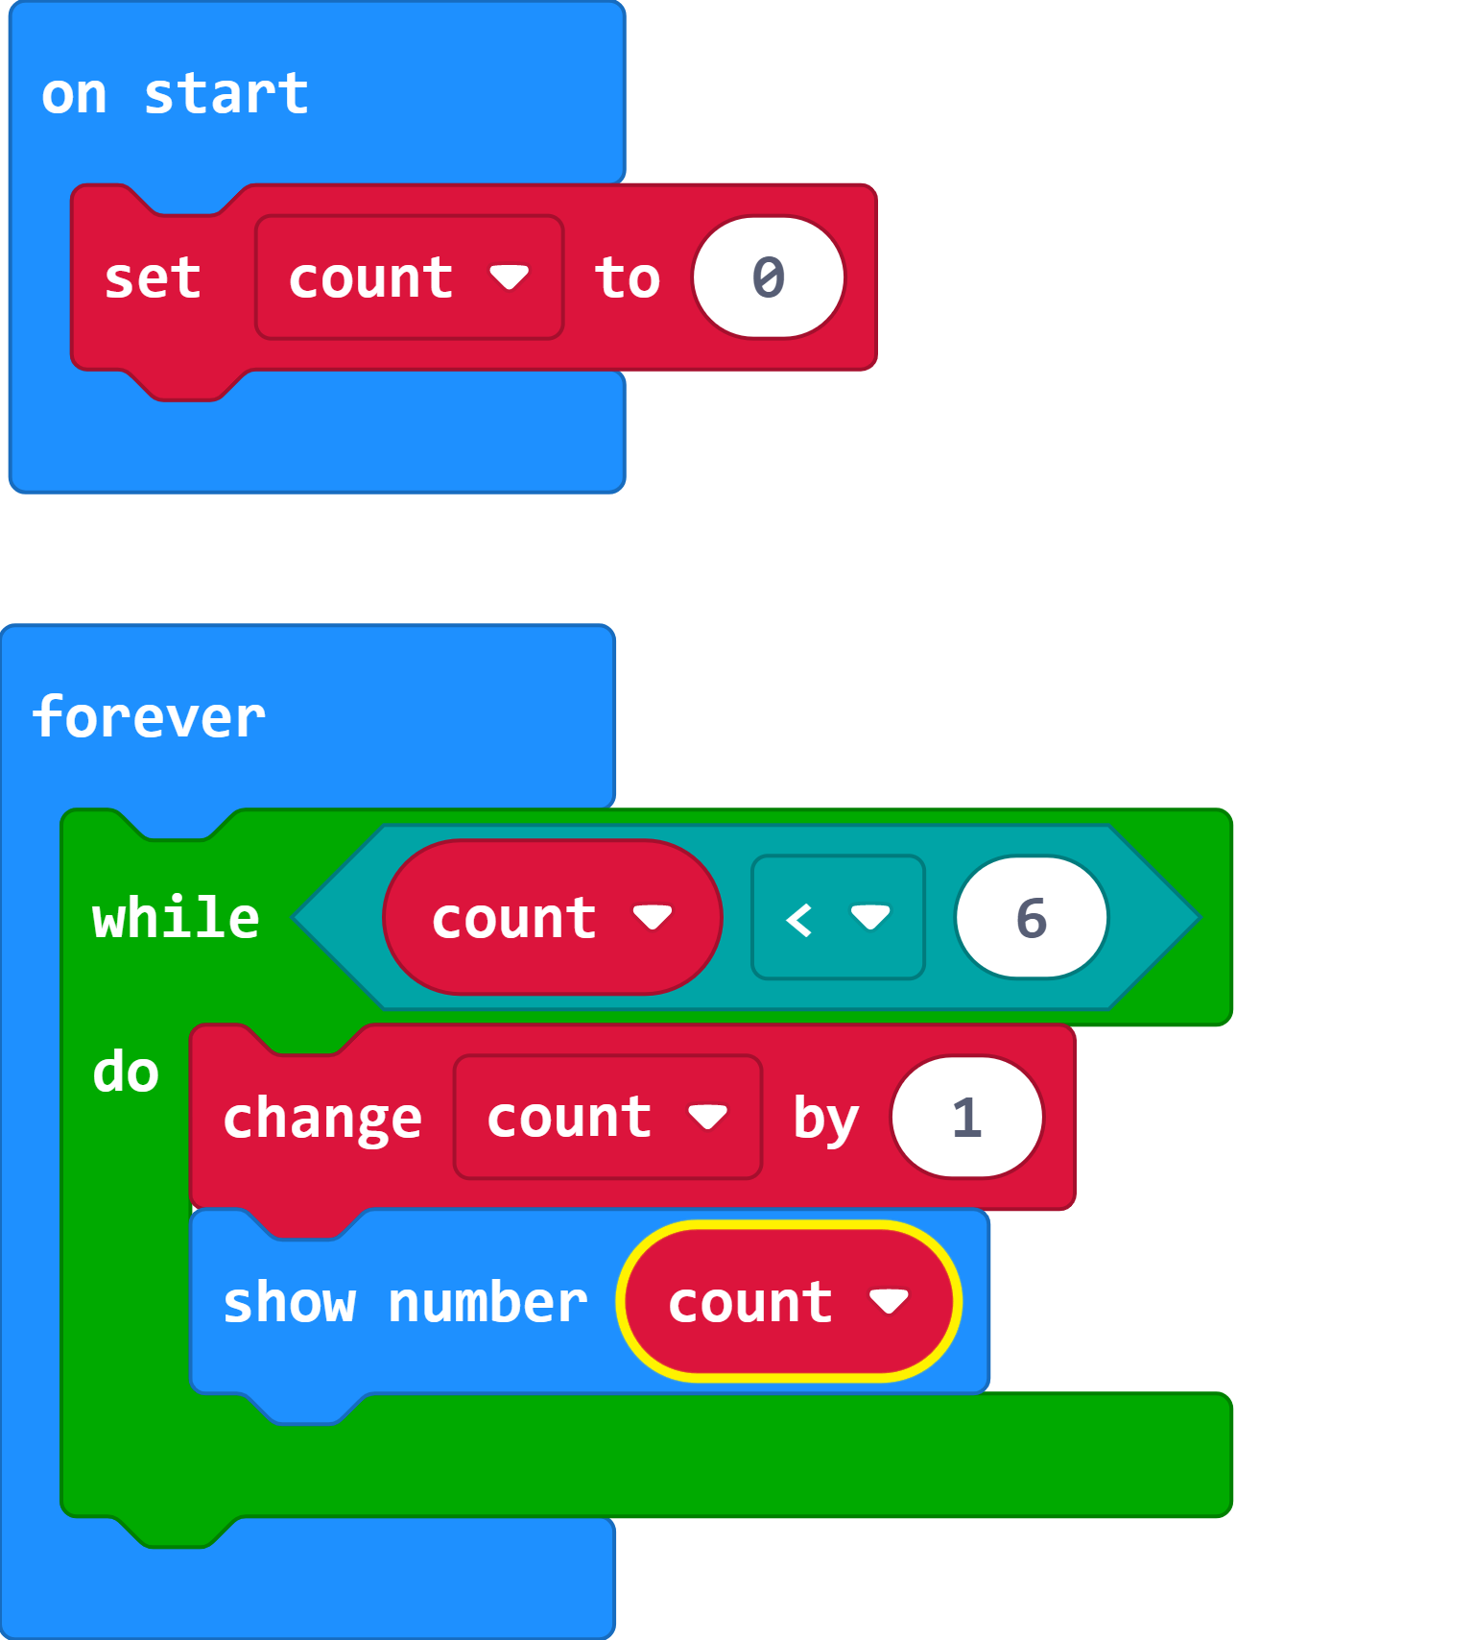
Part 3 - Iteration
Once again indentation is needed to show dependency.
On Start
Set count = 0
Forever
while (count < 6)
count = count + 1
Show number count

Slide 14
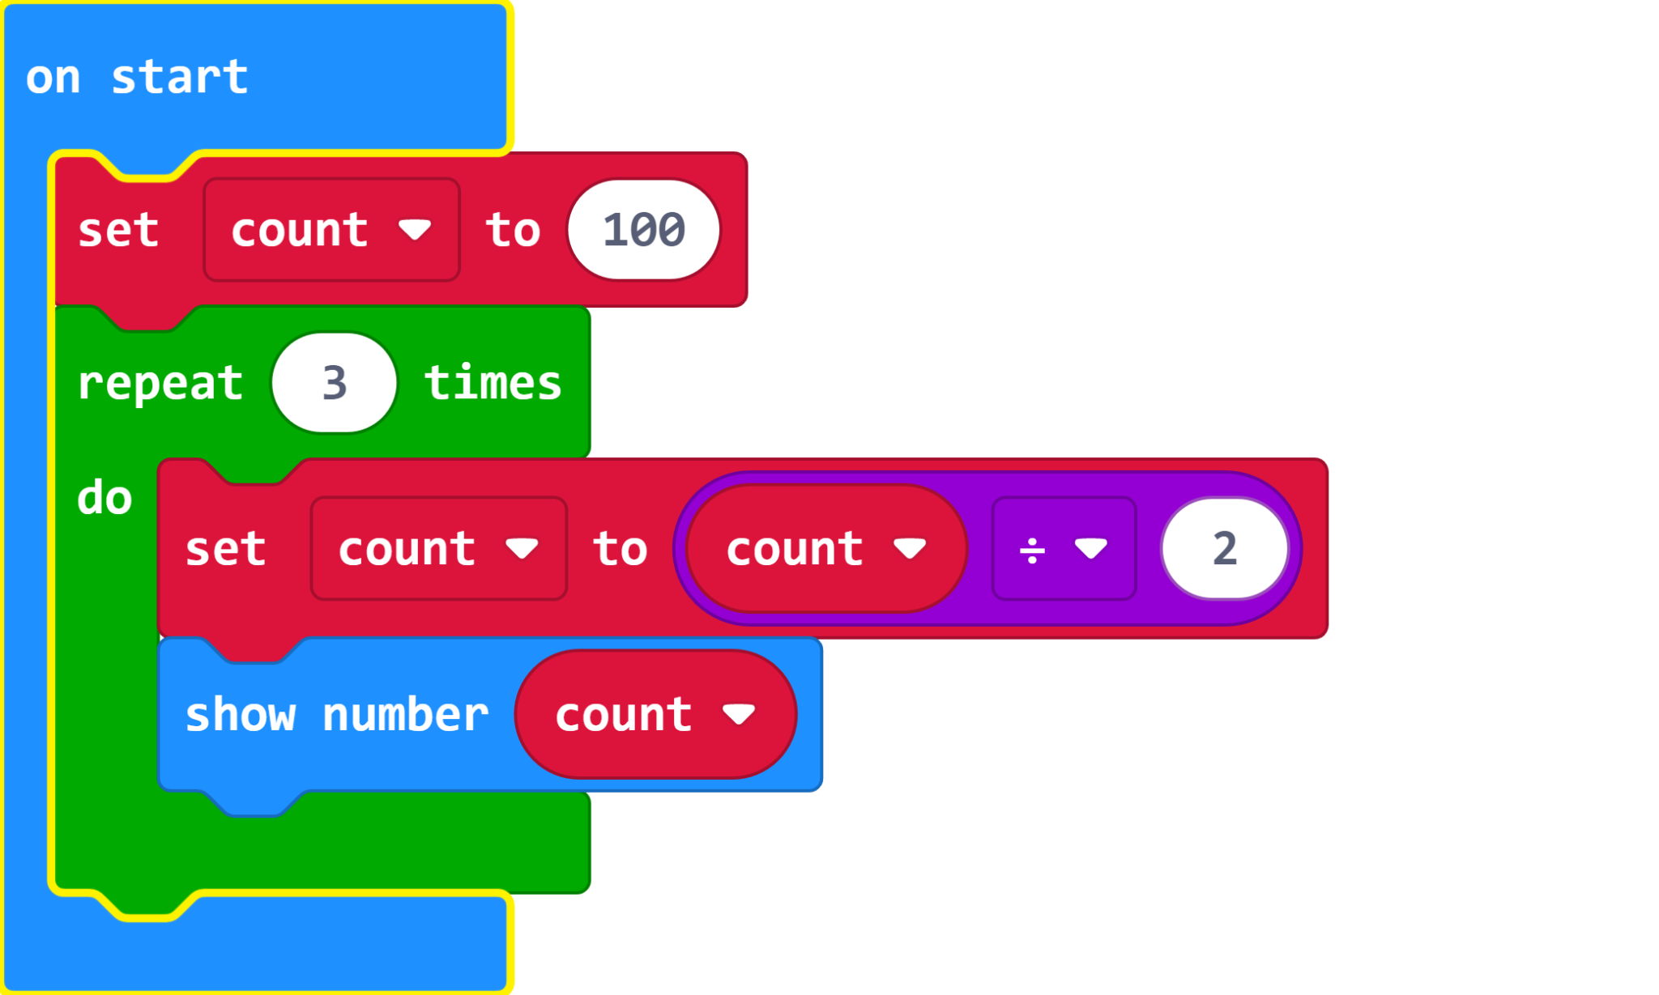
Part 3 - Iteration
On Start
count = 100
repeat 3 times
count = count / 3
show number count

Slide 15
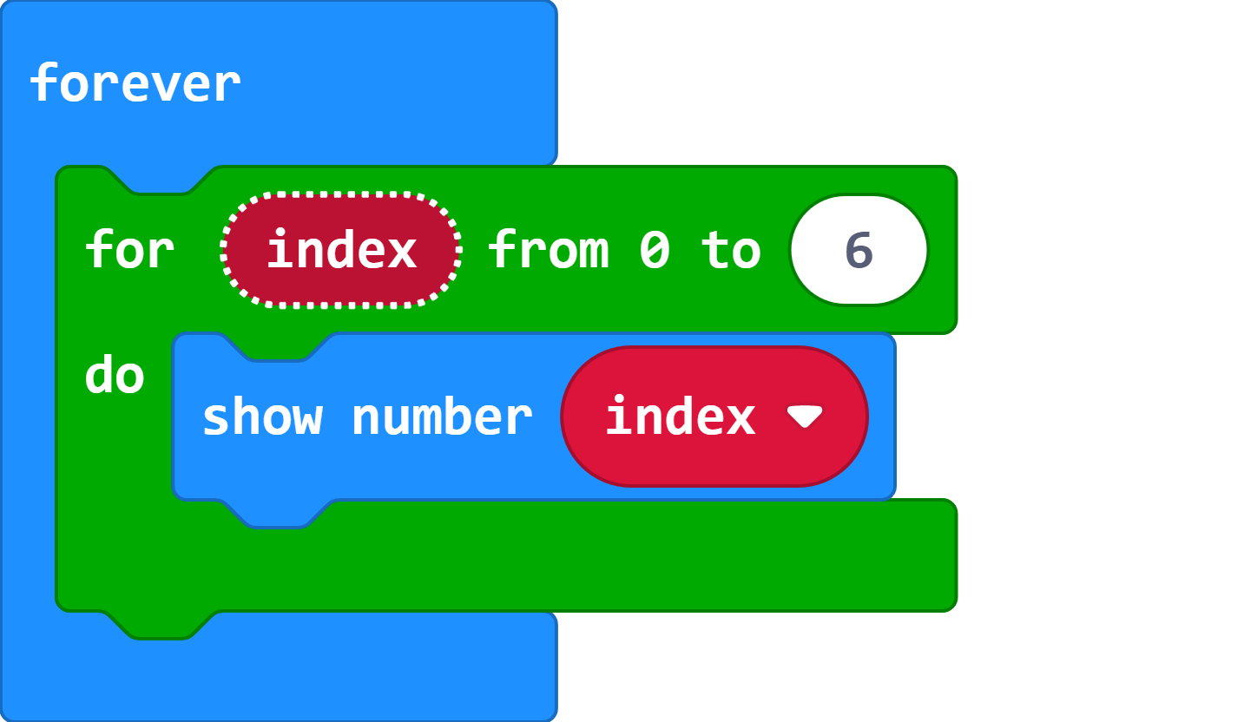
Part 3 - Iteration
Forever
for (index from 0 to 6)
show number index

Slide 16
Bonus - FizzBuzz

Slide 17
Problem Statement - FizzBuzz
Write a program in pseudocode that would print the numbers from 1 to 100 such that:
If the number is a multiple of 3, you need to print "Fizz" instead of that number.
If the number is a multiple of 5, you need to print "Buzz" instead of that number.
If the number is a multiple of both 3 and 5, you need to print "FizzBuzz" instead of that number.
Try to think of a solution to solve this challenge with the help of loops and conditional statements before moving to the solution.

Slide 18
Approach - FizzBuzz
Run a loop from 1 to 100.
Numbers that are divisible by 3 and 5 are always divisible by 15. Therefore check the condition if a number is divisible by 15. If the number is divisible by 15, print "FizzBuzz".
Check the condition if a number is divisible by 3. If the number is divisible by 3, print "Fizz".
Check the condition if a number is divisible by 5. If the number is divisible by 5, print "Buzz".
Note: You can check if a number is divisible by another number using the modulo operator (%). For example: 25 % 5 == 0, therefore 25 is divisible by 5.

Slide 19
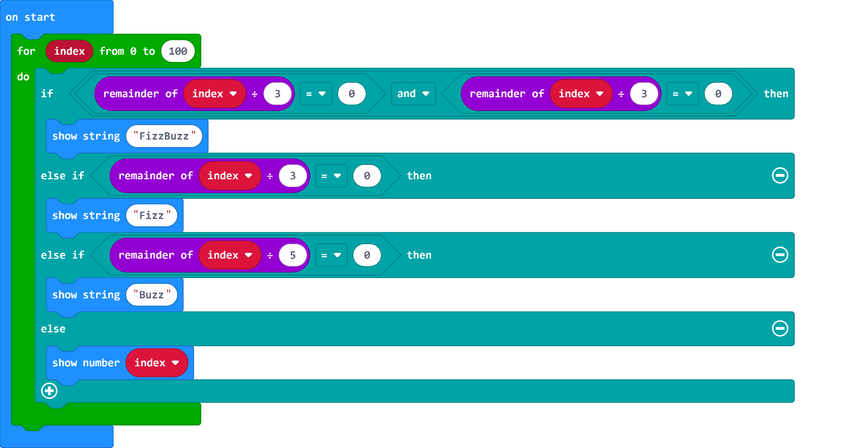
MakeCode Solution

Slide 20
Sources
Chandra, Y. (2021, July 23). How to complete the FIZZBUZZ Challenge in 5 programming languages. MUO.https://www.makeuseof.com/fizzbuzz-challenge/.
Macharia, N. (2018, October 25). How to write pseudocode: A beginner's guide. Medium.https://medium.com/@ngunyimacharia/how-to-write-pseudocode-a-beginners-guide-29956242698.

