Slide 1





Volcano animations
Teacher lesson guide
Lesson 3

Slide 2
Learning objectives:
To decompose a process into stages.
To construct simple flowchart algorithms.
To use repetition in algorithms.

Slide 3
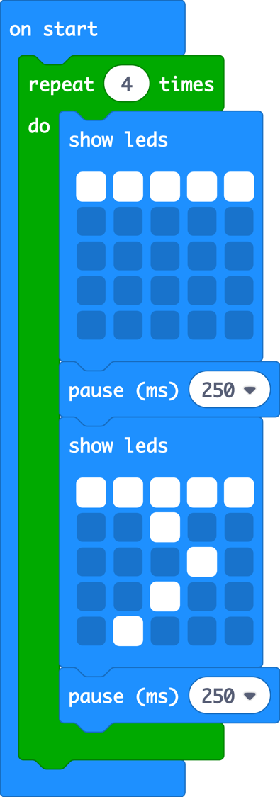
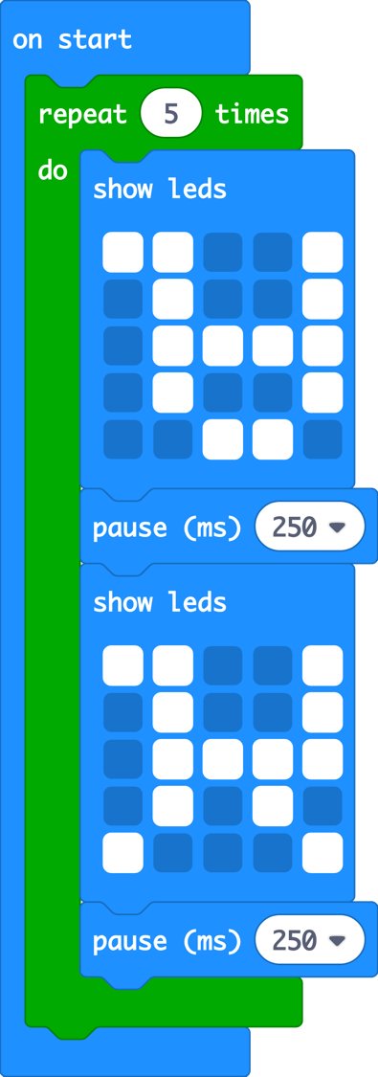
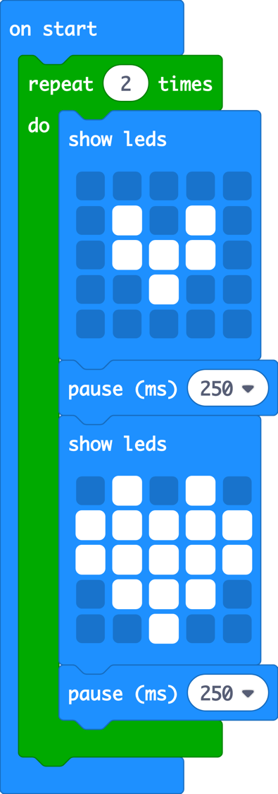

Slide 4
Recapping repetition
What are the similarities between the programs?
What are the differences between the programs?
If all the programs started at the same time, which one would finish first and why?
Notes:
What do all the programs have in common? They all show images using the LEDs; they all use a repeat block; the all use the wait block.
What differences exist between the programs? The images in each program are different; the number of times the images will be repeated in each program are different.
Which program will take the longest/shortest amount of time to run? All the programs have the same amount of steps and the same length delays. Program 2 will take the longest because the program is repeated 5 times; program 3 will be the shortest as it only repeats twice.

Slide 5
Decomposition and repetition
What is decomposition?
How did we use it when we designed our dance algorithms?
How did we use repetition?
Notes:
Decomposition is the process of taking a problem or a task and breaking it down into smaller tasks.

Slide 6
Volcanic eruptions
We are going to create an animation of a volcanic eruption using the micro:bit.
How can we use decomposition to help us create our volcanic eruption animation?
How can we use repetition to help us create our volcanic eruption animation?

Slide 7
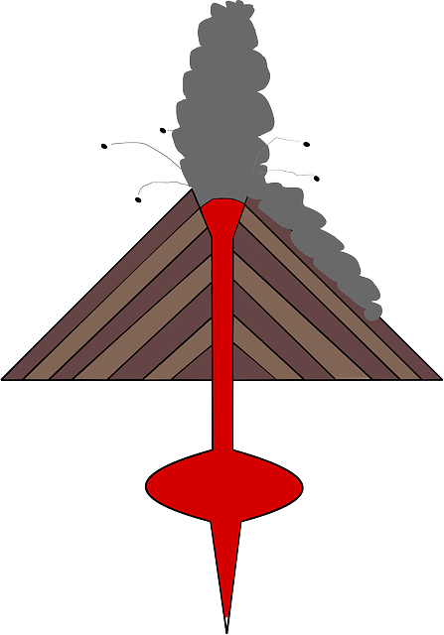
Decomposing Volcanic Eruptions
What are the different stages of a volcanic eruption?

Slide 8
Planning volcanic eruption animations
What should we create before we start writing our programs?
What type of algorithms have we used in this unit?
How did we construct these algorithm?

Slide 9
Planning volcanic eruption animations
Create an algorithm for each stage of the volcanic eruption.
Identify how many times your animation will repeat.

Slide 10
decomposition
abstraction
repetition
algorithms

Slide 11
Identify the concept
Repeating the same instruction or set of instructions several times without having to rewrite each one.
Notes:
Repetition

Slide 12
Identify the concept
A set of sequenced instructions, rules or steps written for a human to follow to help them to complete a task or solve a problem.
Notes:
Algorithms

Slide 13
Identify the concept
Breaking a more complex problem down into smaller tasks .
Notes:
Decomposition

Slide 14
Identify the concept
Focusing on the most important information and/or details and ignoring the less important parts.
Notes:
Abstraction

Slide 15
Learning objectives revisited:
To decompose a process into stages.
To construct simple flowchart algorithms.
To use repetition in algorithms.

Slide 16

LED Planner

Slide 17
Licensing information:
Published by the Micro:bit Educational Foundation microbit.org under the following Creative Commons licence:
Attribution-ShareAlike 4.0 International (CC BY-SA 4.0) https://creativecommons.org/licenses/by-sa/4.0/

