Slide 1
Warm-Up:
Grab the paper off the counter and answer question A on that sheet. If you don’t know, still guess or try to come up with something. You are answering the following questions: What do you think the definition of technology is? What do you think qualifies as a technological advancement? Don’t be afraid to guess or be wrong, no one will see your paper but me ☺

Slide 2
Daily Agenda:
Good Things
Hand back Campus Map and go over them
What is technology lesson:
Stations around the room
Debate and Discussion
Top 3 and why
Video Clips

Slide 3

GOOD THINGS:

Slide 4
Campus Map:
For this activity, you can fix your mistakes and turn them back in for up to a 9/10
You are expected to look over the rough draft and make sure you have everything you were missing the first time around
You can only turn it back in the one time, so make sure you do the best you can for the most points possible

Slide 5
Technology Stations:
You will need to bring your paper from the counter where you wrote your definition of technology and a pen/pencil with you
You will be divided into three groups and will have about 2-5 minutes at each station where you will look over the items displayed, and write down the ones that qualify as technological advancements
No talking to your group, this is an individual activity.
After you have your items written down and are back in your seat, look over the list and put a * next to or circle the three items you think are most important

Slide 6
What is Technology??
What did you put down for the definition of technology???
What is the definition of technology is according to Britannica:
Technology, the application of scientific knowledge to the practical aims of human life or, as it is sometimes phrased, to the change and manipulation of the human environment.
So what do you think qualifies as a technological advancement? Give me some examples.
What do you think one of the oldest technological advancements was? What are some of the newer ones??

Slide 7
Debate & Discussion:
What are some of the items from your list that you put down as a technological advancement and why?
What items did you not put down and why?
Are there any items that someone put down that you disagree with? If so, why?
How about the following couple slides, do you think they count as technological advancements? Why or why not?

Slide 8


Slide 9
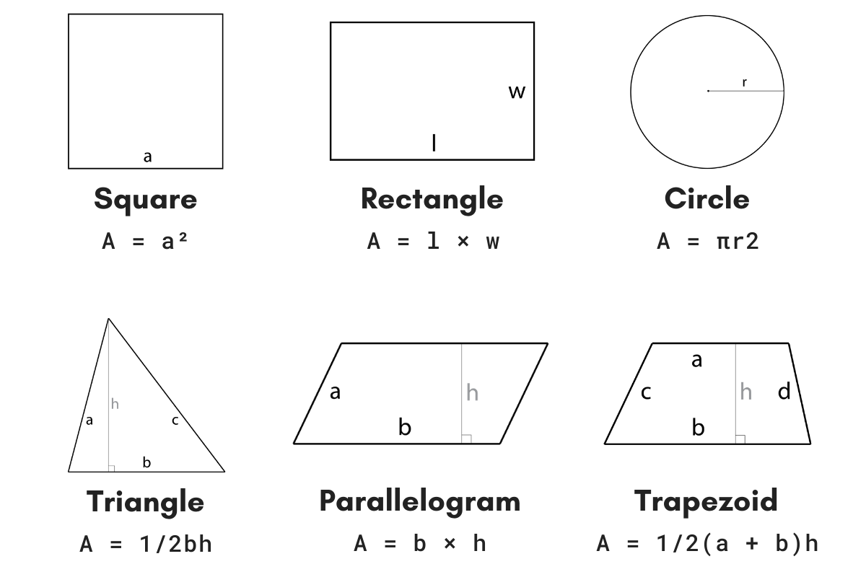

Slide 10

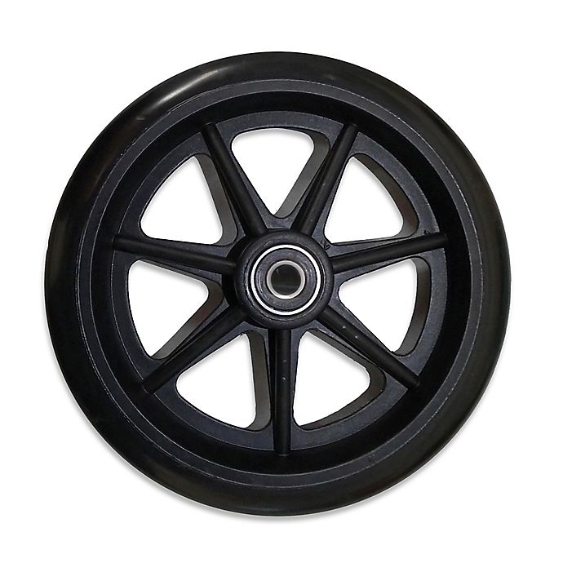

Slide 11
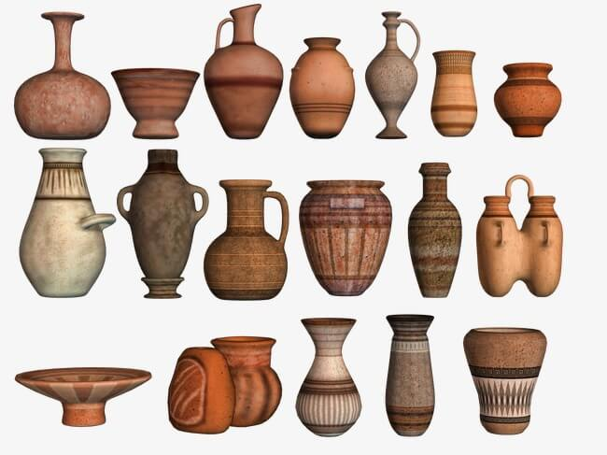

Slide 12
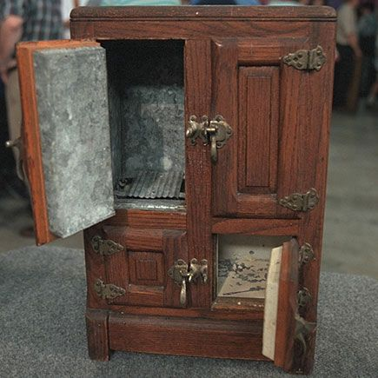

Slide 13


Slide 14


Slide 15


Slide 16



Slide 17
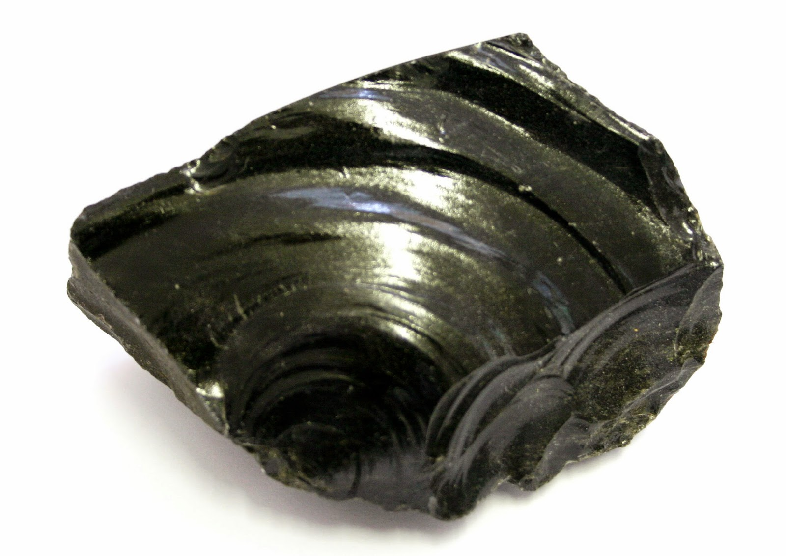

Slide 18


Slide 19
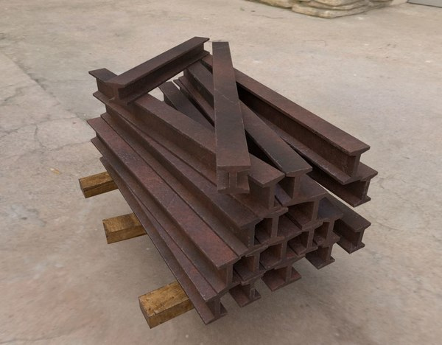

Slide 20


Slide 21
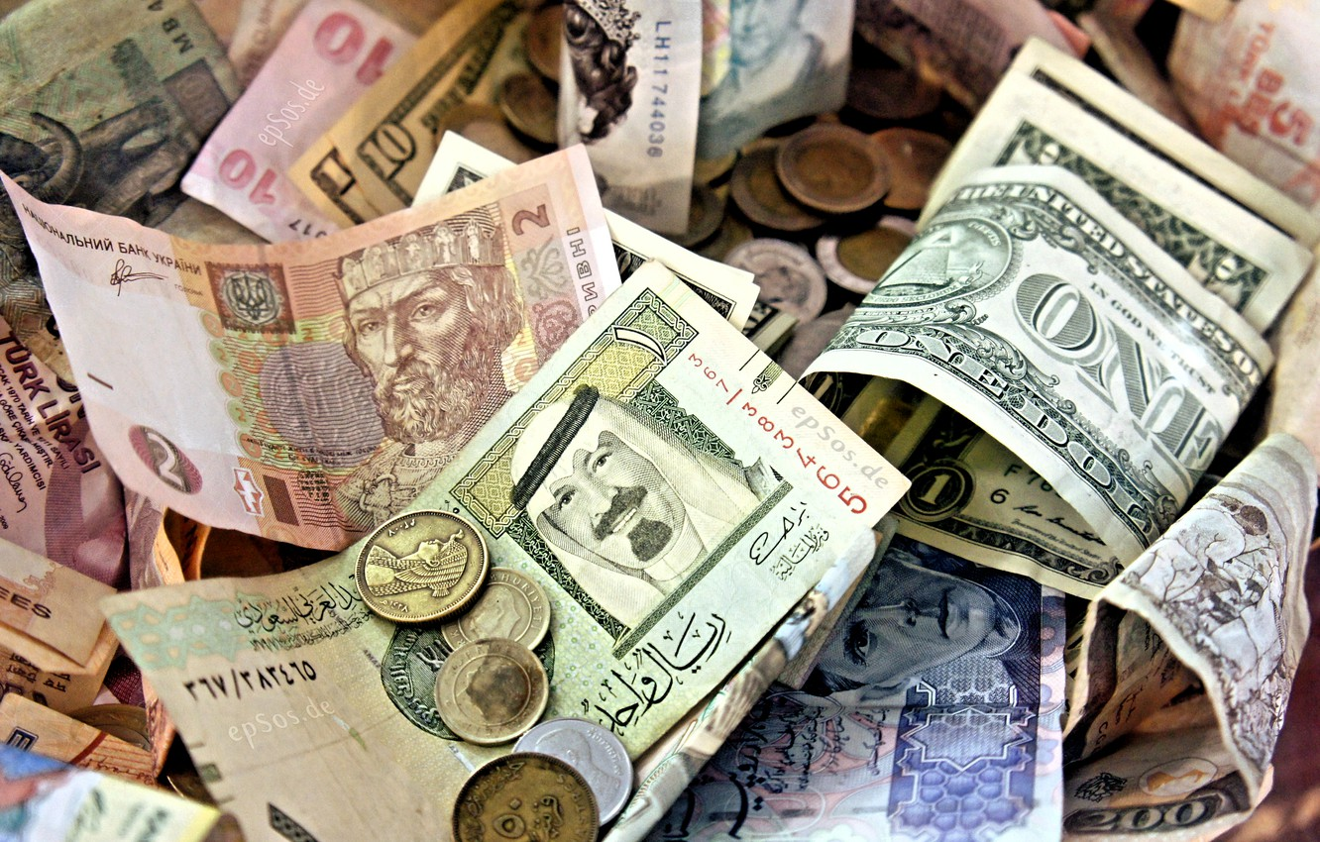

Slide 22
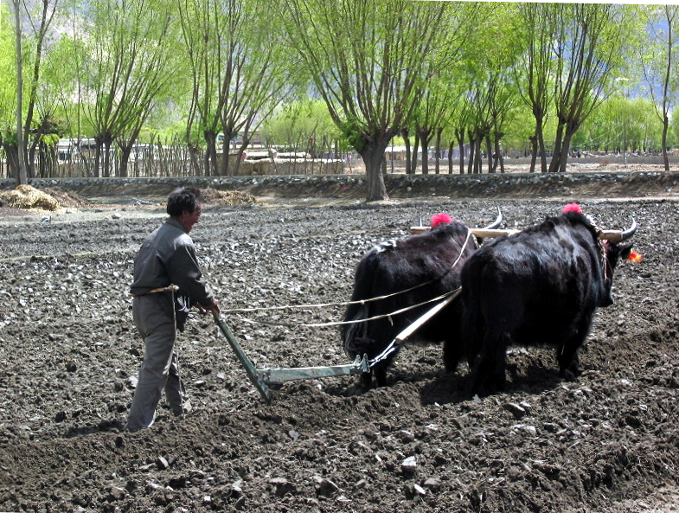

Slide 23
Top Three:
What items did you pick as the top three most important and why?
Do the items you picked, only apply to modern day or were they around and used in ancient history?
Is there any way for all of us as a class to agree to a list of the 3 most important technological advancements, why or why not?
What is the one item of technology you couldn’t do without??

Slide 24
Video Clips:
https://www.youtube.com/watch?v=IJM3yuIDDPQ&t=4s
https://www.youtube.com/watch?v=DENG7Q7VRgo&t=178s

