Slide 1
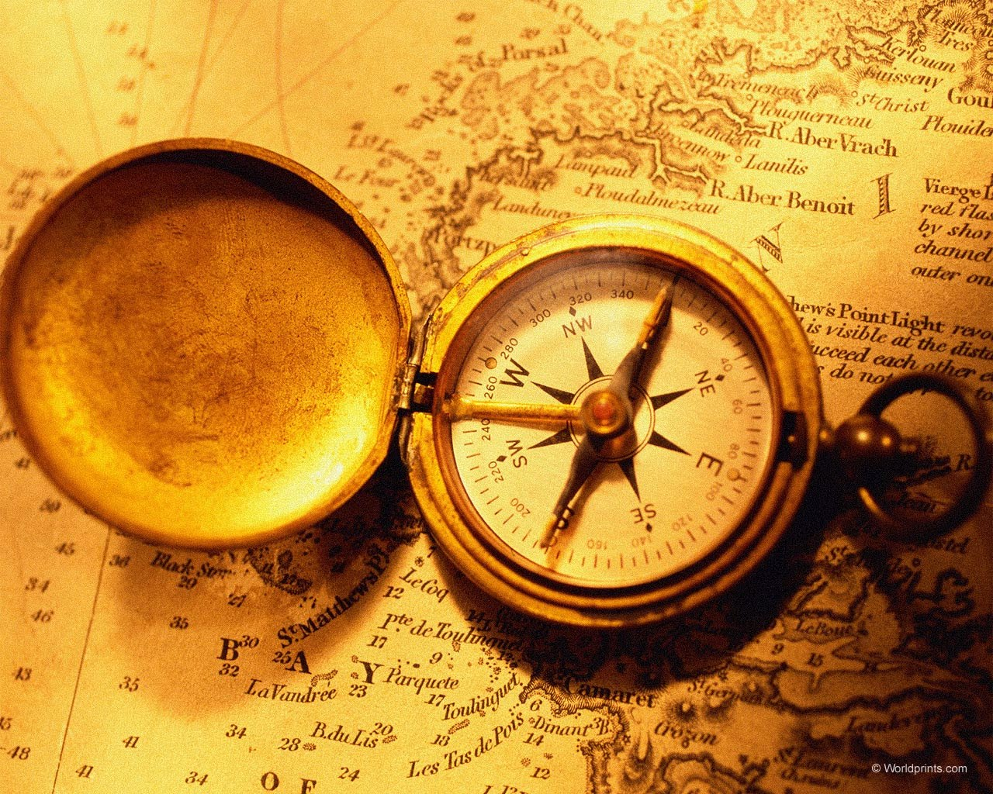
The History of the Compass
This Photo by Unknown Author is licensed under CC BY-NC-ND

Slide 2
Warm-Up:
Questions to consider when you get into class before we discuss them together:
Who do you think invented the compass?
What impact do you think this had on that civilization?
How has the compass evolved through time?
Do we still use them today? What kinds do we have?
Have you ever used a compass before? Where and how?

Slide 3
Daily Agenda:
Basic Compass Skills Questions
Review of compass/directions
Impact of Compass of Age of Exploration/Discovery of the New World
Compass Activity
Make Micro Bit Compass
Which Compass is Better Activity
Post Activity Write-Up and Discussion

Slide 4
Impacts of the compass:
Fill out the compass rose and answer the questions on the worksheet
Don’t worry if you can’t remember your directions (cardinal or intermediate) or don’t know the answer to some of the questions on the worksheet
This is to see what you know going into this lesson and will be asked again at the end to see what you learned
Make sure you put your name on the paper and turn it in on your way out of class today

Slide 5
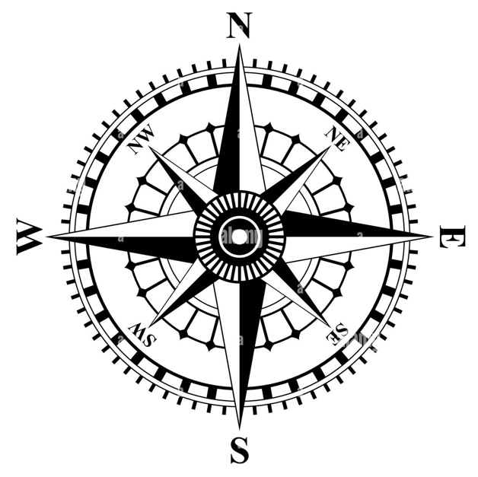
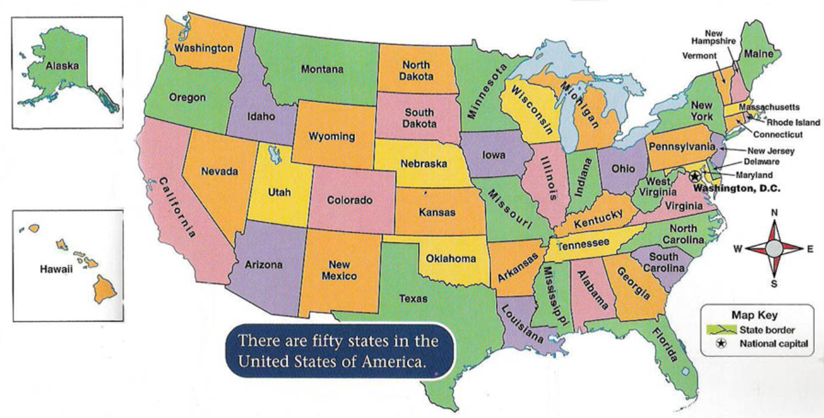

Slide 6
Impact of the Compass on History:
https://www.youtube.com/watch?v=LroX6ThIDpw&t=20s
https://www.youtube.com/watch?v=Eup2J0oAq9Y
DISCUSSION QUESTIONS:
How do the magnetic poles help compasses work?
How does the North/South magnets attract/repel to one another?
What are some ways the compass helped people throughout history?
What are some negative ways the compass impacted civilizations/history?
How do we use compasses today? How many of you have every used a compass?

Slide 7
Making a Micro Bit Compass:
Get out Micro Bit, USB adapter, and open https://microbit.org/code/
First thing we have to do is define the cardinal directions and draw a circle to determine the different degrees.
North is 0*
East is 90*
South 180*
West 270*
Once we have those, we need to decide what degrees fall between the cardinal directions, called the intermediate directions (they would be ½ of 90* = 45*)
North would be 135* to 45*
East would be 45* to 135*
South would be 135* to 225*
West would be 225* to 135*

Slide 8
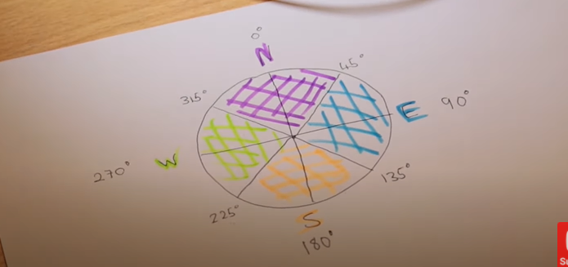
https://www.youtube.com/watch?v=HdNdLlyeFLs&t=168s

Slide 9
Scavenger Hunt Directions:
For this activity, you will be dividing your group of 6 into 3 groups of 2
Once you have done that, you will decide which group is using the micro bit compass, the smartphone compass, and the traditional hand-held compass.
Each group of 2 will have a set of scavenger hunt directions based on the compass they chose – ALL THREE GROUPS HAVE DIFFERENT DIRECTIONS, AND WITHIN THOSE GROUPS, EVERYONE WILL HAVE DIFFERENT STEPS FOR THE SCAVENGER HUNT!!
One partner will need to have a pen/pencil and clipboard to write down your group answers while the other partner is in charge of the compass (you will switch roles halfway through, so don’t worry about who gets to do what to start)
When you leave the library, you need to be on your best behavior. When we are outside, you are following directions and staying on task. If you don’t, you will be written up and sent to ISS for the remainder of class.

Slide 10

Which direction is South?
Which direction is Northeast?
Which direction is West?
Which direction is Southeast?
Which direction is Northwest?
Which direction is East?
Which direction is Southwest?
Which direction is North?

Slide 11
DISCUSSION QUESTIONS:
Which compass was the easiest to use? Why?
Which compass was the hardest to use? Why?
What is something about your compass that worked well?
What was something about your compass that didn’t work well?
Which compass do you think was the best? Why?
Which compass do you think was the worst? Why?
How could each compass be improved?

