Slide 1
What’s The “W” Word in Wyoming?
By Ms. Cline

Slide 2
Background Knowledge
Any guesses on a “W” word that we hear almost everyday in Wyoming? Share with your partner and make a list, be ready to share!

Slide 3
You guessed it! It’s Wind!
Almost everyday, you hear someone comment (or complain:) about the wind.
What are some things you’ve heard people say about the wind in Rawlins?
The wind is almost like a warning to us about the weather, and we are going to use wind as a tool to make predictions about our weather.

Slide 4
How do we measure wind?
No, you don’t just look at your cell phone and check!
Turn to your partner and see if you can take any guesses.

Slide 5
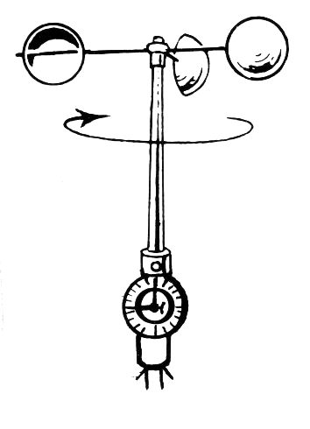
Did anyone guess Anemometer?
://www.youtube.com/watch?v=jTWwnUIygc8
https://www.youtube.com/watch?v=yU6CIoGDY2Q
Notes:
**Note that we are just going to count the rotations to figure out the wind speed as indicated in our experiment. We’re not going to divide by the circumference, this might be a more advanced skill for higher grade levels. **

Slide 6
Learning Targets
We will use data to make predictions and communicate ideas based on wind speeds in Rawlins, Wyoming.
I will build a wind anemometer and use it to predict wind speeds and chart the information that I collect.

Slide 7
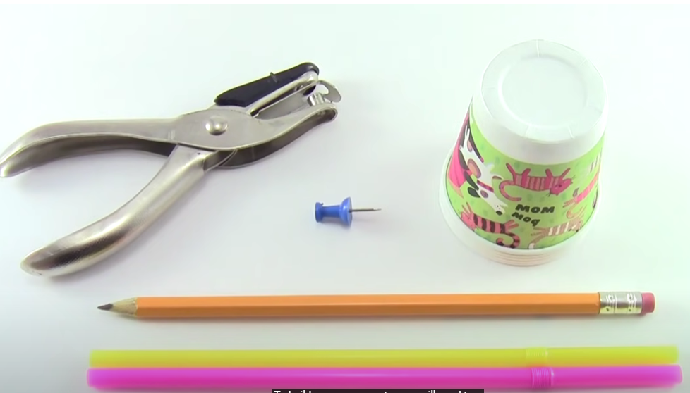
How to Build an Anemometer
https://www.youtube.com/watch?v=Af0LB3abBsk&t=18s
https://www.sciencebuddies.org/science-fair-projects/project-ideas/Weather_p008/weather-atmosphere/how-does-a-wind-meter-work
Supplies:
- a sharpened pencil with an eraser on the end
-a hole punch
-a pushpin
-5- 3 oz paper cups
-straws

Slide 8
Day 2-Using our Anemometer
Target
We will test our anemometers today in front of a fan at low and high speeds to determine if we can improve our model before we test it outside.
I will test my anemometer in front of the fan at low and high speeds to do a test run. I will fix any issues and practice counting the rotations to determine the wind speed.
3-5-ETS1-3. Plan and carry out fair tests in which variables are controlled and failure points are considered to identify aspects of a model or prototype that can be improved.

Slide 9
Counting rotations
On one of your cups, you are going to put a large red circle with permanent marker to help count the rotations as your anemometer rotates with the fans.
We are going to practice with mine first. I’m going to place my anemometer in front of the fan and put the cup with the red dot in front of me and every time it circles by me I’m going to count out loud softly. I’m going to do this for 15 seconds. We’re going to calculate the wind speed by multiplying my number by 4 because 4 x 15 = 60 seconds (1 minute)
****NOTICE, I am just letting the pencil point rest in one hand, while the other hand just forms a circle around it. If you grab your pencil tightly it won’t rotate.****
Look at you! You’re combining multiplication and science skills!

Slide 10
It’s your turn!
We’ll have to take turns counting rotations. We are going to buddy up and help each other count the rotations. I have 3 fans around the room, I’ll show you which fans to wait by. Remember, fans have sharp blades so make sure you hold your anemometer safely away from the fan.
I have a timer set for 15 seconds, make sure you start counting when I say go!
Everyone will calculate for the low fan speed on the paper below. When everyone is done, we’ll calculate for the high fan speeds!
https://www.timer-tab.com/
https://docs.google.com/document/d/1syuRX6nR6SLZTm2Ih0XnYJGaw3UID25JeV-2kJ0oXuA/edit?usp=sharing

Slide 11
Day 3 Using Your Anemometer Outside
Target:
We will use our anemometer outside today to calculate wind speeds.
I will use my anemometer to calculate wind speeds and record my data.

Slide 12
Testing Anemometers
Everyone will take their anemometers outside. Find a spot on the playground where you can hear me, but where the wind isn’t blocked.
I’ll time you for 15 seconds just like we did in the classroom. We’ll try a couple of times and just go with the number that popped up the most!
Please take a look at the clouds around too to help make some predictions about what the clouds, wind, and temperature could mean for any upcoming weather reports.
When we head into class, you’ll need to enter your data into your weather chart.

Slide 13
Weather Tracker
Each student will have a copy of the weather tracker down below, we will be creating our own graphs using Google Sheets later on.
On your tracker, write down the wind speed, the temperature, and what you noticed about the clouds.
https://cms-tc.pbskids.org/global/NC-Weather-Tracker.pdf

Slide 14
Insert your data into Google Sheets
Has anyone ever lost their reading log? Hmmmmm, this sounds familiar.
Well, we’re going to keep your data in Google Sheets so you don’t lose your data!
For 5 days, we will input the wind speed and temperature and cloud observation to see if you can predict what the upcoming weather trends will be based on the data you have collected.
We’ll use mine to help you create your own sheet.
https://docs.google.com/spreadsheets/d/1g41TXTdCjtsjr4Sl9Nqd1ObBo2qY9doeEYMD2lZ34zY/edit?usp=sharing

Slide 15
Presentations!
Scientists need to share their data!
Now that you have collected information about wind, temperature and clouds, you and a buddy are going to create your own slideshow about what the information you have collected.
Slides should include:
-Title and name
-Share at least two slides that show how wind is connected to our weather.
-You must create a line or bar graph using Google Sheets to share on your presentation.
-Any fun facts or vocabulary words you want to share? Great!

