Slide 1
Evaluation of Quantitative Precipitation Estimation from Model, Satellite and Radar
Chongxing Fan
School of Atmospheric Sciences, Nanjing University
SUPERVISOR: Yongsheng Chen
Notes:
Good afternoon, everyone. My name is Chongxing Fan. I’m an undergraduate senior from Nanjing University and this summer I came here to do 3-month scientific research following Professor Yongsheng Chen. Today I’m going to present my results about evaluation of quantitative precipitation estimation from model, satellite and radar.

Slide 2
Contents
01
Introduction
02
Data and Method
03
Result Analyses
04
Conclusions
05
References
Notes:
I’ll divide it into five parts: Introduction, Data and method, Result analyses, conclusions and references.

Slide 3
Contents
01
Introduction
02
Data and Method
03
Result Analyses
04
Conclusions
05
References

Slide 4
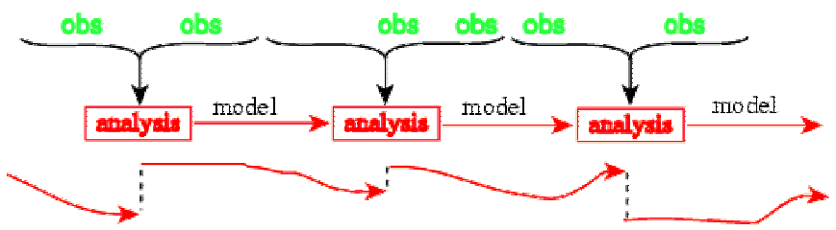
Introduction
Observation including satellite, radar and rain gauge data is combined with model to produce analysis field.
Error structure of observations and forecasts have to be understood to improve data assimilation.
Notes:
Improving weather forecasting is an eternal topic in Atmospheric Science, in which data assimilation plays an important part. Observation including satellite, radar and rain gauge data is combined with model output and produce the analysis field. In order to understand the error structure between these data sources, we conducted this research to evaluate model, satellite and radar estimates compared with rain gauge data.

Slide 5
Contents
01
Introduction
02
Data and Method
03
Result Analyses
04
Conclusions
05
References
Notes:
First of all, we have to get data prepared.

Slide 6
Data
3-km High-Resolution Rapid Refresh (HRRR) in CONUS area
Model: High-Resolution Rapid Refresh(HRRR)
Spatial Resolution: 3km
Temporal Resolution: 1h
Domain: CONUS
Real-time 3-km resolution, hourly updated, cloud-resolving, convection-allowing atmospheric model
Radar assimilation included
Notes:
We choose High-Resolution Rapid Refresh, abbreviated as HRRR as our model. The HRRR is a NOAA real-time 3-km resolution, hourly updated, cloud-resolving, convection-allowing atmospheric model. Radar data is assimilated in the HRRR every 15 min over an 1-h period. One hour precipitation is a variable in the HRRR’s output so we can use it directly.

Slide 7
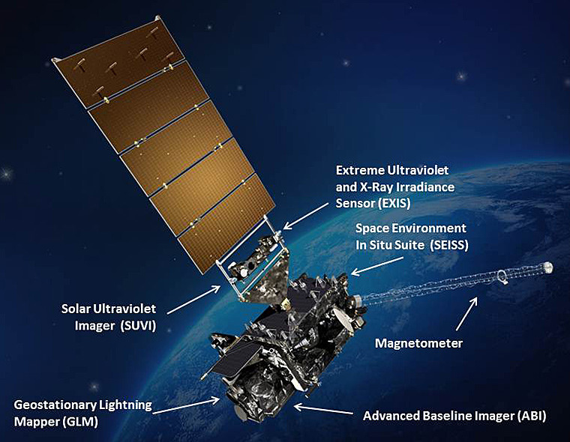
Data
Satellite Estimates: GOES-16 ABI L2+ RRQPE
Spatial Resolution: 2km
Temporal Resolution: 15mins
Domain: Full Disk
The ABI Rainfall Rate algorithm generates the baseline Rainfall Rate product from ABI IR brightness temperatures and is calibrated in real time against microwave-derived rain rates to enhance accuracy. The algorithm generates estimates of the instantaneous rainfall rate at each ABI IR pixel.
Notes:
Next is the GOES-R Series. The GOES-R primary instrument for imaging Earth is the Advanced Baseline Imager (ABI). ABI will view the Earth with 16 different spectral bands includes two visible channels, four near-infrared channels, and ten infrared channels. The ABI Rainfall Rate algorithm generates the baseline Rainfall Rate product from ABI IR brightness temperatures and is calibrated in real time against microwave-derived rain rates to enhance accuracy.

Slide 8
Data
Radar + Gauge Estimates: StageIV
Spatial Resolution: 4km
Temporal Resolution: 1h
Domain: CONUS
Mosaicked into a national product at NCEP, from the regional hourly/6-hourly multi-sensor (radar+gauges) precipitation analyses (MPEs) produced by the 12 River Forecast Centers over CONUS.
Snapshot of a one-hour Stage II (left) and Stage IV (right) analysis.
Notes:
Then we choose StageIV as radar estimates. It is actually a combination of radar and gauge estimates. But since the station-based rain gauge data is sparsely distributed, this high-resolution dataset mainly depends on the radar observation.

Slide 9
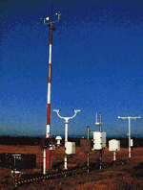
Data
Observation: METAR
Spatial Resolution: 2388 stations
Temporal Resolution: ~5mins
Domain: CONUS
Heated Tipping Bucket (HTB) Precipitation Gauge
Precipitation Accumulation Algorithm
Notes:
Finally METAR station-based observation is selected as a reference dataset. It uses heated tipping bucket precipitation gauge to measure precipitation and employs precipitation accumulation algorithm to retrieve the rainfall rate.

Slide 10
Method
Preprocessing
Interpolation
HRRR
H_std
GOES
G_std
Plot
Eyeball Verification
Radar
R_std
METAR
M_std
Combined
Preprocessing
Statistical Verification
Combination
Analyze
Notes:
In order to compare these four datasets, we have to preprocess them to become an hourly data with standard units. Because these datasets don’t have the same grid, especially for METAR, which is unstructed grid, we have to interpolate HRRR, GOES and radar data into METAR grid. After interpolation and combination we can either plot the rainfall rate of each hour to see the spatial pattern and rain rate with our eyes, or do the statistical analyses using various statistical methods. In this study we mainly do the latter one.

Slide 11
Contents
01
Introduction
02
Data and Method
03
Result Analyses
04
Conclusions
05
References
Notes:
Now I’d like to show you the results.

Slide 12
Result Analyses
We choose July 2018 for our analyses.
Several verification methods are employed.
Average Rainfall Maps/Trends
Probability Distribution Function (PDF) Plots
Average, Variance, Skewness and Kurtosis
Contingency Table
Correlation Analysis
Verification for Dichotomous Forecasts/Estimates
Notes:
We choose July 2018 for our analyses. These methods are employed in our analyses, such as……

Slide 13
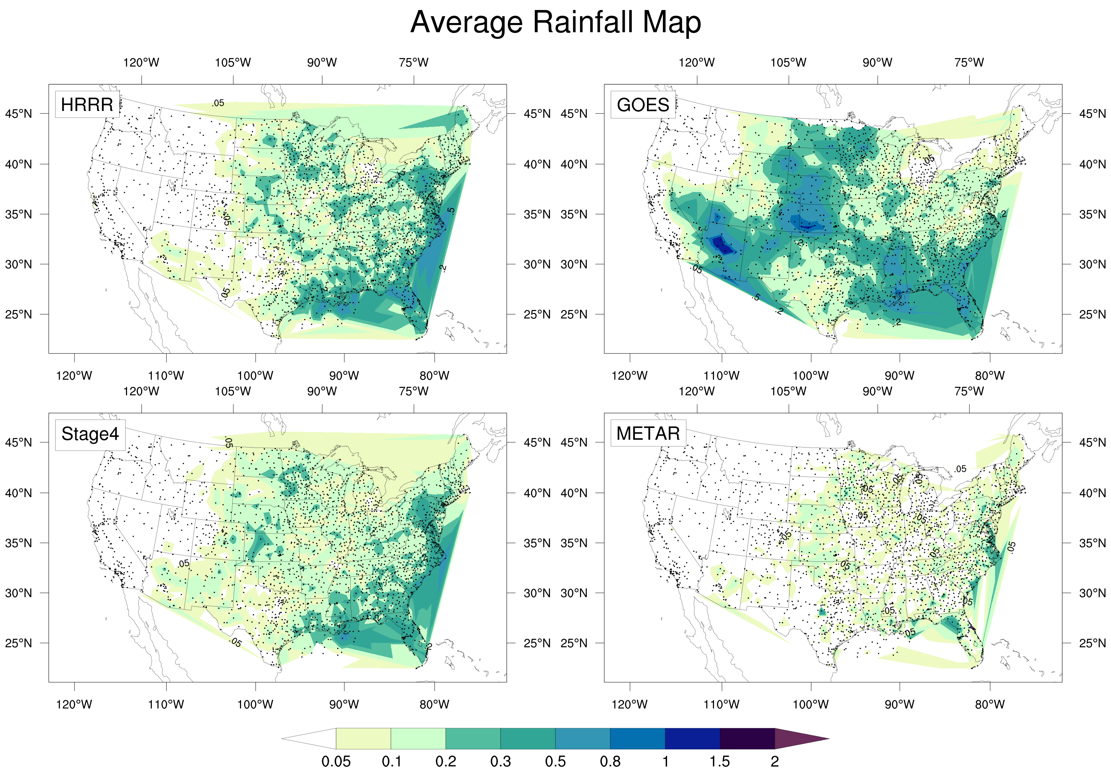
Total precipitation
HRRR: 109.635 mm
GOES: 152.617 mm
Stage4: 99.497 mm
METAR: 48.651 mm
Significant wet bias in forecasts and estimates, especially in GOES estimate.
HRRR
GOES
Stage4
METAR
Notes:
First of all, this is the average rainfall map. Accordingly, these four panels show the HRRR model, GOES satellite, Stage4 multisensory and METAR rain gauge data. They all have been time-averaged so we can draw this single map. Color indicates one hour precipitation value. Total precipitation is listed here. From the plot we can see a significant wet bias in these three datasets when compared with METAR, especially for GOES satellite estimation. You can see in the west US there are some area in blue.

Slide 14
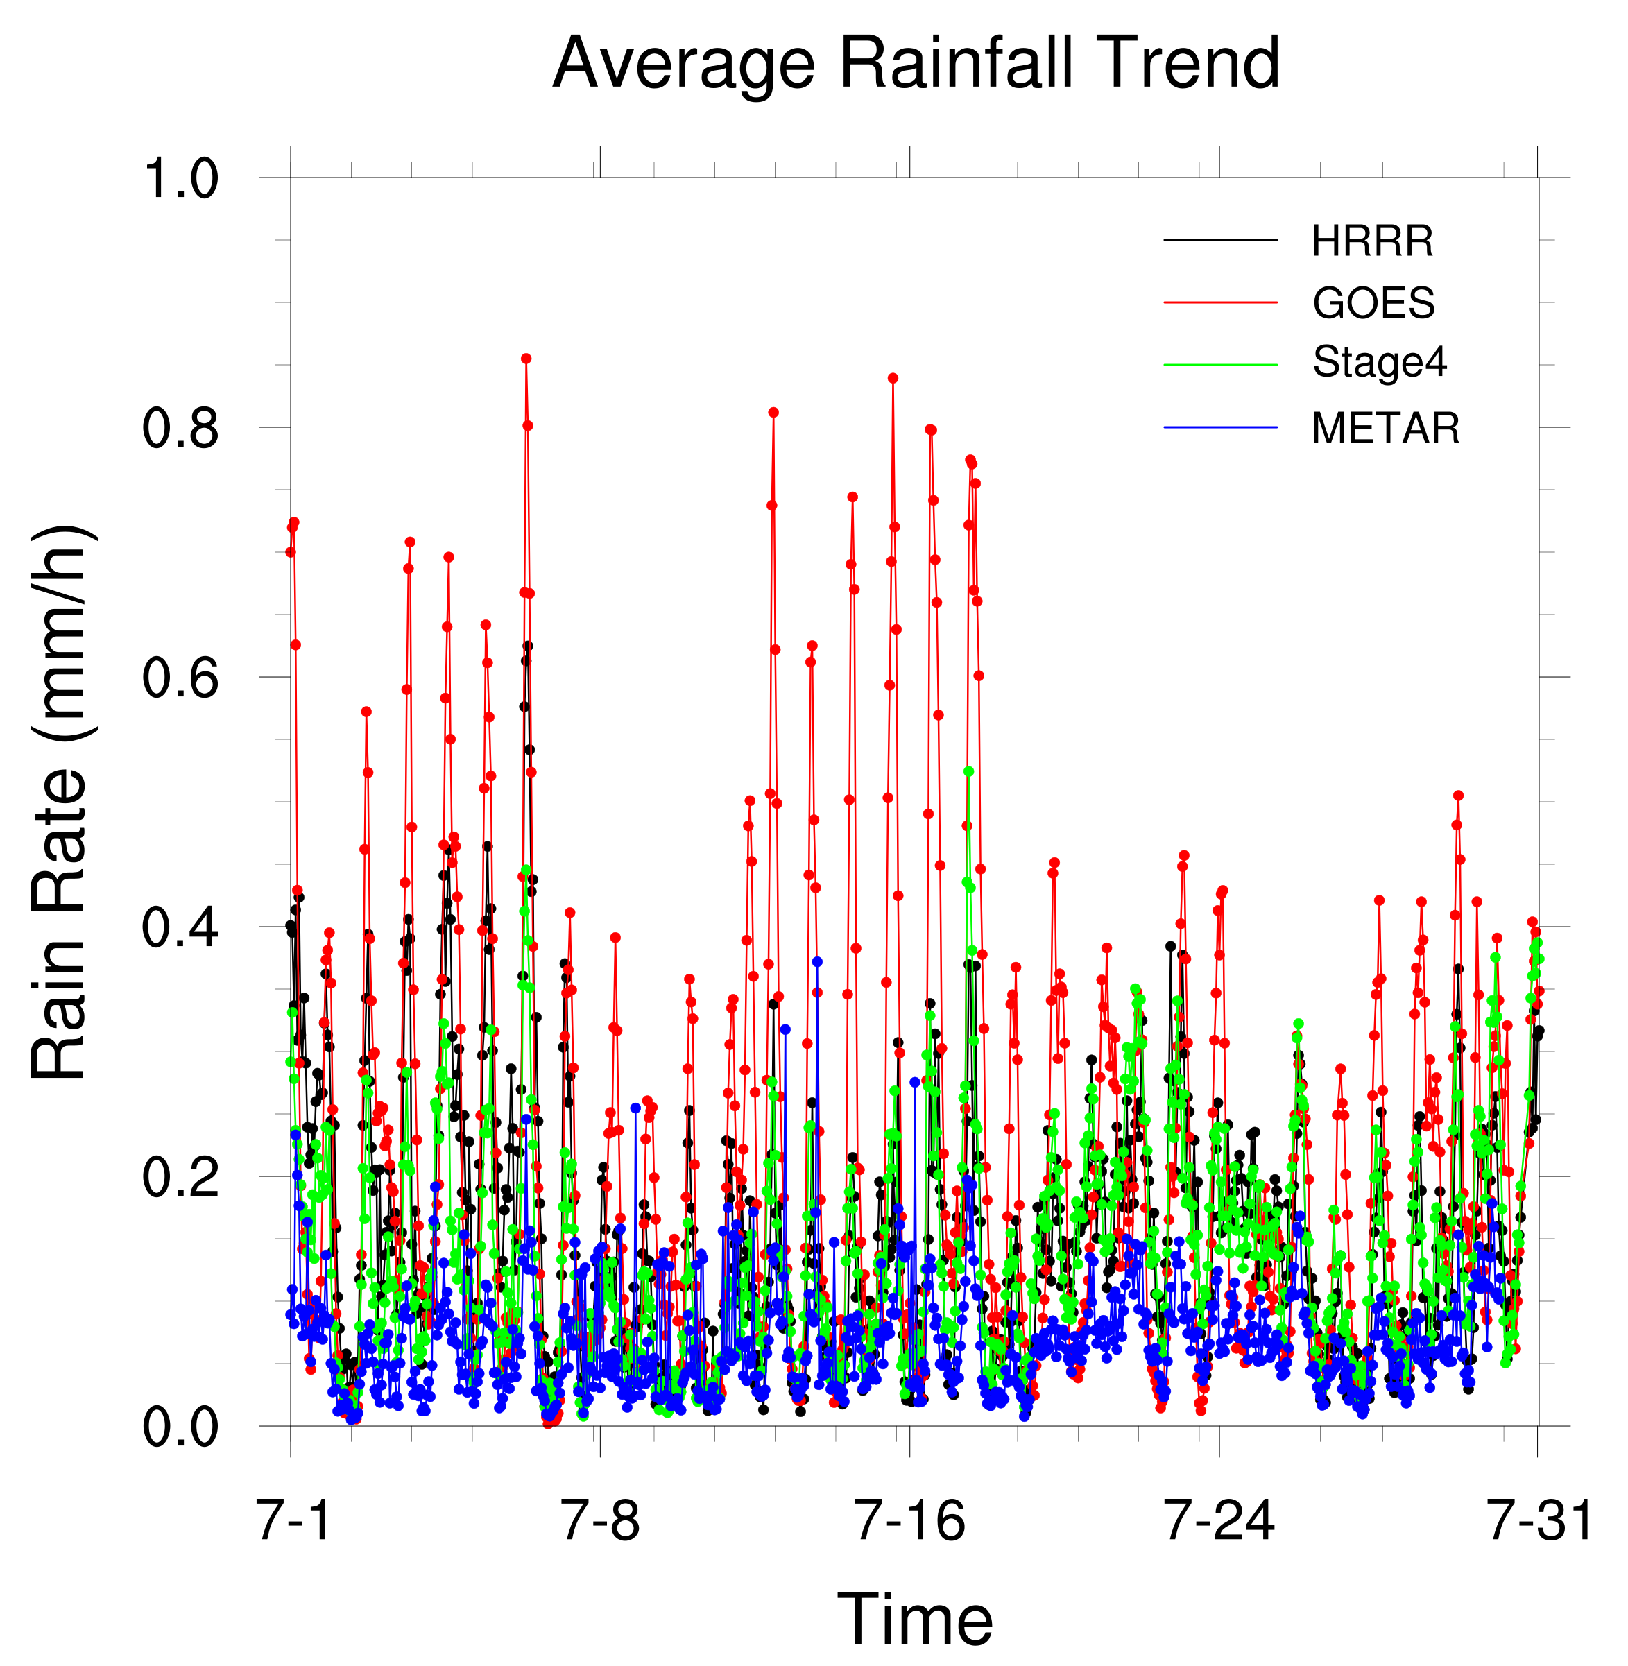
Total precipitation
HRRR: 109.635 mm
GOES: 152.617 mm
Stage4: 99.497 mm
METAR: 48.651 mm
Short and heavy rainfall occurs periodically.
All forecasts and estimates show a wet bias, with the GOES having the largest bias.
HRRR
GOES
Stage4
METAR
Notes:
For the average rainfall trend, we can see four curves in this trend plot. Black is HRRR model, red is GOES satellite, green is Stage4 and blue is METAR. They all have been spatial-averaged across more than 2000 stations so we can draw this single trend plot. We can see that in July short and heavy rainfall occurs periodically, and if we count the peaks in the plot we know that it seems like a diurnal variation. Also wet bias can be seen in this time-series plot. HRRR and Stage4 seem to be close to each other.

Slide 15
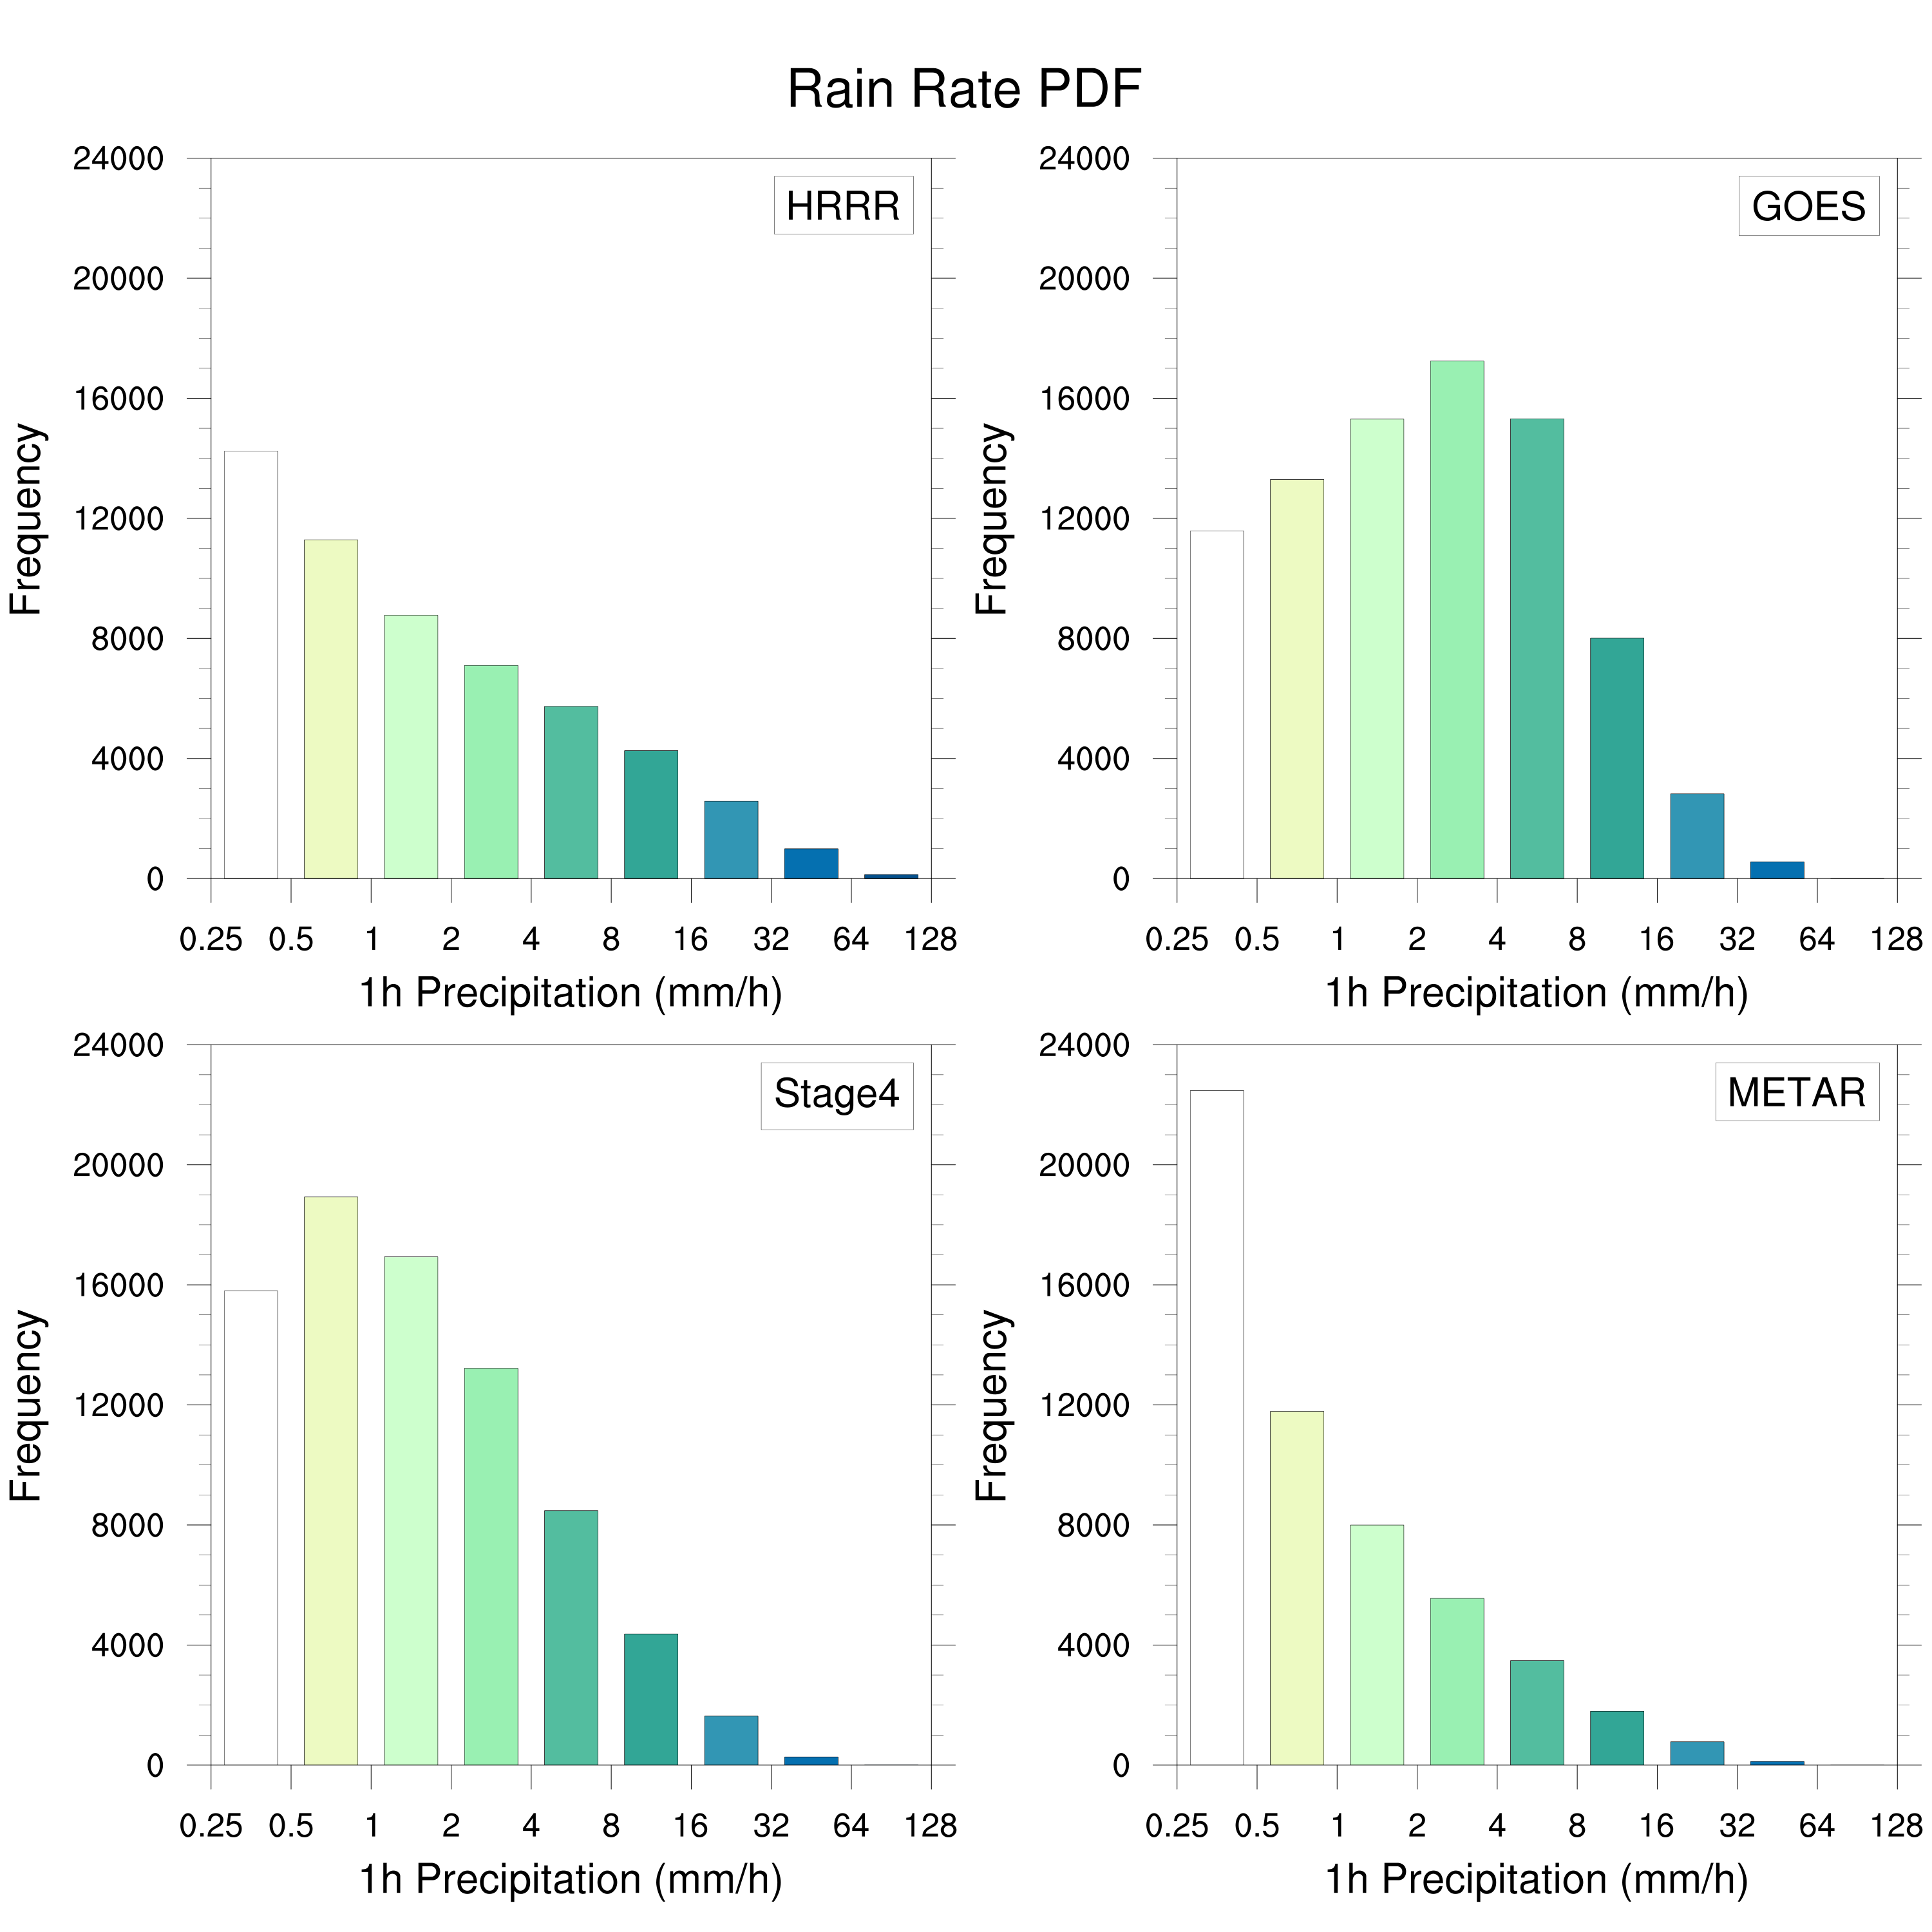
Probability Distribution Function (PDF) plot can clearly show the data distribution.
Compared with METAR, rain rate PDF of GOES satellite shifts to the right, suggesting a wet bias to the observation.
HRRR
GOES
Stage4
METAR
Notes:
Apart from the average map or trend, we can also set some thresholds and analyze the distribution of rain rate. PDF plot can clearly show the data distribution. Here X axis is 1h precipitation and Y is frequency. When compared with METAR, we can see all the three datasets have a right shift, showing a wet bias, which is consistent to the previous result.

Slide 16
Table: Basic Statistics of Error
 | ALL |  |  |  | LIGHT
 | AVG | VAR | SKW | KUR | AVG | VAR | SKW | KUR
HRRR | 0.09 | 3.64 | -25.30 | 9811 | 1.16 | 56.43 | 5.05 | 35.82
GOES | 0.14 | 3.46 | -53.91 | 12770 | 0.55 | 25.85 | 3.72 | 18.90
Stage4 | 0.07 | 1.62 | -123.28 | 47910 | 1.12 | 18.39 | 6.75 | 82.47
Occurrence Frequency
Generally, there is a wet bias during light rain and dry bias during heavy rain.
Because Stage4 combines radar and rain gauge data, it is the most accurate estimate among the three datasets.
5272
892
1630877
13551
 | MEDIUM |  |  |  | HEAVY
 | AVG | VAR | SKW | KUR | AVG | VAR | SKW | KUR
HRRR | -2.96 | 93.95 | 3.17 | 14.03 | -17.27 | 184.74 | 1.43 | 5.46
GOES | -3.43 | 44.67 | 2.12 | 7.52 | -16.43 | 114.88 | 0.38 | 2.51
Stage4 | -0.45 | 29.10 | 2.69 | 15.47 | -7.63 | 101.87 | 0.13 | 1.63
Notes:
Here are some statistics about the error. We split the samples into four categories. “All” means all data is included in the calculation, and we set thresholds for light rain, medium rain and heavy rain. Four basic values are shown here: average, variance, skewness and kurtosis. Here we highlight the results of average error. It is shown that there is an overall slight wet bias in these three QPEs. There is a wet bias during light rain while significant dry bias during heavy rain. But since the occurrence of the heavy rain is much smaller than of the light rain, so the overall average error is a wet bias. Furthermore, absolutely the Stage4 has the best performance among these three estimations.

Slide 17
Diagram: Using 1mm/h as threshold to distinguish rain and non-rain area
False Alarms
Hits
Forecast / Estimates
1 mm/h
Correct Negatives
Misses
1 mm/h
Observation
Notes:
To further evaluate the performance of these estimations, we employ some terms here. We define 1 mm/h as threshold to distinguish rain and non-rain area. After splitting the panel into four sections, we can define them accordingly as Hits, Misses, False Alarms and Correct Negatives.

Slide 18
Table: Contingency Table
 | HRRR |  | GOES |  | Stage4
METAR | YES | NO | YES | NO | YES | NO
YES | 7402 | 11017 | 8057 | 10770 | 15628 | 2790
NO | 20501 | 1.50532e+06 | 47463 | 1.50348e+06 | 26404 | 1.48620e+06
Stage4 has the largest hits and smallest misses.
HRRR has the largest misses, while GOES has the largest false alarms.
 |  | Forecasts/Estimates
 |  | YES | NO
Observation | YES | Hits | Misses
 | NO | False Alarms | Correct Negatives
Notes:
Therefore we can make this contingency table. Corresponding term for each cell is shown here as a table. As we can see in this table, StageIV has the largest hits and smallest misses. What’s new to us is that HRRR has the largest misses and GOES has the largest false alarms.

Slide 19
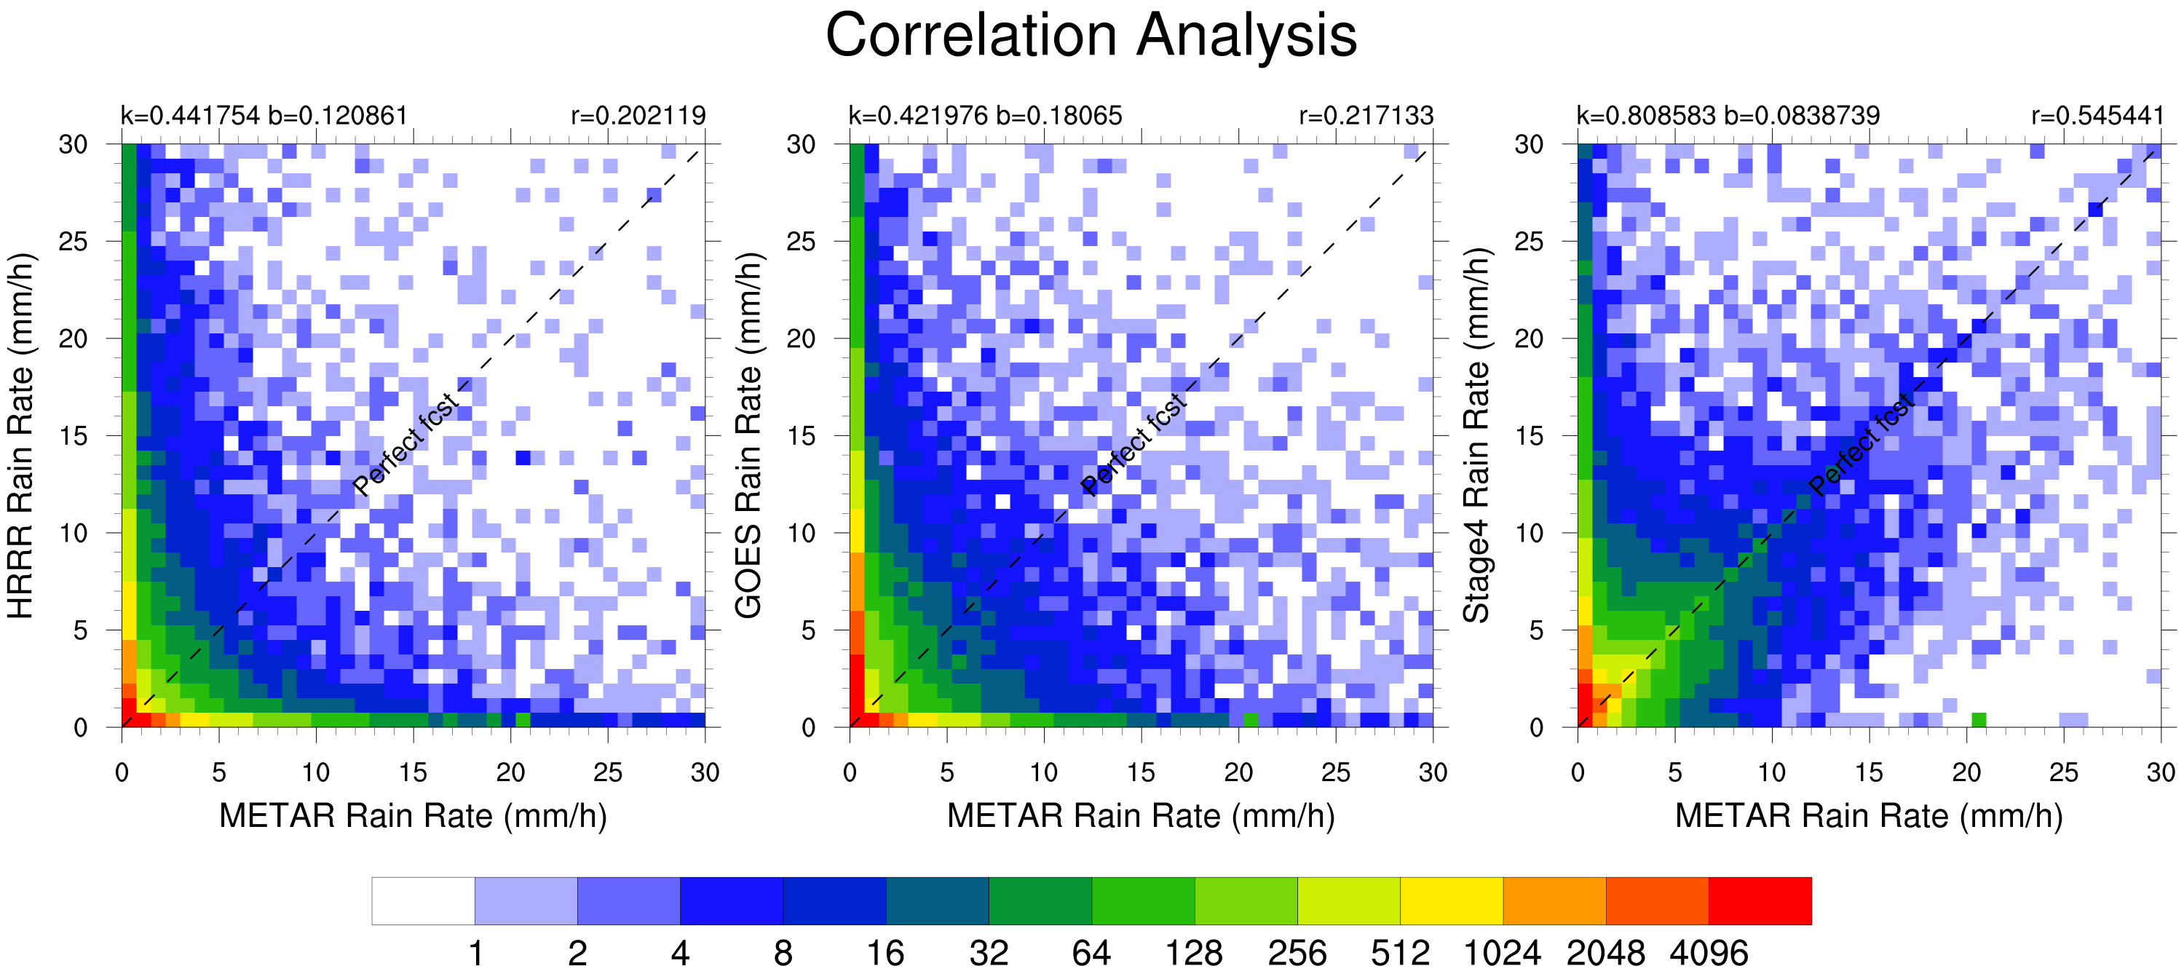
Perfect Forecast
Notes:
To understand the correlation between estimation and observation, we perform the correlation analysis. The black dash line is drawn as a perfect forecast or perfect estimation line. Color indicates the density of the scatter points. We also calculate the linear regression coefficients which are marked in this plot. From the plot, we know that the improvement for the StageIV is shown in this square area. There are fewer misses in StageIV, and samples are gathered close to this perfect forecast line, and thus result in a higher R value.

Slide 20
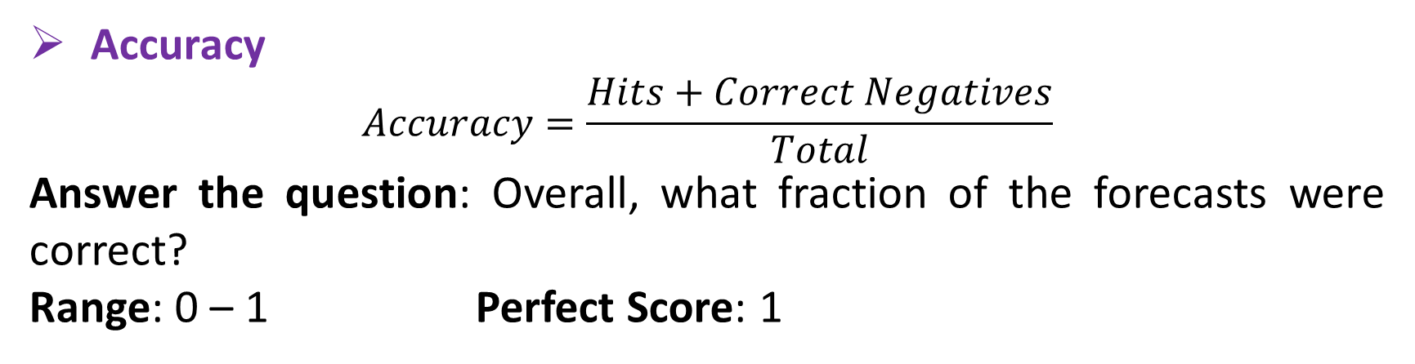
Forecast and Estimates Verification for July 2018
Verification Methods for Dichotomous Forecasts
Accuracy
$$Accuracy=\frac{Hits+Correct Negatives}{Total}$$
Answer the question: Overall, what fraction of the forecasts were correct?
Range: 0 – 1 Perfect Score: 1
Notes:
Using these results, finally we present some scores that can measure the performance of these three datasets. Let’s review these scores first before we continue.

Slide 21
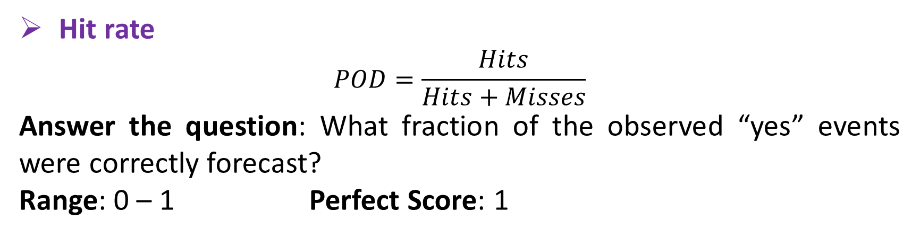
Forecast and Estimates Verification for July 2018
Verification Methods for Dichotomous Forecasts
Hit rate
$$POD=\frac{Hits}{Hits+Misses}$$
Answer the question: What fraction of the observed “yes” events were correctly forecast?
Range: 0 – 1 Perfect Score: 1

Slide 22
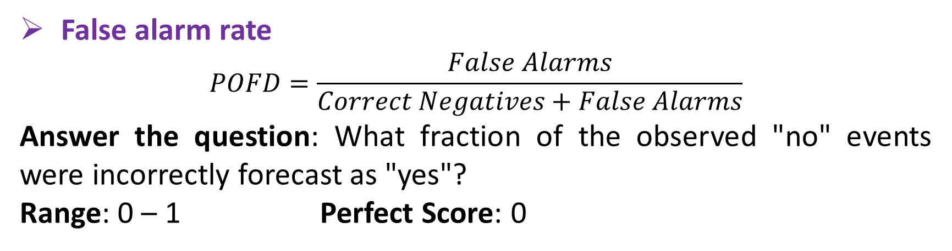
Forecast and Estimates Verification for July 2018
Verification Methods for Dichotomous Forecasts
False alarm rate
$$POFD=\frac{False Alarms}{Correct Negatives+False Alarms}$$
Answer the question: What fraction of the observed "no" events were incorrectly forecast as "yes"?
Range: 0 – 1 Perfect Score: 0

Slide 23
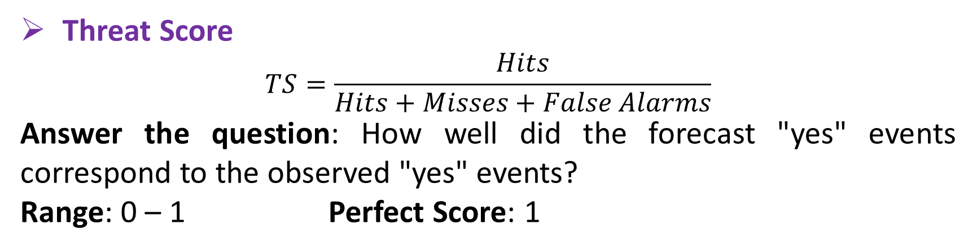
Forecast and Estimates Verification for July 2018
Verification Methods for Dichotomous Forecasts
Threat Score
$$TS=\frac{Hits}{Hits+Misses+False Alarms}$$
Answer the question: How well did the forecast "yes" events correspond to the observed "yes" events?
Range: 0 – 1 Perfect Score: 1

Slide 24
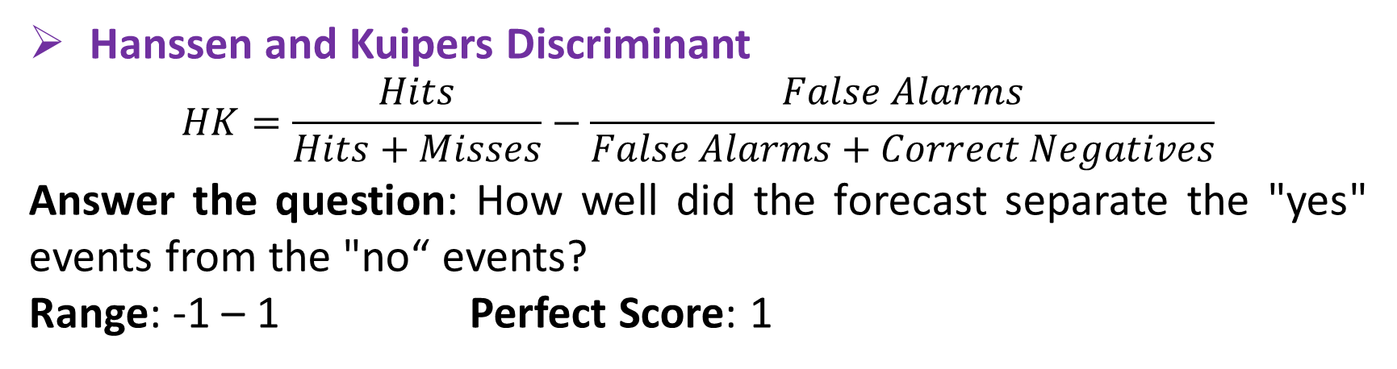
Forecast and Estimates Verification for July 2018
Verification Methods for Dichotomous Forecasts
Hanssen and Kuipers Discriminant
$$HK=\frac{Hits}{Hits+Misses}−\frac{False Alarms}{False Alarms+Correct Negatives}$$
Answer the question: How well did the forecast separate the "yes" events from the "no“ events?
Range: -1 – 1 Perfect Score: 1

Slide 25
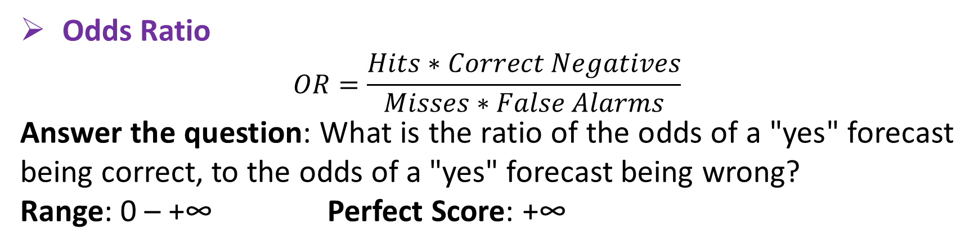
Forecast and Estimates Verification for July 2018
Verification Methods for Dichotomous Forecasts
Odds Ratio
$$OR=\frac{Hits∗Correct Negatives}{Misses∗False Alarms}$$
Answer the question: What is the ratio of the odds of a "yes" forecast being correct, to the odds of a "yes" forecast being wrong?
Range: 0 – +∞ Perfect Score: +∞

Slide 26
Forecast and Estimates Verification for July 2018
Table: Verification Results for Dichotomous Forecast and Estimates
 | HRRR | GOES | Stage4 | Range / Perfect
Accuracy | 0.979590 | 0.962903 | 0.980932 | 0 – 1 / 1
Bias Score | 1.514903 | 2.948956 | 2.282115 | 0 – inf / 1
Hit Rate | 0.401868 | 0.427949 | 0.848518 | 0 – 1 / 1
False Alarm Ratio | 0.734724 | 0.854881 | 0.628188 | 0 – 1 / 0
False Alarm Rate | 0.013436 | 0.030603 | 0.017456 | 0 – 1 / 0
Threat Score | 0.190185 | 0.121542 | 0.348668 | 0 – 1 / 1
HK Discriminant | 0.388432 | 0.397346 | 0.831062 | -1 – 1 / 1
Odds Ratio | 49.3331 | 23.6973 | 315.2873 | 0 – inf / inf
Odds Ratio Skill Score | 0.960265 | 0.919019 | 0.993677 | -1 – 1 / 1
Generally, Stage4 has the best performance.
For most scores, HRRR does better than GOES, and for some others in reverse.
Notes:
So here is the result. I use green, yellow and red to indicate good, medium and bad among these three datasets. Apparently StageIV has the best performance, while HRRR and GOES have their own strengths.

Slide 27
Contents
01
Introduction
02
Data and Method
03
Result Analyses
04
Conclusions
05
References

Slide 28
Conclusions
One hour precipitation obtained from HRRR model, GOES satellite, StageIV multisensory data and METAR rain gauge data are evaluated using various methods.
All QPEs have an overall wet bias. There is significant wet bias during light rain and significant dry bias during heavy rain.
Generally, StageIV has the best performance in evaluating precipitation, since it is a combination of radar and rain gauge.
HRRR has more misses, while GOES has more false alarms.
Notes:
So in conclusion, we perform an evaluation between model, satellite, radar and rain gauge data. Several verification methods are used. And we present to you some main conclusions. Firstly, All QPEs have an overall wet bias. When categorized to different rain rate, we know that significant wet bias occurs during light rain and significant dry bias occurs during heavy rain. Secondly, StageIV has the best performance in evaluating precipitation, since it is a combination of radar and rain gauge. And finally, HRRR has more misses, while GOES has more false alarms, which makes them have their own better scores than each other.

Slide 29
Conclusions
Further study:
More characteristics of the error structure
Causes of these phenomena
How to improve the precipitation estimation
Notes:
Further study may include how to find out more characteristics of the error structure of these datasets, the causes of these phenomena and how to improve the precipitation estimation.

Slide 30
Contents
01
Introduction
02
Data and Method
03
Result Analyses
04
Conclusions
05
References

Slide 31
Acknowledgements
Thanks to Professor Chen for supervising my research.
Thanks to Mitacs and CSC for the opportunity and financial support.
Thanks to my family for their support.
Notes:
That’s all about my results. Thanks to Professor Chen for supervising my project. He gave me many helpful advices during the short 3-month research. Also thanks to Mitacs and China Scholarship Council for providing opportunities and financial supports. Finally thanks to my family for their strong support behind me. Thank you for your listening!

Slide 32
References
Blaylock, B.K., Horel, J.D., Liston, S.T., 2017. Cloud archiving and data mining of High-Resolution Rapid Refresh forecast model output. Computers & Geosciences 109, 43–50. doi:10.1016/j.cageo.2017.08.005
Ebert, B., 2009. Forecast Verification - Issues, Methods and FAQ [WWW Document]. URL http://www.cawcr.gov.au/projects/verification/verif_web_page.html

Slide 33
Thank you for listening!

