Slide 1
ReVo_webtest setup from begining
Xiaofei Cao
Nov/10/2021

Slide 2
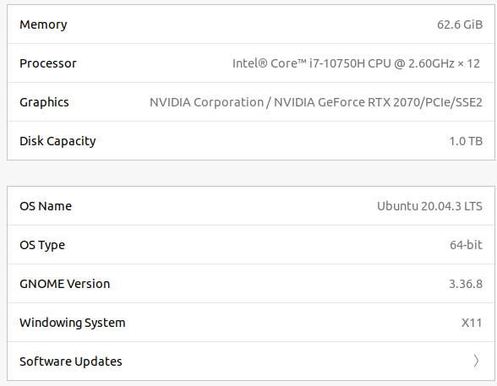
Initial

Slide 3
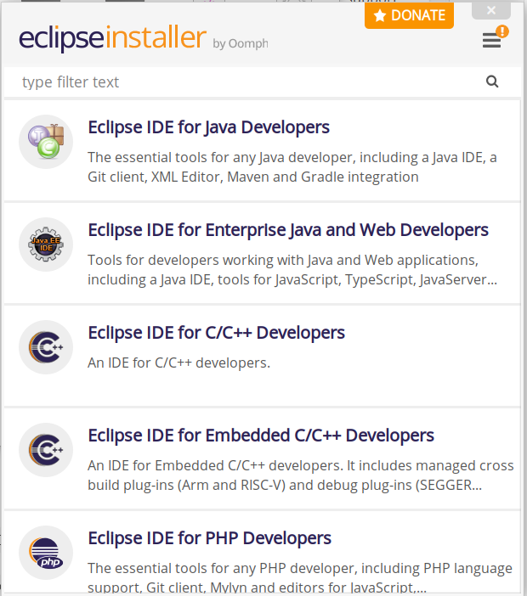
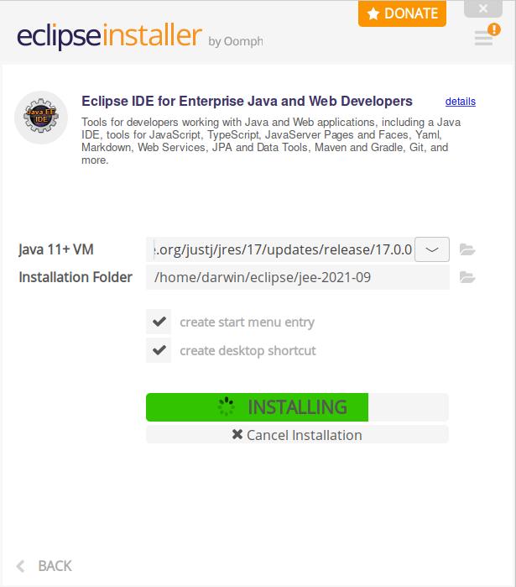
Install eclipse Ubuntu

Slide 4
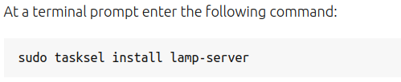

Install LAMP
https://ubuntu.com/server/docs/lamp-applications

Slide 5
Can’t login phpmyadmin?
https://stackoverflow.com/questions/39281594/error-1698-28000-access-denied-for-user-rootlocalhost
https://superuser.com/questions/446764/cant-login-in-phpmyadmin-and-mysql-after-fresh-installation-of-lamp-server-and

Slide 6
Create database
https://github.com/cxfcdcpu/ReVo_webtest
Create test_login database

Slide 7
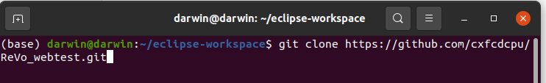
Clone ReVo_webtest

Slide 8
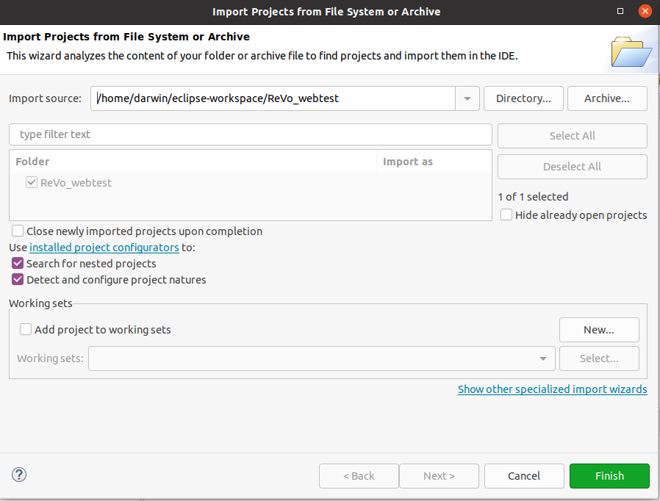
Open in eclipse

Slide 9
Install Tomcat
https://crunchify.com/step-by-step-guide-to-setup-and-install-apache-tomcat-server-in-eclipse-development-environment-ide/

Slide 10
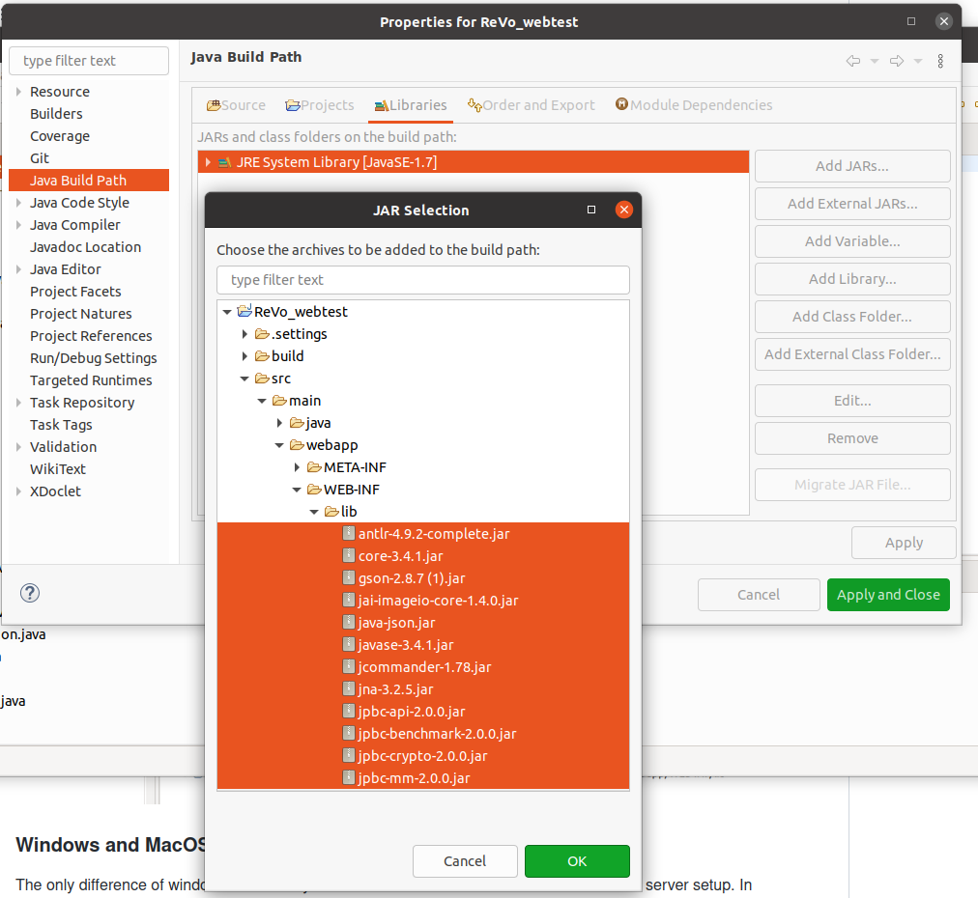
Build path
Add Jar

Slide 11
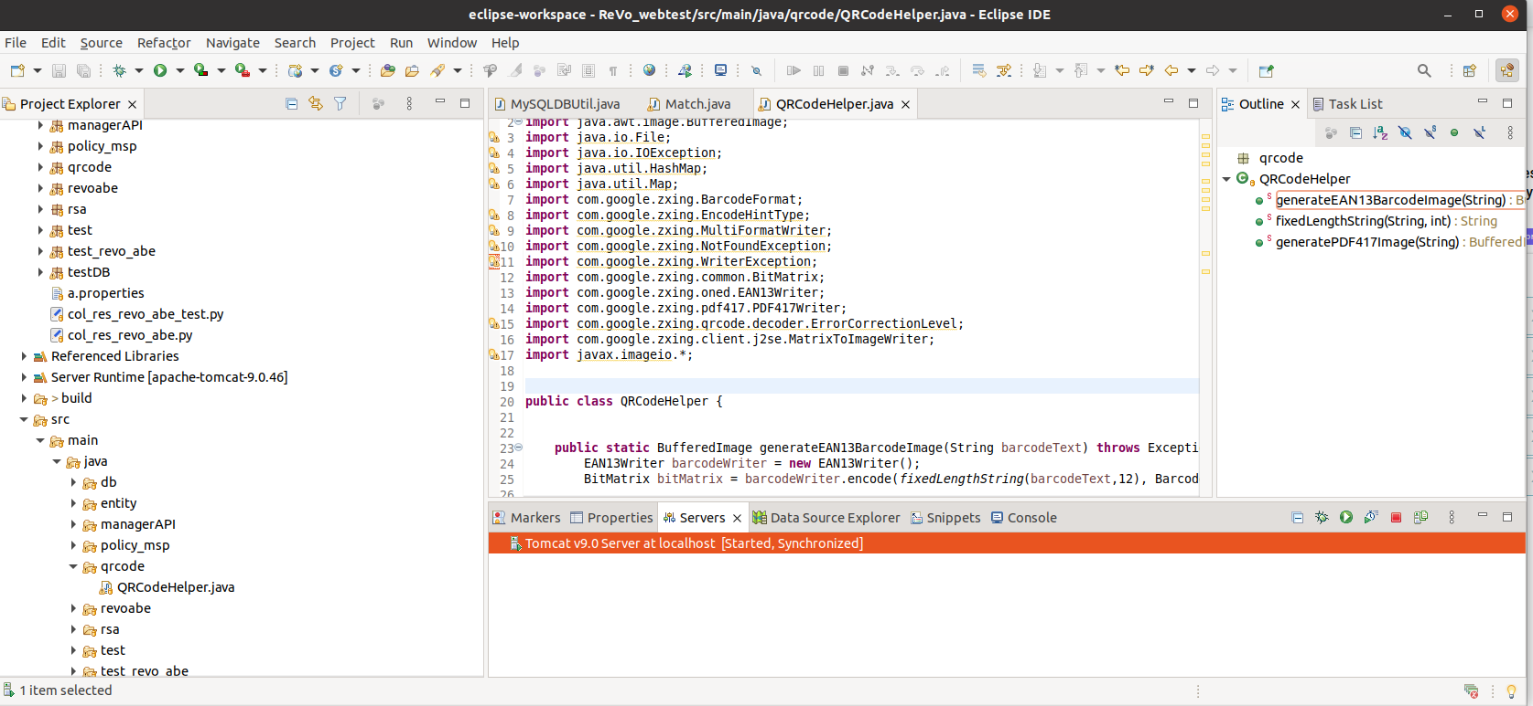
Start Server

