Slide 1
把ppt变成html网页
Convert ppt to html page

Slide 2
将仓库克隆到本地，或者直接下载release
Clone the repository locally, or download the release directly

Slide 3

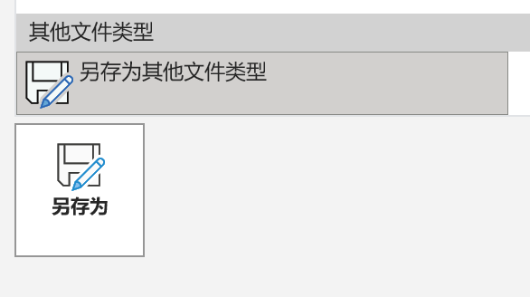
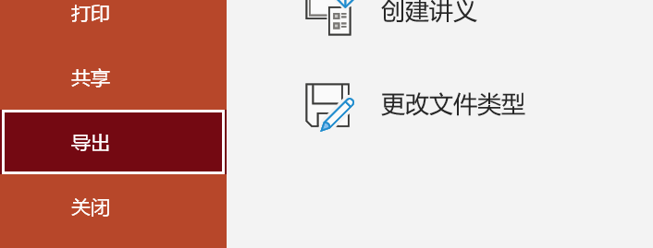
文件-导出-更改文件类型-选择一个图片格式-全部幻灯片
File - Export - Change File Type - Select an image format - All Slides
1
4
5
3
2

Slide 4
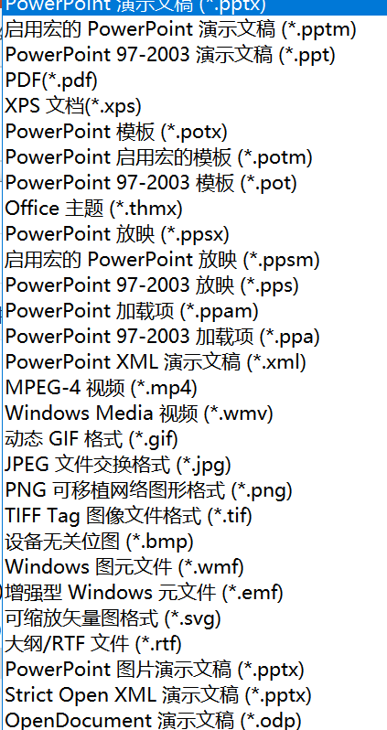
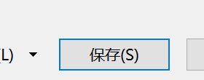
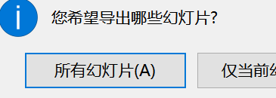
文件-导出-更改文件类型-选择一个图片格式-全部幻灯片
File - Export - Change File Type - Select an image format - All Slides
7
8
6

Slide 5
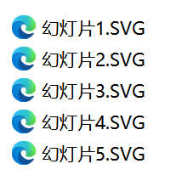
将图片全部复制到`assets`文件夹中
Copy all the images to the `assets` folder

Slide 6
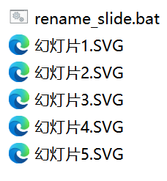
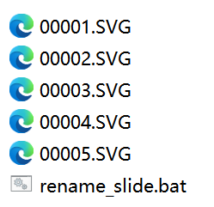
双击运行`assets\rename_slide.bat`，文件名将从`幻灯片1.SVG`变为`00001.SVG`
double click to run `assets\rename_slide.bat`, the file name will change from `幻灯片1.SVG` to `00001.SVG`

Slide 7
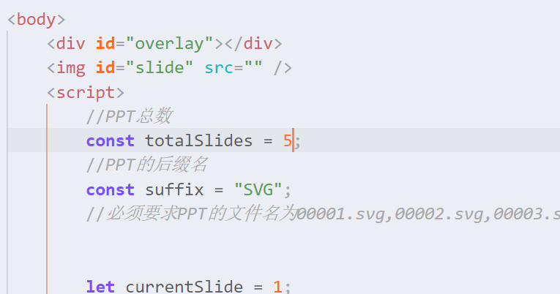
修改`index.html`，将`totalSlides`变量改为幻灯片的数量，将`suffix`改为导出的后缀名
Modify `index.html`, change the `totalSlides` variable to the number of slides, and change `suffix` to the exported suffix

Slide 8
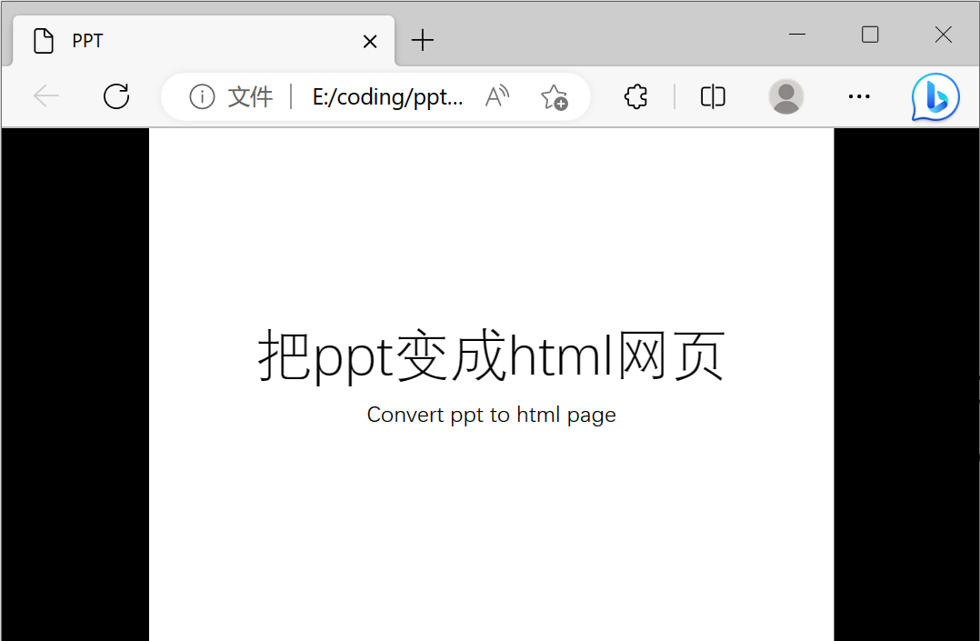
双击`index.html`即可打开网页
Double click `index.html` to open the page

