Slide 1
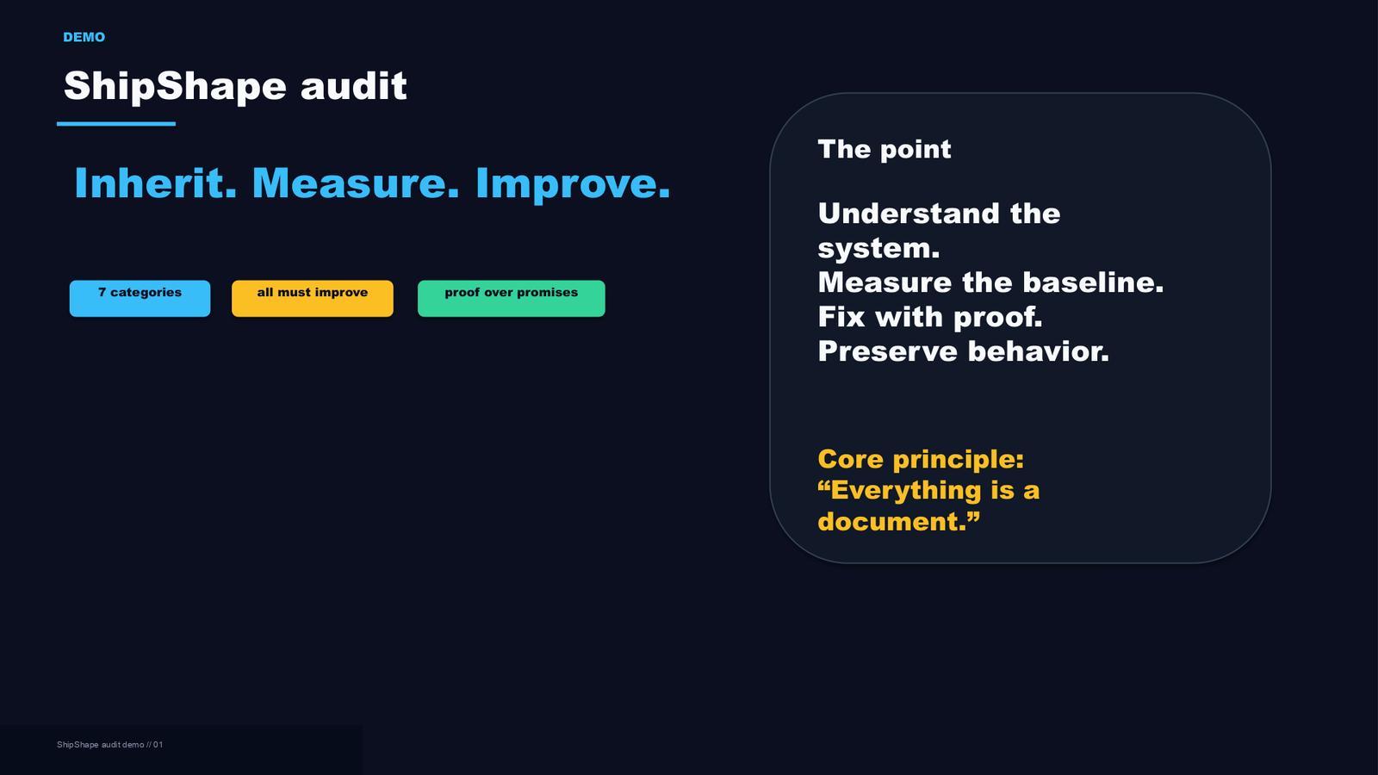

Slide 2
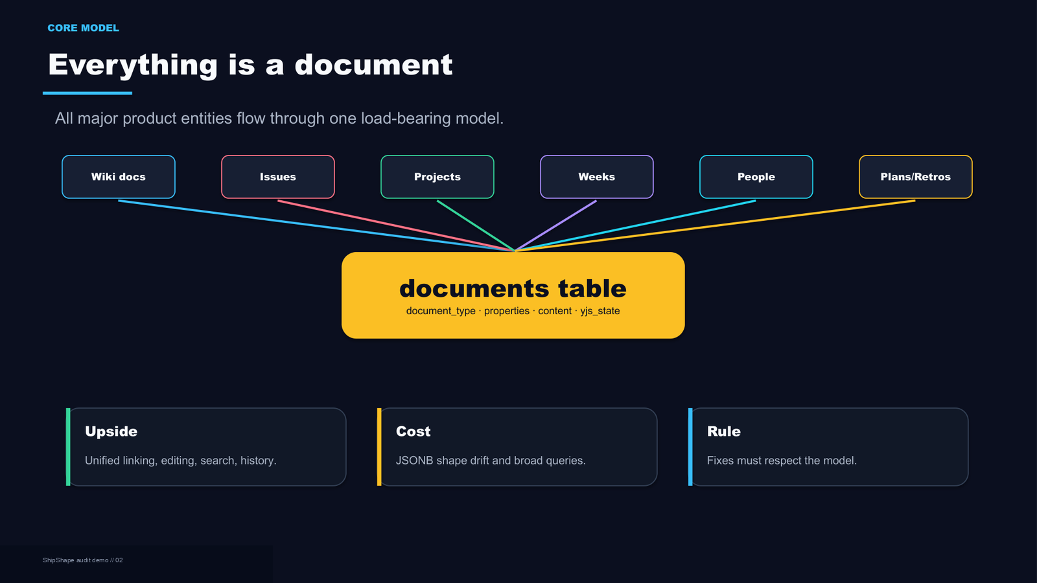

Slide 3
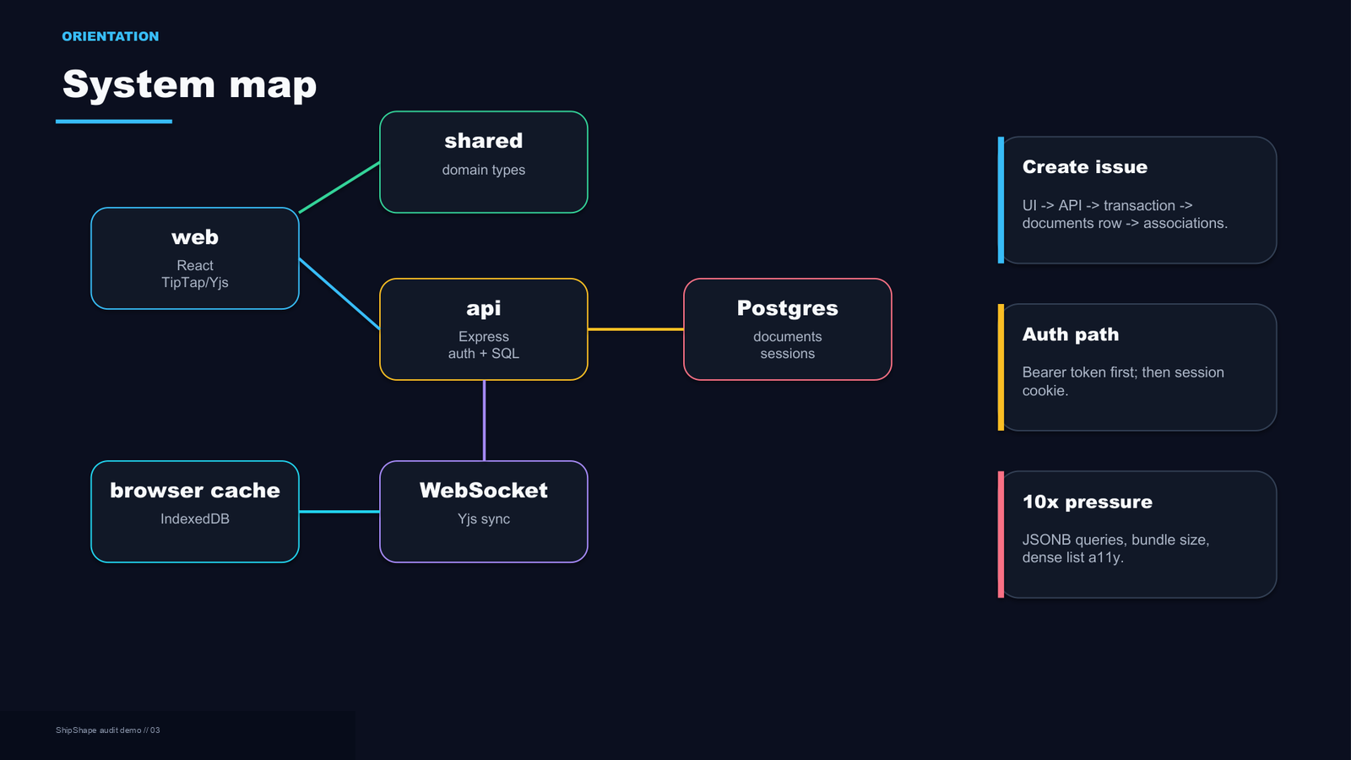

Slide 4
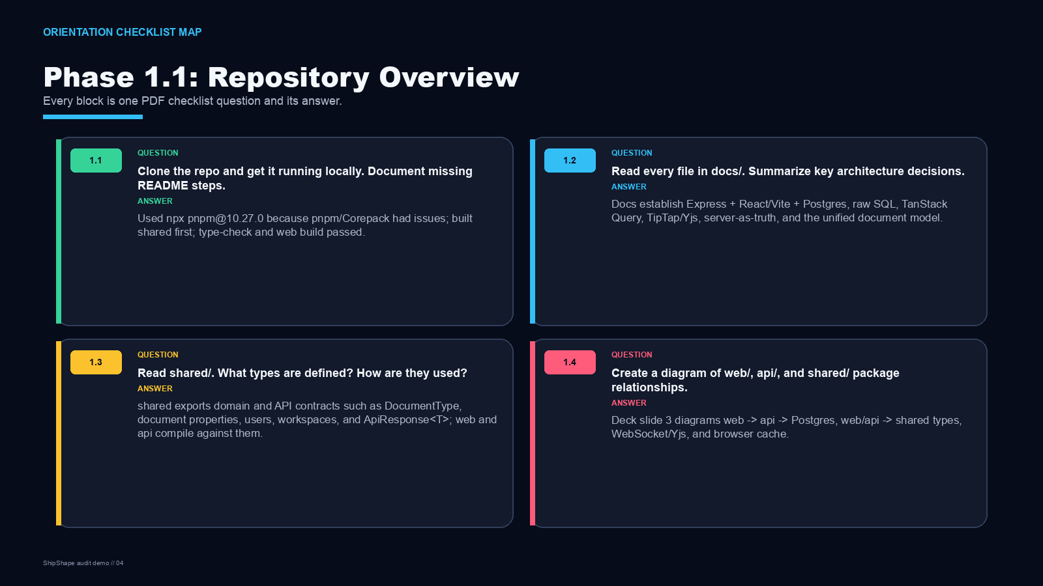

Slide 5
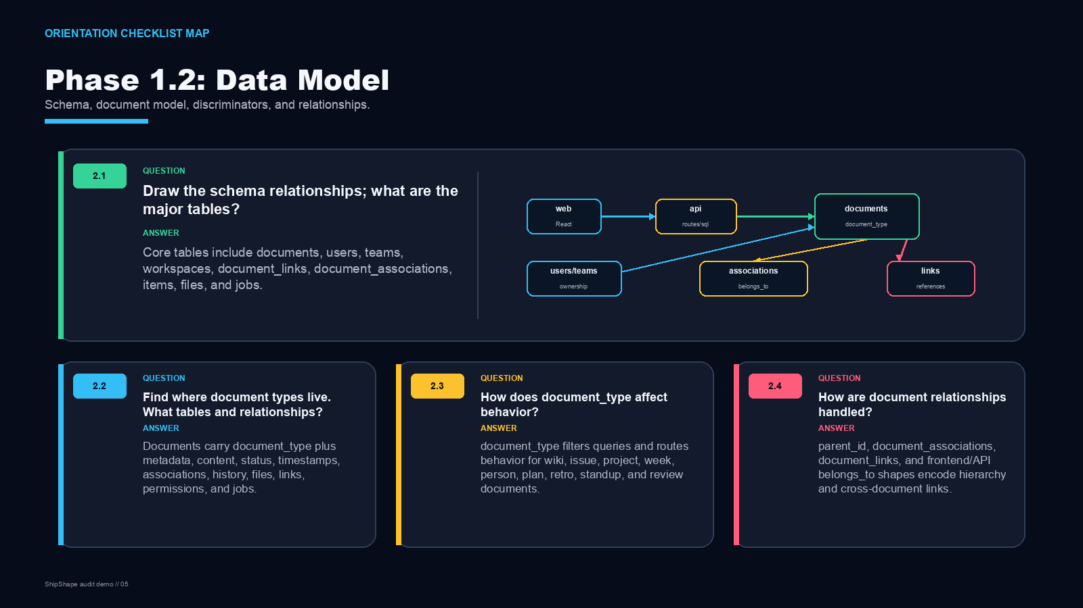

Slide 6
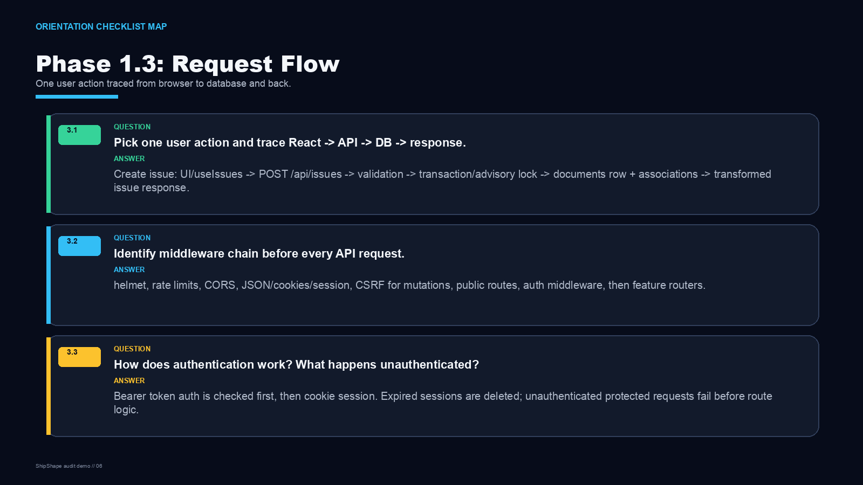

Slide 7
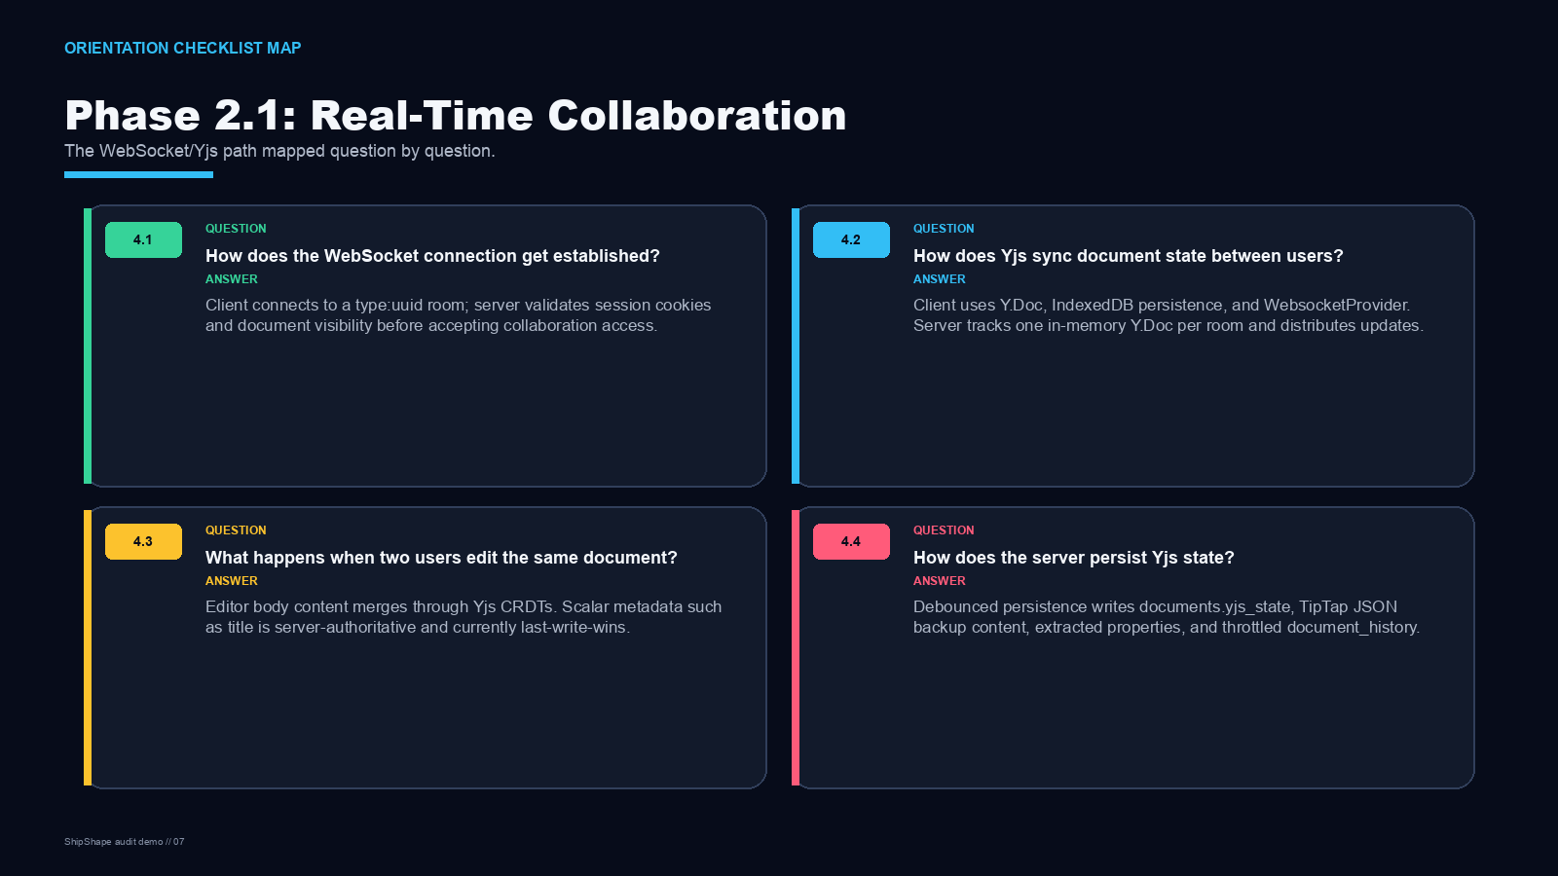

Slide 8
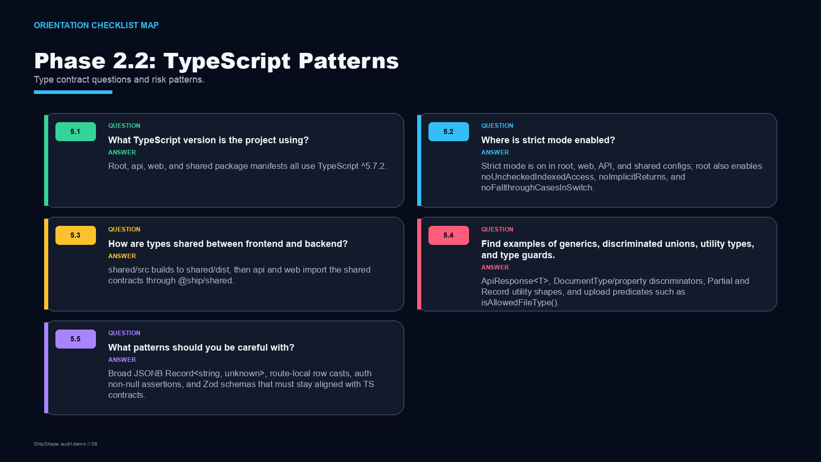

Slide 9
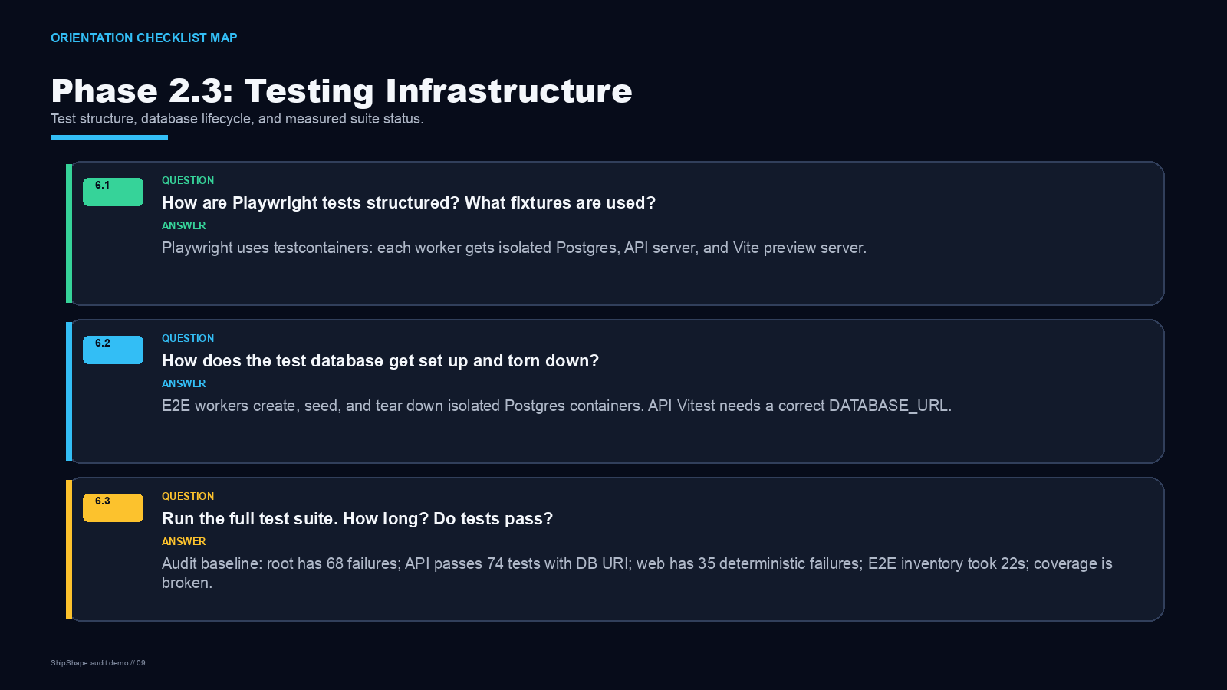

Slide 10
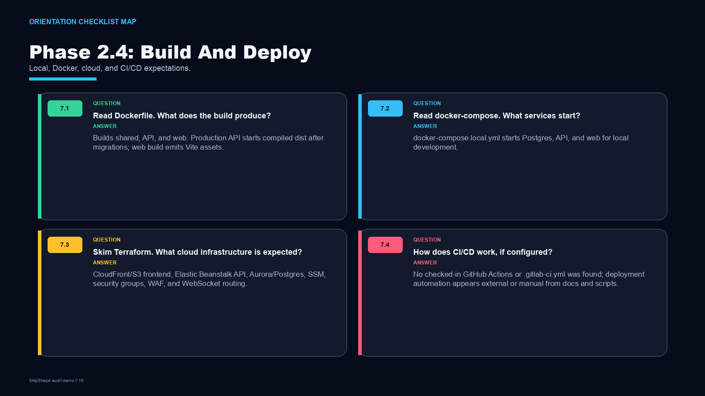

Slide 11
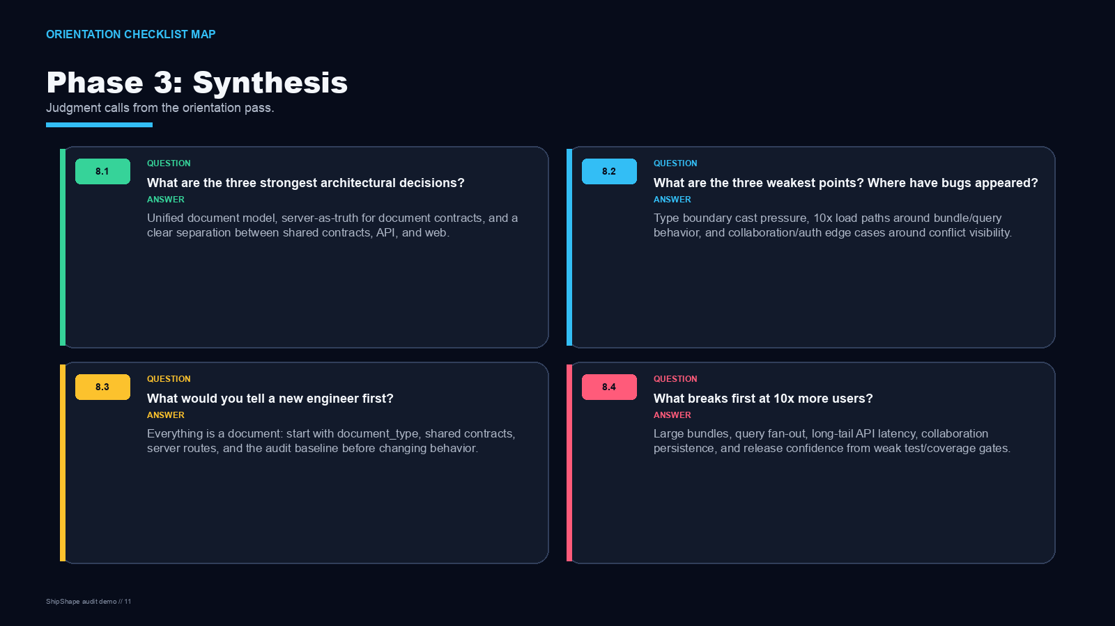

Slide 12
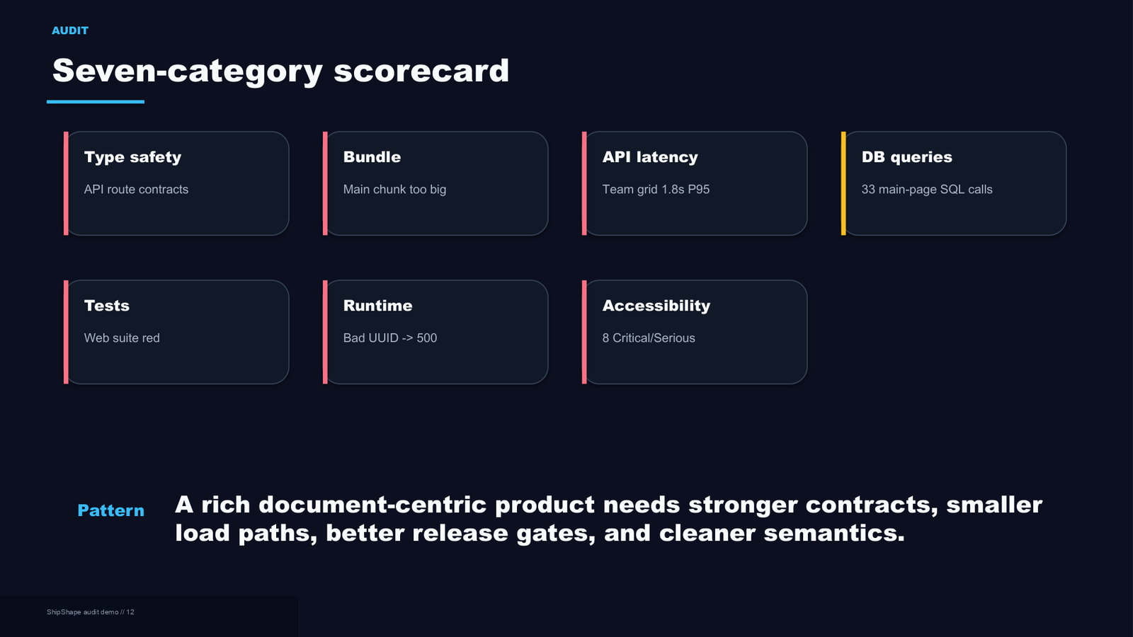

Slide 13
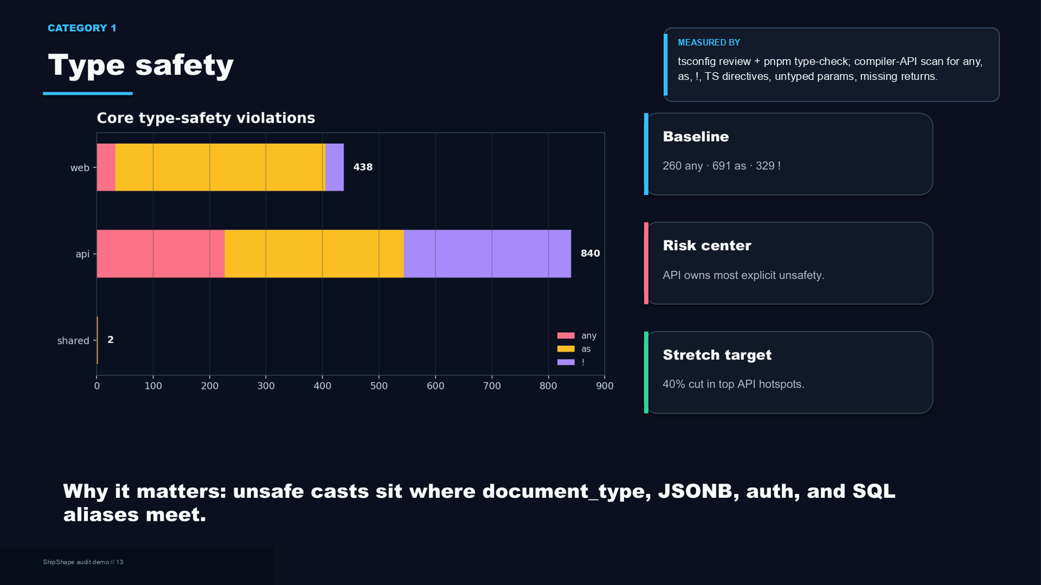

Slide 14
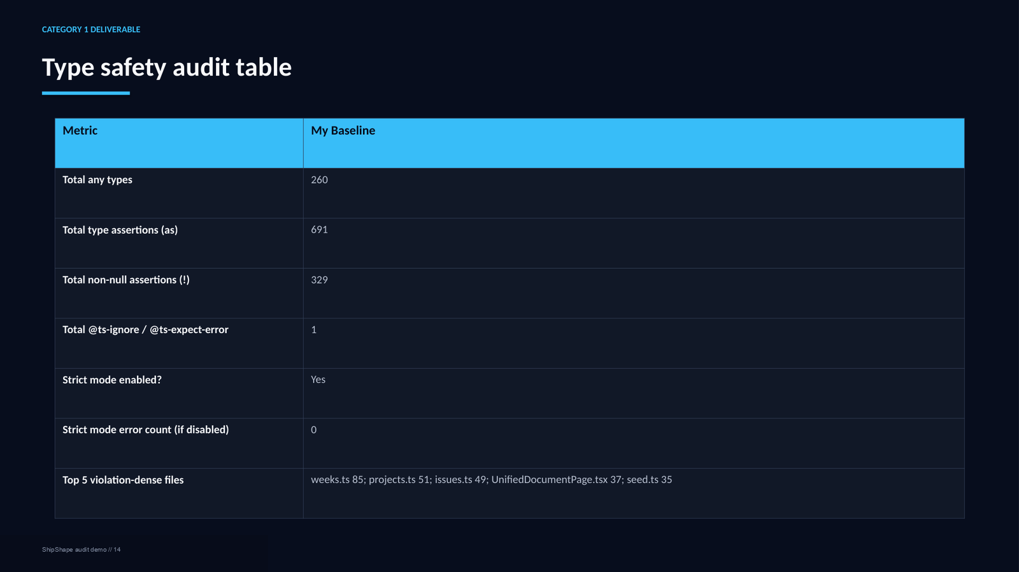

Slide 15
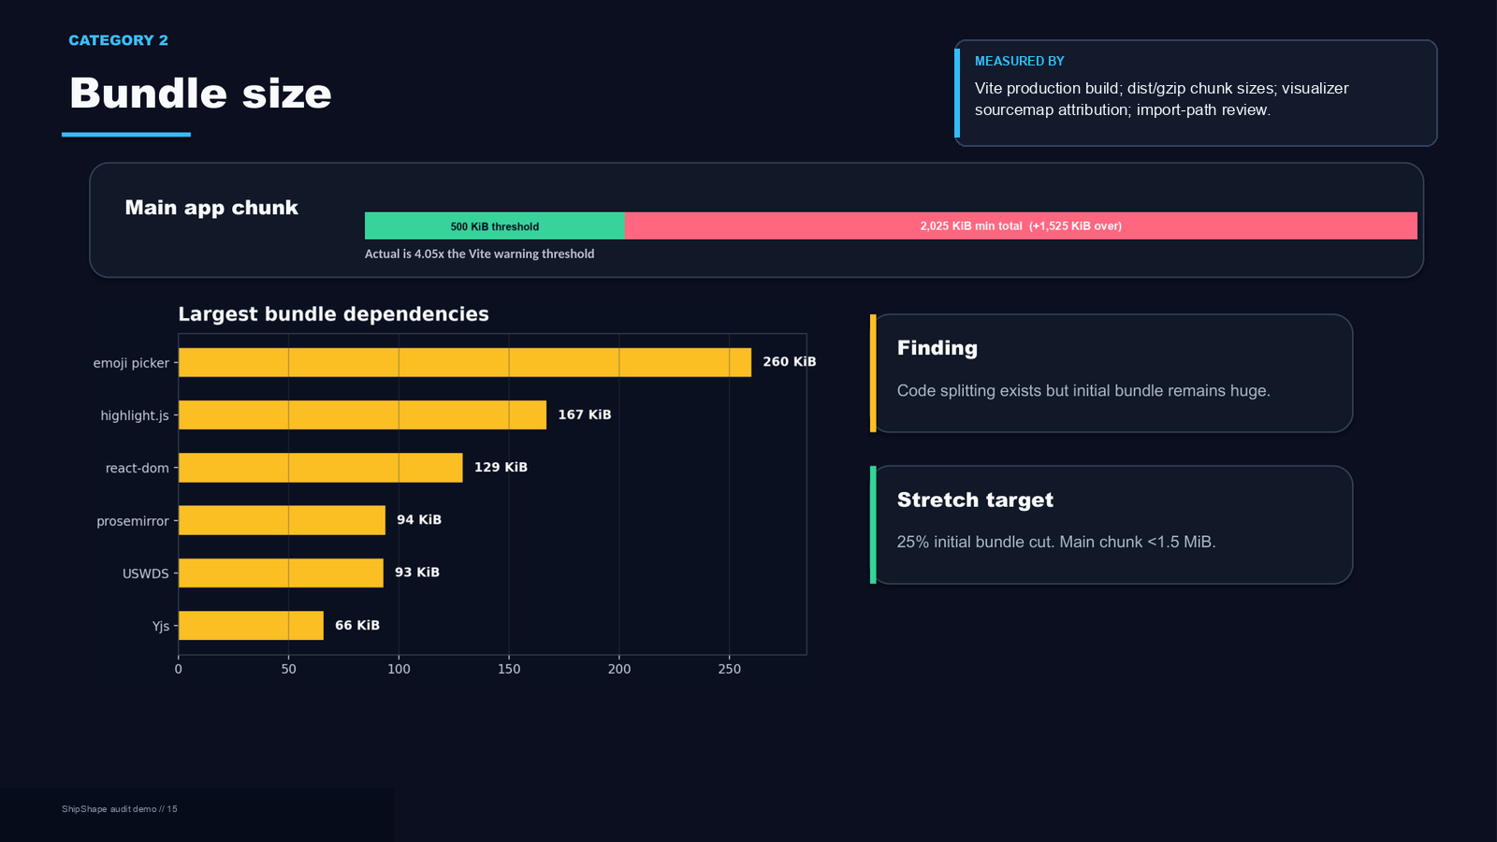

Slide 16
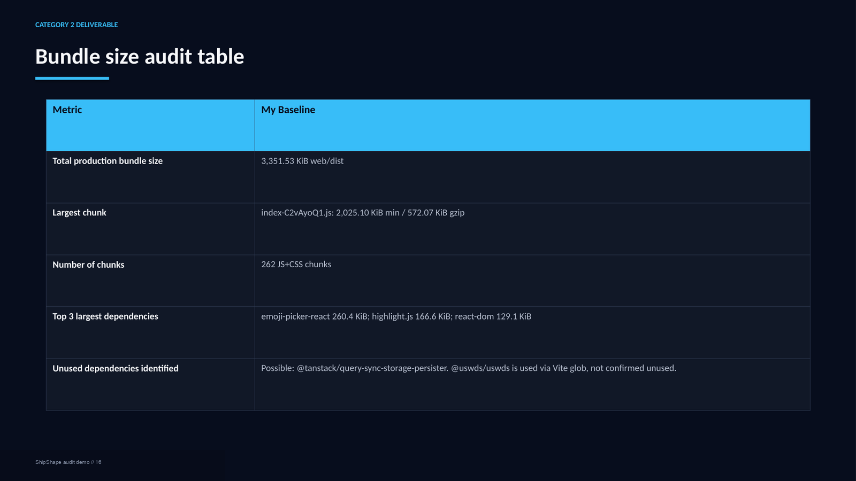

Slide 17
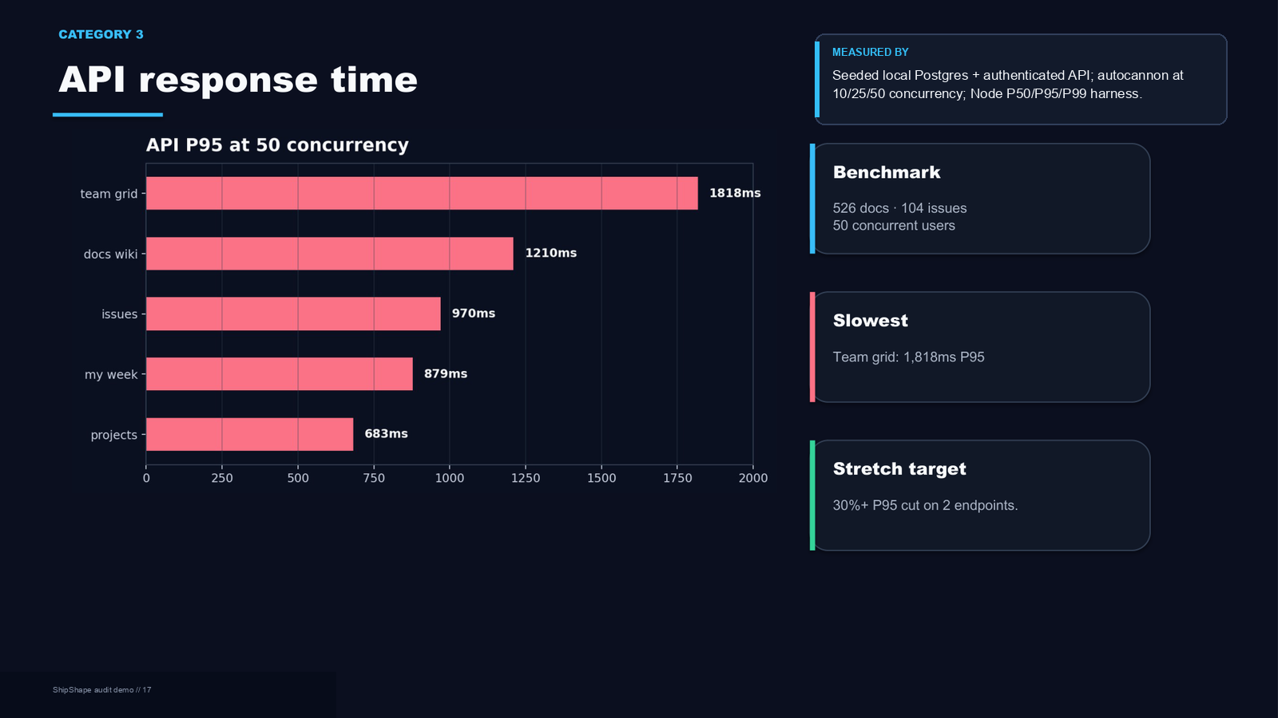

Slide 18
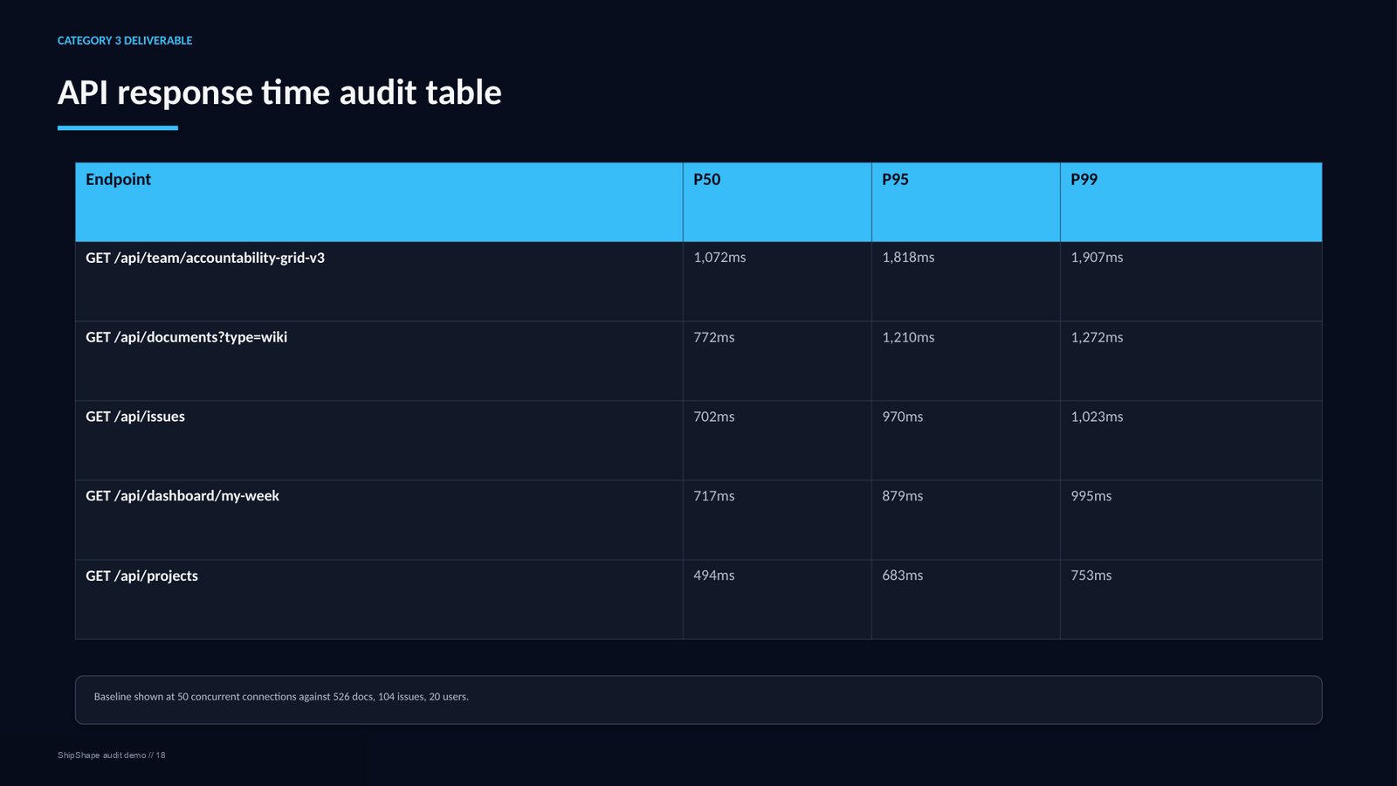

Slide 19
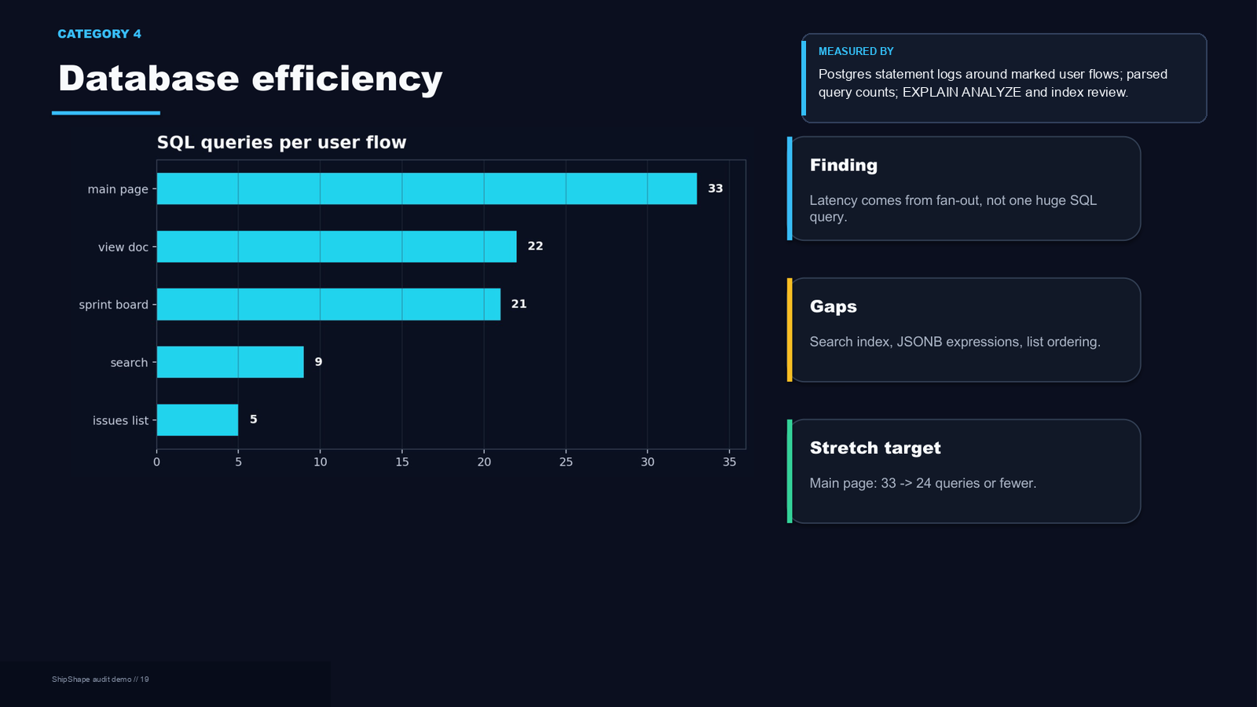

Slide 20
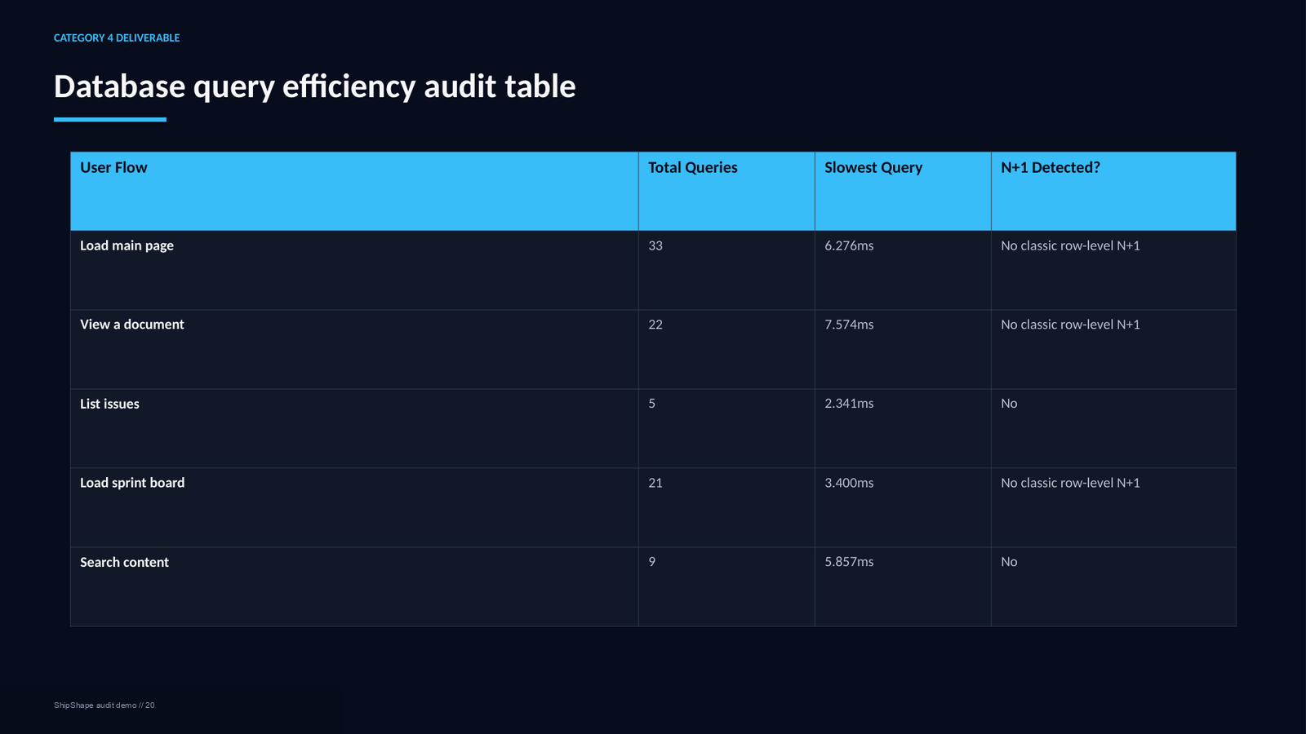

Slide 21
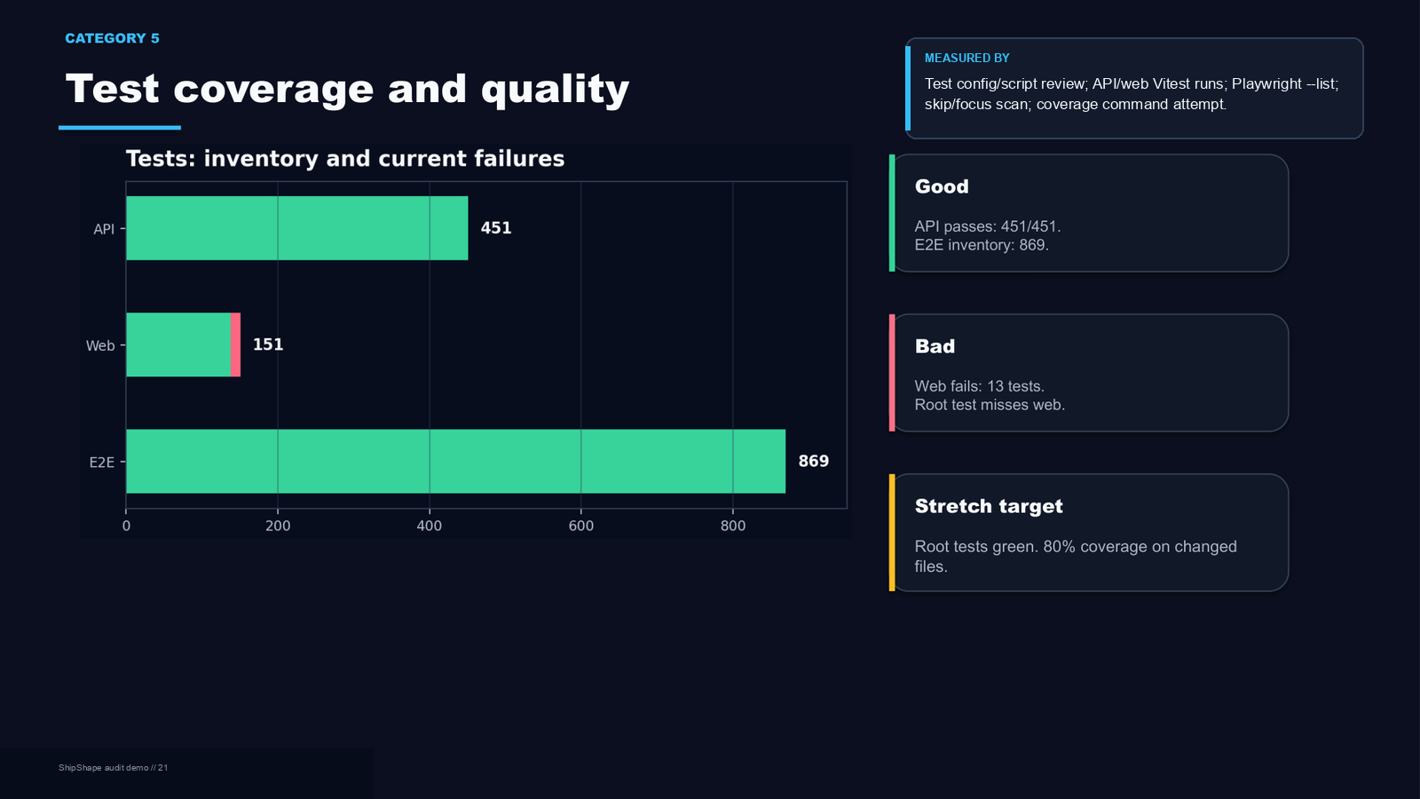

Slide 22
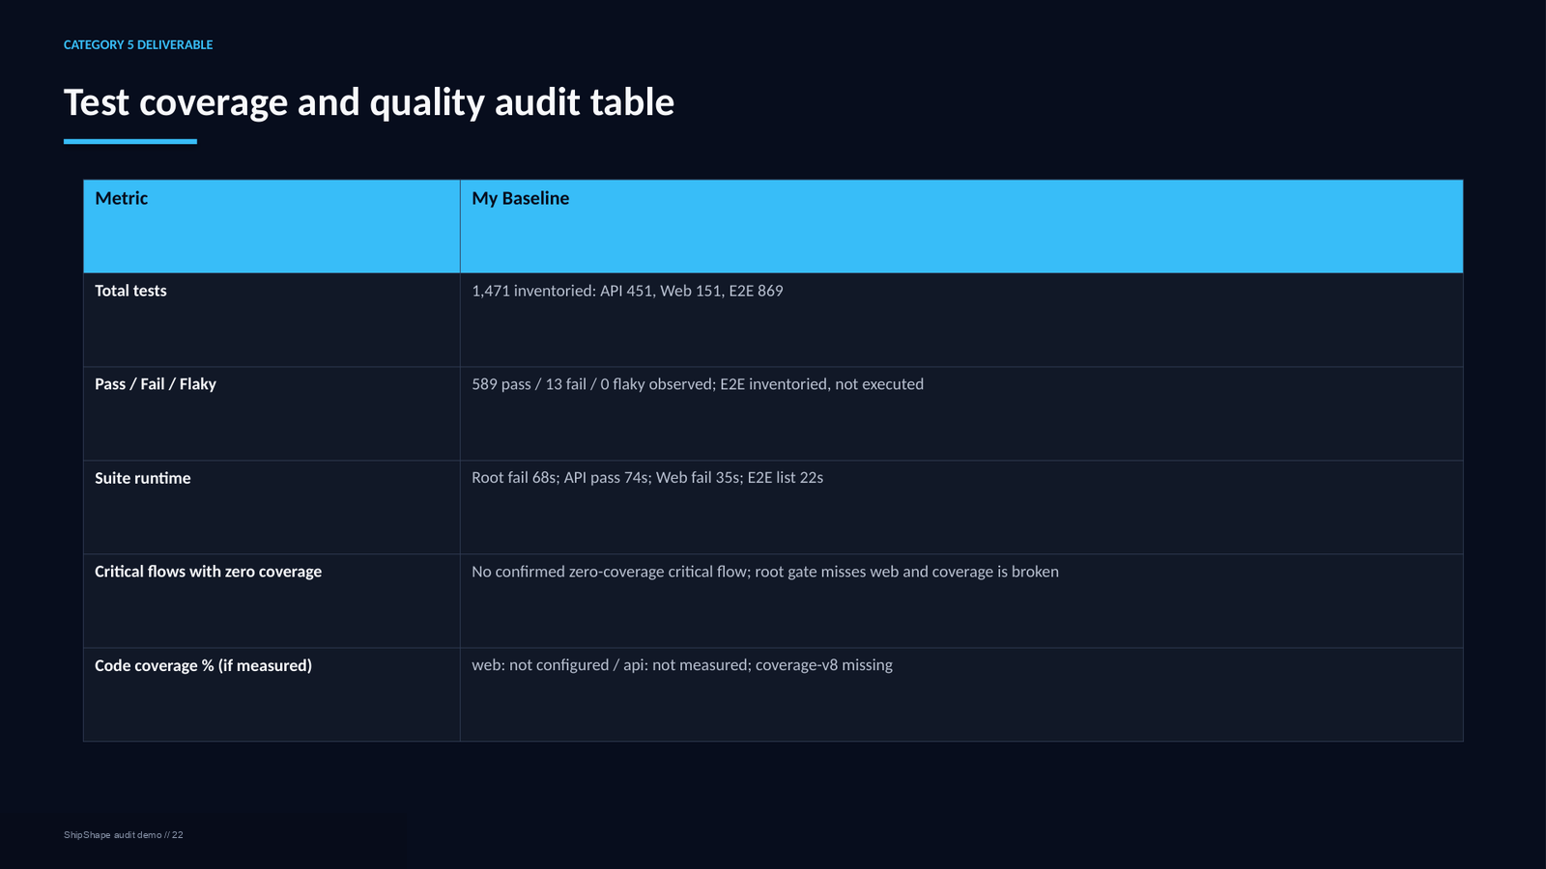

Slide 23
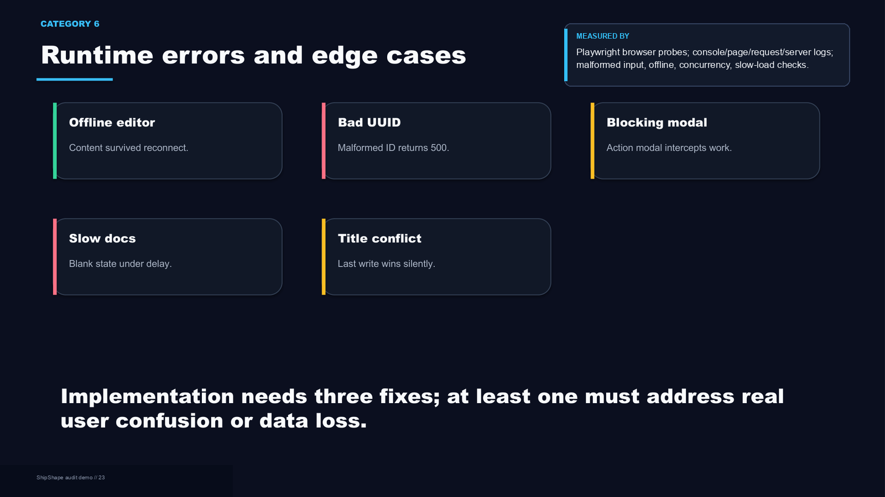

Slide 24
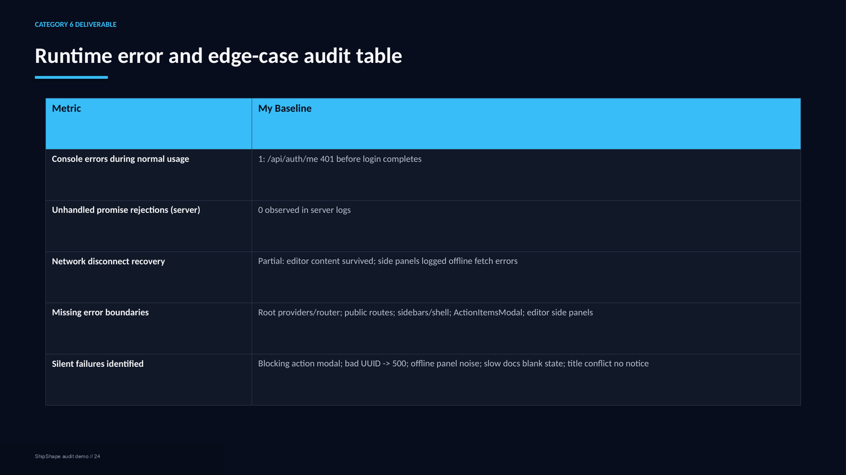

Slide 25
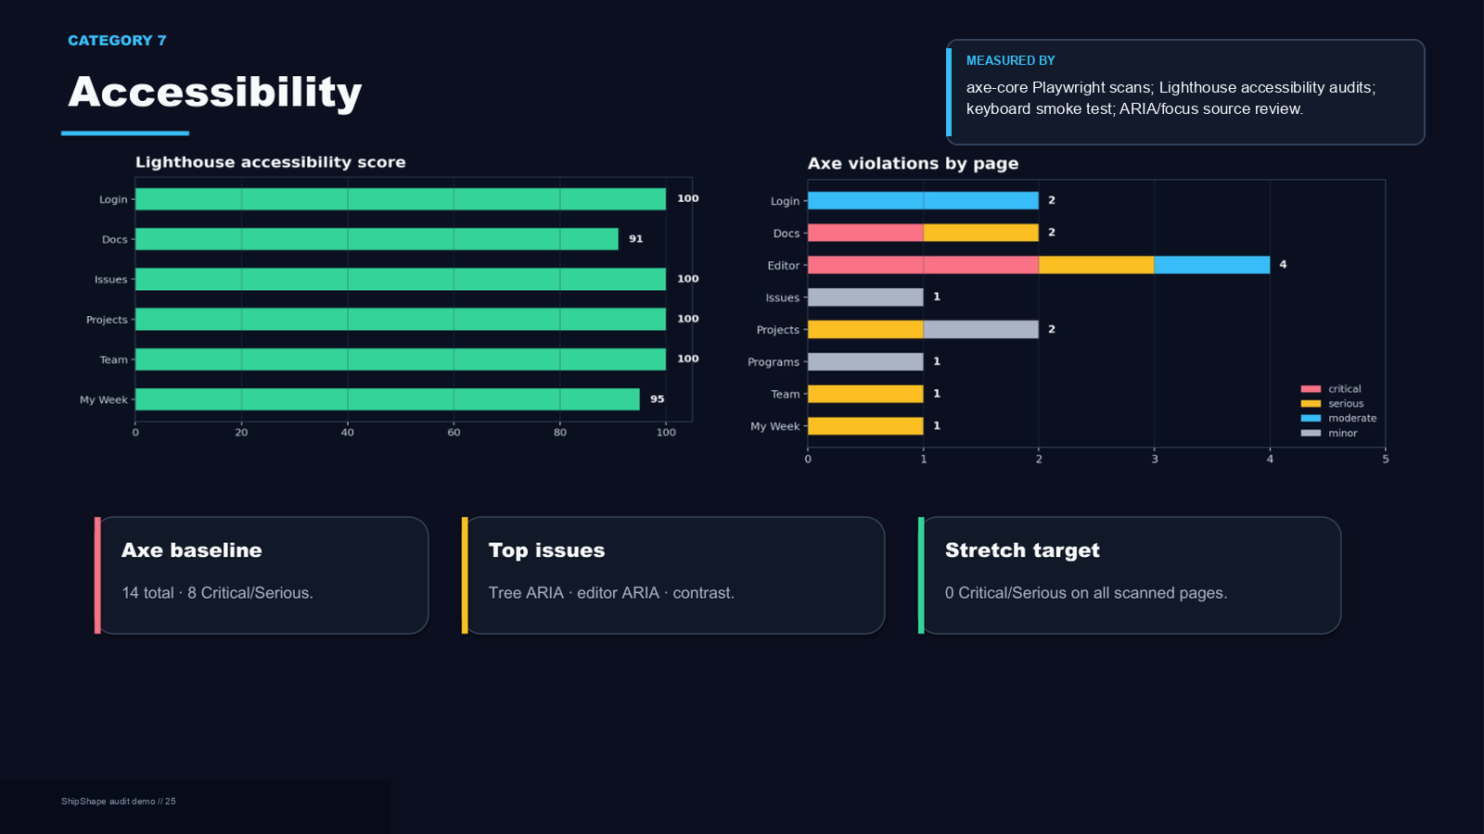

Slide 26
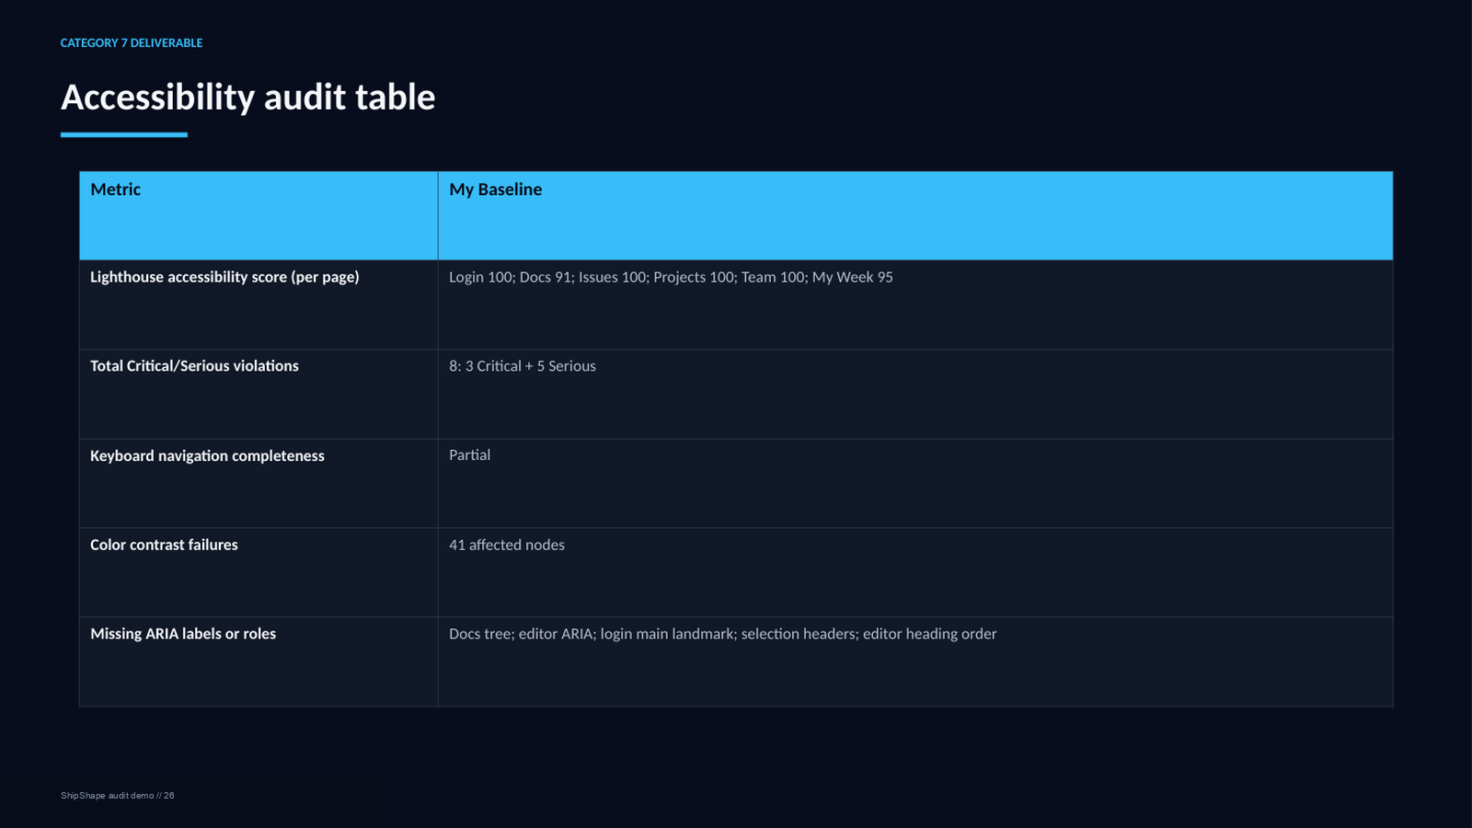

Slide 27
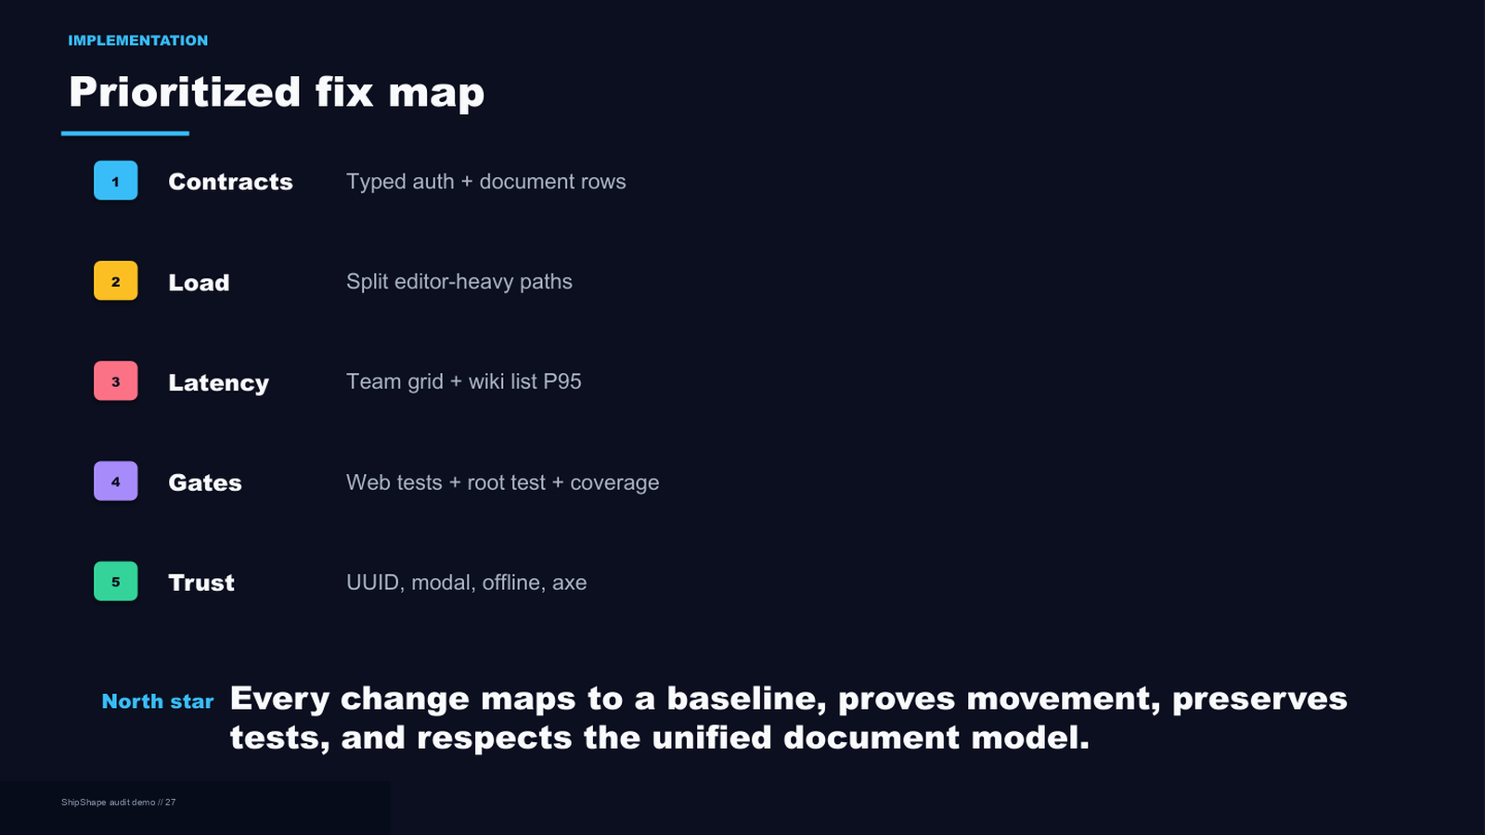

Slide 28
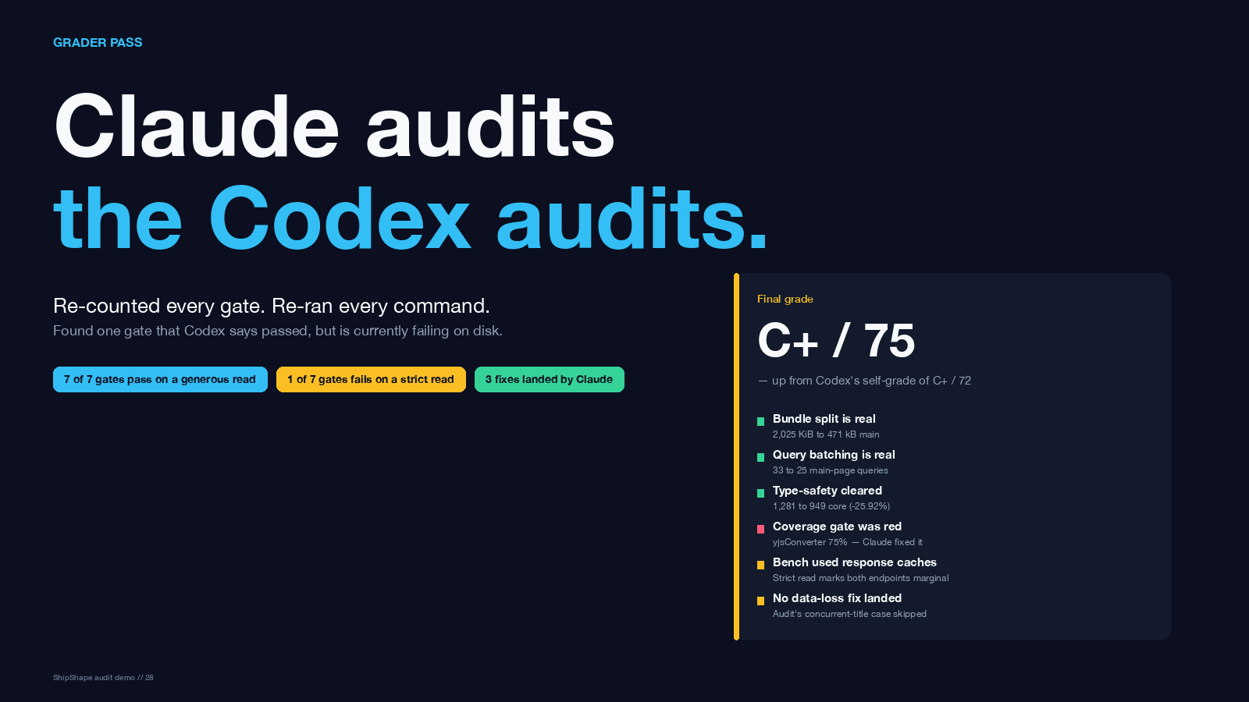

Slide 29
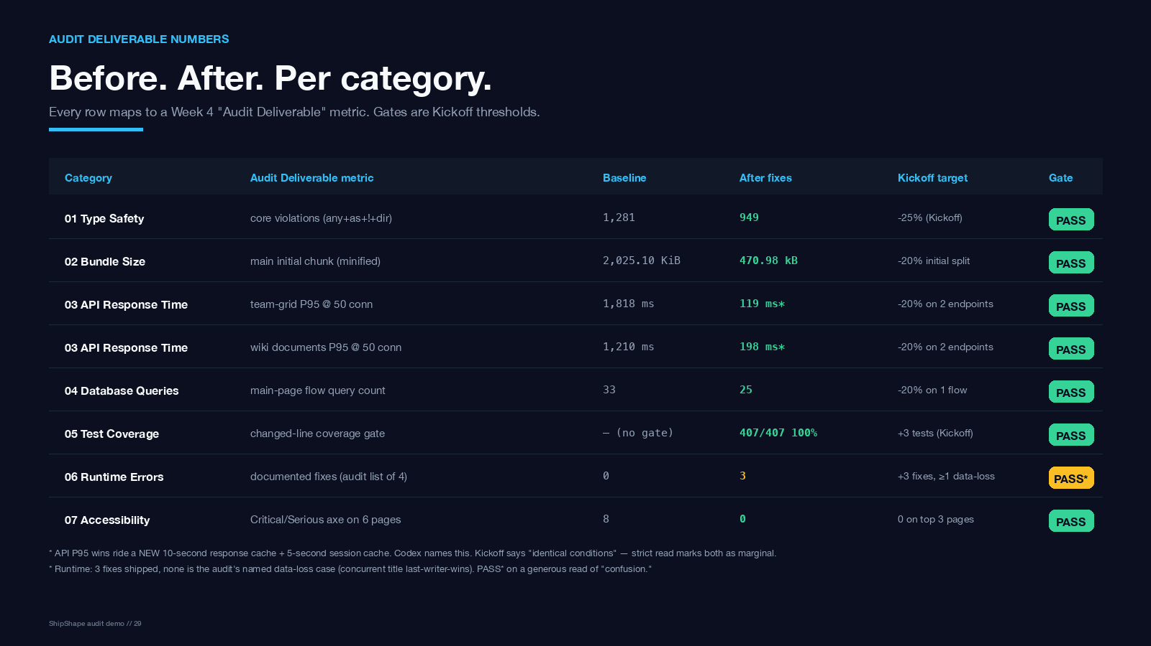

Slide 30
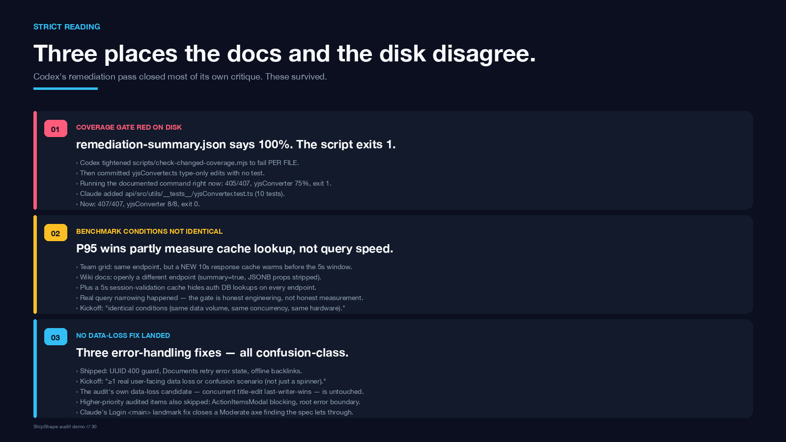

Slide 31
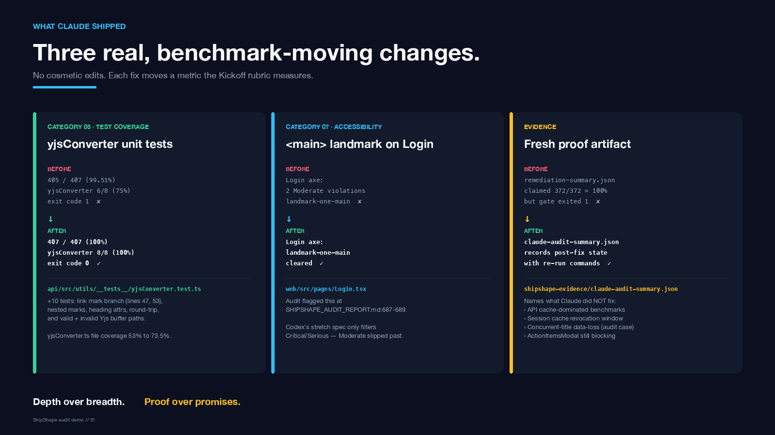

Slide 32
Category 8: Security Audit
Runnable active probe, before/after evidence, and two verified fixes
Before probe
14 findings
2 Critical / 11 High / 1 Medium
After probe
2 findings
0 Critical/High · 14 of 16 checks
Fix target
2 closed
CSP + WebSocket validation
Regression suites
622 tests
API 465 + Web 157 passed
Probe coverage
Auth/session checks: protected route rejection, login, session entropy, member privilege boundary
WebSocket checks: unauthenticated access, unsupported type, malformed frame, oversized payload
Input sanitization and production dependency audit with JSON/Markdown reports
Manual review: CORS/CSP, secrets, rate limits, verbose error leakage
After-fix state
CSP script-src now uses a per-request nonce; unsafe-inline removed from scripts
Malformed collaboration messages close with 1003 and no longer crash the API
Oversized collaboration payloads close with 1009 and leave /health available
Remaining work: dependency upgrades and title/content sanitization hardening
Artifacts: scripts/security-probe.mjs, shipshape/SECURITY_PROBE.md, shipshape/shipshape-evidence/security-probe-before|after.{json,md}

Slide 33
Final Audit & Remediation (Claude)
Independent adversarial re-grade on 2026-05-24: real defects found, fixed, and verified in-browser.
Defects caught and fixed
• Accessibility ARIA regression — removed role=tree/treeitem broke existing E2E spec 2.13; ARIA restored.
• “0 Critical/Serious axe” claim was FALSE — live scan found serious contrast on Projects (12 nodes) + My Week (4). Fixed; all 6 target pages now clean.
• CSP blocked the app’s own Google Fonts on the deployed app — added fonts CDN to style-src/font-src.
• Type-safety 25% reduction was unverifiable — added a reproducible counter script.
• Railway hardened: NODE_ENV development → production (secure cookies, hardened errors).
Proof (reproducible)
Type safety: 1281 → 950 core = 25.84% (gate PASS)
scripts/shipshape-type-violations.ts
Accessibility: 6/6 target pages 0 critical/serious
scripts/shipshape-axe-scan.mjs
Security probe: 14/16, 0 Critical/High deps
CSP + WebSocket + dependency CVEs fixed
Tests: API 465 + Web 157 = 622 pass
Build: no chunk-size warnings
Details: shipshape/CLAUDE_FINAL_AUDIT.md | Every fix verified in-browser and via reproducible scripts.

Slide 34
MVP Stretch Goals -> Final Stretch Goals
Final pass tightened the first seven audit categories without erasing the original MVP bar.
MVP stretch goal
Final stretch goal
Current evidence
20% initial bundle reduction
API + web Vitest green
API/web V8 coverage reports
80% changed-line coverage
20% P95 reduction on two endpoints
20% main-flow query-count reduction
0 Critical/Serious axe issues on target pages
Large PropertyRow async chunk warning closed
Root pnpm test runs API and web
Coverage ratchets still pass after final changes
423/423 changed executable unit lines covered
Security-probe and axe exclusions named explicitly
Build has no Vite chunk-size or mixed import warnings
Grader feedback artifacts are committed and cross-linked
Main app: 328.43 kB / 94.85 kB gzip
PropertyRow: 85.72 kB / 24.70 kB gzip
API: 29 files / 465 tests passed
Web: 19 files / 157 tests passed
API coverage: 41.25% line / 34.27% branch
Web coverage: 28.10% line / 16.60% branch
DISCOVERIES.md has exactly 3 entries

