Slide 1



UART 8N1
RTL design and simulation
Author: Cao Xuan Binh 2510462
50 MHz system clock
115200 baud, 8N1
Notes:
UART controller configured for 8 data bits, no parity and one stop bit.
Source: UART 8N1 full
https://docs.google.com/document/d/17Au_pMJEInJm9FcX5MmbhdXGJXfIqr5DqbhTCfcQv7o

Slide 2
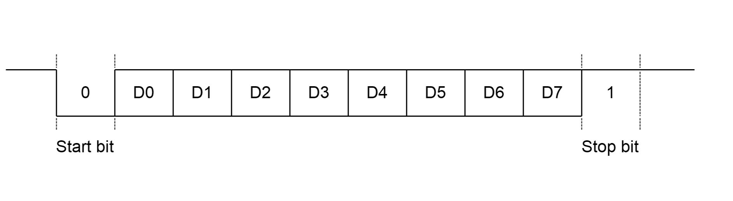
What is UART 8N1?
- UART stands for Universal Asynchronous Receiver/Transmitter. It sends and receives data one bit at a time without a shared clock signal between the two devices. The transmitter converts parallel data into serial bits, and the receiver combines the bits back into parallel data.
- 8N1 describes the frame format: 8 data bits, no parity bit (N), and 1 stop bit. A frame also begins with 1 start bit, so each frame contains 10 bits in total.
- Frame order: Start (0), D0 to D7, Stop (1). D0 is transmitted first, and the line stays high when idle.
UART frame format
The line stays high when idle.
Eight data bits follow, with D0 first.
One low start bit begins the frame.
One high stop bit ends the frame.
2
Notes:
8N1 means 8 data bits, no parity and one stop bit. A complete frame contains 10 bits.
Source: UART 8N1 full
https://docs.google.com/document/d/17Au_pMJEInJm9FcX5MmbhdXGJXfIqr5DqbhTCfcQv7o

Slide 3
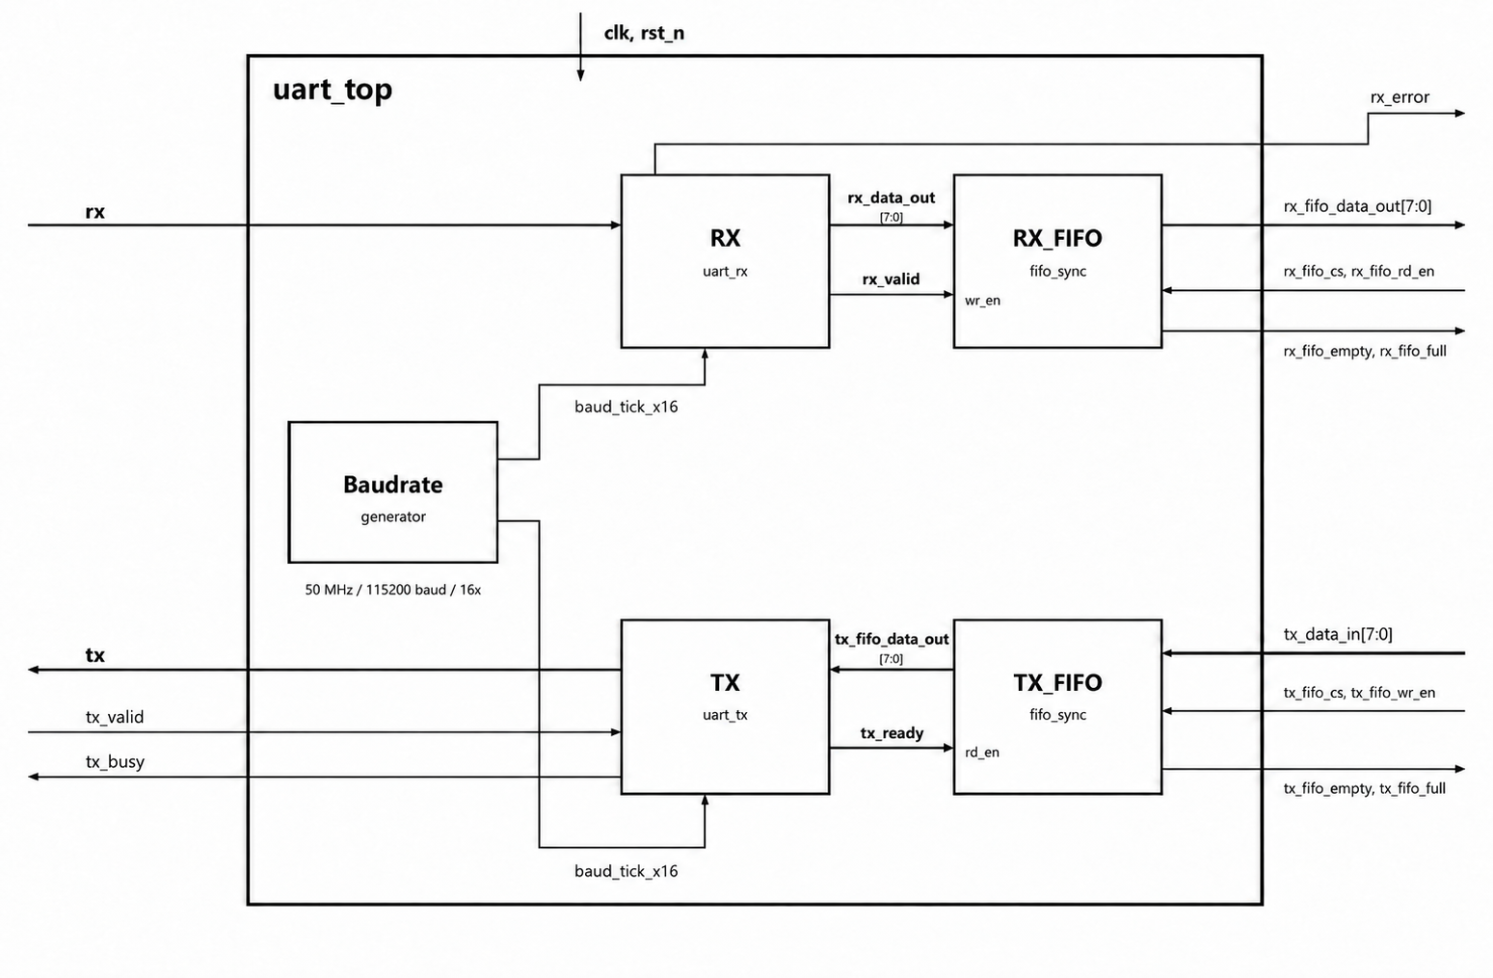
Controller structure
uart_top integrates a baud-rate generator, UART TX, UART RX, and two synchronous FIFOs.
baud_rate_generator provides timing ticks.
tx_fifo and rx_fifo queue data on each side.
uart_tx(transmitter) sends data.
uart_rx(receiver) receives data.
3
Notes:
TX and RX share the system clock and baud_tick_x16. The serial RX input is asynchronous to the system clock.
Source: UART 8N1 full
https://docs.google.com/document/d/17Au_pMJEInJm9FcX5MmbhdXGJXfIqr5DqbhTCfcQv7o

Slide 4
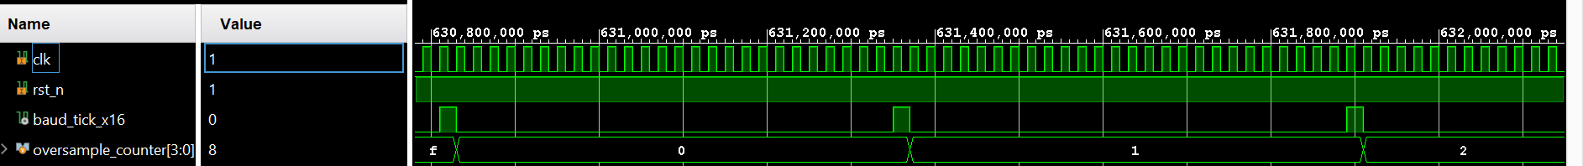
Baud-rate generator
- Clock frequency: 50 MHz
- Target baud rate: Baud rate is the number of symbols transmitted or received per second. This UART uses one bit per symbol. The target baud rate is 115200 baud, which corresponds to 115200 bits/s on the serial line.
- Oversampling divides each bit period into smaller timing steps so that the receiver can sample near the middle of a bit and the transmitter can change bits exactly at bit boundaries.
This project uses OVERSAMPLE = 16, so each bit period contains 16 timing ticks. The receiver uses these ticks to choose when to sample.
- The divisor sets how many system clock cycles pass between timing ticks.
Divisor = CLK_Freq/(Baud_rate*oversample) = 50 000 000 / (115200 × 16) ≈ 27.13
The project uses DIVISOR = 27.
4
Notes:
The tick is a one-system-clock-cycle timing enable. It occurs once every 27 clk cycles. It is not a separate clock domain.
Source: UART 8N1 full
https://docs.google.com/document/d/17Au_pMJEInJm9FcX5MmbhdXGJXfIqr5DqbhTCfcQv7o

Slide 5
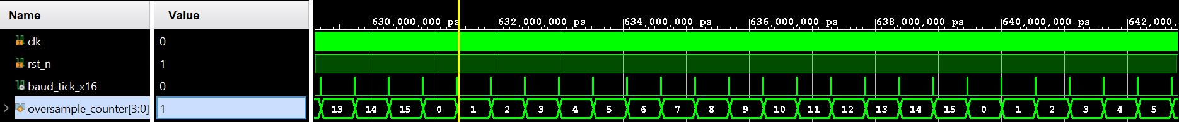
Bit timing
One tick every 27 clock cycles
One bit = 16 ticks = 432 clock cycles
Bit period = 8.64 µs
Actual baud rate ≈ 115741 baud
Baud-rate error ≈ +0.47%
5
Notes:
The integer divider makes the actual baud rate slightly higher than the target. TX advances at the bit boundary. RX samples near the middle of each bit.
Source: UART 8N1 full
https://docs.google.com/document/d/17Au_pMJEInJm9FcX5MmbhdXGJXfIqr5DqbhTCfcQv7o

Slide 6
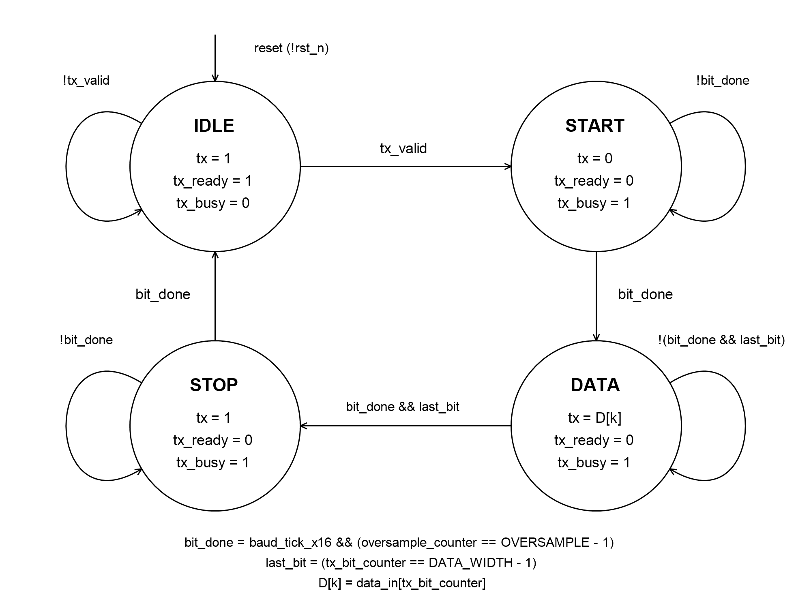
TX(TRANSMITTER) state machine
IDLE: keep tx high and wait for data.
START: drive tx low for one bit.
DATA: send D0 through D7.
STOP: drive tx high for one bit.
TX interface
data_in[7:0]: byte to send
tx_valid: transmission request
tx_ready: ready for new data
tx_busy: frame in progress
tx: serial output
7
Notes:
The TX FSM follows IDLE, START, DATA and STOP. It counts 16 baud_tick_x16 pulses per bit.
Source: UART 8N1 full
https://docs.google.com/document/d/17Au_pMJEInJm9FcX5MmbhdXGJXfIqr5DqbhTCfcQv7o

Slide 7
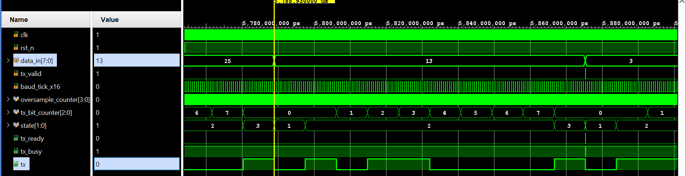
TX waveform
- Each bit lasts 16 timing ticks.
- At counter value 15, TX finishes the current bit.
- TX then sends the next bit or changes state.
Example: data_in = 13 (decimal) = 00001101 (binary).
From the IDLE state (state 0) to the end of the STOP state (state 3), tx sends 0101100001 (leftmost bit first).
The first bit, 0, is the start bit. The last bit, 1, is the stop bit.
The 8 bits in between are the data, sent D0 first: 10110000. Read in reverse (D7 to D0), they give 00001101 = 13.
8
Notes:
bit_end = baud_tick_x16 && (oversample_counter == 15). This marks a bit boundary. TX does not sample incoming data at this point.
Source: UART 8N1 full
https://docs.google.com/document/d/17Au_pMJEInJm9FcX5MmbhdXGJXfIqr5DqbhTCfcQv7o

Slide 8
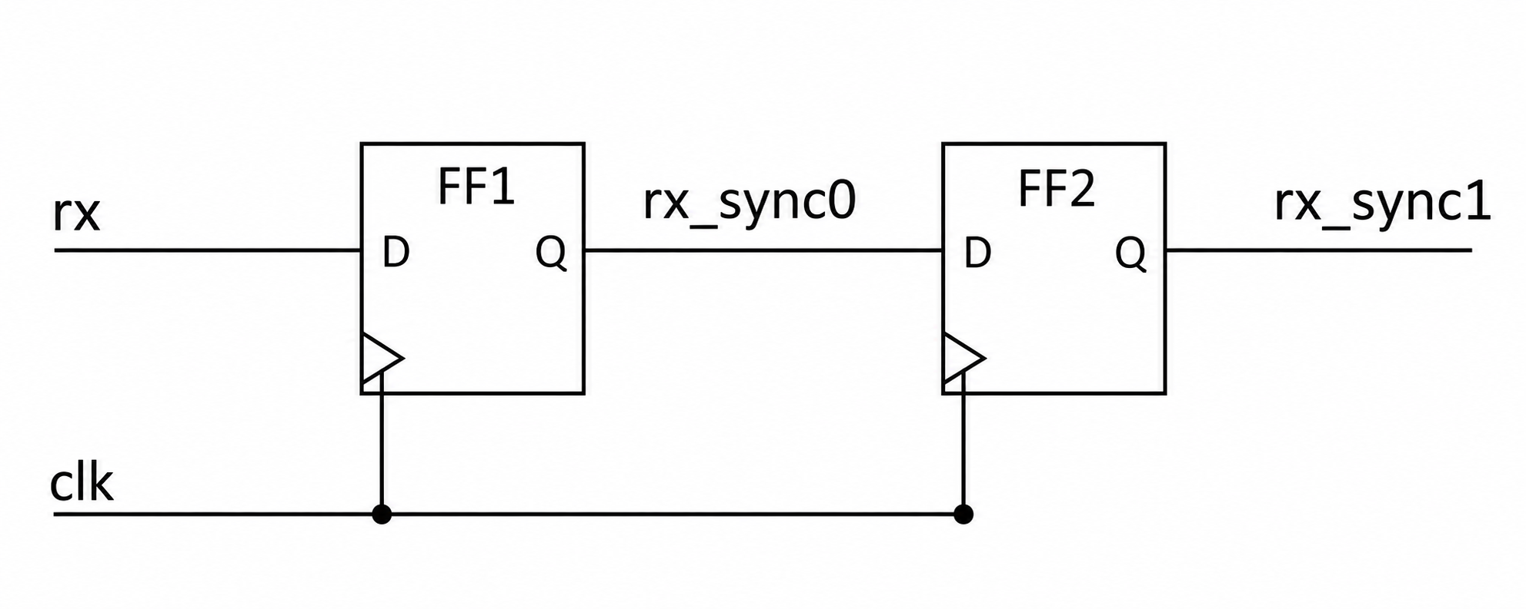
RX(RECEIVER) input synchronization
The rx input does not share the system clock, so it may change close to a rising edge of clk. This can violate the first flip-flop's setup or hold time and cause metastability. The synchronizer passes rx through rx_sync0 and then rx_sync1. Both flip-flops use clk, giving the first stage time to settle before the second stage samples it.
The RX logic uses only rx_sync1. This reduces the chance of metastability reaching the rest of the circuit, but does not remove the risk completely.
9
Notes:
The chain is rx, rx_sync0, rx_sync1. It gives the first stage time to settle and reduces the chance of metastability propagating. It does not guarantee zero risk or correct arbitrary data errors.
Source: UART 8N1 full
https://docs.google.com/document/d/17Au_pMJEInJm9FcX5MmbhdXGJXfIqr5DqbhTCfcQv7o

Slide 9
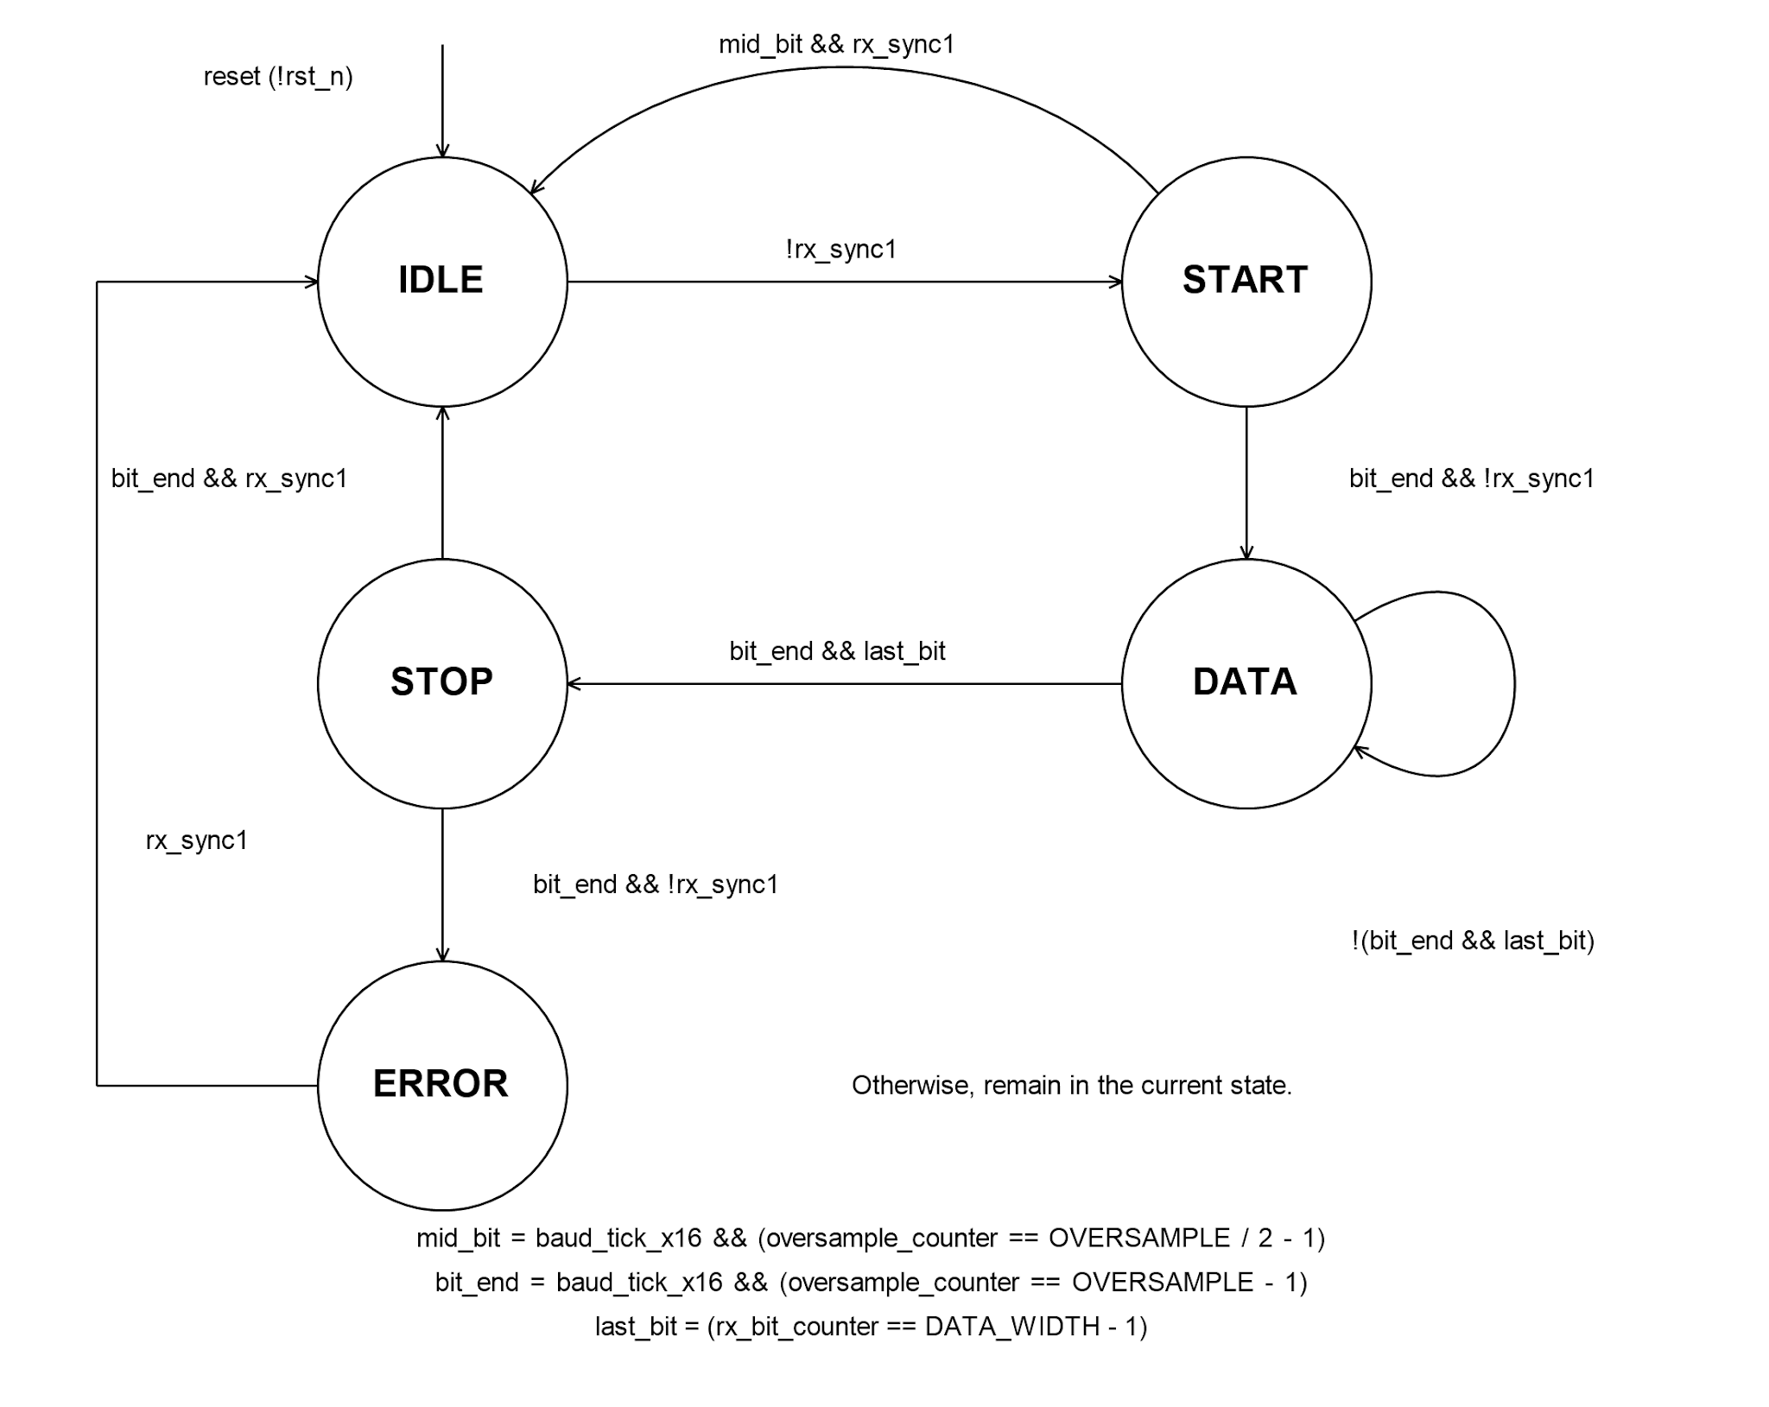
RX(RECEIVER) state machine
IDLE: wait for a low start bit.
START: check the start bit.
DATA: collect the eight data bits.
STOP: check the stop bit.
ERROR: wait for the line to return high.
RX sampling
RX uses 16 timing ticks per bit.
Counter 7: sample near the middle.
Counter 15: finish the current bit.
The bit counter runs from D0 to D7.
11
Notes:
In START, a high line at mid_bit returns RX to IDLE. A low line at bit_end moves RX to DATA. After D7, RX enters STOP. In STOP, the mid-bit check controls data-valid output, while the end-of-bit check controls the next state.
Source: UART 8N1 full
https://docs.google.com/document/d/17Au_pMJEInJm9FcX5MmbhdXGJXfIqr5DqbhTCfcQv7o

Slide 10
RX Mealy state table
Current state | Input condition | Next state | Outputs
IDLE | rx_sync1 = 0 | START | (0, 0, 0)
IDLE | rx_sync1 = 1 | IDLE | (0, 0, 0)
START | mid_bit && rx_sync1 | IDLE | (0, 0, 0)
START | bit_end && !rx_sync1 | DATA | (0, 0, 0)
START | Otherwise | START | (0, 0, 0)
DATA | bit_end && last_bit | STOP | (0, 0, 0)
DATA | Otherwise | DATA | (0, 0, 0)
STOP | mid_bit && rx_sync1 | STOP | (1, 0, rx_shift_reg)
STOP | bit_end && rx_sync1 | IDLE | (0, 0, 0)
STOP | bit_end && !rx_sync1 | ERROR | (0, 0, 0)
STOP | Otherwise | STOP | (0, 0, 0)
ERROR | rx_sync1 = 1 | IDLE | (0, 0, 0)
ERROR | rx_sync1 = 0 | ERROR | (0, 1, 0)
The output tuple is (rx_valid, rx_error, rx_data_out). The conditions below use OVERSAMPLE = 16 and DATA_WIDTH = 8.
mid_bit = baud_tick_x16 && (oversample_counter == 7). RX uses this point to sample near the middle of a bit.
bit_end = baud_tick_x16 && (oversample_counter == 15). This marks the end of the current bit.
last_bit = (rx_bit_counter == 7). This indicates the final data bit, D7.
rx_data_out[7:0] holds the received byte only while rx_valid is high.
In STOP, a high line at mid_bit asserts rx_valid.
At bit_end, a low stop bit sends RX to ERROR.
rx_error stays high in ERROR while the line is low.

Slide 11
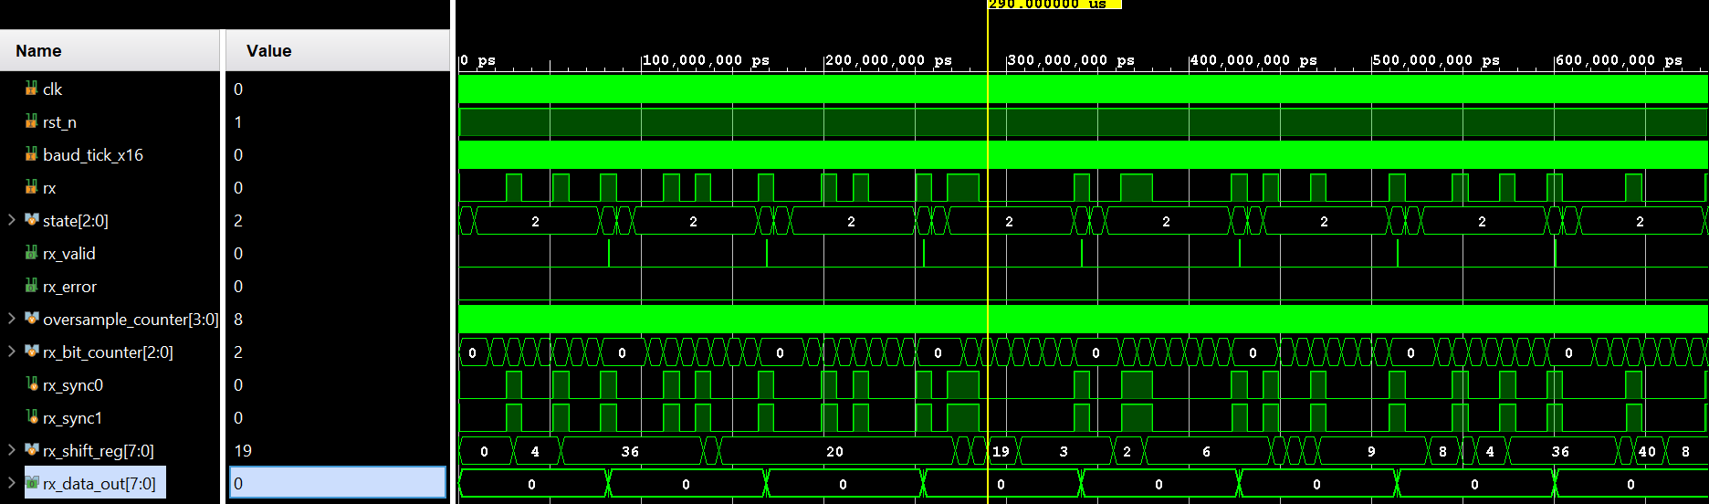
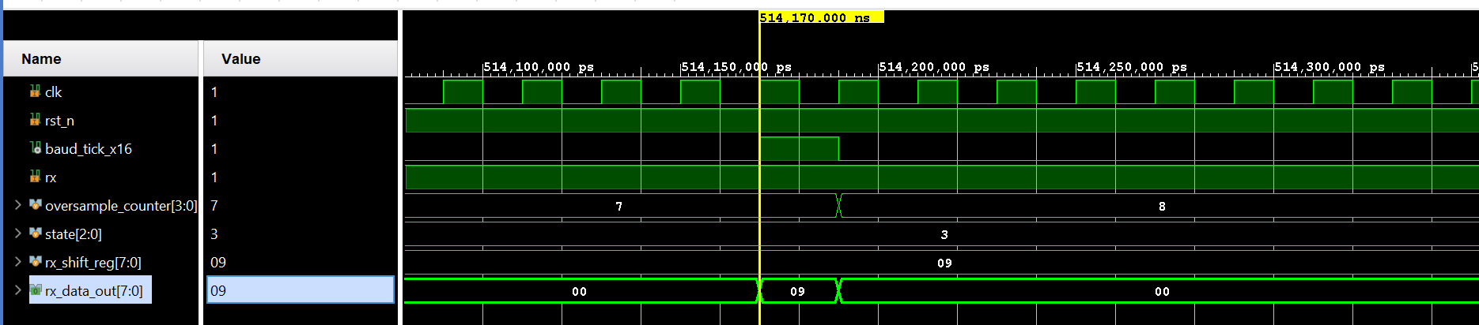
RX data_out
rx_data_out[7:0] holds the received byte only while rx_valid is high (state STOP). Before that, it stays 0 while rx_shift_reg fills bit by bit.
In the second waveform, rx_data_out is valid for one clk cycle only (baud_tick_x16 = 1, oversample_counter = 7, middle of the stop bit).
12
Notes:
This describes the current RTL, not all UART implementations. rx_data_out returns to zero when rx_valid is low. STOP can assert valid at its midpoint and later enter ERROR if the line is low at its end.
Source: UART 8N1 full
https://docs.google.com/document/d/17Au_pMJEInJm9FcX5MmbhdXGJXfIqr5DqbhTCfcQv7o

Slide 12
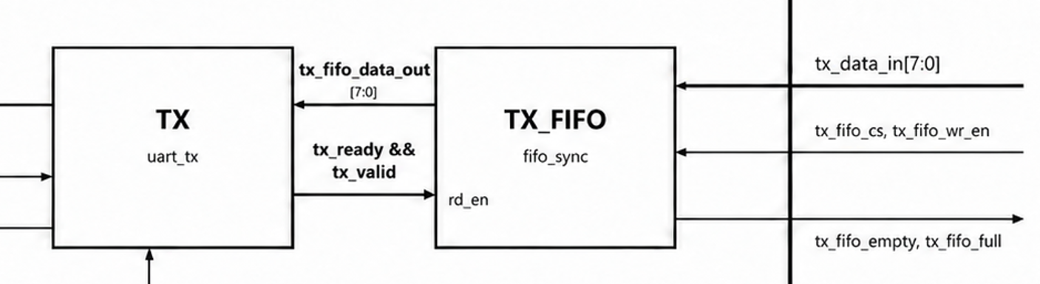
FIFO for TX in UART
A FIFO is added on TX side so data can wait in a queue.
TX FIFO: outside logic writes bytes in; uart_tx reads them out and sends.
Size: FIFO_DEPTH = 8 bytes, width = 8 bits.
Bytes remain in the FIFO until they are read.
 | Write enable | Data in | Read enable | Data out
TX FIFO | tx_fifo_wr_en (external) | tx_data_in | tx_ready && tx_valid | UART TX Data in

Slide 13
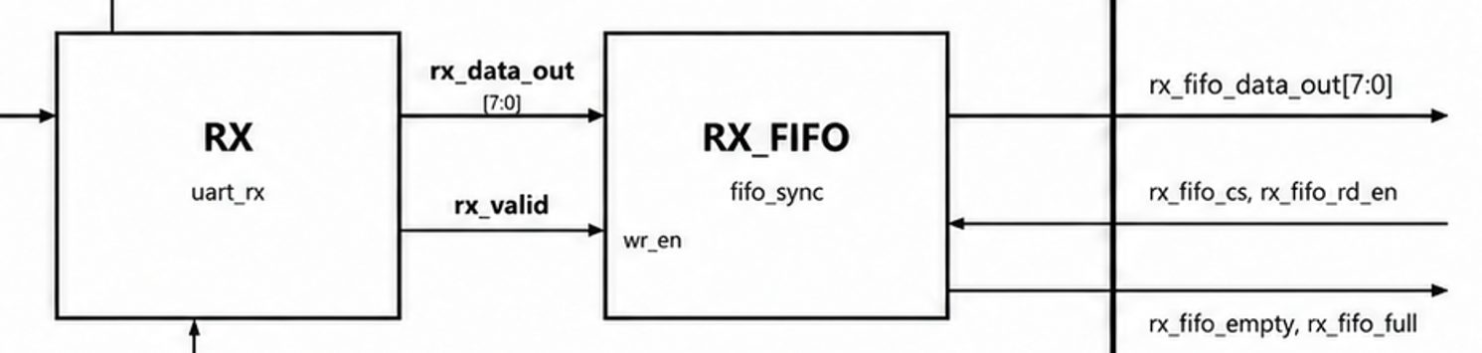
FIFO for RX in UART
A FIFO is added on RX side so data can wait in a queue.
RX FIFO: each rx_valid pulse writes the received byte; outside logic reads it later.
Size: FIFO_DEPTH = 8 bytes, width = 8 bits.
Bytes remain in the FIFO until they are read.
 | Write enable | Data in | Read enable | Data out
RX FIFO | rx_valid | rx_data_out | rx_fifo_rd_en (external) | rx_fifo_data_out

Slide 14
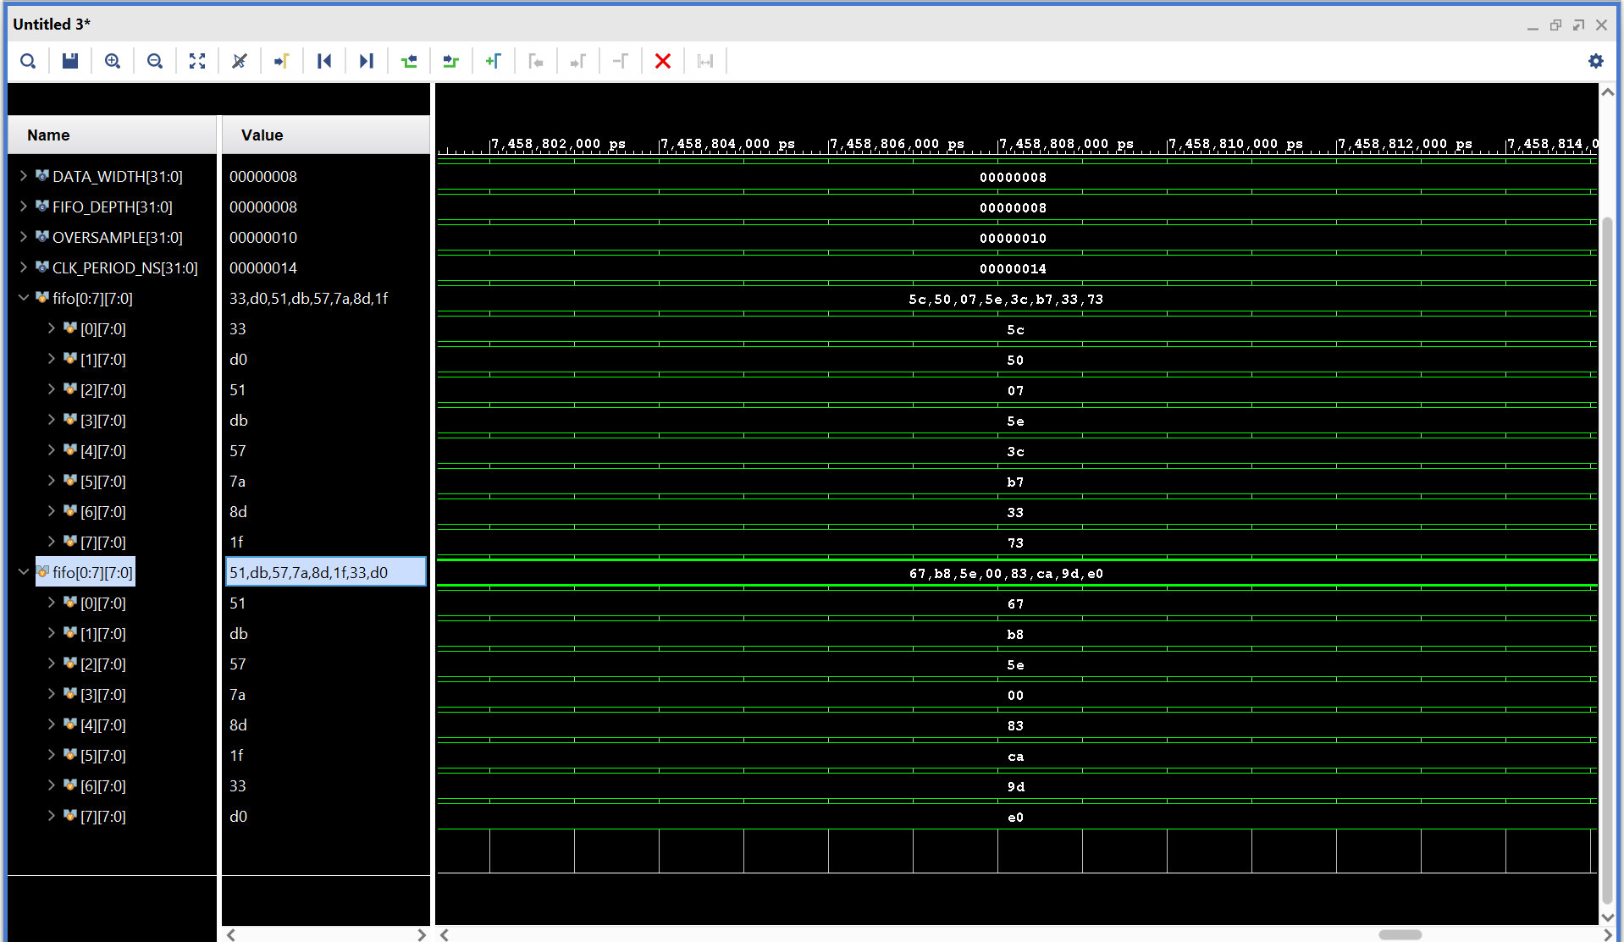
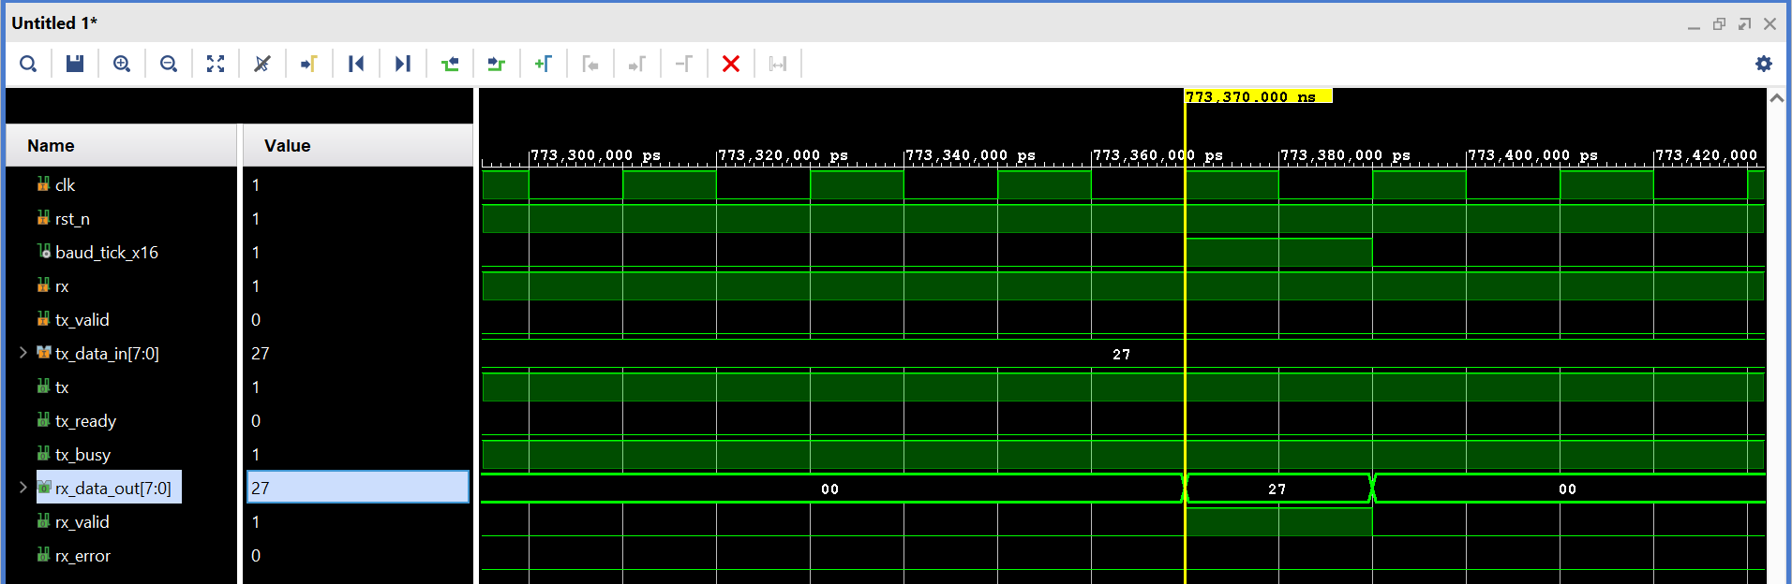
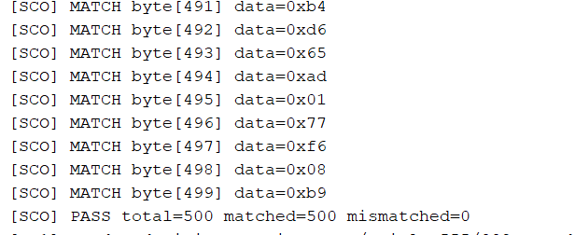
Loop Back test TX → RX
Connect TX output to RX input.
Compare each received byte when rx_valid is high.
13
Notes:
The source document describes the test setup and the valid-data interval. It does not provide a numerical pass count. Do not interpret this slide as a claim of exhaustive verification.
Source: UART 8N1 full
https://docs.google.com/document/d/17Au_pMJEInJm9FcX5MmbhdXGJXfIqr5DqbhTCfcQv7o

Slide 15
Summary
Design
- The controller sends and receives UART 8N1 frames at 115200 baud (50 MHz clock, 16× oversampling).
- One shared generator provides the 16× timing ticks (divisor 27, baud-rate error ≈ +0.47%).
TX changes bits at the bit boundary; RX samples near the middle of each bit.
TX and RX FIFOs (depth 8) buffer data on both sides.
Results
- Loopback test: 500/500 bytes data from [0;255] received correctly.
Limitations
- FIFOs have no overflow flag: a byte written to a full RX FIFO is dropped.- Tested only in loopback, where TX and RX share one baud tick; clock mismatch between devices is not yet tested.
Full 0x00–0xFF range, framing error (stop bit = 0) and false-start cases are not yet covered.
SVA checks ran only under constrained-random loopback traffic, which produces valid frames only. The RX transitions START→IDLE (false start), STOP→ERROR (stop bit = 0) and ERROR→IDLE (line returns high) have not been exercised by directed tests.
14
Notes:
The presentation follows the current UART 8N1 full Google Doc. No additional performance or hardware validation claims are made.
Source: UART 8N1 full
https://docs.google.com/document/d/17Au_pMJEInJm9FcX5MmbhdXGJXfIqr5DqbhTCfcQv7o

