Slide 1
CAMERA RASPBERRYPI

Slide 2
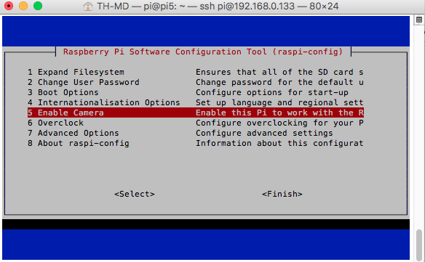
Enable Camera
sudo raspi-config

Slide 3
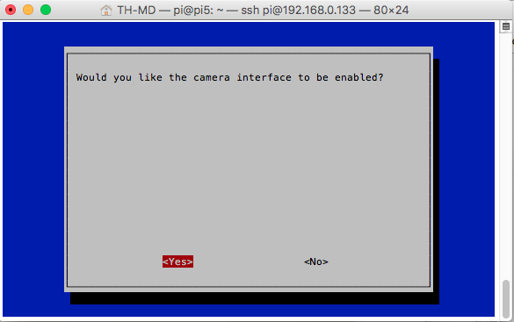
Enable Camera

Slide 4
RUN COMMAND LINE
Capture image
raspistill -t 5000 -o 1.jpg
Record Video
raspivid -t 5000 -o video.h264

Slide 5
INSTALL OMXPLAYER
sudo apt-get update
sudo apt-get install omxplayer
omxplayer [file_name]

Slide 6
INSTALL FBI
sudo apt-get update
sudo apt-get install fbi
sudo fbi -T 2 [file_name]

Slide 7
CAMERA ON PYTHON
sudo apt-get update
sudo apt-get install python-picamera

Slide 8
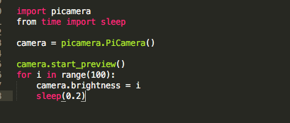
PREVIEW CAMERA

Slide 9
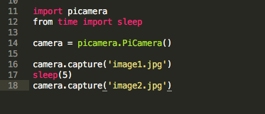
CAPTURE IMAGE

Slide 10
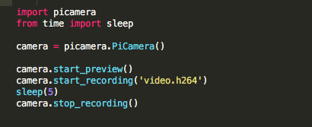
RECORD VIDEO

