Slide 1

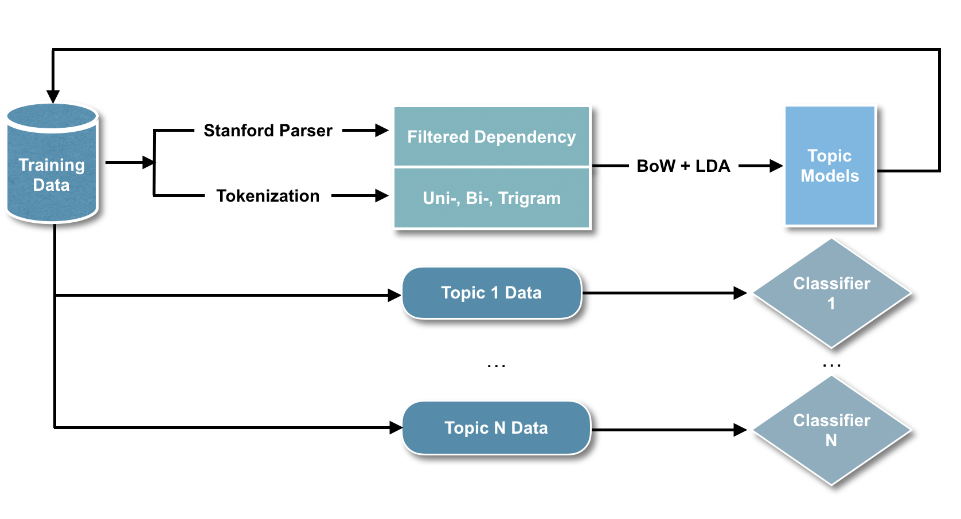
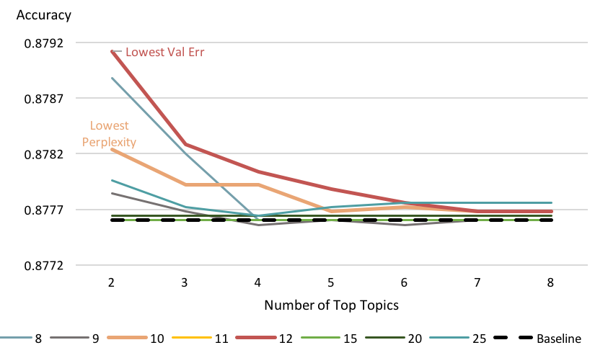
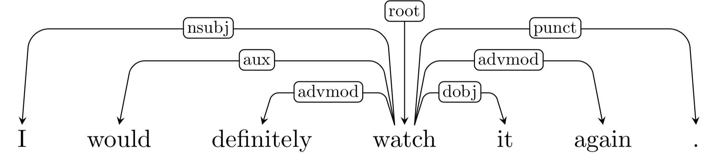
The Use of Global Topic Information and Local Semantic Relationship in Sentiment Analysis
Jiachen Ning; Linhong Li; Shiqi Xiao; Xiangting Chen
Carnegie Mellon University
Overview
Topic-based Ensemble
Background:
Sentiment analysis aims to extract subjective affect information from body of texts. The goal of this project is to build an interpretable sentiment analyzer on a dataset that contains a collection of 50,000 reviews posted on IMDB.
We explored effective sentiment analysis along two trajectories:
Extracting representative text embeddings
The most common text tokenization method is using N-grams. However, previous research argued that n-gram tokenization does not fully capture the gist of a document, and pairs of grammatically related words (i.e., dependency pairs) should also be incorporated as features as they might capture important long-distance information ^{[3][4].}
Building an adaptive classification ensemble
Neural networks perform most of the heavy-lifting in state-of-the-art pipelines, demonstrating the insufficiency of a single classifier like Naive Bayes or Support Vector Machine in performing the task. Topic modelling has been shown to improve sentiment classification accuracy on Twitter data ^{[2]}.
Contributions:
Motivated by these two approaches, we proposed a feature vectorization scheme to capture grammatical dependency, and an ensemble of topic-specific classifiers to alleviate the burden of a single classifier having to learn complicated decision boundaries for the entire corpus.
The second group of experiments only used regular BoW vectors to compare the performance of a single classifier and a topic-based ensemble.
During validation, topic-based ensemble outperformed a single classifier under specific hyperparameter settings. This indicates that the number of latent topics assumed affects how the topics are correlated with sentiments, and how biased the ensemble classifiers are affects their collective decisions. Table 2 reports test accuracy using the two best hyperparameter combinations.
Number of latent topics assumed:
LDA hyperparameters were finetuned by 5-fold cross validation:
10 latent topics yielded the lowest perplexity
12 latent topics yielded the lowest validation error
The number of latent topics that scored the lowest LDA perplexity achieved the best test accuracy and improved classification accuracy by 1.18%.
This suggests that a topic model that clusters the data well is suitable for building a topic-based ensemble that can enhance baseline performance.
How biased the ensemble classifiers are:
Increasing the number of classifiers a single document is assigned to increases the number of examples each classifier sees, thus decreasing the topic-specific bias each classifier assumes.
Figure 3 shows that higher classifier bias increased validation accuracy.
Figure 2 Flowchart of Training Process
Customized Bag-of-Words
The first group of experiments used a single classifier but with different feature vectorizations to test the efficacy of customized BoW vectors.
Baseline accuracy obtained by using BoW vectorization and text-frequency (TF) vectorization on 1-3 gram tokenization.
Lemmatization alone decreased classification accuracy.
Combining lemmatized 1-3 gram tokens with dependency pairs in BoW vectors boosted test accuracy by 9.82%.
TF vectors improved test accuracy similarly (by 5.33%).
Token | Vector | Accuracy
1-3grams | BoW | 0.84476
1-3grams | TF | 0.85336
1-3grams + Lemmatize | BoW | 0.83812
1-3grams + Lemmatize + Dependency | BoW | 0.94296
1-3grams + Lemmatize + Dependency | TF | 0.90668
Figure 1. Example of Parser Output
Methods
Note: In all tests, we used NB.
Training:
Lemmatized the training data and eliminated HTML tags (e.g., ‘<br>’).
Used Stanford Parser ^{[1]} to extract the lexical dependencies between words. Irrelevant dependencies were left out according to previous research ^{[3]}.
Generated new bigrams from extracted dependency pairs. Combined with regular 1-3 gram tokens to create customized bag-of-words (BoW) vectors.
Modeled training set topic distributions by Latent Dirichlet Allocation (LDA).
Distributed texts to their most relevant classifiers for topic-specific training.
Testing:
Obtained testing set topic distributions using the trained topic model.
Passed testing data to all topic-specific classifiers. Weighted their predictions by topic relevance to get the final classifications.
Table 1 Experiments with Customized Bag-of-Words
Number of Topics
Token & Vector | Topics | Accuracy
1-3grams & BoW | - | 0.84792
1-3grams & BoW | 10 | 0.85972
1-3grams & BoW | 12 | 0.84792
1-3grams + Lemmatize + Dependency & BoW | 10 | 0.94296
Figure 3 Validation Accuracy of Different Hyperparameter Settings
Future Work
Combine customized feature vectors with the topic-specific classifiers, which requires fine-tuning the hyperparameters for the end-to-end experiments using cross-validation.
Explore alternative vectorizations with rich information like lexical polarity.
Analyze individual topic-specific classifiers for better model interpretability.
Note: In all tests, we used NB. In all tests with Topic Modeling, we used LDA and set the number of top topics to be 2.
Table 2 Experiments with Topic-Based Ensemble
References
De Marneffe, M. C., & Manning, C. D. (2008). Stanford typed dependencies manual (pp. 338-345). Technical report, Stanford University.
Ficamos, P., & Liu, Y. (2016). A topic based approach for sentiment analysis on Twitter data. International Journal of Advanced Computer Science and Applications, 7(12), 201-205.
Nastase, V., Shirabad, J. S., & Caropreso, M. F. (2006). Using dependency relations for text classification. In Proceedings of the 19th Canadian conference on artificial intelligence (pp. 12-25).
Xia, R., Zong, C., & Li, S. (2011). Ensemble of feature sets and classification algorithms for sentiment classification. Information Sciences, 181(6), 1138-1152.

