Slide 1
DSP: Semmtech Ideation Group F4
Xiaotian Chen, Zsófia Katona, Dimitrios Papadopoulos, Florian de Graaf
3 November 2023

Slide 2
The challenge
“From 2024 onwards reporting on the sustainability of business activities will become mandatory for all (large) corporations in Europe, in compliance with the CSRD and the EU taxonomy of sustainable activities.”
Problem: most companies are not ready, due to the limited amount of available source data from suppliers and the lack of interoperability of the data.
Notes:
Due to new regulations, all (large) corporations in Europe will have to start reporting on the sustainability of their business activities from 2024. All activities must be reported in compliance with the CSRD (Corporate Sustainability Reporting Directive) and the EU taxonomy of sustainable activities. However, most companies are not ready, because of the limited amount of available source data from suppliers and the lack of interoperability of the data. At the moment, companies use different ways of reporting and structure data according to their own standards. This makes it difficult for other stakeholders to obtain and process this data.

Slide 3
How can we share the EU taxonomy as Linked Data?
How can we represent the EU taxonomy in a Linked Data format?
1
Sub-questions
How can we automate the construction of Linked Data schema related to the EU taxonomy depending on the dataset(s)?
2
Sustainable ontology
Goal
Notes:
In order to improve the current situation, we want to know how we can share the EU taxonomy as Linked Data. Before we can answer that, we must know how the EU taxonomy can be translated into a Linked Data format manually. Afterwards, we want to know how we can automate the outcome of the first question, making it faster and easier to construct a Linked Data schema related to the EU taxonomy. In the end, this will result in a robust ontology that can dynamically change when data is added, making it a sustainable model. To be clear: our main goal is not to automate the generation of reports based on input data from companies, but we want to automatically build an ontology based on the features in the EU taxonomy.

Slide 4
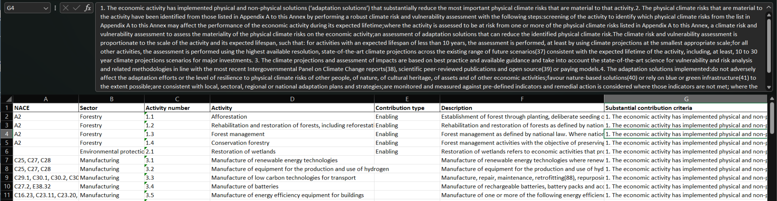
Current state of research
Starting point: EU resources on the Taxonomy
Large parts of crucial information are in free text → translating these into Linked Data be a major challenge in the project
Notes:
We started our research by inspecting and understanding the EU Taxonomy, based mostly on EU Resources.
An evident challenge: large parts of the information are in free text (such as the so-called contribution criteria, which decide whether an economic activity can be considered sustainable or not). Therefore, we believe that a large part of the implementation of the project will be dedicated to translating these into a Linked Data schema.
Besides EU Resources, we have started looking into other important aspects based on literature:
Methodologies for ontology construction - to ensure that we have a sound structured approach.
Ontology evaluation methods - to ensure that we can objectively assess the quality of the schema we build.
The papers listed here are some examples of what we have found so far - they are literature reviews themselves, which we think will be very useful to compare existing methodologies and select the ones which are most suitable for our project.

Slide 5
Current state of research
Directions for literature search
Methodologies for ontology construction
Jones et al. (1998), Fernández-López and Gómez-Pérez (2003), Iqbal et al. (2013)...
Ontology evaluation methods
Hlomani and Stacey (2014), Poveda-Villalón (2014), Tartir et al. (2010)...
Notes:
We started our research by inspecting and understanding the EU Taxonomy, based mostly on EU Resources.
An evident challenge: large parts of the information are in free text (such as the so-called contribution criteria, which decide whether an economic activity can be considered sustainable or not). Therefore, we believe that a large part of the implementation of the project will be dedicated to translating these into a Linked Data schema.
Besides EU Resources, we have started looking into other important aspects based on literature:
Methodologies for ontology construction - to ensure that we have a sound structured approach.
Ontology evaluation methods - to ensure that we can objectively assess the quality of the schema we build.
The papers listed here are some examples of what we have found so far - they are literature reviews themselves, which we think will be very useful to compare existing methodologies and select the ones which are most suitable for our project.

Slide 6
Progress so far
Started from the test taxonomy provided
Transformed into Turtle Language
Created Basic relationships of activities with sectors and naces
Linked Nace vocabulary

Slide 7
Next steps
Translate whole taxonomy as a schema
Create pipeline for updating instances of activities
Extract information from free text (e.g. contribution criteria) using NLP for a sector
Use information to expand schema
Evaluate based on methodologies or users

Slide 8
Future?
Platform for browsing the taxonomy in Linked Data format
Standardise for other sectors

Slide 9
Data and resources
We are currently using the data from EU Taxonomy and we decided to focus on the activities of one sector as the input data to proceed our research.
Publicly available vocabularies
NLP and ML for extracting information from free text.
Evaluation tools and platforms.

Slide 10
Questions?
Xiaotian Chen, Florian de Graaf, Zsófia Katona, Dimitrios Papadopoulos
3 November 2023

Slide 11
References
Jones, D., Bench-Capon, T., & Visser, P. (1998). Methodologies for ontology development.
Fernández-López, M., & Gómez-Pérez, A. (2002). Overview and analysis of methodologies for building ontologies. The knowledge engineering review, 17(2), 129-156.
Iqbal, R., Murad, M. A. A., Mustapha, A., & Sharef, N. M. (2013). An analysis of ontology engineering methodologies: A literature review. Research journal of applied sciences, engineering and technology, 6(16), 2993-3000.
Hlomani, H., & Stacey, D. (2014). Approaches, methods, metrics, measures, and subjectivity in ontology evaluation: A survey. Semantic Web Journal, 1(5), 1-11.
Poveda-Villalón, M., Gómez-Pérez, A., & Suárez-Figueroa, M. C. (2014). Oops!(ontology pitfall scanner!): An on-line tool for ontology evaluation. International Journal on Semantic Web and Information Systems (IJSWIS), 10(2), 7-34.
Tartir, S., Arpinar, I. B., & Sheth, A. P. (2010). Ontological evaluation and validation. Theory and applications of ontology: Computer applications, 115-130.

