Slide 1
The sampled data we see comes from this type of process yet we rarely
know the indentity of f(x) or the source of the noise though we hope it is random.
NOISE
x_{i}
f(x_{i})
+
y_{i}
y_{i} = f(x_{i}) + e_{i}
And then we typically get a subsample of this data

Slide 2
y_{i} = f(x_{i}) + e_{i}
y_{i} - f(x_{i}) = e_{i}
e_{i} = E[(y_{i} - f(x_{i}))]

Slide 3
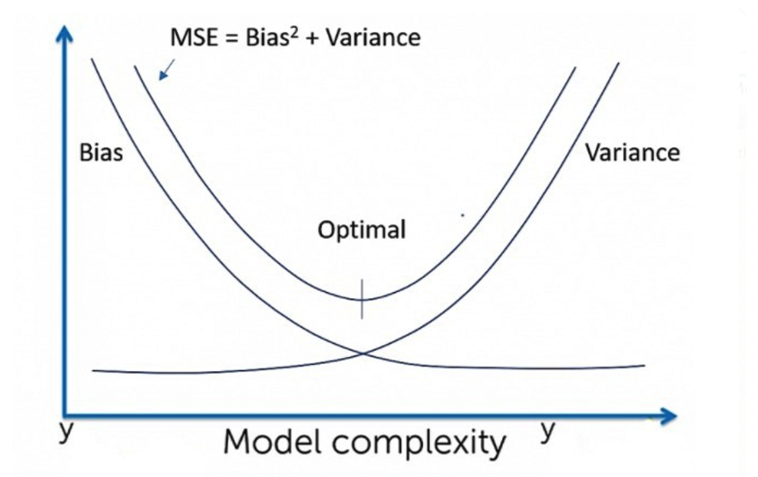

Slide 4
Var of Irreducible Error
Bias² Of The Model
Variance Of The Model

