Slide 1
Optimized UAV
Service Network
A Full-Process Optimization Framework for Urban
Low-Altitude UAV Networks in Megacities
Case Study
Yangpu District, Shanghai — A Typical Central Urban Area

Slide 2
Agenda
01
Background & Research Gap
02
Data Preprocessing
03
Path Planning
04
Vertiport Deployment
05
Simulation Analysis
06
Conclusion & Global Significance

Slide 3
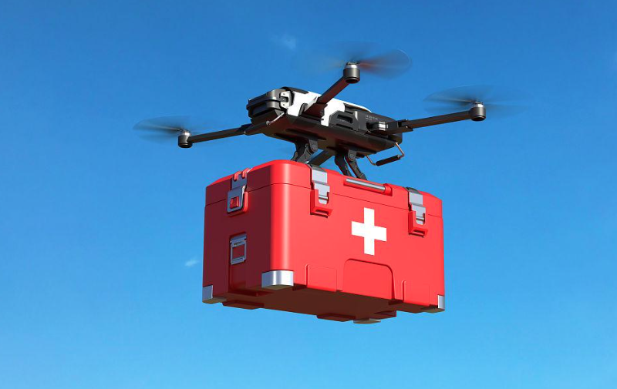

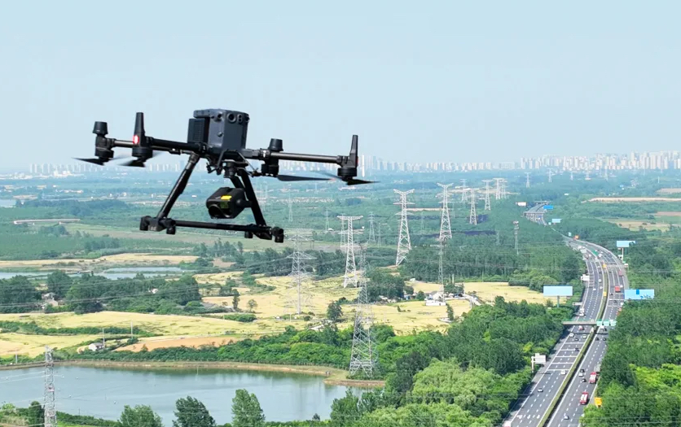
The Urban UAV Challenge
Low-Altitude Economy Growth
City Governance & Emergency Services
The 15th Five-Year Plan for
National Economic and Social Development
We should accelerate the development of industrial clusters in strategic emerging fields such as new energy, new materials, aviation and aerospace, and the low-altitude economy.
Day-to-Day Deliveries & Logistics
Imagine an economy not built on highways and rail lines—but on digital air corridors, autonomous drones, vertiports, and AI-supported logistics. This is what the report Morgondagens Flyg calls the “low altitude economy”—an emerging industrial ecosystem operating primarily below 500 feet.
City Governance

Slide 4
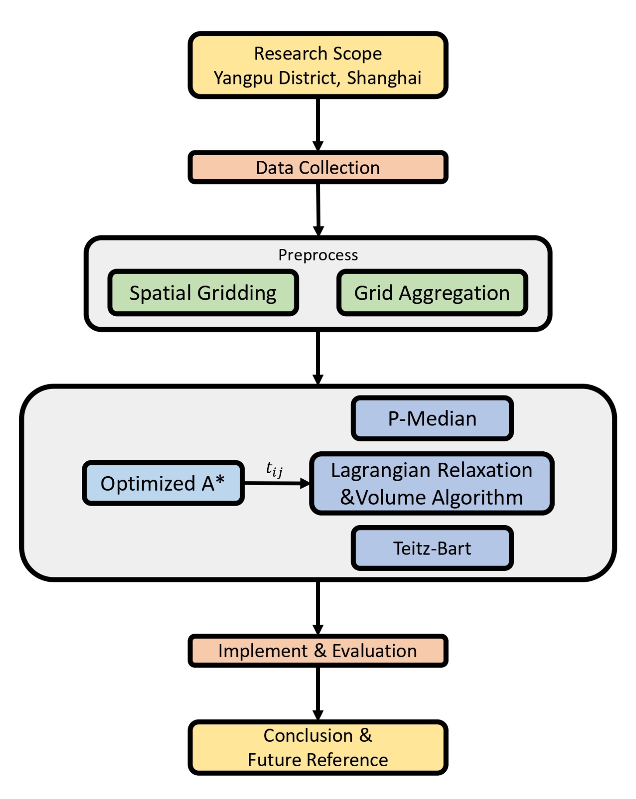
Proposed Optimization Framework
Limitations and Solutions
Full-Process Pipeline
Prior Work Limitations
• Discrete buildings obstacles raises computational complexity
• Oversimplified path planning algorithm
• Numerous siting schemes lack comprehensive comparisons
• No integrated vertiport-path planning workflow
Our Proposed Solutions
① Adopt spatial gridding to embed data and reduce collision analysis
② Flexible direction expansion and physics-based cost function
③ Integrated P-Median + Lagrangian optimization
④ Full-chain replicable framework for urban districts

Slide 5
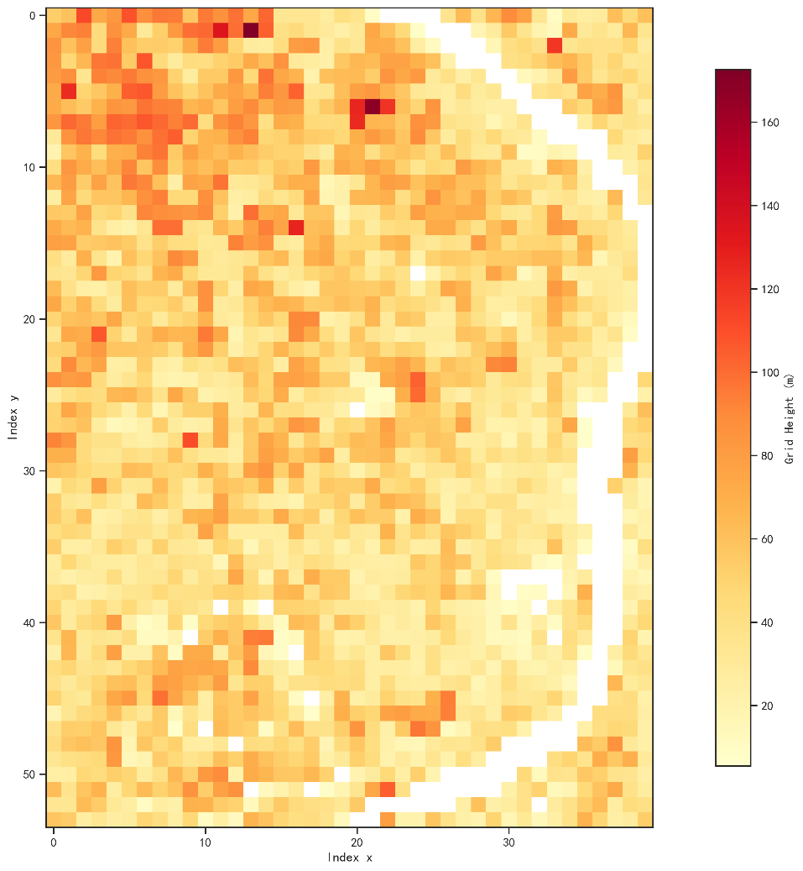
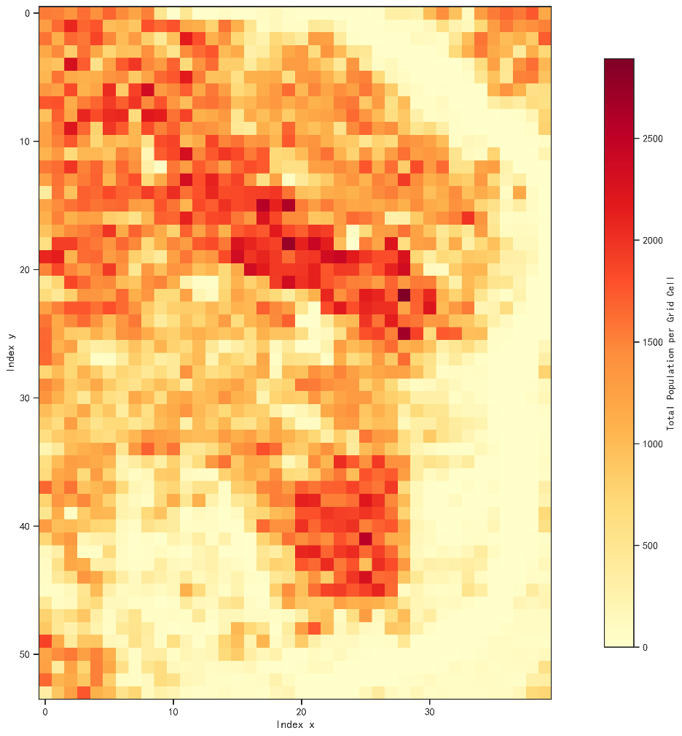
Spatial Gridding and Data Prerocessing
Research Scope Gridding
Yangpu District discretized into 200m x 200m grid units.
1
200m x 200m Grid Units
Total: 2,160 spatial demand grids
2
Building Height Aggregation
Max building height per grid as obstacle reference
3
Population Distribution
Resident population as demand intensity weights
4
No-Fly Zone Marking
Restricted zones tagged as impassable

Slide 6
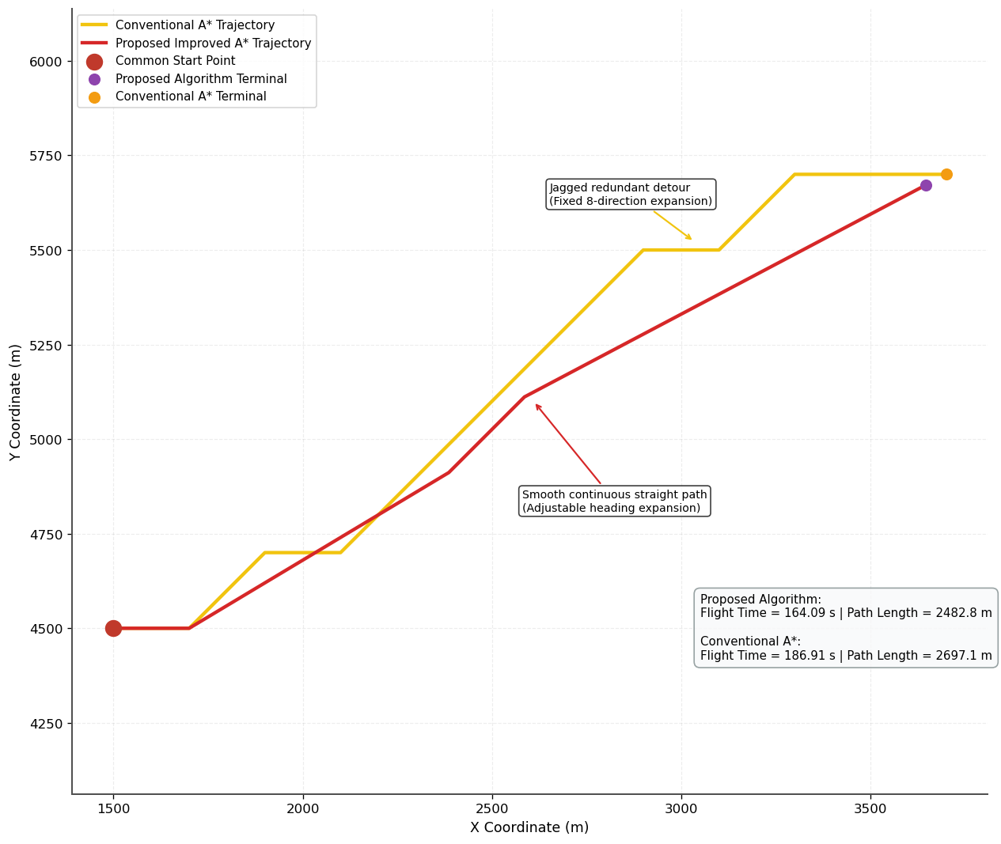
Path Planning
Three Key Upgrades
1. Flexible Direction Expansion
The direct heading angle from current grid to target is added to the candidate set.
✓ Continuous step lengths yield smooth trajectories
✓ Eliminates redundant zigzag segments
2. Physics-Based Cost Function
Replaced with real flight time and scan terrain grid-by-grides.
✓ Two modes: gradient <0.3 (cruise) or ≥0.3 (climb)
✓ Minimizes altitude fluctuation for smooth flight
3. Embedded Hard Constraints
All regulatory and performance limits enforced during node expansion
✓ Altitude ceiling 115m — path discarded if exceeded
✓ Single-climb height ≤25m — regulation-compliant

Slide 7
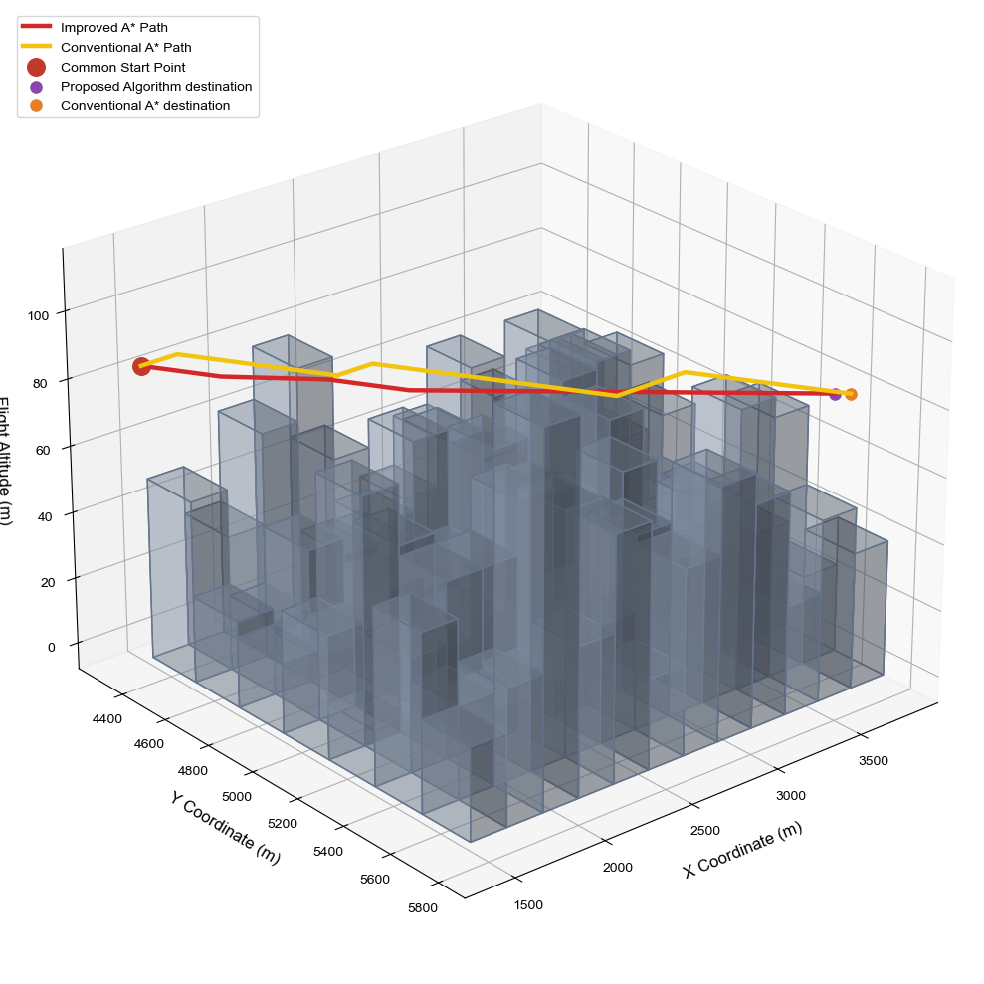
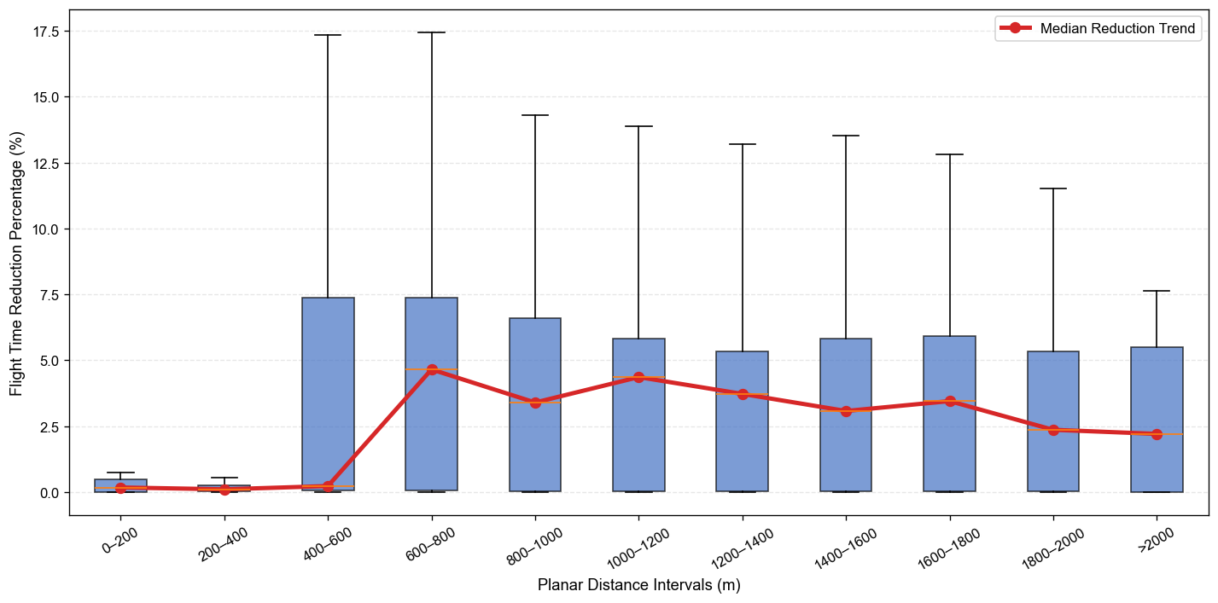
Simulation Analysis
Simulation Results
Percentage reduction in flight time achieved by our algorithm across segmented travel distance ranges
 | Improved A* | Conventional A*
Average running time (s) | 0.544433 | 0.480137
Median running time (s) | 0.252000 | 0.295000

Slide 8
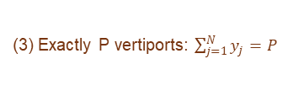


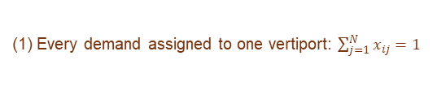
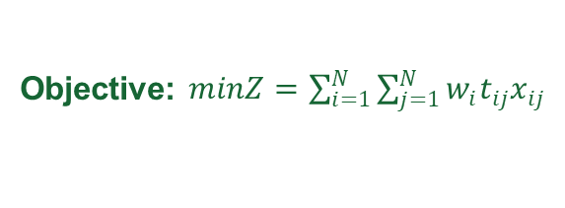


Vertiport Deployment
The Location Problem
Lagrangian Relaxation
Select P vertiports from N candidate grids to minimize total population-weighted flight time
Relax the equality constraint into the objective using multipliers
Decision Variables
Relaxed Dual Problem
$$y_{j}∈\{0,1\}$$
: 1 if grid j is a vertiport
$$\text{Initialize bounds }\text{and}\text{ algorithm hyperparameters}$$
$$x_{ij}∈\{0,1\}$$
: 1 if demand i assigned to vertiport j
$$\text{Compute dual lower bound }\text{and}\text{ primal upper bound iteratively}$$
$$w_{i}, t_{ij}$$
: Population weight and flight time
$$\text{Smooth subgradient and update Lagrangian multipliers}$$
$$\text{Adjust parameters, restart and check convergence}$$
Objective: $\begin{aligned}minZ=\sum_{i=1}^{N}{\sum_{j=1}^{N}{w_{i}t_{ij}x_{ij}}}\end{aligned}$
$$\begin{aligned}L\left(λ\right)=\min_{x,y}{\sum_{i=1}^{N}{\sum_{j=1}^{N}{w_{i}t_{ij}x_{ij} }+\sum_{i=1}^{N}{λ_{i}\left(1−\sum_{j=1}^{N}{x_{ij}}\right)}}}\end{aligned}$$
Constraints
(1) Every demand assigned to one vertiport: $\sum_{j=1}^{N}{x_{ij}=1}$
(2) Assign only to selected vertiports: $x_{ij}≤y_{j}$
(3) Exactly P vertiports: $\sum_{j=1}^{N}{y_{j}=P}$
Algorithm | Objective Value(s) | Computation Time(s)
Greedy + Teitz‑Bart | 98,103,389.99 | 8.9
Genetic Algorithm | 96,883,597.14 | 36.6
 | 96,154,712.49 | 610.3

Slide 9
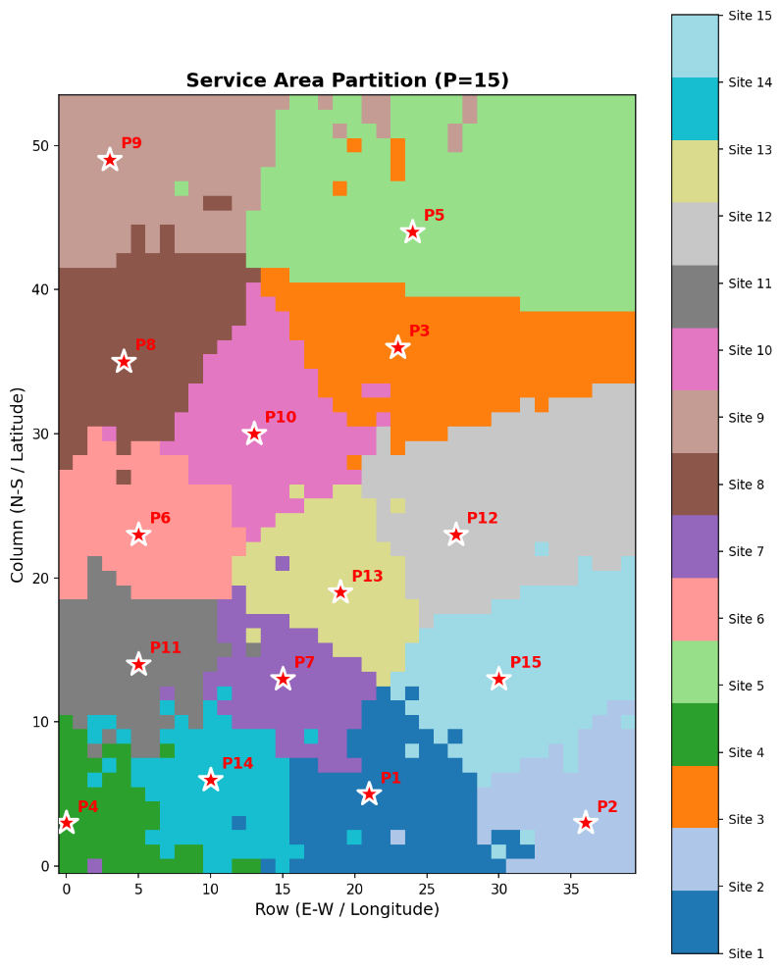
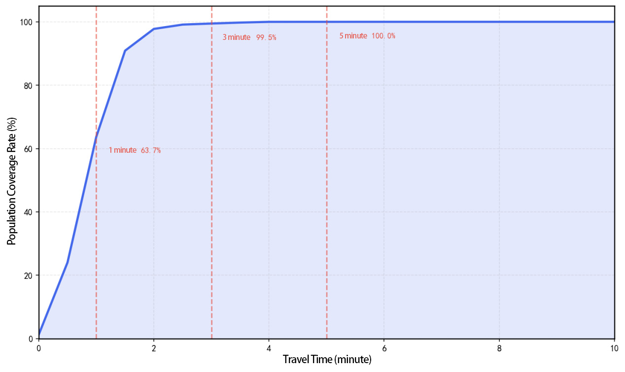
Simulation Analysis
OPTIMALITY GAP
POPULATION COVERAGE
SERVICE RADIUS
0.9174%
119K
5 min
Near-globally optimal
Residents per vertiport
Full coverage

Slide 10

Summary
A replicable, China-originated governance solution for global megacity UAV planning
Standardized and secure low-altitude economic development
Spatial Gridding
3D Path Planning
Vertiport Deployment
Optimized Network
200m x 200m cells
Improved A* algorithm
P-Median + Lagrangian
Validated by simulation

Slide 11
CONCLUSION
A Standardized, Secure
Low-Altitude Blueprint
For Megacities Worldwide
A replicable, China-originated governance solution for global UAV network planning
Strategic Policy Alignment
Supporting China's 15th Five-Year Plan and global low-altitude economic development
Practical & Scalable
Validated through real-world data from Yangpu District, Shanghai's central urban area
Optimized UAV Service Network
Thank you

