Slide 1
MIMIC-IV ICU 真实世界证据分析汇报
早期升压药使用与院内死亡风险：Target Trial Emulation + IPTW/AIPW
汇报目的
向老板和医学团队展示 RWE 项目的研究设计、数据提取、统计分析和医学解释。
当前结果为 preliminary analysis，适合内部讨论和简历项目展示。
重点不是证明疗效，而是展示如何处理 ICU 观察性治疗策略中的 confounding by indication。
9,502
Analytic cohort
3,772
Early VP 0-6h
5,730
No early VP
1.17 pp
AIPW risk difference
MIMIC-IV RWE briefing | preliminary analysis | slide 1

Slide 2
1. 研究问题与临床背景
ICU 治疗策略分析中，粗比较通常会受到疾病严重程度影响
Research Question
Adult sepsis-coded first ICU stays 中，ICU admission 后 6 小时内早期使用升压药是否与院内死亡风险相关？
Treatment strategy: early vasopressor initiation within 0-6 hours.
Comparator: no vasopressor initiation within 0-6 hours.
Why RWE Methods Matter
早期升压药患者通常更重，粗死亡率比较容易误导。
需要 target trial emulation 明确定义 time zero、grace period、baseline confounders。
使用 PS/IPTW/AIPW 评估 measured confounding 调整后的 treatment strategy association。
MIMIC-IV RWE briefing | preliminary analysis | slide 2

Slide 3
2. Target Trial Emulation 框架
将 EHR 观察性数据尽量整理成“模拟试验”的分析结构
Population
Adult first ICU stay + sepsis ICD proxy + 6h landmark
Treatment
Vasopressor started within 0-6h after ICU admission
Comparator
No vasopressor initiation within 0-6h
Outcome
Hospital mortality
Confounders
Demographics, admission type, care unit, first-6h vitals/labs
Estimand
Average effect / adjusted risk difference in target population
MIMIC-IV RWE briefing | preliminary analysis | slide 3

Slide 4
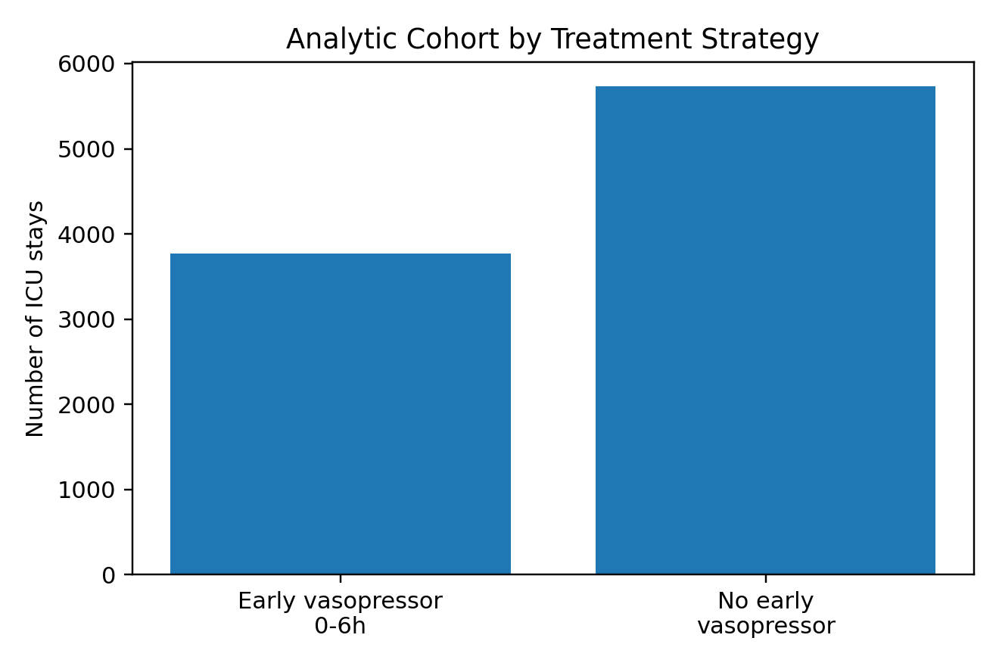
3. 数据构建流程
从源数据表构建 one-row-per-ICU-stay analysis dataset
Core Source Tables
hosp: patients, admissions, diagnoses_icd, labevents
icu: icustays, inputevents, d_items, chartevents
Output: patient/stay-level cohort + exposure + covariates + outcome
Derived Variables
first_vasopressor_time and early_vasopressor flag
first-6-hour vitals/labs: HR, MAP/MBP, RR, temperature, lactate, creatinine, WBC, platelet, albumin, bilirubin
hospital_expire_flag as primary outcome
MIMIC-IV RWE briefing | preliminary analysis | slide 4

Slide 5
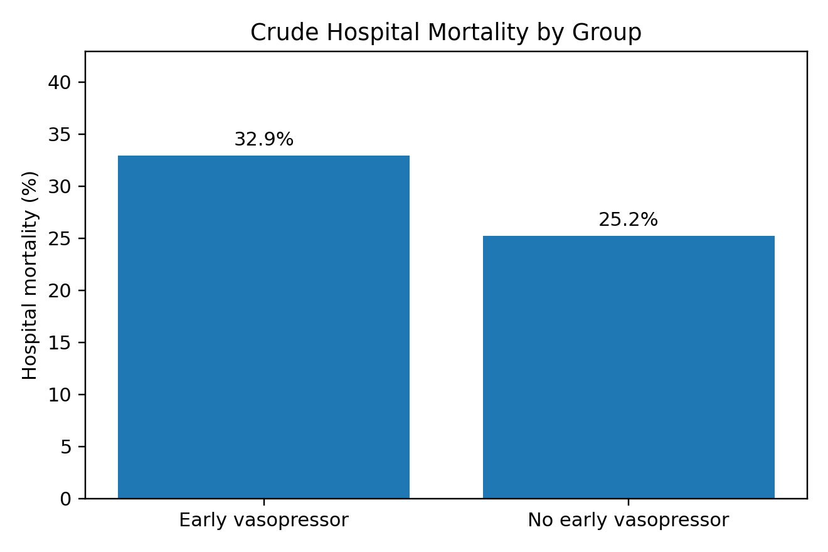
4. Cohort Summary
当前可用于内部讨论和简历项目展示的 preliminary cohort
9,502
Analytic cohort
3,772
Early VP (39.7%)
5,730
No early VP (60.3%)
28.3%
Overall mortality
Interpretation of crude results
Early VP crude mortality: 32.9%
No early VP crude mortality: 25.2%
粗结果不能直接做因果解读；早期用药通常代表病情更重。
MIMIC-IV RWE briefing | preliminary analysis | slide 5

Slide 6
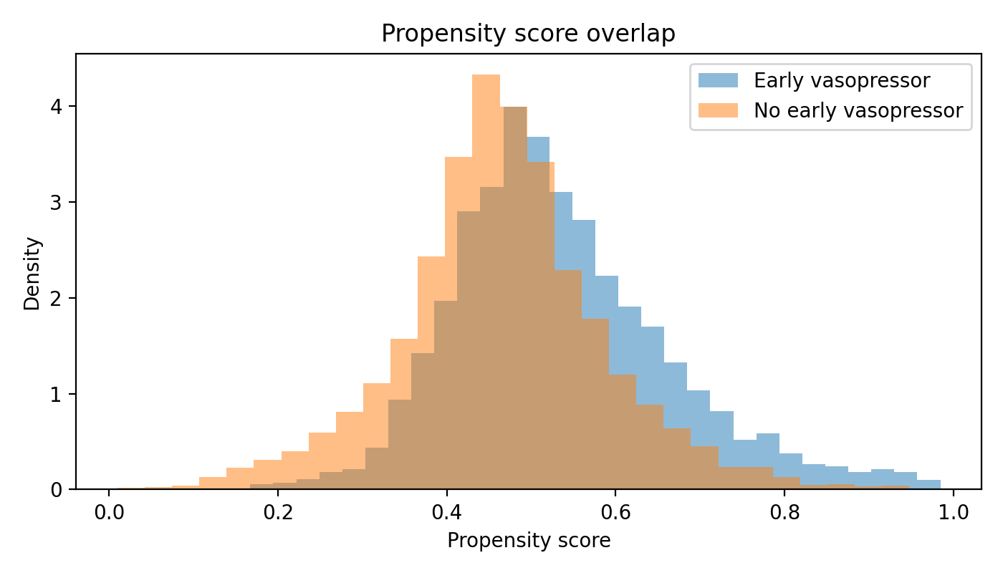
5. Propensity Score 与 Overlap
检查 treated/control 是否存在可比较区域
Key Message
两组 propensity score 分布存在重叠，支持后续加权分析。
早期升压药组分布略偏高，符合“病情更重者更可能早期用药”的临床预期。
正式研究可进一步做 overlap trimming / positivity check。
MIMIC-IV RWE briefing | preliminary analysis | slide 6

Slide 7
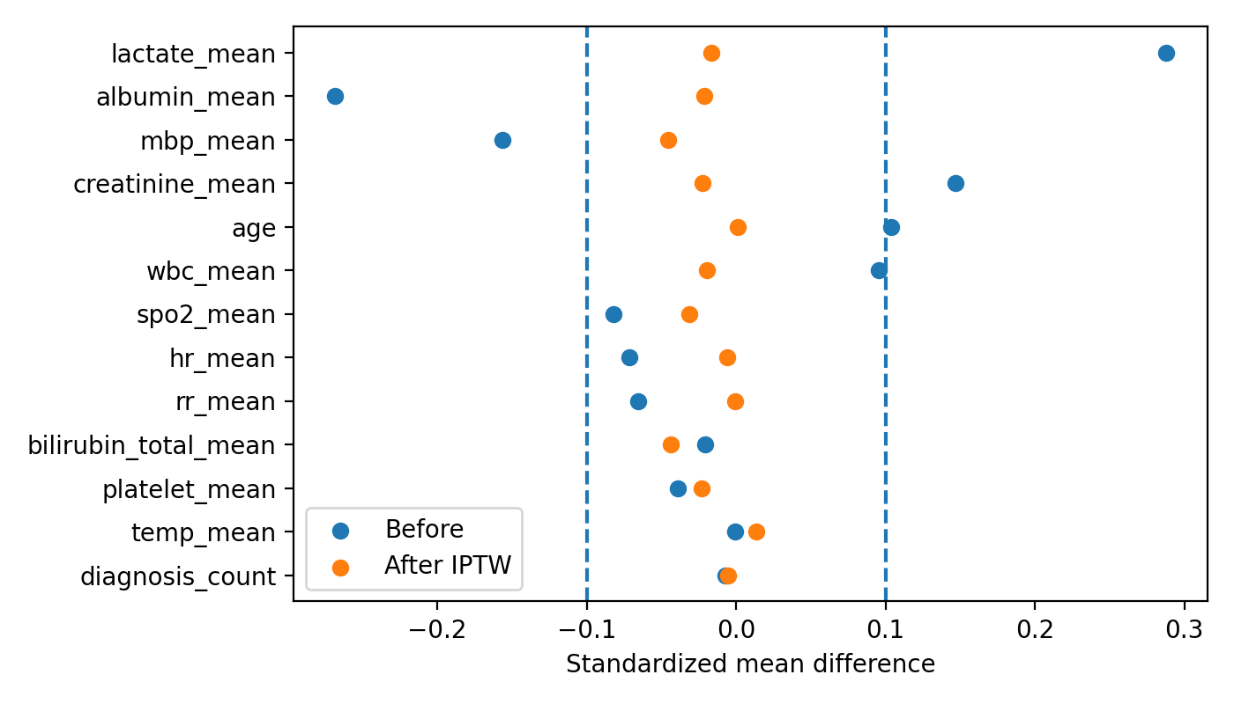
6. Covariate Balance Diagnostics
IPTW 后 measured baseline covariates 的平衡性改善
Balance Summary
13/13 numeric covariates had |SMD| < 0.1 after IPTW.
Max |SMD| before weighting: 0.288.
Max |SMD| after IPTW: 0.046.
Measured confounding 改善，但 unmeasured confounding 仍需谨慎。
MIMIC-IV RWE briefing | preliminary analysis | slide 7

Slide 8
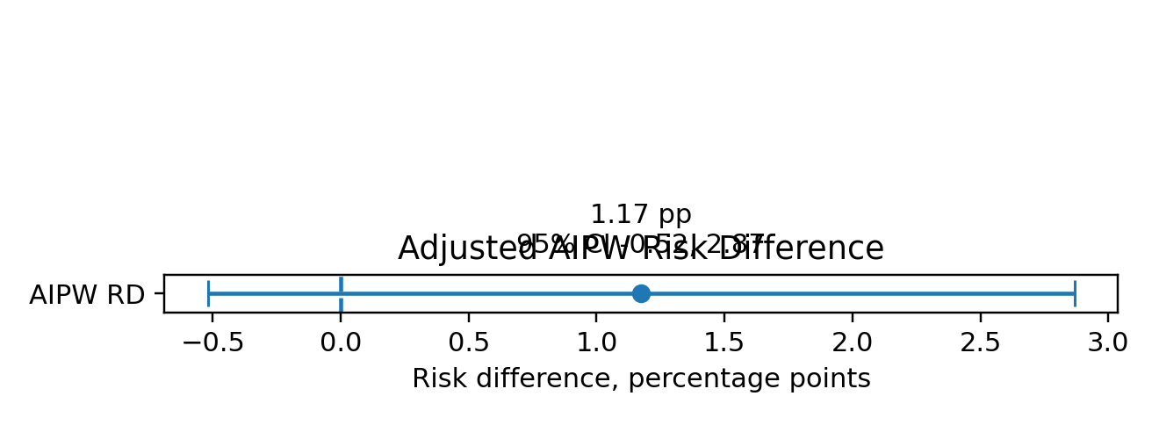
7. Adjusted Results
AIPW 调整后 risk difference 接近 null
Adjusted Estimate
AIPW risk difference: 1.17 percentage points.
95% CI: -0.52 to 2.87 percentage points.
置信区间跨 0；不支持从当前版本中得出明确方向性因果结论。
与粗死亡率差异相比，调整后估计明显减弱。
MIMIC-IV RWE briefing | preliminary analysis | slide 8

Slide 9
8. 医学解读
结论表达要强调“观察性关联”而不是“证明疗效”
For Medical Team
早期升压药是 ICU shock severity 的强信号，不能把 crude mortality 直接解释为治疗有害。
当前 adjusted RD 接近 null，提示 baseline measured covariates 调整后关联减弱。
需要复核 sepsis onset、shock 定义、升压药 itemid、液体复苏和 SOFA/Charlson。
For Boss / Business Audience
项目展示完整 RWE pipeline：cohort design → data extraction → TFL → causal adjustment → medical interpretation。
结果可用于内部方法展示和实习/简历项目，不应作为 clinical guidance。
下一步可升级为 protocol/SAP + sensitivity analyses + reproducible report。
MIMIC-IV RWE briefing | preliminary analysis | slide 9

Slide 10
9. 局限性与风险控制
把方法学风险讲清楚，反而更贴近 RWE 工作要求
Current Limitations
Sepsis 使用 ICD proxy；正式研究应验证 Sepsis-3 derived onset。
Time zero 当前为 ICU admission；可能与真实 sepsis onset 有偏差。
仍存在 residual/unmeasured confounding。
CSV malformed rows 的读取容错适合 portfolio；正式研究需源文件完整性核验。
How We Control Risk
使用 6h landmark/grace period 降低 immortal time bias。
仅使用 baseline/first-6h covariates 做 confounding adjustment。
用 PS overlap、SMD/love plot 做诊断。
报告中避免 “proved / causal proof” 等过度措辞。
MIMIC-IV RWE briefing | preliminary analysis | slide 10

Slide 11
10. 下一步计划
将 portfolio 项目升级为更接近正式 RWE study deliverables
Technical Next Steps
接入 mimic-code derived tables: sepsis3, SOFA, Charlson, vasopressor, ventilation。
补充 sensitivity analyses: 0-3h/0-6h/0-12h window, early vs delayed 6-24h。
加入 subgroup analyses: lactate/MAP/shock severity/ventilation。
RWE Deliverables
Protocol outline: research question, estimand, cohort, endpoints, bias control。
SAP: analysis set, missing data, PS, IPTW/AIPW, sensitivity analyses。
TFL: cohort flow, Table 1, balance diagnostics, outcome estimates, figures。
MIMIC-IV RWE briefing | preliminary analysis | slide 11

Slide 12
11. Take-home Message
这是一份更贴近 RWE & Analytics 实习岗位的项目展示
One-sentence Summary
We built a reproducible MIMIC-IV ICU RWE analysis of 9,502 adult sepsis-coded first ICU stays and showed that crude mortality differences between early and non-early vasopressor strategies were attenuated after PS/IPTW/AIPW adjustment.
Why This Fits the JD
真实世界观察性研究：cohort construction + treatment strategy + outcome analysis。
方案/SAP/报告：明确 TTE elements、bias control、statistical methods。
数据分析：SQL/Python extraction, PS diagnostics, IPTW, AIPW, TFL outputs。
医学沟通：主动讨论 confounding by indication 和临床定义验证。
MIMIC-IV RWE briefing | preliminary analysis | slide 12

