Slide 1

Xingyi,Chen

Slide 2
History
mongoDB = “Humongous DB”
Open-source
Document-based
“High performance, high availability”
Automatic scaling
C-P on CAP
Notes:
Too much text.
Open Source
High Performance
CA bullets

Slide 3








Other NoSQL Types
Key-value
Graph database
Document-oriented
Column family
Notes:
Huge quantity of data => Distributed systems => expensive joins =>
New fields, new demands (graphs) =>
Different data strucutres:
Simplier or more specific

Slide 4
Motivations
Problems with SQL
Rigid schema
Not easily scalable
Requires unintuitive joins
Perks of mongoDB
Easy interface with common languages (Java, Javascript, PHP, etc.)
DB tech should run anywhere (VM’s, cloud, etc.)
Keeps essential features of RDBMS’s while learning from key-value noSQL systems
Notes:
Quotes from a person

Slide 5
Features
Document-Oriented storege
Full Index Support
Replication & High Availability
Auto-Sharding
Querying
Fast In-Place Updates
Map/Reduce
Agile
Scalable

Slide 6
Data Model
Document-Based (max 16 MB)
Documents are in BSON format, consisting of field-value pairs
Each document stored in a collection
Collections
Have index set in common
Like tables of relational db’s.
Documents do not have to have uniform structure

Slide 7
JSON
“JavaScript Object Notation”
Easy for humans to write/read, easy for computers to parse/generate
Objects can be nested
Built on
name/value pairs
Ordered list of values

Slide 8
BSON
“Binary JSON”
Binary-encoded serialization of JSON-like docs
Also allows “referencing”
Embedded structure reduces need for joins
Goals
Lightweight
Traversable
Efficient (decoding and encoding)

Slide 9
BSON Types
Type | Number
Double | 1
String | 2
Object | 3
Array | 4
Binary data | 5
Object id | 7
Boolean | 8
Date | 9
Null | 10
Regular Expression | 11
JavaScript | 13
Symbol | 14
JavaScript (with scope) | 15
32-bit integer | 16
Timestamp | 17
64-bit integer | 18
Min key | 255
Max key | 127
The number can be used with the $type operator to query by type!
http://docs.mongodb.org/manual/reference/bson-types/

Slide 10
The _id Field
By default, each document contains an _id field. This field has a number of special characteristics:
Value serves as primary key for collection.
Value is unique, immutable, and may be any non-array type.
Default data type is ObjectId, which is “small, likely unique, fast to generate, and ordered.” Sorting on an ObjectId value is roughly equivalent to sorting on creation time.

Slide 11
SQL vs MongoDB
RDBMS | MongoDB
Database | Database
Table, View | Collection
Row | Document (JSON, BSON)
Column | Field
Index | Index
Join | Embedded Document
Foreign Key | Reference
Partition | Shard

Slide 12
Mongo is basically schema-free
The purpose of schema in SQL is for meeting the requirements of tables and quirky SQL implementation
Every “row” in a database “table” is a data structure, much like a “struct” in C, or a “class” in Java. A table is then an array (or list) of such data structures
So we what we design in mongoDB is basically same way how we design a compound data type binding in JSON

Slide 13
Linking vs. Embedding
Embedding is a bit like pre-joining data
Document level operations are easy for the server to handle
Embed when the “many” objects always appear with (viewed in the context of) their parents.
Linking when you need more flexibility

Slide 14
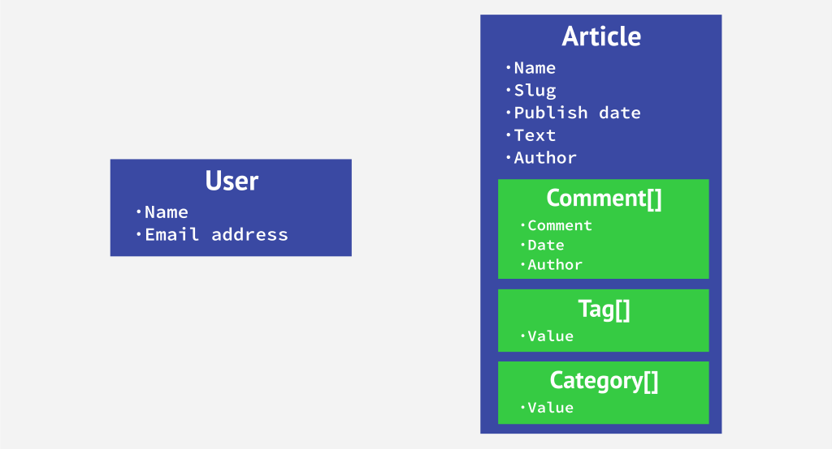
Embedding & Linking

Slide 15
Example
book = {
title: "MongoDB: The Definitive Guide",
authors : [
{ _id: "kchodorow", name: "Kristina Chodorow” },
{ _id: "mdirolf", name: "Mike Dirolf” }
]
published_date: ISODate("2010-09-24"),
pages: 216,
language: "English"
}
author = {
_id: "kchodorow",
name: "Kristina Chodorow",
hometown: "New York"
}
db.books.find( { authors.name : "Kristina Chodorow" } )

Slide 16
What is bad about SQL ( semantically )
“Primary keys” of a database table are in essence persistent memory addresses for the object. The address may not be the same when the object is reloaded into memory. This is why we need primary keys.
Foreign key functions just like a pointer in C, persistently point to the primary key.
Whenever we need to deference a pointer, we do JOIN
It is not intuitive for programming and also JOIN is time consuming

Slide 17
What is good about mongoDB?
De-normalization provides Data locality, and Data locality provides speed

Slide 18
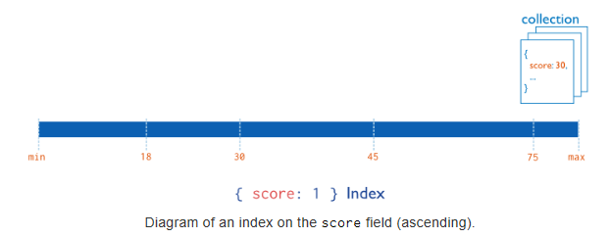
Index in MongoDB
Types
Single Field Indexes
Compound Field Indexes
Multikey Indexes
Single Field Indexes
db.users.ensureIndex( { score: 1 } )

Slide 19
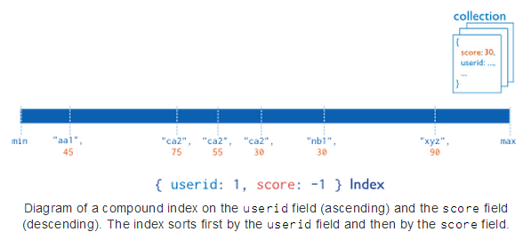
Index in MongoDB
Types
Single Field Indexes
Compound Field Indexes
Multikey Indexes
Compound Field Indexes
db.users.ensureIndex( { userid:1, score: -1 } )

Slide 20
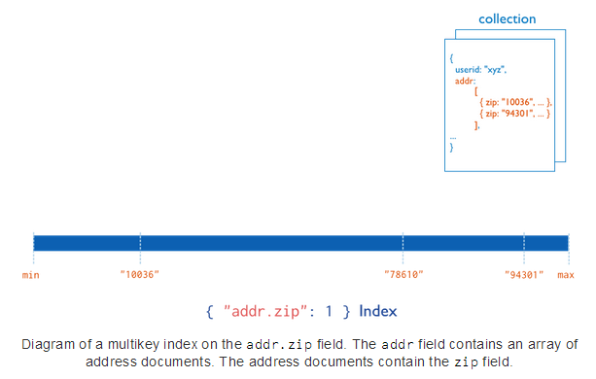
Index in MongoDB
Types
Single Field Indexes
Compound Field Indexes
Multikey Indexes
Multikey Indexes
db.users.ensureIndex( { addr.zip:1} )

Slide 21
Aggregation
Operations that process data records and return computed results.
MongoDB provides aggregation operations
Running data aggregation on the mongod instance simplifies application code and limits resource requirements.

Slide 22
Pipelines
Modeled on the concept of data processing pipelines.
Provides:
filters that operate like queries
document transformations that modify the form of the output document.
Provides tools for:
grouping and sorting by field
aggregating the contents of arrays, including arrays of documents
Can use operators for tasks such as calculating the average or concatenating a string.

Slide 23
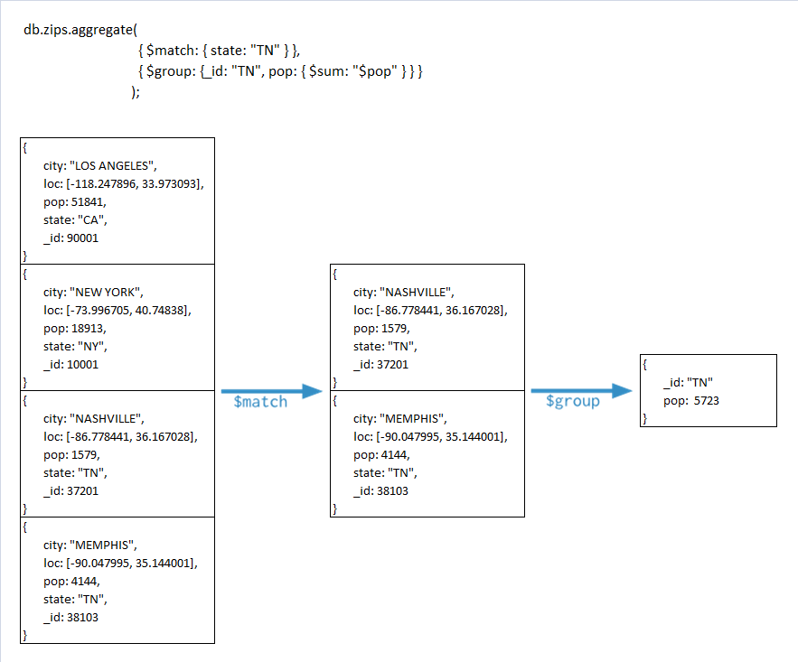

Slide 24
Single Purpose Aggregation Operations
Special purpose database commands:
returning a count of matching documents
returning the distinct values for a field
grouping data based on the values of a field.
Aggregate documents from a single collection.
Lack the flexibility and capabilities of the aggregation pipeline and map-reduce.

Slide 25

Replica Sets
Host1:10000
Redundancy and Failover
Zero downtime for upgrades and maintaince
Master-slave replication
Strong Consistency
Delayed Consistency
Geospatial features
Host2:10001
Host3:10002
replica₁
Client
Notes:
DC – Data center

Slide 26
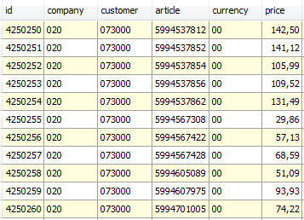
Sharding
Partition your data
Scale write throughput
Increase capacity
Auto-balancing
shard₁
shard₂
Host1:10000
Host2:10010
configdb
Host3:20000
Client
Host4:30000

Slide 27
Mixed
shard₁
...
Host1:10000
shard_{n}
Host2:10001
Host4:10010
Host3:10002
replica₁
configdb
Host5:20000
Client
Host6:30000
Host7:30000

Slide 28
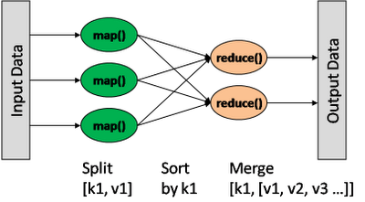
Map/Reduce
db.collection.mapReduce(
<mapfunction>,
<reducefunction>,
{
out: <collection>,
query: <>,
sort: <>,
limit: <number>,
finalize: <function>,
scope: <>,
jsMode: <boolean>,
verbose: <boolean>
}
)
var mapFunction1 = function() { emit(this.cust_id, this.price); };
var reduceFunction1 = function(keyCustId, valuesPrices)
{ return sum(valuesPrices); };
Notes:
http://docs.mongodb.org/manual/reference/method/db.collection.mapReduce/#db.collection.mapReduce

Slide 29

Theory of noSQL: CAP
C
Many nodes
Nodes contain replicas of partitions of data
Consistency
all replicas contain the same version of data
Availability
system remains operational on failing nodes
Partition tolarence
multiple entry points
system remains operational on system split
A
P
CAP Theorem: satisfying all three at the same time is impossible

Slide 30
Thanks

