Slide 1
International Financial Management
13th Edition
by Jeff Madura
© 2018 Cengage Learning. All Rights Reserved. May not be copied, scanned, or duplicated, in whole or in part, except for use as permitted in a license distributed with a certain product or service or otherwise on a password-protected website for classroom use.

Slide 2
5 Currency Derivatives
Chapter Objectives
Describe the characteristics and use of forward contracts.
Describe the characteristics and use of currency futures contracts.
Describe the characteristics and use of currency call option contracts.
Describe the characteristics and use of currency put option contracts.

Slide 3
What is a Currency Derivative?
A currency derivative is a contract whose price is derived from the value of an underlying currency.
Examples include forwards/futures contracts and options contracts.
Derivatives are used by MNCs to:
  Speculate on future exchange rate movements
  Hedge exposure to exchange rate risk

Slide 4
Forward Market (1 of 4)
A forward contract is an agreement between a corporation and a financial institution:
  To exchange a specified amount of currency
  At a specified exchange rate called the forward rate
  On a specified date in the future

Slide 5
Forward Market (2 of 4)
How MNCs Use Forward Contracts
Hedge their imports by locking in the rate at which they can obtain the currency.
Bank Quotations on Forward Rates
Bid/Ask Spread is wider for less liquid currencies.
May negotiate an offsetting trade if an MNC enters into a forward sale and a forward purchase with the same bank.
Non-deliverable forward contracts (NDF) can be used for emerging market currencies where no currency delivery takes place at settlement; instead, one party makes a payment to the other party.

Slide 6
Forward Market (3 of 4)
Premium or Discount on the Forward Rate
(Exhibit 5.1)
F = S(1 + p)
where:
  F is the forward rate
  S is the spot rate
  p is the forward premium, or the percentage by which the forward rate exceeds the spot rate.
  Arbitrage — If the forward rate was the same as the spot rate, arbitrage would be possible.

Slide 7
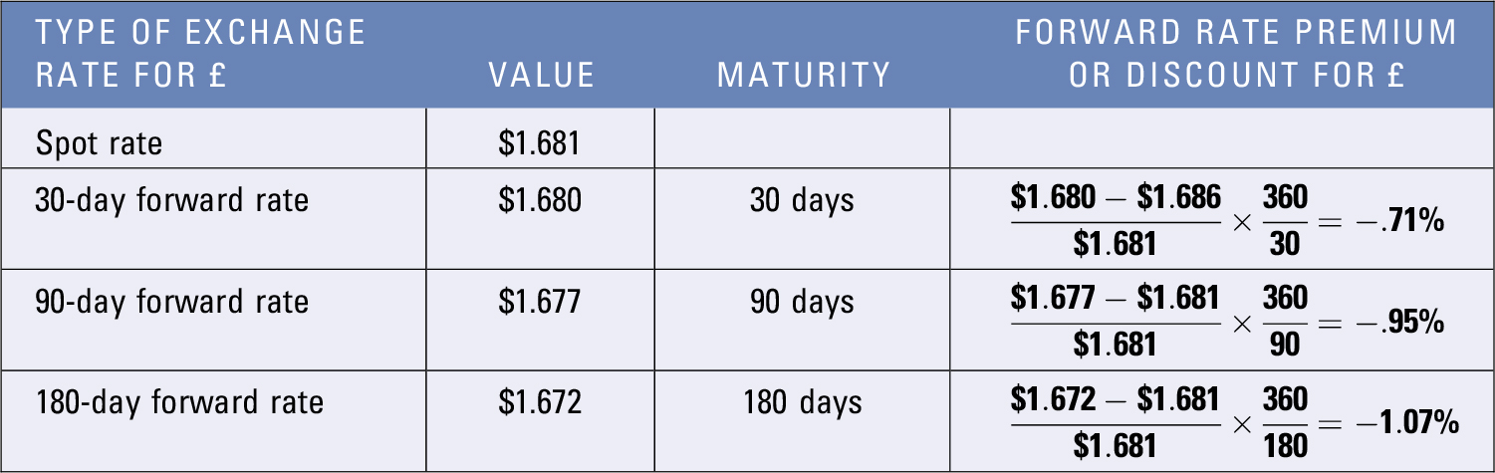
Exhibit 5.1 Computation of Forward Rate
Premiums or Discounts

Slide 8
Forward Market (4 of 4)
Movements in the Forward Rate over Time — The forward premium is influenced by the interest rate differential between the two countries and can change over time.
Offsetting a Forward Contract — An MNC can offset a forward contract by negotiating with the original counterparty bank.
Using Forward Contracts for Swap Transactions — Involves a spot transaction along with a corresponding forward contract that will ultimately reverse the spot transaction.
Non-deliverable forward contracts (NDF) — Can be used for emerging market currencies where no currency delivery takes place at settlement; instead, one party makes a payment to the other party.

Slide 9
Currency Futures Market (1 of 6)
Similar to forward contracts in terms of obligation to purchase or sell currency on a specific settlement date in the future.
Contract Specifications: Differ from forward contracts because futures have standard contract specifications:
  Standardized number of units per contract (See Exhibit 5.2)
  Offer greater liquidity than forward contracts
  Typically based on U.S. dollar, but may be offered on cross-rates
  Commonly traded on the Chicago Mercantile Exchange (CME)

Slide 10
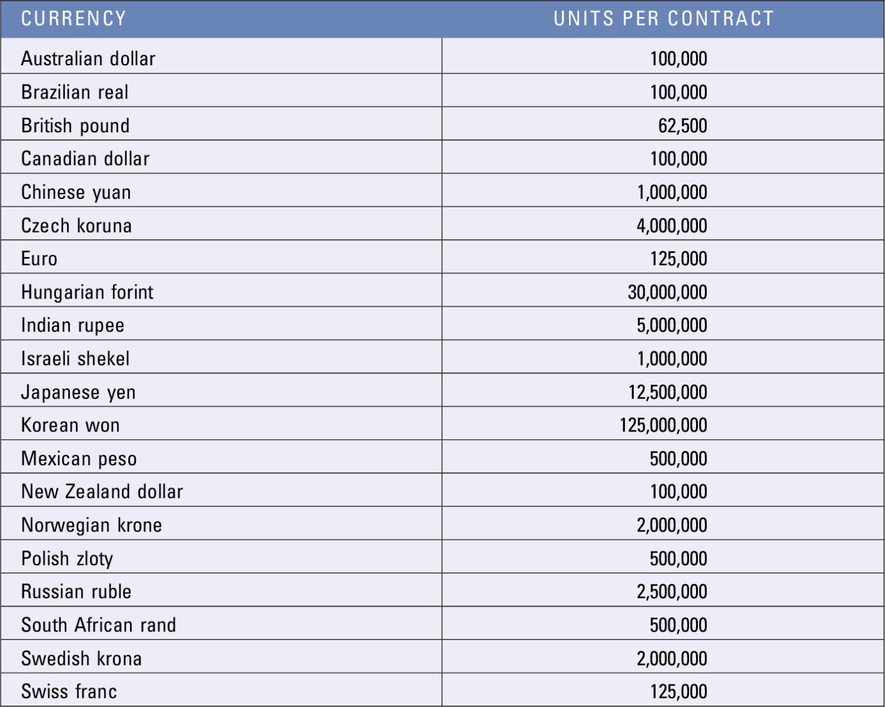
Exhibit 5.2 Currency Futures Contracts Traded on the Chicago Mercantile Exchange

Slide 11
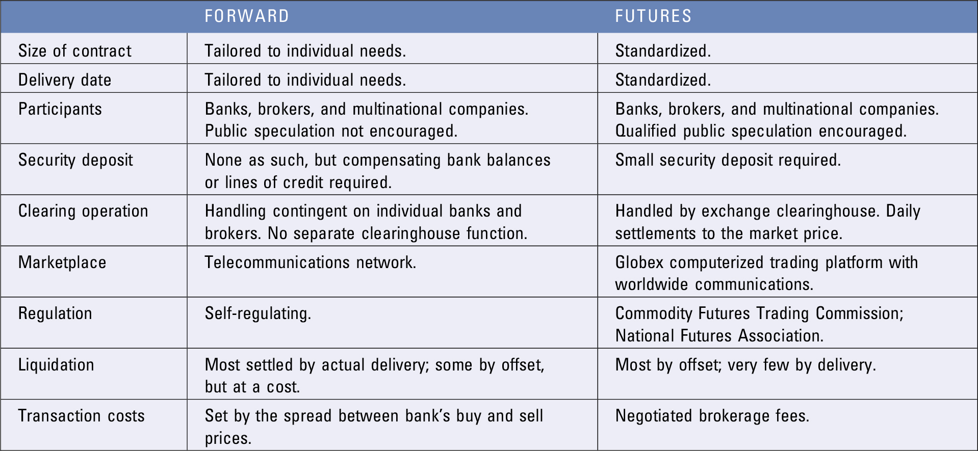
Exhibit 5.3 Comparison of the Forward and Futures Market

Slide 12
Currency Futures Market (2 of 6)
Trading Currency Futures
Firms or individuals can execute orders for currency futures contracts by calling brokerage firms.
Trading platforms for currency futures: Electronic trading platforms facilitate the trading of currency futures. These platforms serve as a broker, as they execute the trades desired.
Currency futures contracts are similar to forward contracts in that they allow a customer to lock in the exchange rate at which a specific currency is purchased or sold for a specific date in the future.

Slide 13
Currency Futures Market (3 of 6)
Comparing Futures to Forward Contracts
Currency futures contracts are similar to forward contracts in that they allow a customer to lock in the exchange rate at which a specific currency is purchased or sold for a specific date in the future. (Exhibit 5.3)
Pricing Currency Futures — The price of currency futures will be similar to the forward rate
Credit Risk of Currency Futures Contracts — To minimize its risk, the CME imposes margin requirements to cover fluctuations in the value of a contract, meaning that the participants must make a deposit with their respective brokerage firms when they take a position.

Slide 14
Currency Futures Market (4 of 6)
How Firms Use Currency Futures
Purchasing Futures to Hedge Payables — The purchase of futures contracts locks in the price at which a firm can purchase a currency.
Selling Futures to Hedge Receivables — The sale of futures contracts locks in the price at which a firm can sell a currency.
Closing Out a Futures Position (Exhibit 5.4)
  Sellers (buyers) of currency futures can close out their positions by buying (selling) identical futures contracts prior to settlement.
  Most currency futures contracts are closed out before the settlement date.

Slide 15
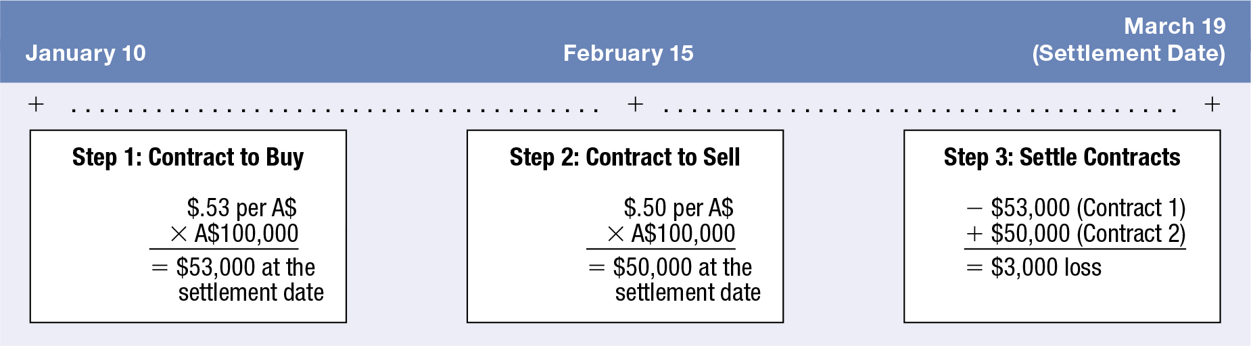
Exhibit 5.4 Closing Out a Futures Contract

Slide 16
Currency Futures Market (5 of 6)
Speculation with Currency Futures (Exhibit 5.5)
Currency futures contracts are sometimes purchased by speculators attempting to capitalize on their expectation of a currency’s future movement.
Currency futures are often sold by speculators who expect that the spot rate of a currency will be less than the rate at which they would be obligated to sell it.

Slide 17
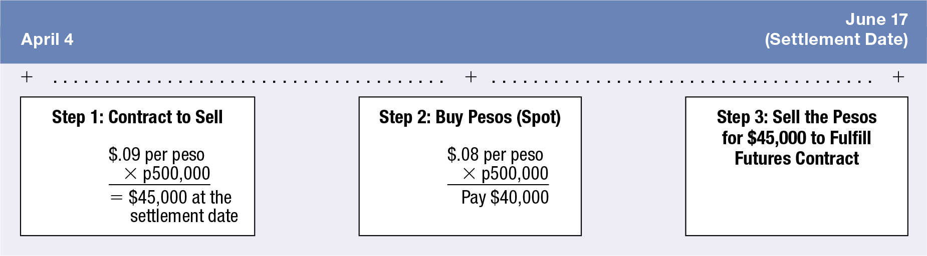
Exhibit 5.5 Source of Gains from Buying Currency Futures

Slide 18
Currency Futures Market (6 of 6)
Speculation with Currency Futures (cont.)
Efficiency of the currency futures market
  If the currency futures market is efficient, the futures price should reflect all available information.
  Thus, the continual use of a particular strategy to take positions in currency futures contracts should not lead to abnormal profits.
  Research has found that the currency futures market may be inefficient. However, the patterns are not necessarily observable until after they occur, which means that it may be difficult to consistently generate abnormal profits from speculating in currency futures.

Slide 19
Currency Call Options (1 of 5)
Grants the right to buy a specific currency at a designated strike price or exercise price within a specific period of time.
If the spot rate rises above the strike price, the owner of a call can exercise the right to buy currency at the strike price.
The buyer of the option pays a premium.
If the spot exchange rate is greater than the strike price, the option is in the money. If the spot rate is equal to the strike price, the option is at the money. If the spot rate is lower than the strike price, the option is out of the money.

Slide 20

Currency Call Options (2 of 5)
Factors Affecting Currency Call Option Premiums
The premium on a call option (C) is affected by three factors:
  Spot price relative to the strike price (S – X): The higher the spot rate relative to the strike price, the higher the option price will be.
  Length of time before expiration (T): The longer the time to expiration, the higher the option price will be.
  Potential variability of currency (σ): The greater the variability of the currency, the higher the probability that the spot rate can rise above the strike price.

Slide 21
Currency Call Options (3 of 5)
How Firms Use Currency Call Options
  Using call options to hedge payables
  Using call options to hedge project bidding to lock in the dollar cost of potential expenses
  Using call options to hedge target bidding of a possible acquisition
  Speculation

Slide 22
Currency Put Options (1 of 8)
Grants the right to sell a currency at a specified strike price or exercise price within a specified period of time.
If the spot rate falls below the strike price, the owner of a put can exercise the right to sell currency at the strike price.
The buyer of the options pays a premium.
If the spot exchange rate is lower than the strike price, the option is in the money. If the spot rate is equal to the strike price, the option is at the money. If the spot rate is greater than the strike price, the option is out of the money.

Slide 23

Currency Put Options (2 of 8)
Factors Affecting Put Option Premiums
Put option premiums are affected by three factors:
  Spot rate relative to the strike price (S–X): The lower the spot rate relative to the strike price, the higher the probability that the option will be exercised.
  Length of time until expiration (T): The longer the time to expiration, the greater the put option premium.
  Variability of the currency (σ): The greater the variability, the greater the probability that the option may be exercised.

Slide 24
SUMMARY (1 of 4)
A forward contract specifies a standard volume of a particular currency to be exchanged on a particular date. Such a contract can be purchased by a firm to hedge payables or sold by a firm to hedge receivables. A currency futures contract can be purchased by speculators who expect the currency to appreciate; it can also be sold by speculators who expect the currency to depreciate. If the currency depreciates then the futures contract declines, allowing those speculators to benefit when they close out their positions.

Slide 25
SUMMARY (2 of 4)
Futures contracts on a particular currency can be purchased by corporations that have payables in that currency and wish to hedge against the possible appreciation of that currency. Conversely, these contracts can be sold by corporations that have receivables in that currency and wish to hedge against the possible depreciation of that currency and wish to hedge against its possible depreciation.

Slide 26
SUMMARY (3 of 4)
Call options allow the right to purchase a specified currency at a specified exchange rate by a specified expiration date. They are used by MNCs to hedge future payables. They are commonly purchased by speculators who expect that the underlying currency will appreciate.
Put options allow the right to sell a specified currency at a specified exchange rate by a specified expiration date. They are used by MNCs to hedge future receivables. They are commonly purchased by speculators who expect that the underlying currency will depreciate.

Slide 27
SUMMARY (4 of 4)
Call options on a specific currency can be purchased by speculators who expect that currency to appreciate. Put options on a specific currency can be purchased by speculators who expect that currency to depreciate.

