Slide 1
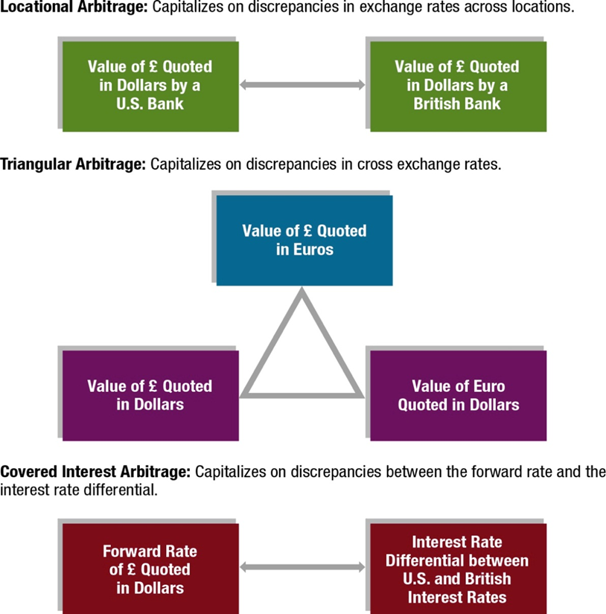
Exhibit 7.8 Comparing Arbitrage Strategies

Slide 2
Interest Rate Parity (3 of 6)
Determining the Forward Premium
Effect of the interest rate differential: The relationship between the forward premium (or discount) and the interest rate differential according to I R P is simplified in an approximated form:
where
p = forward premium (or discount)
F = forward rate in dollars
S = spot rate in dollars
i_{h} = home interest rate
i_{f} = foreign interest rate
Implications: If the forward premium is equal to the interest rate differential as just described, then covered interest arbitrage will not be feasible.

Slide 3
Interest Rate Parity (6 of 6)
Considerations When Assessing Interest Rate Parity
Transaction costs
  The actual point reflecting the interest rate differential and forward rate premium must be farther from the I R P line to make covered interest arbitrage worthwhile. (See Exhibit 7.10)
Political risk
  A crisis in the foreign country could cause its government to restrict any exchange of the local currency for other currencies.
Differential tax laws
  Covered interest arbitrage might be feasible when considering before-tax returns but not necessarily when considering after-tax returns.

Slide 4
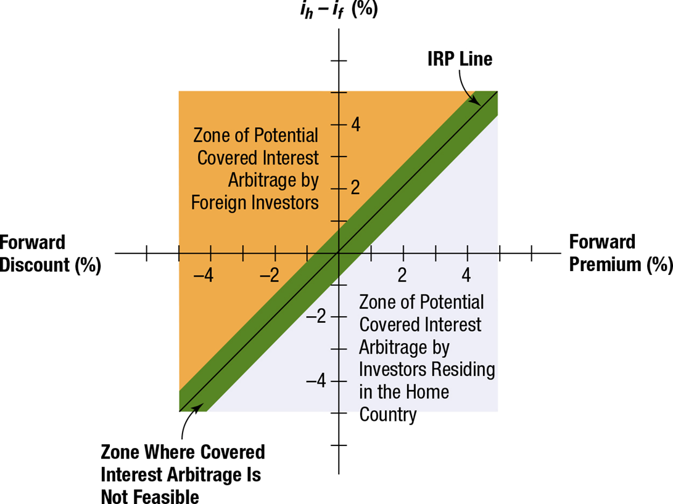
Exhibit 7.10 Potential for Covered Interest Arbitrage When Considering Transaction Costs

