Slide 1
Ch. 9 Forecasting Exchange Rates

Slide 2
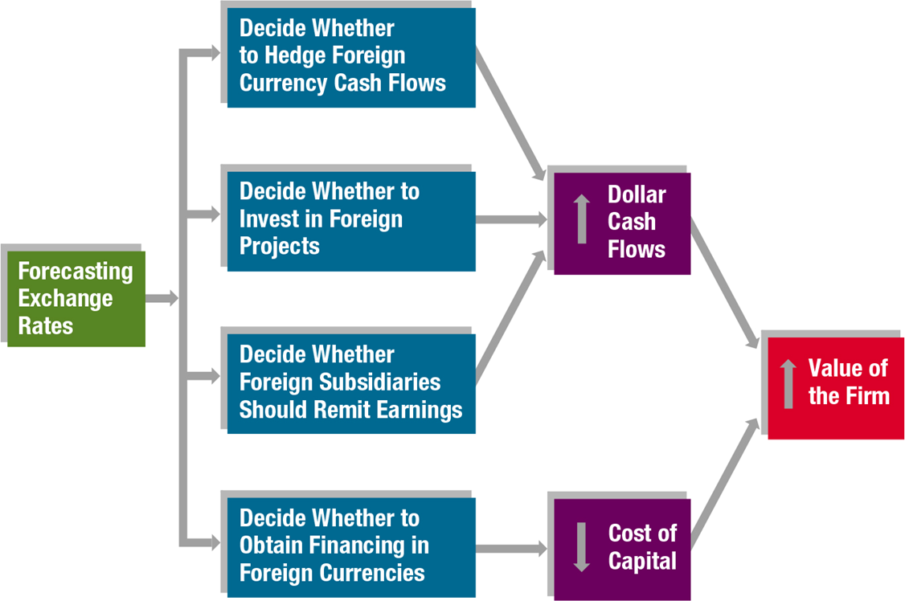
Why Firms Forecast Exchange Rates

Slide 3
Forecasting Techniques
Technical Forecasting
Fundamental Forecasting
Market-Based Forecasting
Mixed Forecasting

Slide 4
Technical Forecasting

Slide 5
Fundamental Forecasting

Slide 7
Market-Based Forecasting

Slide 8
Mixed Forecasting

Slide 9
Forecasts of the Mexican Peso Drawn from Each Forecasting Technique
FORECAST TECHNIQUE | FACTORS CONSIDERED | SITUATION | FORECAST
Technical | Recent movement in peso | The peso's value declined below a specific threshold level in the last few weeks. | The peso's value will continue to fall now that it is beyond the threshold level.
Fundamental | Economic growth, inflation, interest rates | Mexico's interest rates are high, and inflation should remain low. | The peso's value will rise as U.S. investors capitalize on the high interest rates by investing in Mexican securities.
Market-based | Spot rate, forward rate | The peso's forward rate exhibits a significant discount, which is attributed to Mexico's relatively high interest rates. | Based on the forward rate, which provides a forecast of the future spot rate, the peso's value will decline.

Slide 10
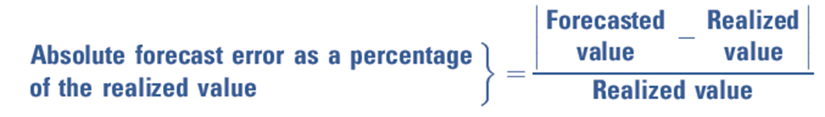
Assessment of Forecast Performance
Forecast Error among techniques
Forecast bias over time

Slide 11
Comparing Forecast Errors among Forecast Techniques
(1) | (2) | (3) | (4) | (5) | (6) | (7) = (5) − (6)
PERIOD | PREDICTED VALUE OF ZLOTY BY MODEL 1 | PREDICTED VALUE OF ZLOTY BY MODEL 2 | REALIZED VALUE OF ZLOTY | ABSOLUTE FORECAST ERROR USING MODEL 1 | ABSOLUTE FORECAST ERROR USING MODEL 2 | DIFFERENCE IN ABSOLUTE FORECAST ERRORS (MODEL 1 − MODEL 2)
1 | $.20 | $.24 | $.16 | $.04 | $.08 | $−.04
2 | .18 | .20 | .14 | .04 | .06 | −.02
3 | .24 | .20 | .16 | .08 | .04 | .04
4 | .26 | .20 | .22 | .04 | .02 | .02
5 | .30 | .18 | .28 | .02 | .10 | −.08
6 | .22 | .32 | .26 | .04 | .06 | −.02
7 | .16 | .20 | .14 | .02 | .06 | −.04
8 | .14 | .24 | .10 | .04 | .14 | −.10
 |  |  |  | Sum = .32 Mean = .04 | Sum = .56 Mean = .07 | Sum = −.24 Mean = −.03

Slide 12
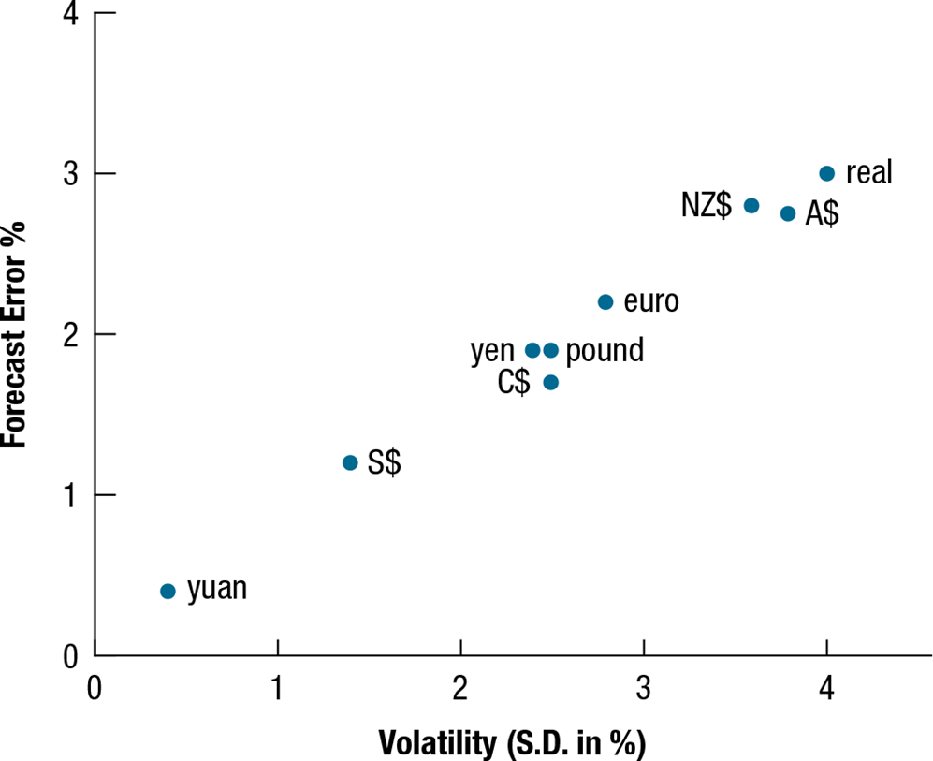
How the Forecast Error Is Affected by Volatility

Slide 13
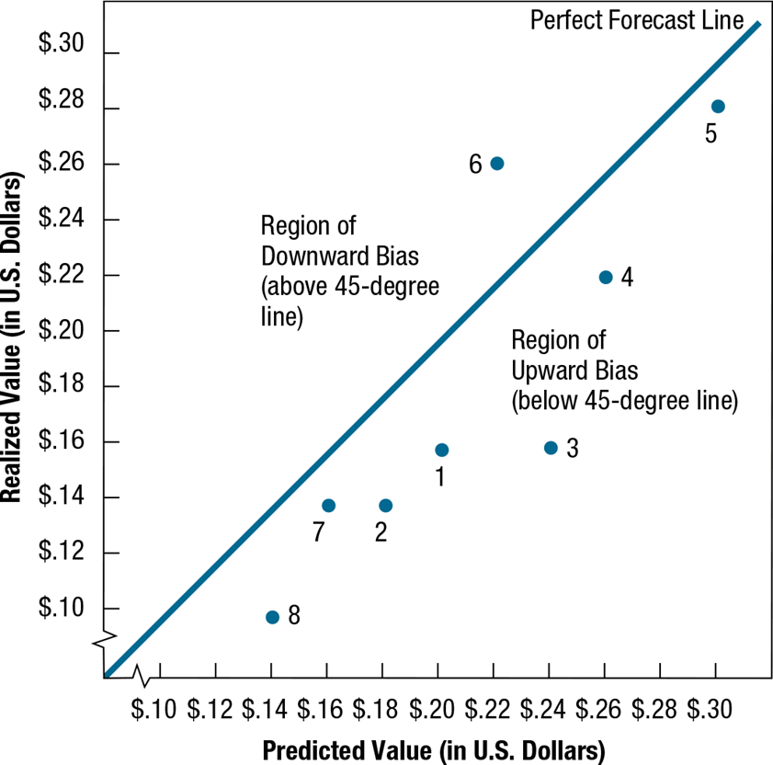
Evaluating Bias
Graphical analysis
Regression

