Slide 1

Article: How American Express Excel as a Data-Driven Culture
Chen yunyan
Associate data analyst – cohort 1

Slide 2

Table of Content
Introduction
Importance of Data
Building up Data Literate Culture
Conclusion
Q&A

Slide 3
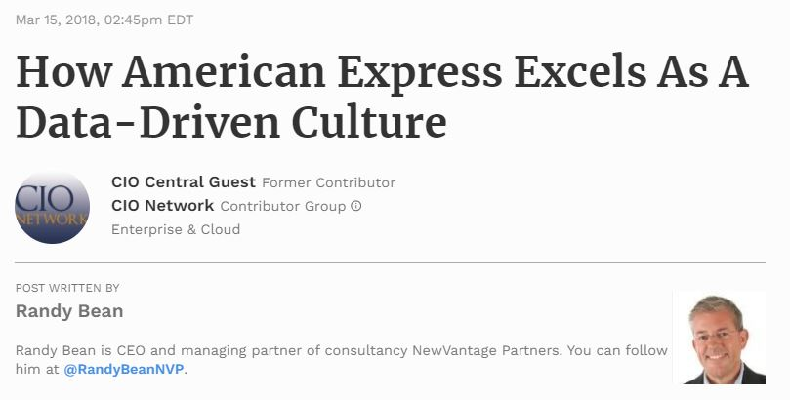

Introduction
American multinational financial services corporation.
best known for its charge card, credit card, and traveler's cheque businesses.
Ranks no. 67 on the Fortune 500 (2020)
$43 billion in revenues.

Slide 4

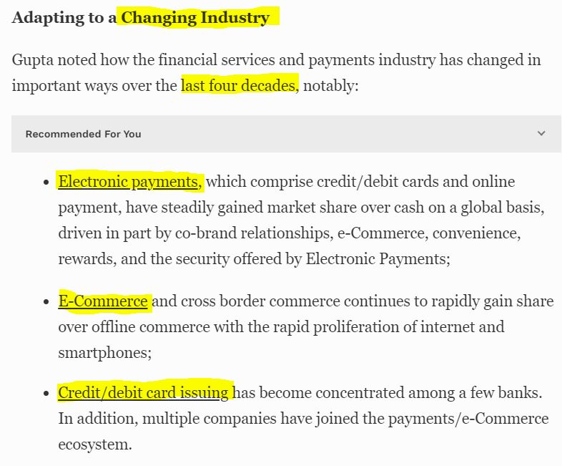
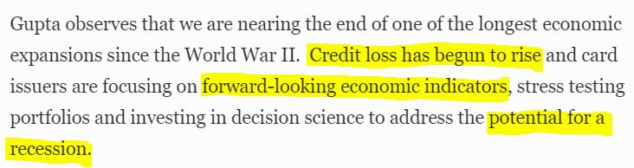
Importance of Data
Data Explosion due to changes in industry
Risk Detection for credit loss and potential of recession

Slide 5
Building up Data Literate Culture
Analytical skills
Statistical Methodologies
Data visualizations
Data fluency
Learning
Mentoring

Slide 6

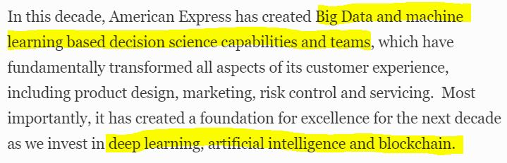
Analytical skills
Utilize and develop analytical thinking skills
Utilize proper problem-solving techniques
Example: Credit card detection and prevention – ML model

Slide 7

Statistical Methodologies
Utilize and embrace statistics within organization
Perform massively parallel processing (MPP)

Slide 8


Data Visualizations
Simplify data, enabling various skills-set to absorb and utilize data
Example: PREMIER INSIGHTS launch by American Express Global Business Travel

Slide 9

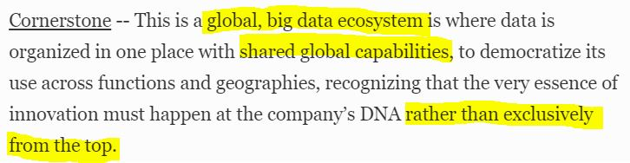
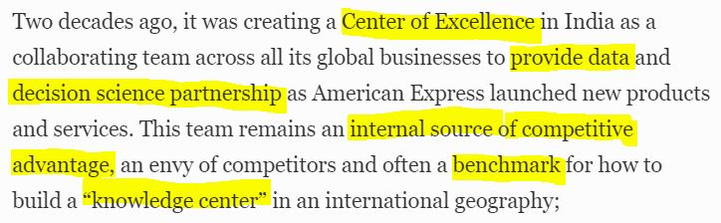
Data Fluency
Utilize the language, vocabulary, and conversational skills that go along with data literacy
Example: Center of Excellence in India

Slide 10

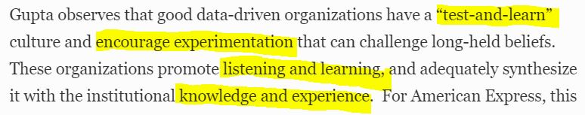
Learning
Establish a consistent learning cadence, studying and learning different areas of data and analytics

Slide 11

Mentoring
Allow those who have more data literacy skills to pass those skills on to other employees within the organisation

Slide 12
Conclusion
Shifting towards a data-driven organization requires a cultural change.
To become data-driven, the organization needs to focus more on data and start using data in their day-to-day activities.

Slide 13

Q & A session
Notes:
https://www.forbes.com/sites/ciocentral/2018/03/15/how-american-express-excels-as-a-data-driven-culture/#450d40ea1635

