Slide 1

Capstone Project 2: Zomato
Presented By: Chen Yunyan

Slide 2
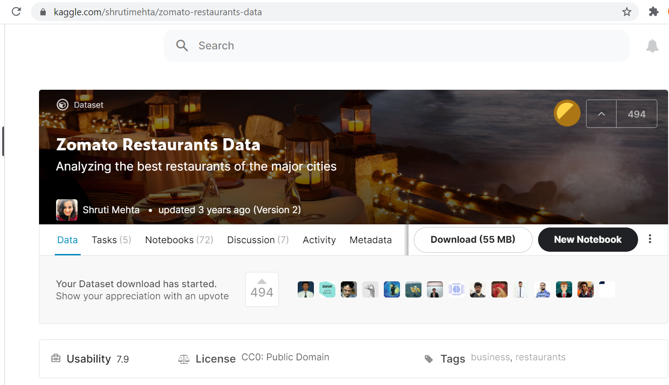
Data Source

Slide 3

Background
Data Analyst in Zomato, a global restaurant rating website & mobile application.
Exclusive Campaign Project which collaborates with the restaurants.
Looking for highly recommended restaurants.
Introduce discount offers for both dine-in and online delivery service to Zomato Pro Members.
Priority Delivery Benefits for Zomato Pro Members.

Slide 4
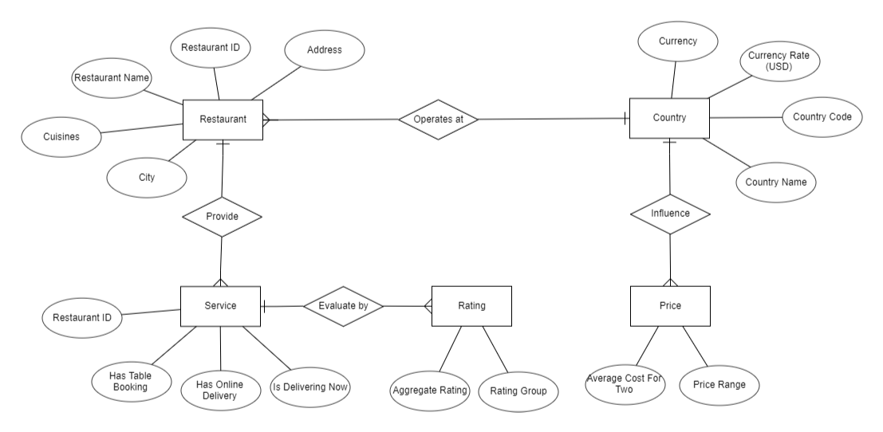
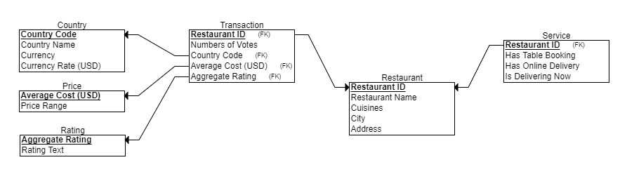
ER-Diagram & Schema

Slide 5
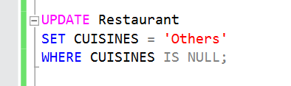
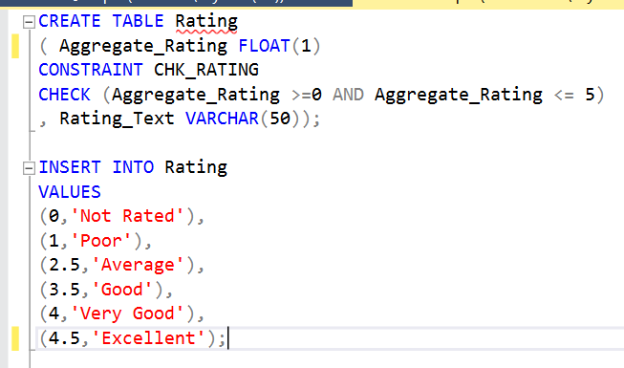
Data Preparation
Import flat file to MySQL
Remove Null
Create New Table

Slide 6
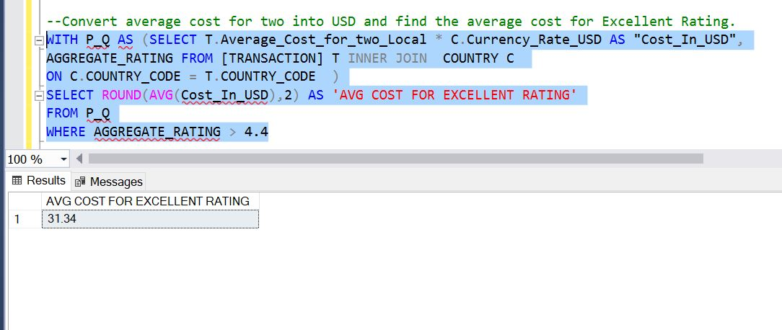
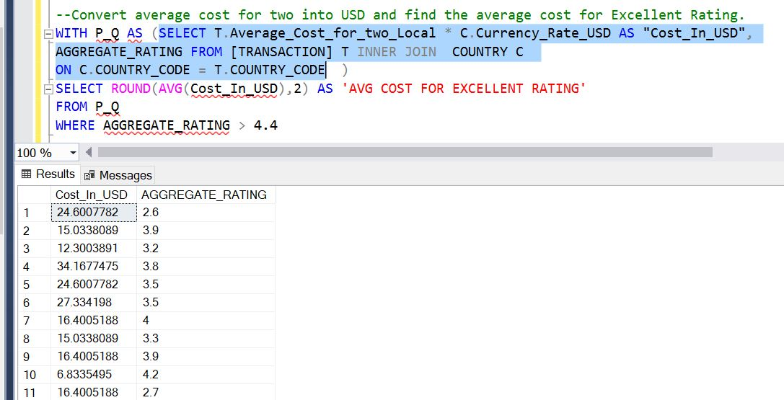
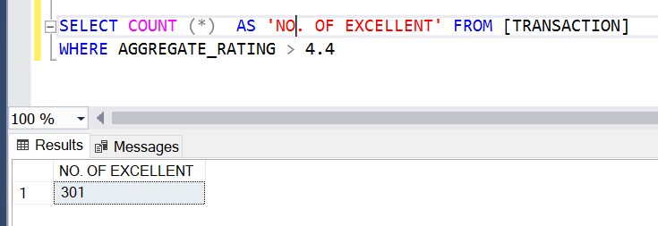
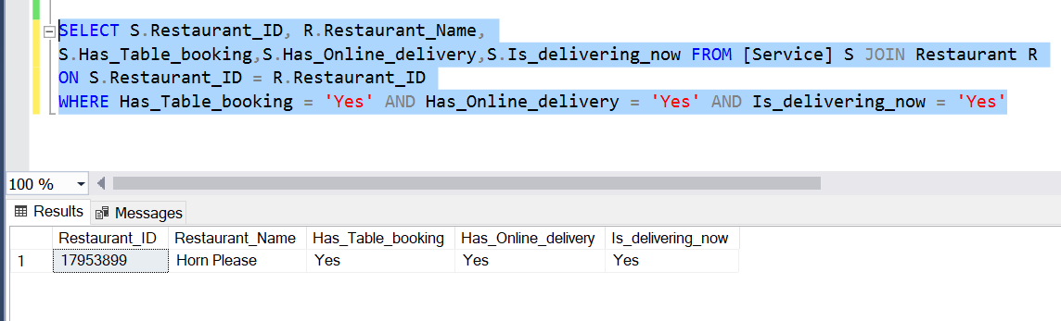
SQL

Slide 7
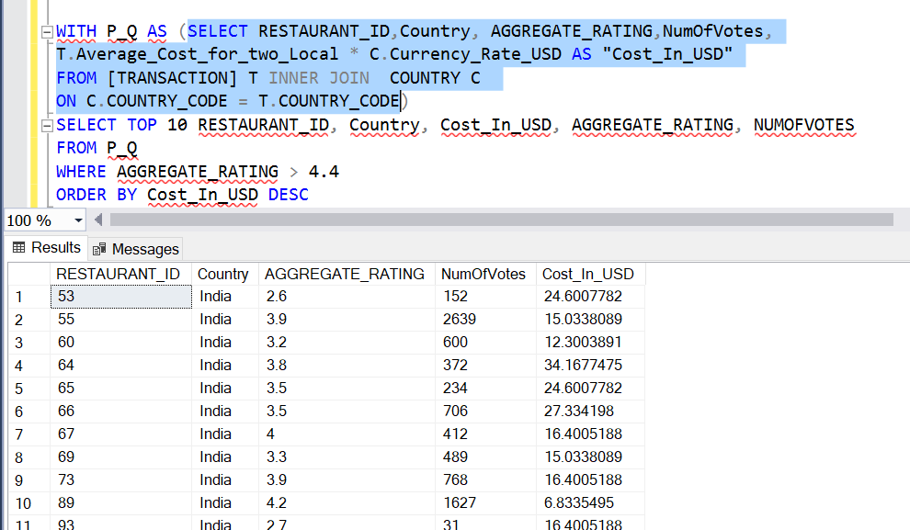
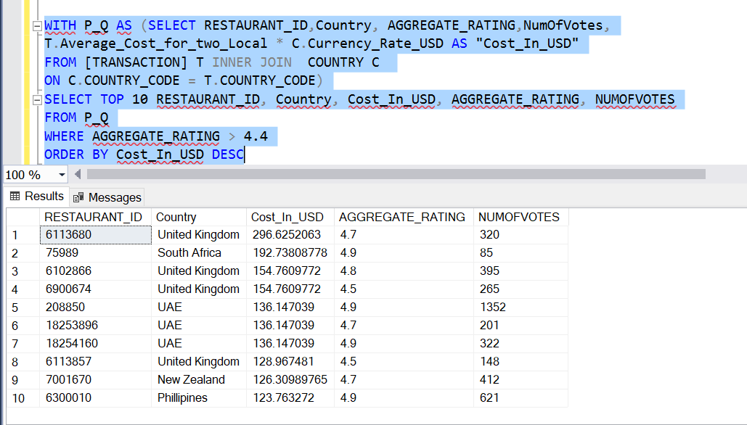
SQL--Convert average cost for two into USD and find the top 10 Restuarant for Excellent Rating with the highest cost.

Slide 8
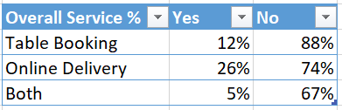
Excel

Slide 9
Recommendation
Country: UAE, United States, United Kingdom
Higher votes indicates higher number of active and satisfied user.
Higher average cost for two indicates the spending power of the customer and may bring in higher income in terms of advertisement fees.
Delivery Priority Benefit may not be so attractive as many of the restaurants do not have online delivery service yet.

Slide 10

Thank You!

