Slide 1

COVID-19 Visualization
data-visualization-project
Group 1
URL: https://oss.raynor.top

Slide 2
Why we do that?
For changing dates
For more accurate location
For visualization needs
We want to find an EPIDEMIC map which can choose dates flexibly which satisfy our own needs.
We want to find an EPIDEMIC map which can be accurate to the specified city.
We also need some Visualization needs:zoom,color,search,even an API for COVID-19 Data.

Slide 3
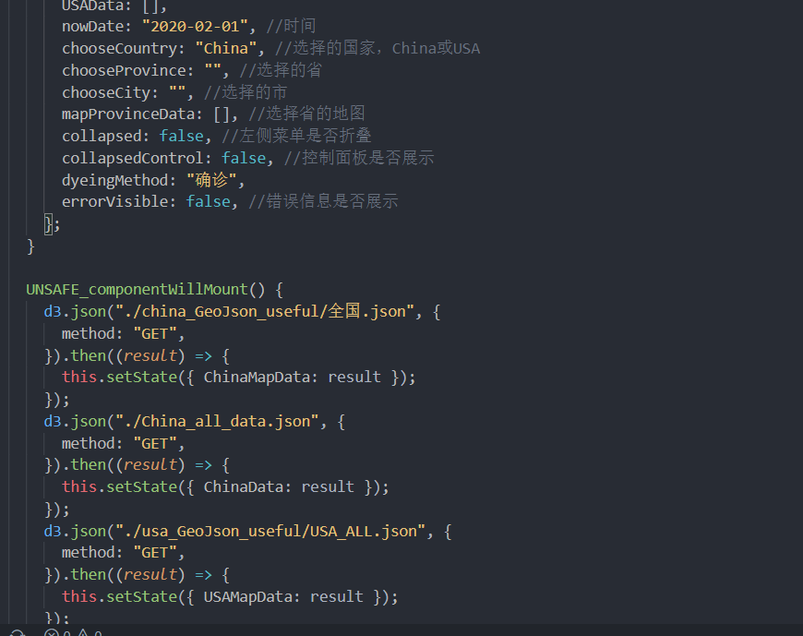
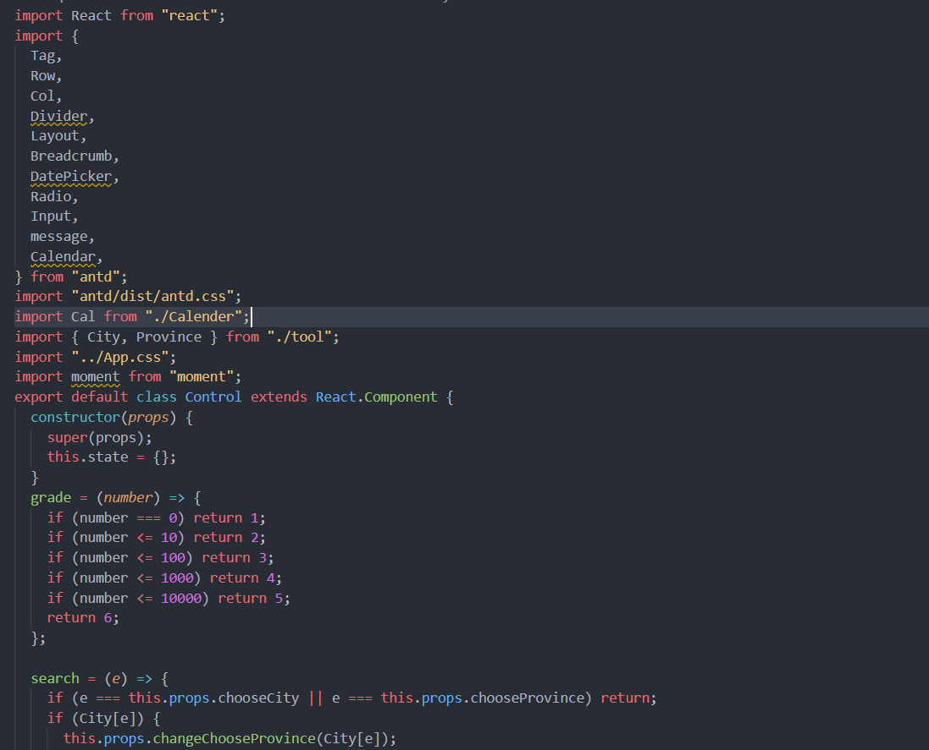
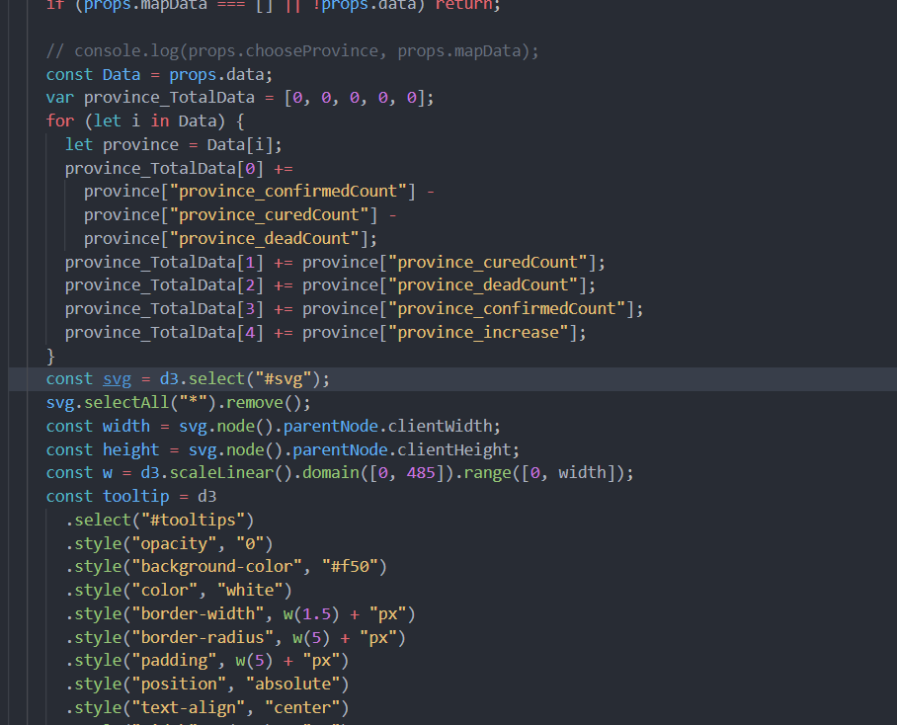
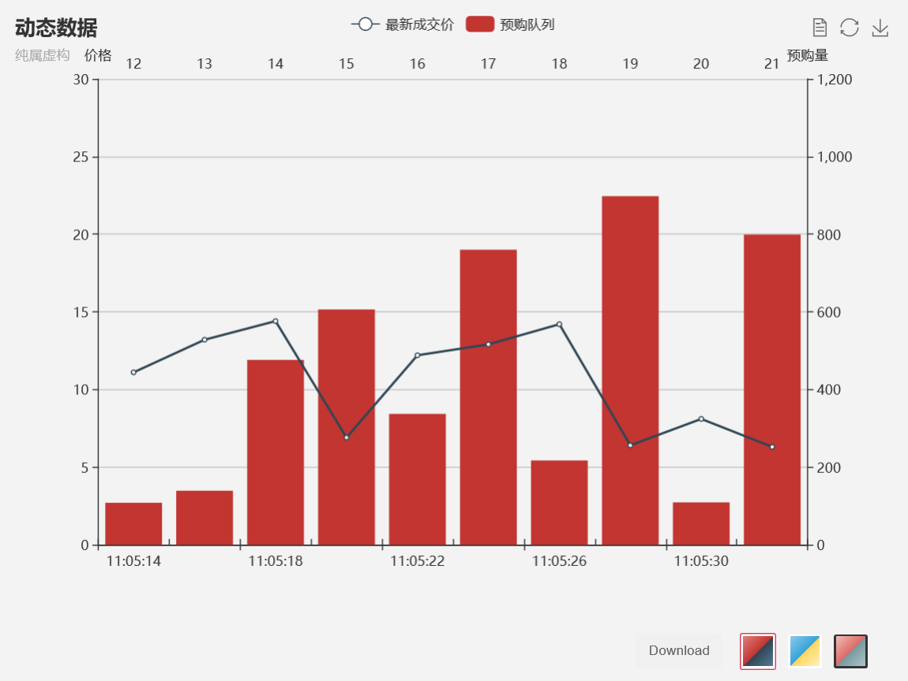
About our project
some of our dependent libraries:
React
Antd
A JavaScript library for building user interfaces
A design system for enterprise-level products
D3.js
Echarts
Manipulating documents based on data
A JavaScript library for data-visulization

Slide 4

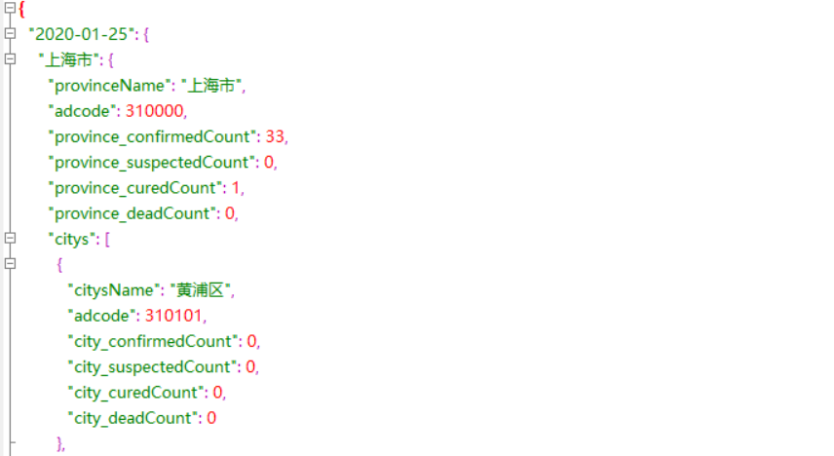
About data
•From github
.
•CSV to JSON
•Accurate to the city.
•China:https://oss.raynor.top/China_all_data.json
•USA: https://oss.raynor.top/USA_all_data.json

Slide 5
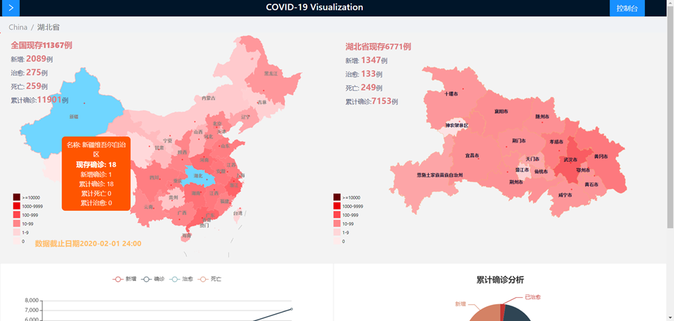
Project show

Slide 6
INSIGHT
中国：疫情什么时候基本控制？什么时候完全受控
2月3日到2月19日疫情增速极快--why？ 2-20日疫情大转折---why？ 外省死亡率低？
美国：fake news！ 3.16-4.18日 一个月迅速 70万 5月1日全面复工后新增速度没变，可能防护做的太好了 5.30日 累计170万 死亡10万 7月10日 累计317万 死亡12.6万 什么时候结束：？

Slide 7
TeamWork
： d3.js绘制疫情地图 数据搜集清洗 34%
： React设计整体框架、搭建 33%
： echarts图表绘制整理 33%

Slide 8
谢谢欣赏

