Slide 1
CE/CZ4153 Tutorial dApp Development Workshop
Zhang Chengxuan
chengxua001@e.ntu.edu.sg
2025.9.10

Slide 2
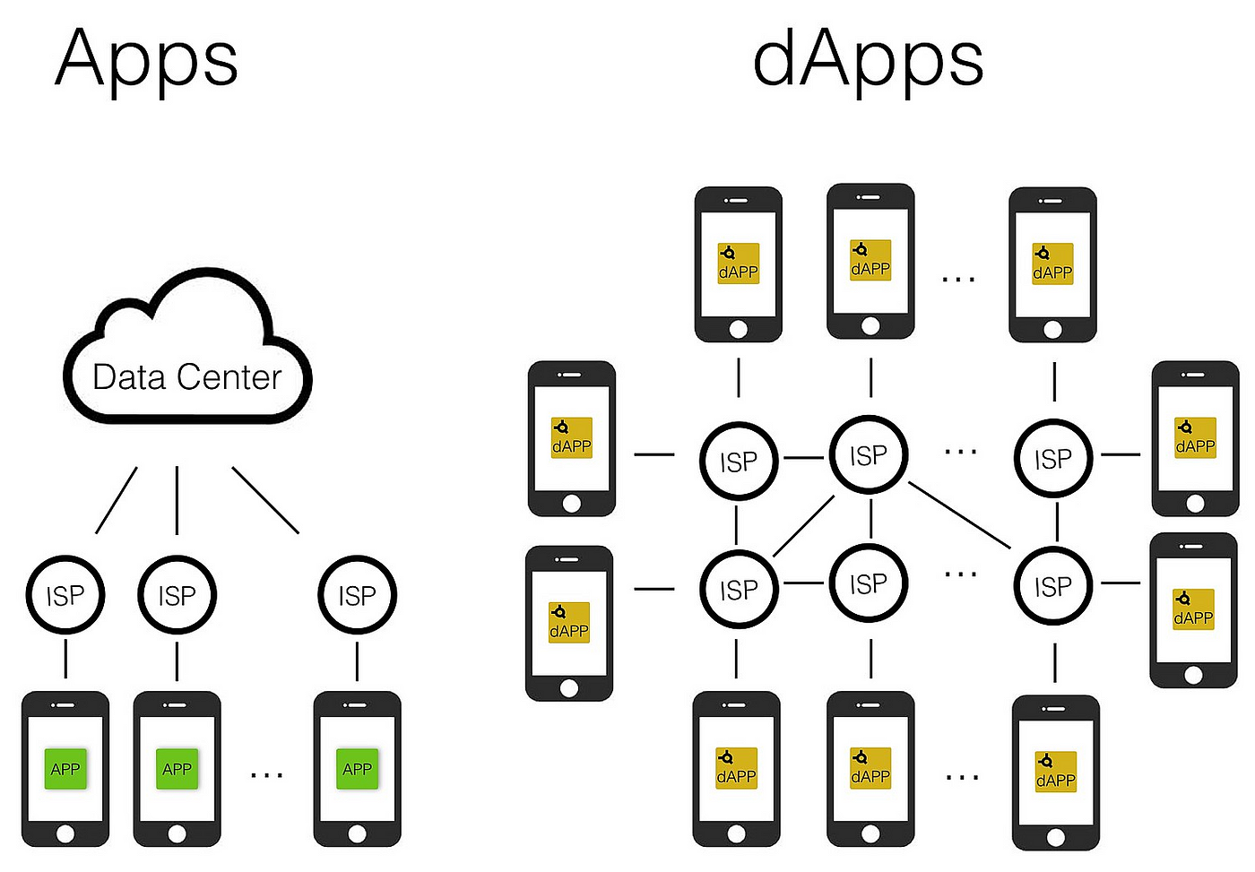
What is dApp?
Decentralized applications powered by blockchain.
Source: https://towardsdatascience.com/what-is-a-dapp-a455ac5f7def
Notes:
ISP: Internet Service Provider
On the left side, for traditional Apps, the ISP provides access to a centralized Data Center that hosts the app's data and functionalities.
On the right side, for dApps (decentralized applications), the ISP provides access to a decentralized network where the app's data and functionalities are distributed across multiple nodes, rather than being hosted in a central server.
This decentralized structure is a key feature of dApps.

Slide 3
Why developing dApp? Reliable Service
Traditional Network Applications
C/S Architecture, e.g., Zoom desktop App.
B/S Architecture, e.g., www.ntu.edu.sg
Issue: distributed/centralized server may crash sometimes
Blockchains like Bitcoin or Ethereum have seamlessly worked for many years without any crash issue.
Notes:
C/S: Client-server
B/S: Browser-server

Slide 4
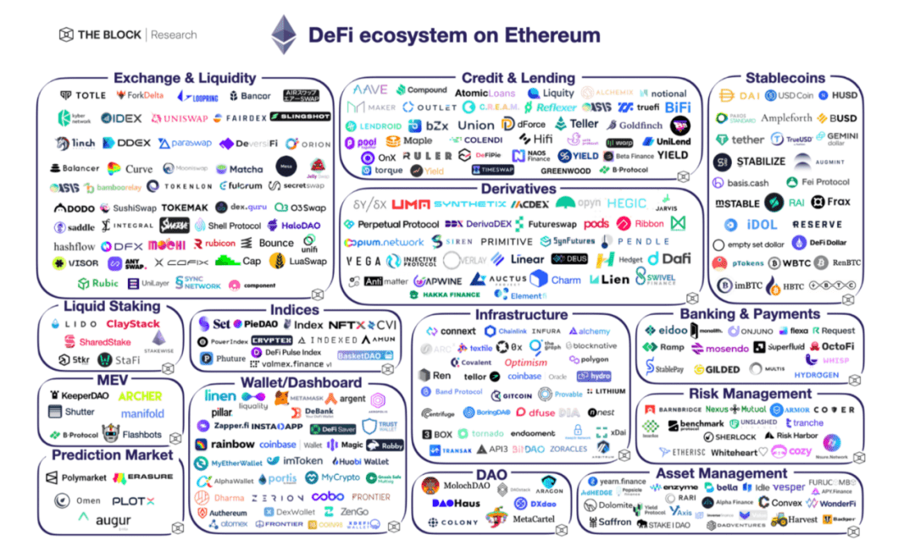
Why developing dApp? New Opportunities!
Blockchain is a network for value exchange among users.
Source: https://www.btcfans.com/en-us/article/72488
Notes:
Source: 2022-DeFi, Web 3, NFT / Gaming and Multi-Channel Perspectives_Btcfans

Slide 5
How to develop a dApp?
dApp = Smart contracts + Javascript/HTML
Backend - Smart contracts implement business logic and are run on one or many blockchains.
Frontend - Javascript / HTML implements the UI of the dApp and communicates with smart contracts through sending blockchain transactions.

Slide 6
Lock dApp
Lock a certain amount of money with a given timestamp.
In the future, users can withdraw their money back.
Moreover, the owner can unlock the money if they want.

Slide 7
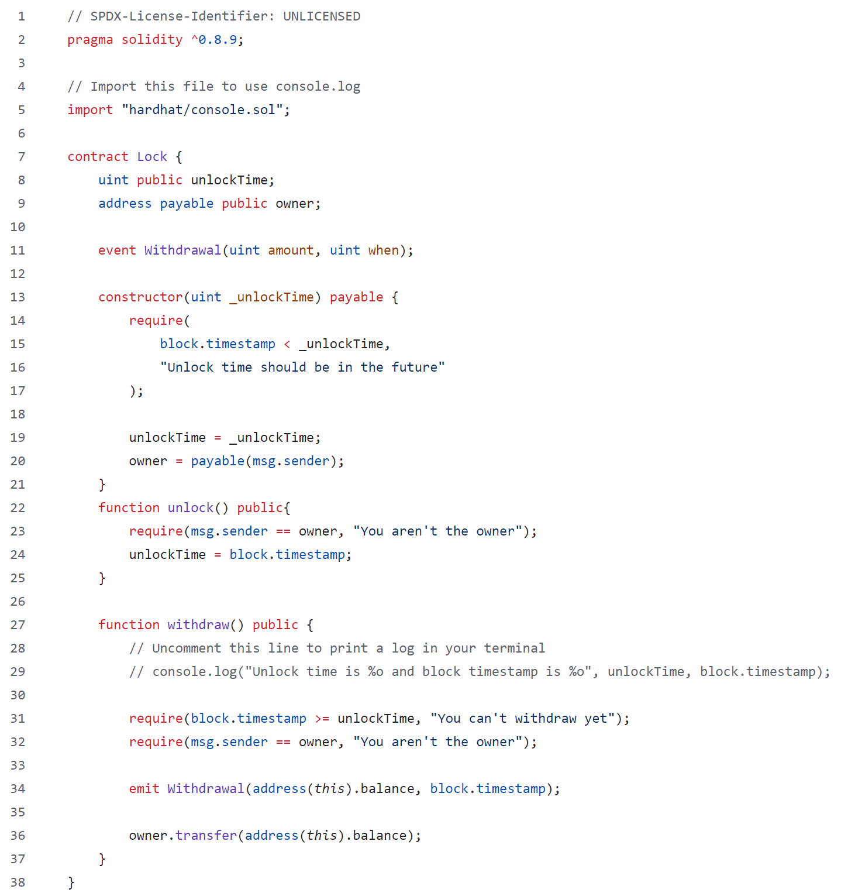
Lock dApp

Slide 8
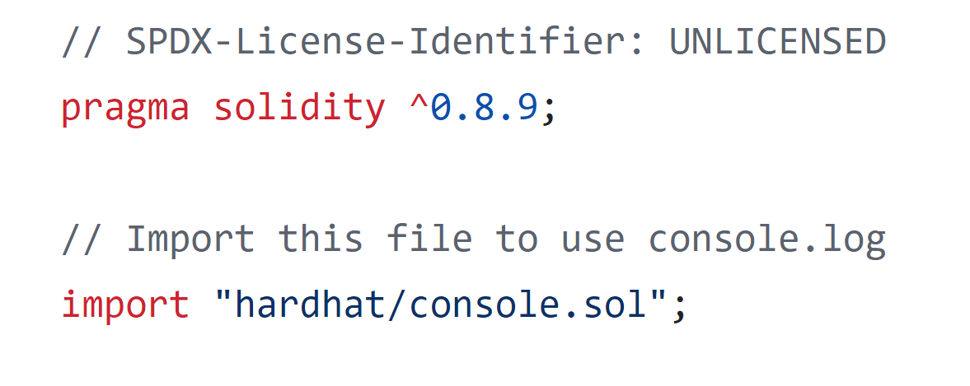
Lock dApp
Solidity Version Later than 0.8.9
Import External Library

Slide 9
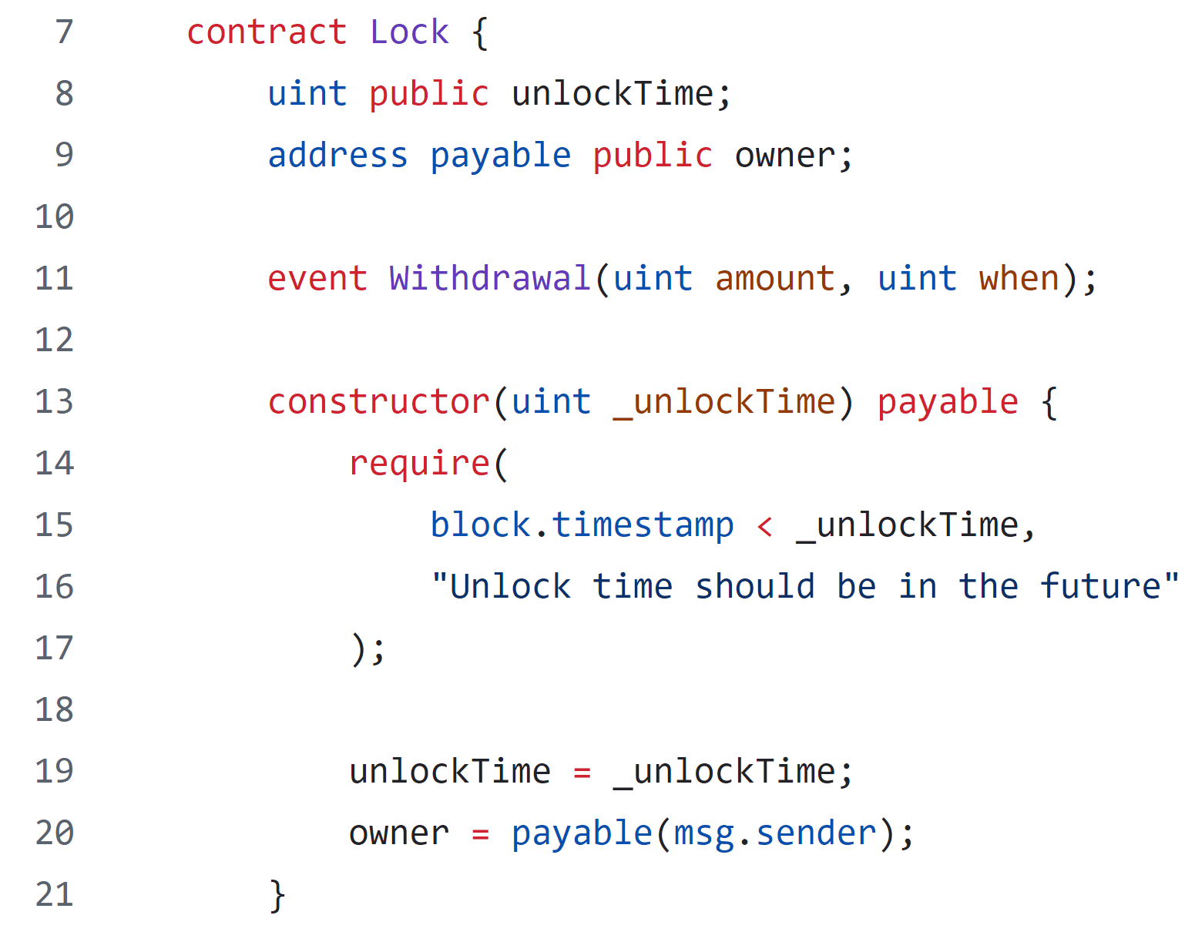
Lock dApp
Contract Name: Lock
Variable Declarations
Event Declaration
Condition Checking

Slide 10
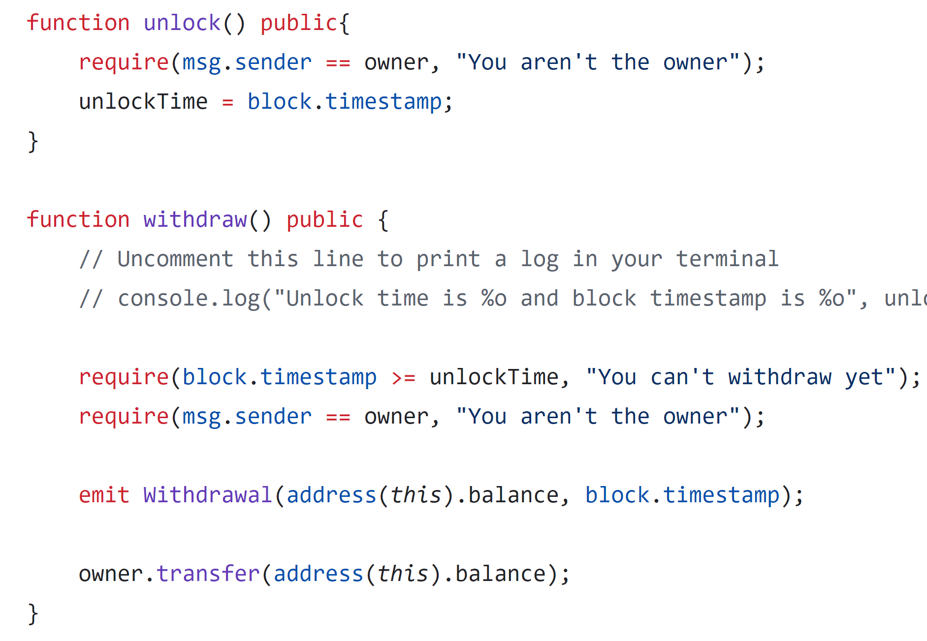
Lock dApp
Condition Checking
Condition Checking
Emit Event
Transfer Token Balance

Slide 11
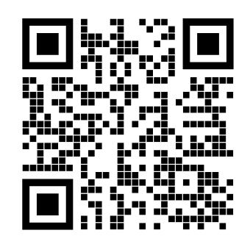
Let’s try to run it!!
https://github.com/BlockchainCourseNTU/hello-dapp

Slide 12
Vote dApp
Allows creation of multiple elections with a defined duration and admin control.
Admin registers constituencies, voters, and candidates, ensuring no self-registration.
Voters cast a single vote for candidates within their constituency.
Admin closes the election after the set duration, ending voting.
Tracks and displays votes for each candidate by constituency.

Slide 13
Vote dApp
Election Factory
createElection(_durationInMinutes, _electionName)
Election 1
Election 2
Election 3
Election 4
… …

Slide 14
Variables
admin
electionName
electionStatus
electionDuration
votersList
voterExist
voterData
candidateList
candidateExist
candidateData
consituencyList
consituencyExist
consituencyData
Functions
Election
Add
addConsituency
addCandidate
addVoter
Get
getCandidatesIdList
getConsituencyCandidates
getCandidateConsituency
getConsituencyIdList
getVotersIdList
getConsituencyVoters
getVoterConsituency
Vote
castVote
getVotes
Close
closeElection
Structs
Voter
voterId
name
email
phoneNo
consituencyId
age
voted
Candidate
candidateId
name
email
phoneNo
consituencyId
party
Consituency
consituencyId
name
candidates
voters
votes (mapping of address to uint)
winner
https://github.com/schadokar/election-ethereum-react-dapp/blob/master/ethereum/contracts/election.sol

Slide 15
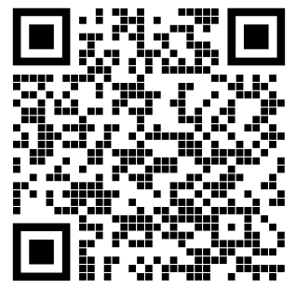
Let’s try to run it!!
https://github.com/schadokar/election-ethereum-react-dapp

Slide 16
60-minute session map
00–09
09–23
23–37
37–54
54–60
dApp foundations
Lock and MetaMask
Election frontend/backend
Tokenization
Questions
Pre-class: install dependencies, add the local MetaMask network, and run all checks.
NANYANG TECHNOLOGICAL UNIVERSITY | SINGAPORE
16
Notes:
Use this slide to set expectations. Foundations 9 minutes; Lock 14; Election 14; Tokenization 17; startup recap and questions 6. Installation happens before class.

Slide 17
Three transaction paths
LOCK
ELECTION
TOKENIZATION
React + MetaMask
React + Express
Next.js + wallet
User sees and approves each write
Server chooses and signs
Burner wallet or MetaMask signs
Ask four questions: where is the key, who signs, what reaches RPC, and what becomes contract state?
NANYANG TECHNOLOGICAL UNIVERSITY | SINGAPORE
17
Notes:
Compare the signer in every demo. Lock: MetaMask signs. Election: the Express server signs with an unlocked Ganache account. Tokenization: a local burner wallet or MetaMask signs. The signer location changes the trust model.

Slide 18
Lock frontend, wallet and contract
Original React UI
MetaMask
Ganache RPC
Lock.sol
Builds deployment and method requests
Holds the key and asks the user to sign
Local chain 31337 mines the transaction
Stores owner, unlock time and ETH
Reads show state without mining. Deploy, unlock and withdraw each create a wallet confirmation and a receipt.
NANYANG TECHNOLOGICAL UNIVERSITY | SINGAPORE
18
Notes:
Trace the original React frontend through the EIP-1193 provider to MetaMask, then Ganache and Lock.sol. The frontend builds the request. MetaMask holds the key, displays the confirmation, and signs. Ganache mines the transaction.

Slide 19
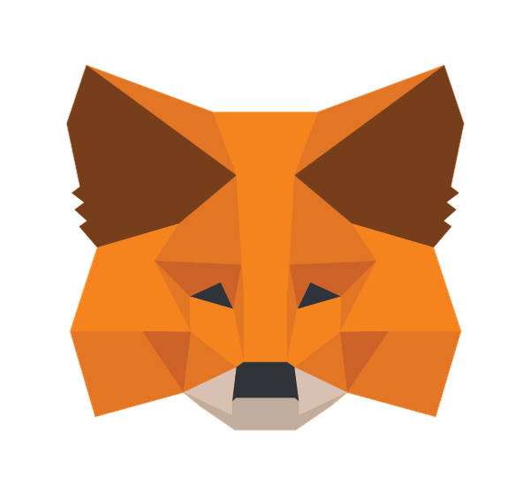
Lock live demo with MetaMask
1 Connect to Localhost 8545, chain ID 31337
2 Deploy with a future UTC time and small wei value
3 Confirm owner unlock and withdrawal
4 Verify the contract balance becomes zero
Every write has two visible stages: wallet approval and mined confirmation.
NANYANG TECHNOLOGICAL UNIVERSITY | SINGAPORE
19
Notes:
Run ./run-lock.command. Add http://127.0.0.1:8545 with chain ID 31337 in MetaMask and import the printed disposable key. Connect, deploy with a near future UTC time, unlock as owner, and withdraw. Never use real funds or reuse this development key.

Slide 20
Election frontend and backend
Original React UI
Express API
Server Web3
Election contracts
Forms and route navigation
Validates HTTP input and selects actions
Uses an unlocked local account
Factory plus per-election state
The student does not approve a wallet prompt. The backend chooses the sender and signs the transaction.
NANYANG TECHNOLOGICAL UNIVERSITY | SINGAPORE
20
Notes:
The original browser sends HTTP JSON to Express on port 4000. Express uses Web3 and an unlocked Ganache account to sign. Election state lives in the factory and election contracts. This classroom design adds a trusted backend between the student and the chain.

Slide 21
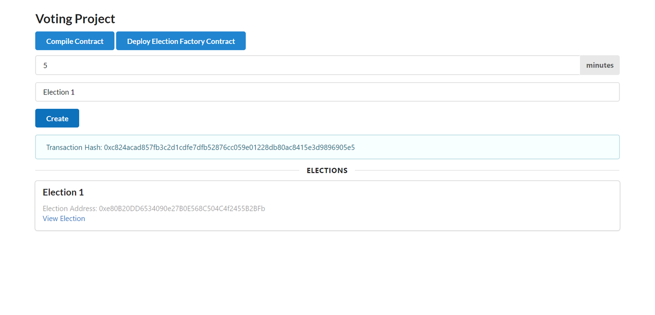
Election original UI demo
Create an election
Open its contract address
Add a constituency
Trace React → Express → Web3 → contract
Discuss the trust boundary: Express signs.
NANYANG TECHNOLOGICAL UNIVERSITY | SINGAPORE
21
Notes:
Run ./run-election.command. Create an election through the original form, open the returned election address, and add a constituency. Show one React component, its Express route, and the corresponding contract method. Source: https://github.com/schadokar/election-ethereum-react-dapp commit 14d44375056819f20296691c73adf642f54d6819.

Slide 22
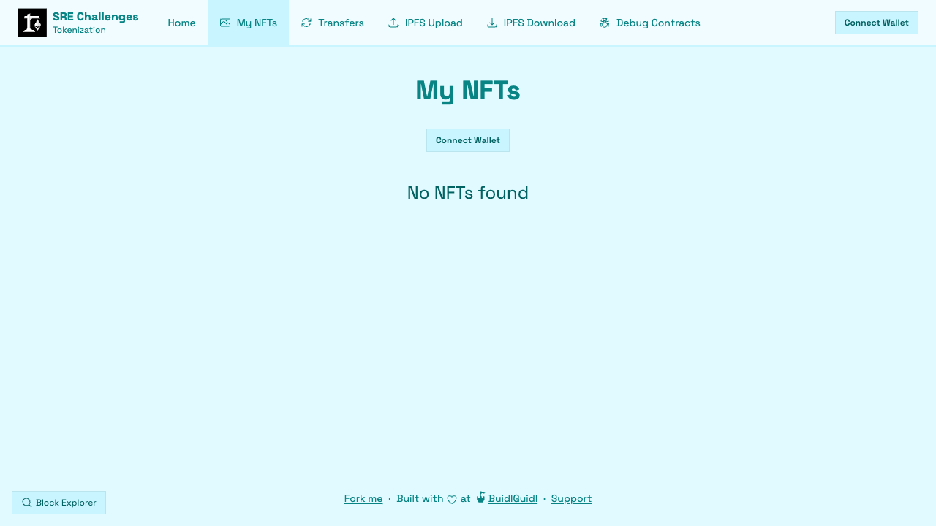
Project 3: Scaffold-ETH 2 Tokenization
Official teaching project
Next.js + RainbowKit + wagmi
Hardhat + OpenZeppelin ERC-721
Minting, transfers, events and IPFS exercises
Maintained tests and Debug Contracts
Upstream challenge, not a workshop-only contract
NANYANG TECHNOLOGICAL UNIVERSITY | SINGAPORE
22
Notes:
This is the official Scaffold-ETH 2 SpeedRunEthereum challenge-tokenization extension generated with create-eth 2.0.23. Challenge source commit: ecc5ac0a774fd0e7400babe800c01d6525a5b827. License: MIT, BuidlGuidl. Source: https://github.com/scaffold-eth/se-2-challenges/tree/challenge-tokenization.

Slide 23
Tokenization frontend and onchain evidence
Next.js UI
Wallet
ERC-721
Metadata
Holdings, mint and transfer pages
Burner account or MetaMask
ownerOf, balanceOf and Transfer
tokenURI, JSON and media
Ownership is verified onchain. The description and image can live elsewhere.
For a real-world asset, define who issues the token and what legal right it represents.
NANYANG TECHNOLOGICAL UNIVERSITY | SINGAPORE
23
Notes:
Trace Next.js through wagmi and the selected wallet to Hardhat and the ERC-721 contract. ownerOf(tokenId) is the onchain ownership fact. tokenURI points to metadata, and metadata points to media. A real-world legal claim requires a separate issuer and legal framework. Source: official challenge README and OpenZeppelin ERC-721 implementation included in the project.

Slide 24
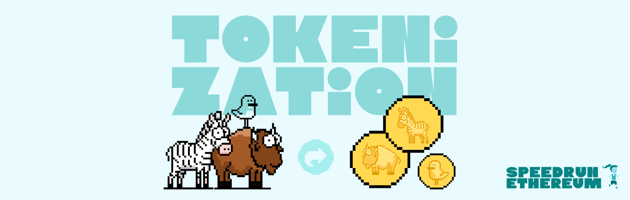
Mint, transfer and explain the evidence
1
MINT
A transaction creates token #n
2
TRANSFER
Ownership moves to the second address
3
VERIFY
ownerOf and Transfer event agree
The screen, contract read and event history explain the same ownership change.
NANYANG TECHNOLOGICAL UNIVERSITY | SINGAPORE
24
Notes:
Run ./run-tokenization.command. Use the burner wallet for speed or MetaMask for a persistent wallet. Mint an NFT, copy a second address from an incognito window, transfer the token, then verify the receiving wallet, ownerOf(tokenId), and the Transfer event. Source: official Scaffold-ETH 2 Tokenization challenge README.

Slide 25
One-command local stack
./run-lock.command
Ganache + original React
MetaMask signs
./run-election.command
Ganache + Express + original React
Server Web3 signs
./run-tokenization.command
Hardhat + official Next.js
Burner wallet or MetaMask signs
First install happens before class. Ctrl+C stops the complete stack and the next run creates a fresh chain.
NANYANG TECHNOLOGICAL UNIVERSITY | SINGAPORE
25
Notes:
Each launcher installs pinned dependencies on first run, starts a local chain, deploys the project contracts, starts required frontend/backend processes, waits for readiness, and opens the browser. Run only one at a time because the projects share ports 3000 and 8545.

Slide 26
Architecture comparison and questions
LOCK
ELECTION
TOKENIZATION
User-controlled key
MetaMask confirmation
Trusted server key
No browser approval
Burner or MetaMask
Ownership plus metadata
Who holds the key? What does the user approve? Which evidence proves the final state?
NANYANG TECHNOLOGICAL UNIVERSITY | SINGAPORE
26
Notes:
Close by asking students to name the signer and trust boundary in each project. Revisit onchain state versus UI state and NFT metadata. Suggested questions: Which architecture would you use for a public app? What must a backend still provide? What does ownerOf prove, and what does it not prove?

