Slide 1
CE/CZ4153 Tutorial dApp Development Workshop
Zhang Chengxuan
chengxua001@e.ntu.edu.sg
2025.9.10

Slide 2
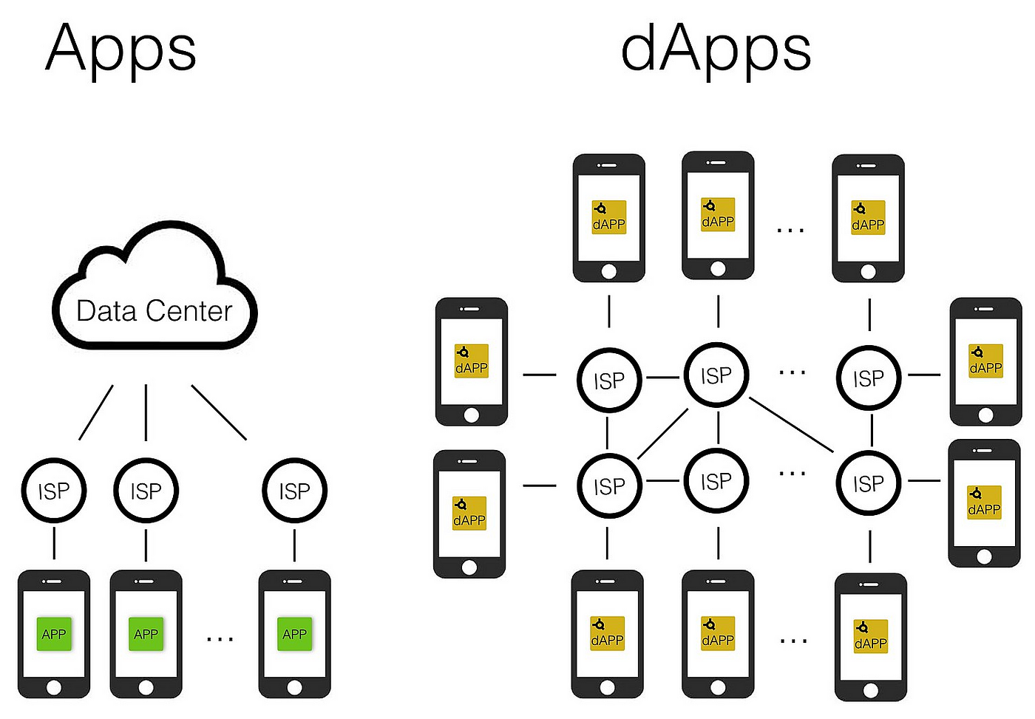
What is dApp?
Decentralized applications powered by blockchain.
Source: https://towardsdatascience.com/what-is-a-dapp-a455ac5f7def
Notes:
ISP: Internet Service Provider
On the left side, for traditional Apps, the ISP provides access to a centralized Data Center that hosts the app's data and functionalities.
On the right side, for dApps (decentralized applications), the ISP provides access to a decentralized network where the app's data and functionalities are distributed across multiple nodes, rather than being hosted in a central server.
This decentralized structure is a key feature of dApps.

Slide 3
Why developing dApp? Reliable Service
Traditional Network Applications
C/S Architecture, e.g., Zoom desktop App.
B/S Architecture, e.g., www.ntu.edu.sg
Issue: distributed/centralized server may crash sometimes
Blockchains like Bitcoin or Ethereum have seamlessly worked for many years without any crash issue.
Notes:
C/S: Client-server
B/S: Browser-server

Slide 4
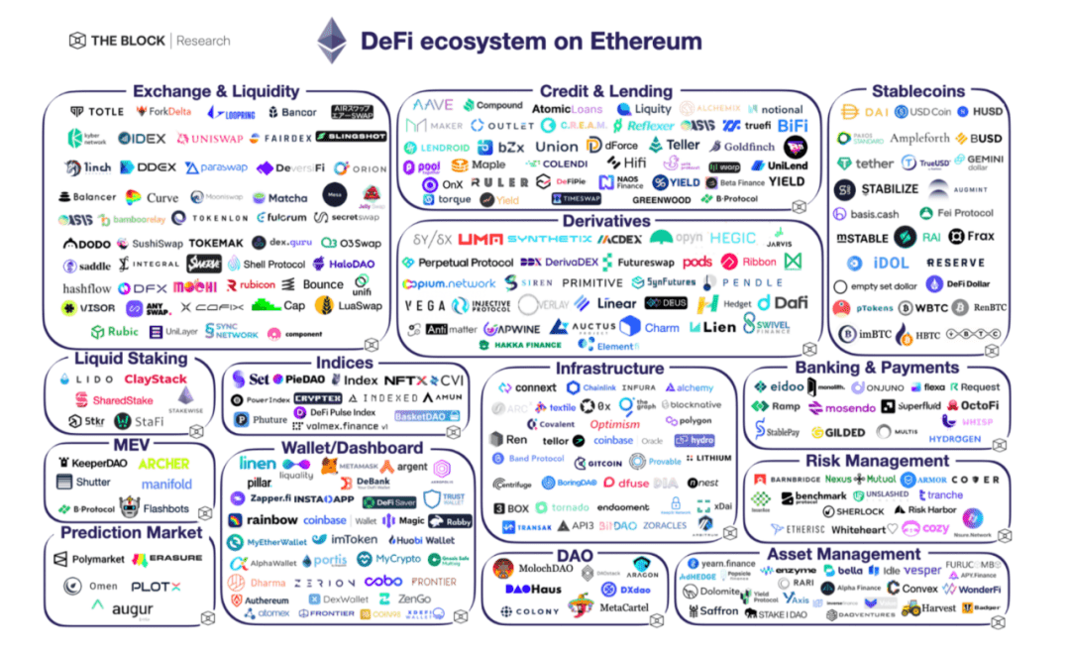
Why developing dApp? New Opportunities!
Blockchain is a network for value exchange among users.
Source: https://www.btcfans.com/en-us/article/72488
Notes:
Source: 2022-DeFi, Web 3, NFT / Gaming and Multi-Channel Perspectives_Btcfans

Slide 5
How to develop a dApp?
dApp = Smart contracts + Javascript/HTML
Backend - Smart contracts implement business logic and are run on one or many blockchains.
Frontend - Javascript / HTML implements the UI of the dApp and communicates with smart contracts through sending blockchain transactions.

Slide 6
Lock dApp
Lock a certain amount of money with a given timestamp.
In the future, users can withdraw their money back.
Moreover, the owner can unlock the money if they want.

Slide 7
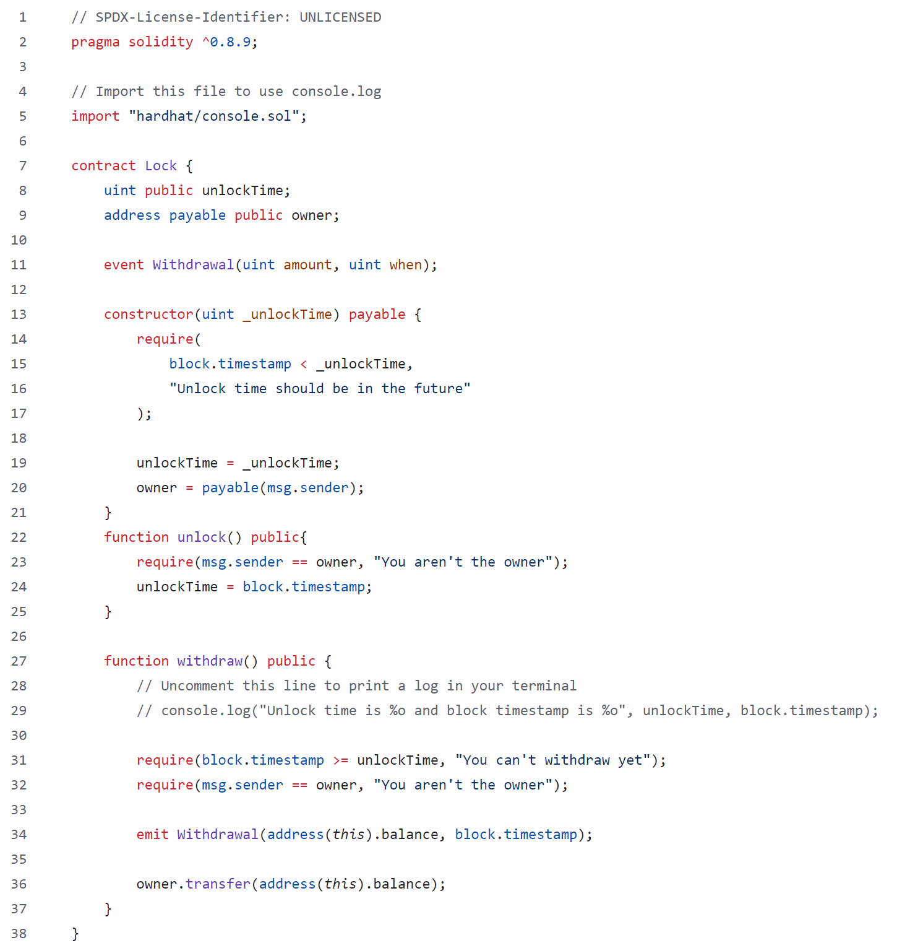
Lock dApp

Slide 8
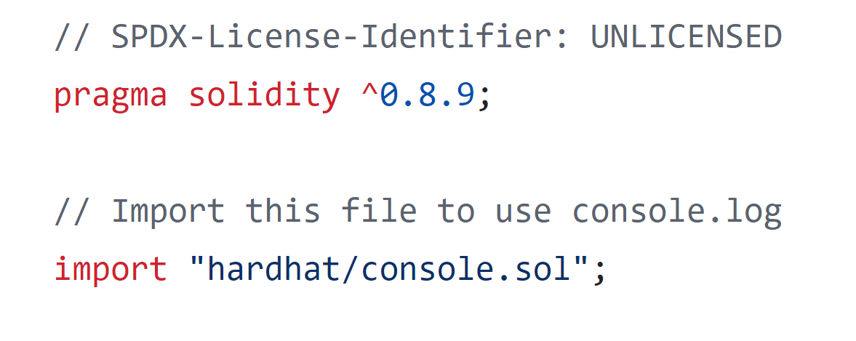
Lock dApp
Solidity Version Later than 0.8.9
Import External Library

Slide 9
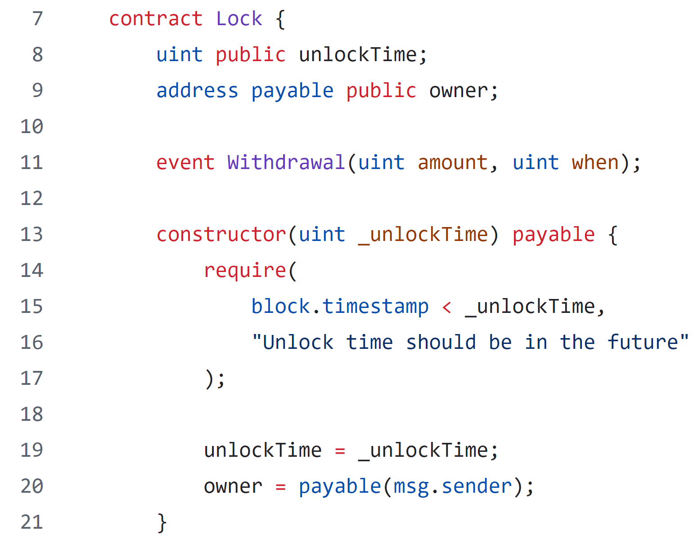
Lock dApp
Contract Name: Lock
Variable Declarations
Event Declaration
Condition Checking

Slide 10
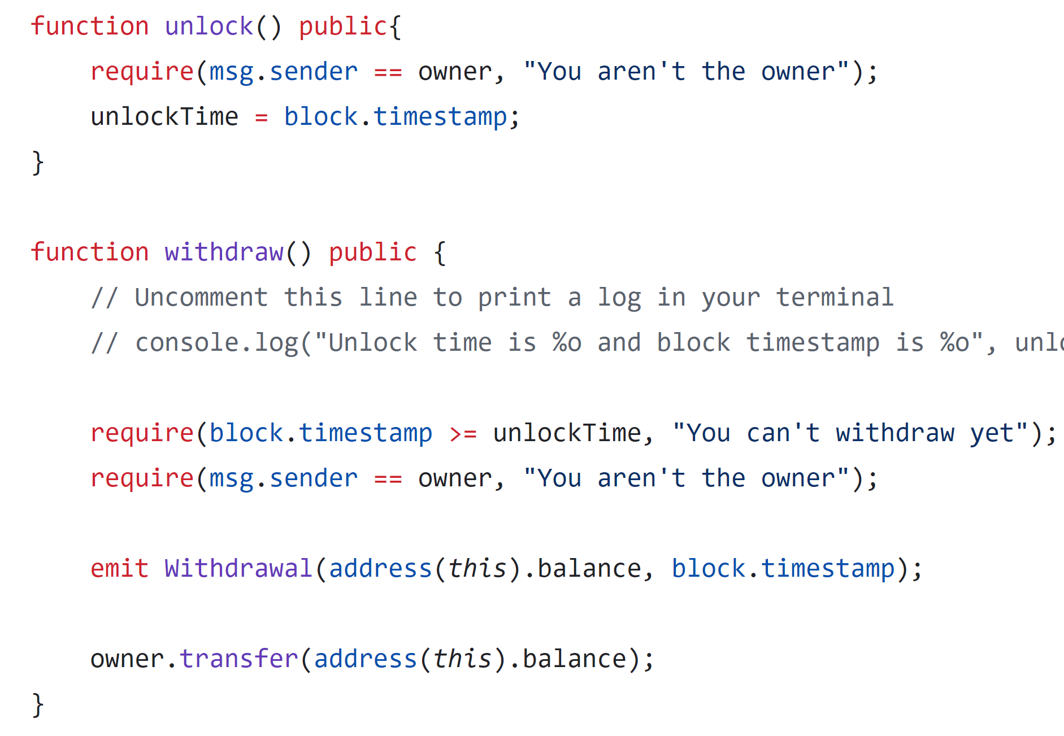
Lock dApp
Condition Checking
Condition Checking
Emit Event
Transfer Token Balance

Slide 11
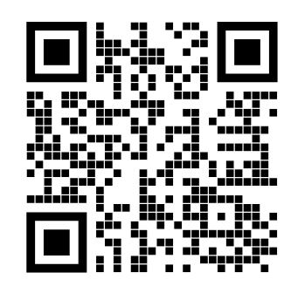
Let’s try to run it!!
https://github.com/BlockchainCourseNTU/hello-dapp

Slide 12
Vote dApp
Allows creation of multiple elections with a defined duration and admin control.
Admin registers constituencies, voters, and candidates, ensuring no self-registration.
Voters cast a single vote for candidates within their constituency.
Admin closes the election after the set duration, ending voting.
Tracks and displays votes for each candidate by constituency.

Slide 13
Vote dApp
Election Factory
createElection(_durationInMinutes, _electionName)
Election 1
Election 2
Election 3
Election 4
… …

Slide 14
Variables
admin
electionName
electionStatus
electionDuration
votersList
voterExist
voterData
candidateList
candidateExist
candidateData
consituencyList
consituencyExist
consituencyData
Functions
Election
Add
addConsituency
addCandidate
addVoter
Get
getCandidatesIdList
getConsituencyCandidates
getCandidateConsituency
getConsituencyIdList
getVotersIdList
getConsituencyVoters
getVoterConsituency
Vote
castVote
getVotes
Close
closeElection
Structs
Voter
voterId
name
email
phoneNo
consituencyId
age
voted
Candidate
candidateId
name
email
phoneNo
consituencyId
party
Consituency
consituencyId
name
candidates
voters
votes (mapping of address to uint)
winner
https://github.com/schadokar/election-ethereum-react-dapp/blob/master/ethereum/contracts/election.sol

Slide 15
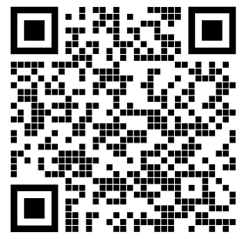
Let’s try to run it!!
https://github.com/schadokar/election-ethereum-react-dapp

Slide 16
Third project: Crowdfunding
A campaign has an owner, target and deadline
Supporters contribute ETH before the deadline
Successful campaign: owner claims the funds
Failed campaign: each supporter requests a refund
16
Notes:
Time budget: 2 minutes.
New teaching implementation: crowdfunding/contracts/Crowdfund.sol. Explain how this extends the Lock example to multiple participants and two settlement outcomes.

Slide 17
Campaign lifecycle
Funding: contributions are open before deadline
Success: deadline passed and raised >= goal
Failure: deadline passed and raised < goal
Settlement rules live inside the smart contract
17
Notes:
Time budget: 3 minutes.
The local test clock allows a ten-minute campaign to finish during the workshop. Production users cannot advance block time. Raised is cumulative and remains unchanged after refunds.

Slide 18
Claim and refund conditions
claim(): owner only, deadline passed, goal reached
claimed = true before sending the balance
refund(): deadline passed, goal missed
contributions[msg.sender] = 0 before sending ETH
18
Notes:
Time budget: 3 minutes.
Show the actual source in crowdfunding/contracts/Crowdfund.sol. State changes occur before external calls. A failed transfer reverts the whole transaction. Discuss repeated settlement and why success/refund branches are exclusive.

Slide 19
One-command local setup
./run-lock.command 127.0.0.1:4181
./run-election.command 127.0.0.1:4182
./run-crowdfunding.command 127.0.0.1:4183
Each script installs dependencies and starts its demo
19
Notes:
Time budget: 2 minutes.
Use the printed http://127.0.0.1 URL, not the localhost hostname. On macOS double-click the .command file or run it from Terminal. Node.js 20+ is required, Node 24 recommended. First install is pre-work. Each project has an isolated local chain, compiled contracts and a webpage. Default mode signs using disposable local accounts.

Slide 20
Live demo: successful campaign
Open Crowdfunding and select Supporter A
Contribute 0.5 ETH twice to the 1 ETH campaign
Advance past deadline, then select Owner
Owner claims: balance becomes 0, claimed is true
20
Notes:
Time budget: 5 minutes.
Script: ./run-crowdfunding.command. On the webpage, the default campaign is already deployed. Select account 1, Contribute twice. Advance past deadline. Select account 0. Owner claims. Point out the confirmed transaction hash and status 1.

Slide 21
Live demo: failed campaign
New campaign, then select Supporter A
Contribute only 0.5 ETH and advance past deadline
Owner claim fails because the goal was missed
Supporter refund succeeds and clears their record
21
Notes:
Time budget: 4 minutes.
Select Owner for the failed claim attempt, then Supporter A for the refund. A repeat refund should fail with Nothing to refund. State inspection uses fresh chain reads after every confirmation.

Slide 22
Failure cases to predict
Claim before deadline
Claim using a supporter account
Contribute after deadline
Refund twice or refund a successful campaign
22
Notes:
Time budget: 2 minutes.
Ask students to predict which require rejects each action. Run ./run-crowdfunding.command --test to execute the assertions. Negative cases are part of a successful demonstration.

Slide 23
Student exercise
Fund a campaign using two supporters
Let it miss the target, then refund Supporter A
Confirm Supporter B can still receive their refund
Write an assertion that refunds remain independent
23
Notes:
Time budget: 2 minutes.
Expected result: A record becomes zero and B record stays unchanged until B refunds. Automated tests already contain this scenario as a reference. Allow students to explain the invariant before showing the test.

Slide 24
Project notes and questions
Local UI writes wait for transaction confirmation
Workshop Election adds missing voting checks
Local accounts and synthetic data keep setup simple
README documents commands, fixes and expected results
24
Notes:
Time budget: 2 minutes.
Original slides describe intended behavior. The checked-in workshop Election fixes voter registration, candidate existence, constituency and deadline checks. The upstream original stays under election/upstream. Clarify the old reliability claim: frontends and RPC services can fail even when the chain is live. Total: original section 35 minutes, this section 25 minutes.

