Slide 1
CE/CZ4153 Tutorial dApp Development Workshop
Zhang Chengxuan
chengxua001@e.ntu.edu.sg
2025.9.10

Slide 2
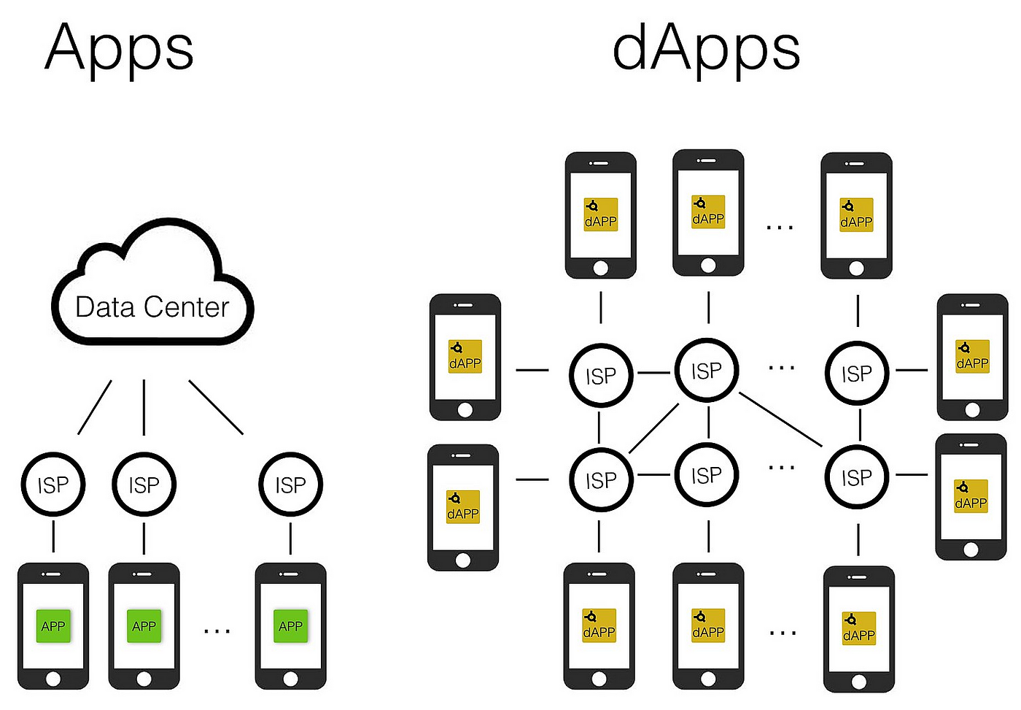
What is dApp?
Decentralized applications powered by blockchain.
Source: https://towardsdatascience.com/what-is-a-dapp-a455ac5f7def
Notes:
ISP: Internet Service Provider
On the left side, for traditional Apps, the ISP provides access to a centralized Data Center that hosts the app's data and functionalities.
On the right side, for dApps (decentralized applications), the ISP provides access to a decentralized network where the app's data and functionalities are distributed across multiple nodes, rather than being hosted in a central server.
This decentralized structure is a key feature of dApps.

Slide 3
Why developing dApp? Reliable Service
Traditional Network Applications
C/S Architecture, e.g., Zoom desktop App.
B/S Architecture, e.g., www.ntu.edu.sg
Issue: distributed/centralized server may crash sometimes
Blockchains like Bitcoin or Ethereum have seamlessly worked for many years without any crash issue.
Notes:
C/S: Client-server
B/S: Browser-server

Slide 4
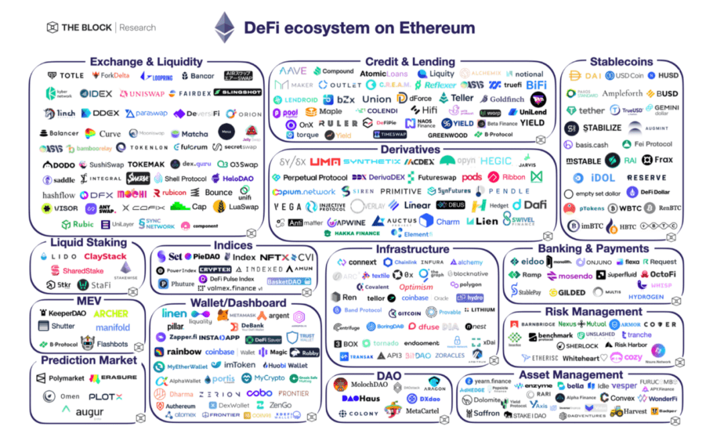
Why developing dApp? New Opportunities!
Blockchain is a network for value exchange among users.
Source: https://www.btcfans.com/en-us/article/72488
Notes:
Source: 2022-DeFi, Web 3, NFT / Gaming and Multi-Channel Perspectives_Btcfans

Slide 5
How to develop a dApp?
dApp = Smart contracts + Javascript/HTML
Backend - Smart contracts implement business logic and are run on one or many blockchains.
Frontend - Javascript / HTML implements the UI of the dApp and communicates with smart contracts through sending blockchain transactions.

Slide 6
Lock dApp
Lock a certain amount of money with a given timestamp.
In the future, users can withdraw their money back.
Moreover, the owner can unlock the money if they want.

Slide 7
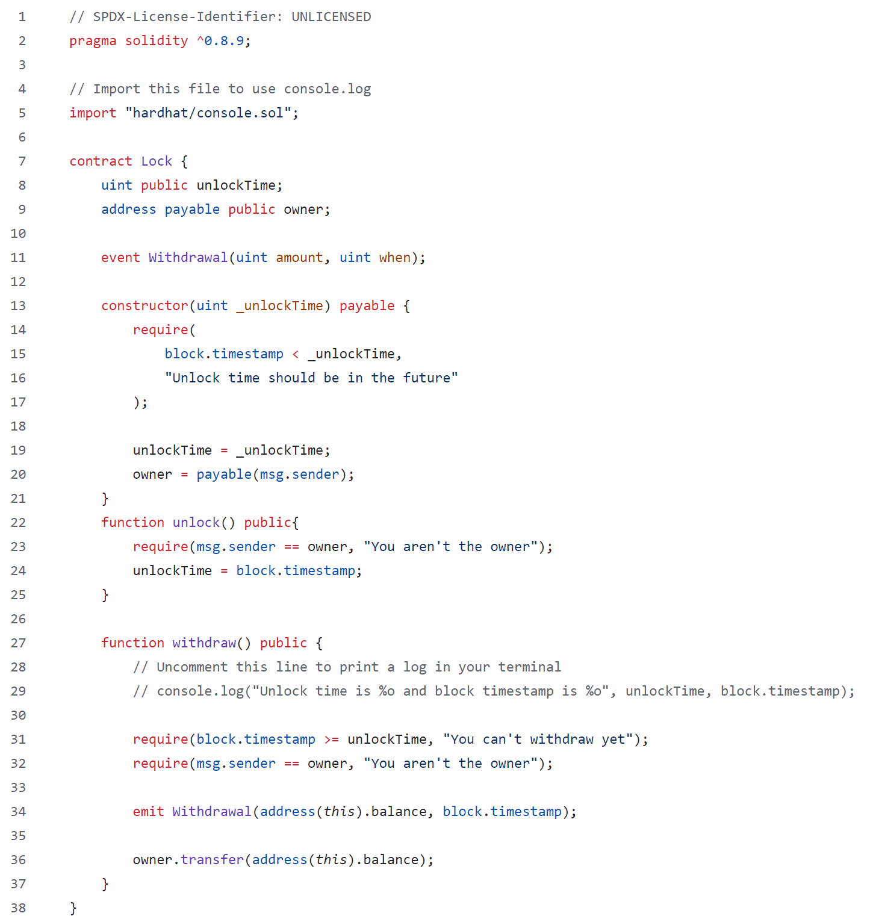
Lock dApp

Slide 8
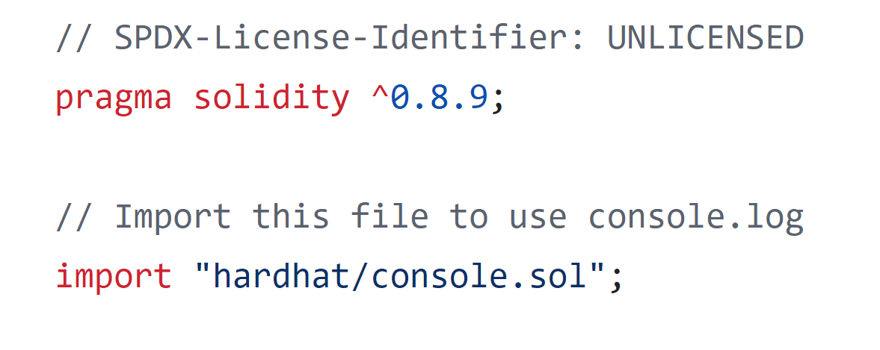
Lock dApp
Solidity Version Later than 0.8.9
Import External Library

Slide 9
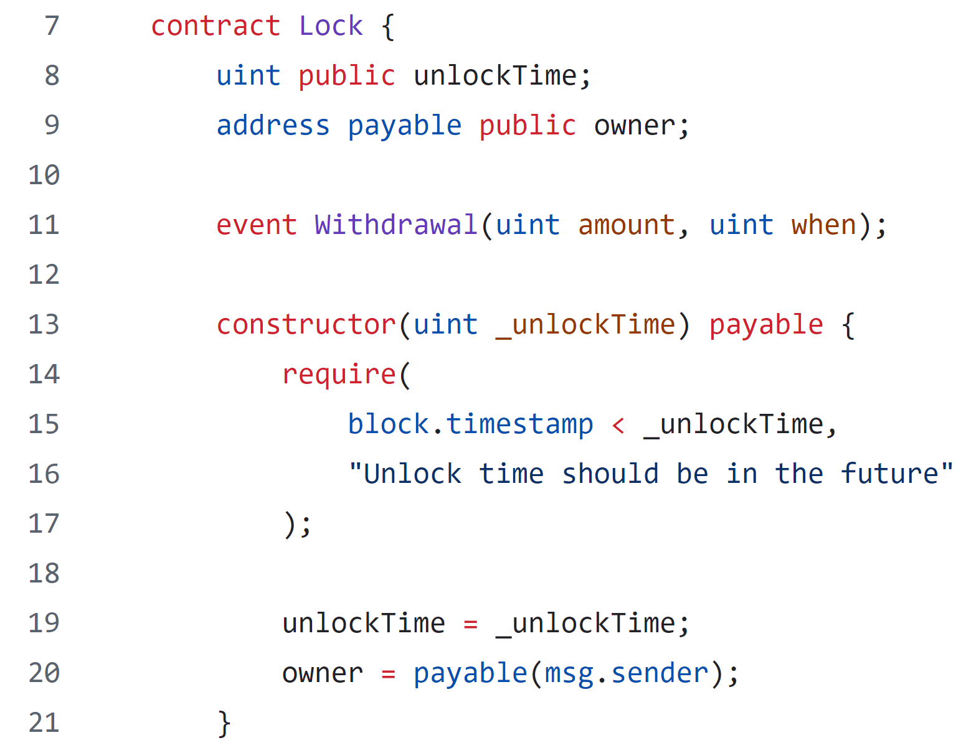
Lock dApp
Contract Name: Lock
Variable Declarations
Event Declaration
Condition Checking

Slide 10
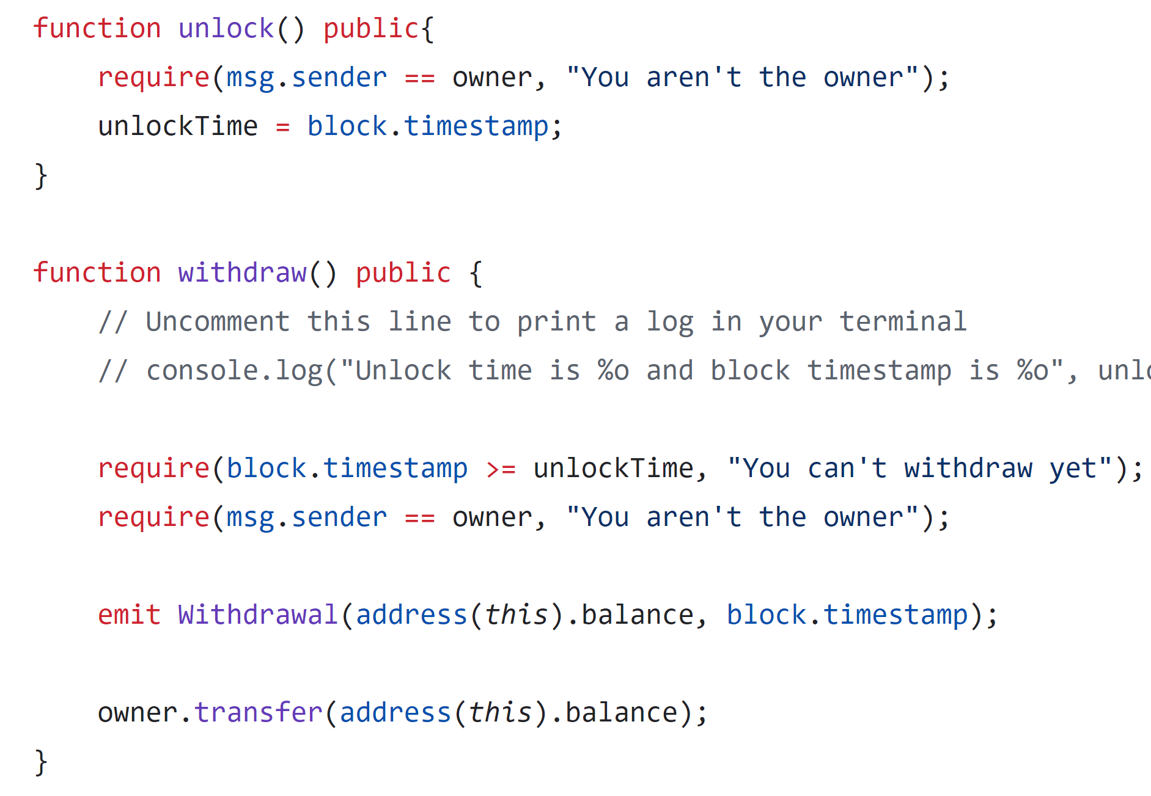
Lock dApp
Condition Checking
Condition Checking
Emit Event
Transfer Token Balance

Slide 11
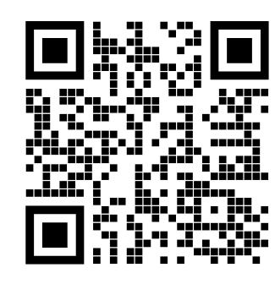
Let’s try to run it!!
https://github.com/BlockchainCourseNTU/hello-dapp

Slide 12
Vote dApp
Allows creation of multiple elections with a defined duration and admin control.
Admin registers constituencies, voters, and candidates, ensuring no self-registration.
Voters cast a single vote for candidates within their constituency.
Admin closes the election after the set duration, ending voting.
Tracks and displays votes for each candidate by constituency.

Slide 13
Vote dApp
Election Factory
createElection(_durationInMinutes, _electionName)
Election 1
Election 2
Election 3
Election 4
… …

Slide 14
Variables
admin
electionName
electionStatus
electionDuration
votersList
voterExist
voterData
candidateList
candidateExist
candidateData
consituencyList
consituencyExist
consituencyData
Functions
Election
Add
addConsituency
addCandidate
addVoter
Get
getCandidatesIdList
getConsituencyCandidates
getCandidateConsituency
getConsituencyIdList
getVotersIdList
getConsituencyVoters
getVoterConsituency
Vote
castVote
getVotes
Close
closeElection
Structs
Voter
voterId
name
email
phoneNo
consituencyId
age
voted
Candidate
candidateId
name
email
phoneNo
consituencyId
party
Consituency
consituencyId
name
candidates
voters
votes (mapping of address to uint)
winner
https://github.com/schadokar/election-ethereum-react-dapp/blob/master/ethereum/contracts/election.sol

Slide 15
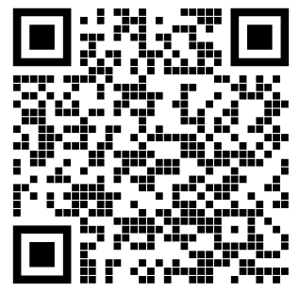
Let’s try to run it!!
https://github.com/schadokar/election-ethereum-react-dapp

