Slide 1


Movie Market Analysis
GUETARI Bader
Ni he

Slide 2
Objective
Our goal: to provide strategies for film companies to invest in the film market.
As the film market has grown in size in recent years, it has become important to analyse the preferences of the film market - what types of films are rated more highly? What types of films do studios like to make to make money, and what types of films are the most popular each year?
We will analyse 5000 films on the IMDB website to come up with the results we want.

Slide 3

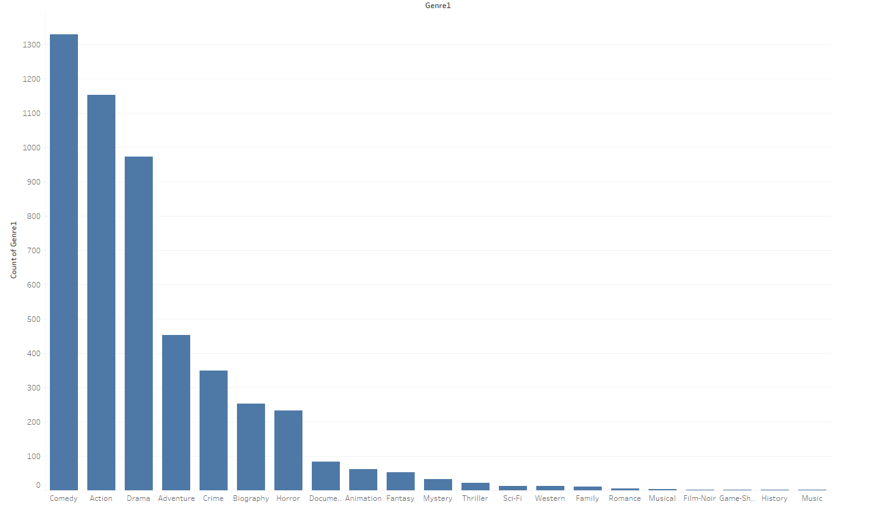
Of those 5,000 films from 1916 to 2016, the most filmed genres were: Comedy, Action, Drama
So does that mean that studios think these three genres are profitable enough?

Slide 4
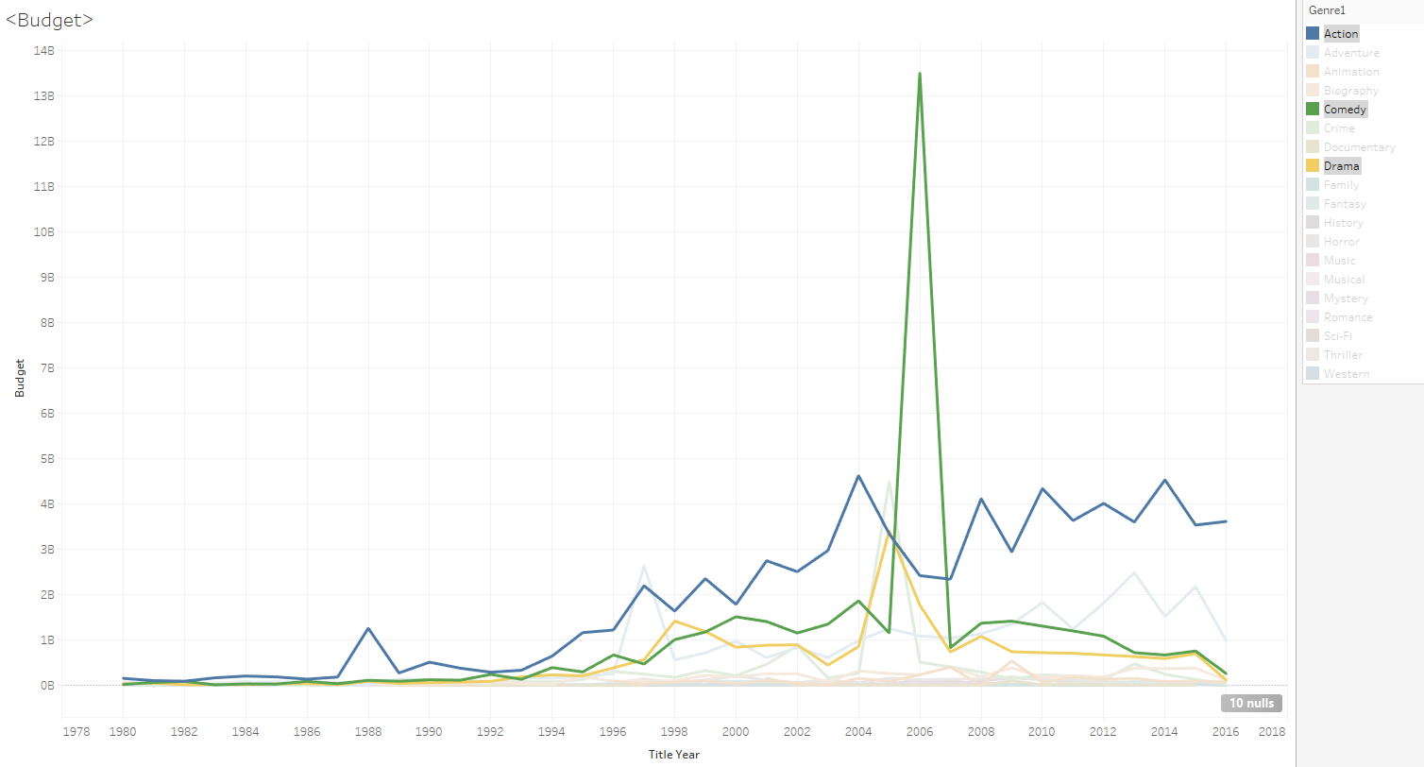
odd
The comedy, drama and action genres all have very high budgets, but there is a very high point here in 2006 for comedy, which is easy to understand, as one or more very high budget comedy films in 2006 drove up the overall comedy genre budget.
So to avoid this we will use the average.

Slide 5
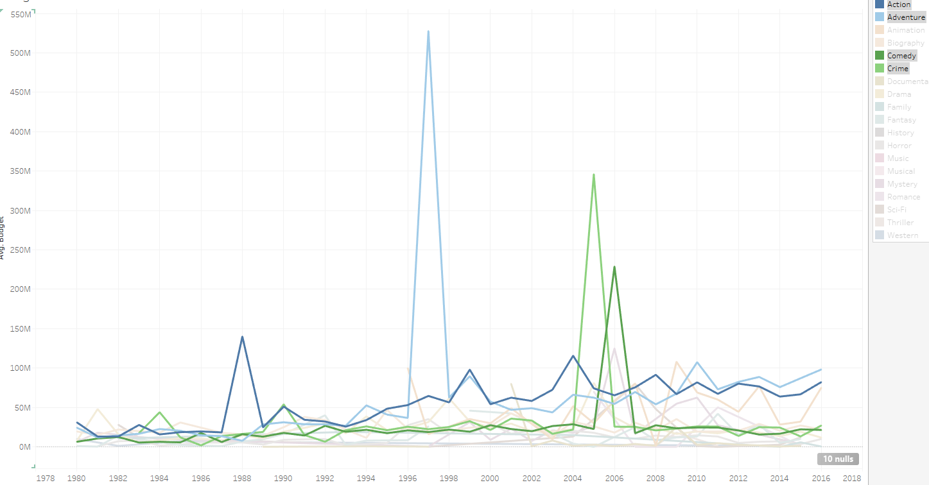
The film market's preference for genres is not definitive but varies from year to year.
1988: The market for action films was opened up, and since then there has been a stable and broad market for action films
1997: The studios invested large budgets in adventure films and since then the cost of adventure films has remained high
2005: Crime films have remained low budget and virtually unchanged since 2005, when they tested the market. This seems to mean that crime films were not well received by the market that year.
2006: The budgets for comedies suddenly became larger, and we believe that the studios wanted to move to other genres and chose comedies because the previous year's crime films were not doing well. In terms of budgets, it seems that the comedies that followed were not popular either
We will verify all our points with Gross

Slide 6
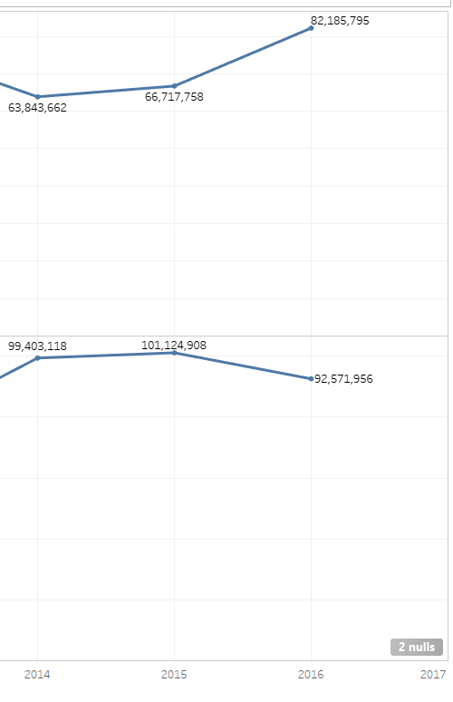
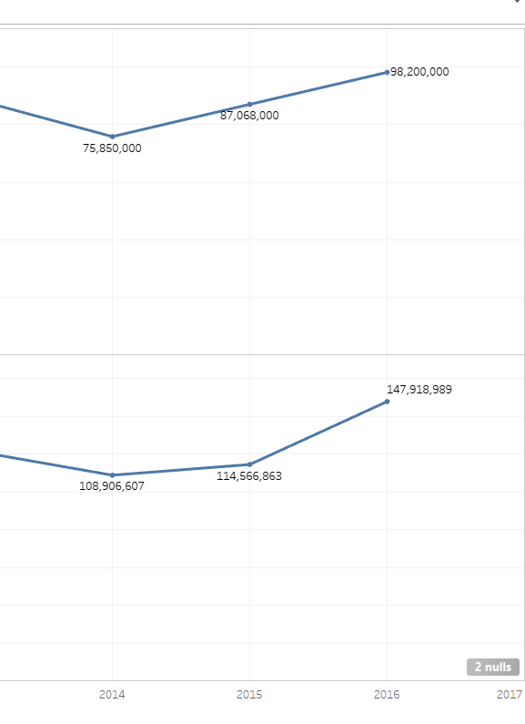
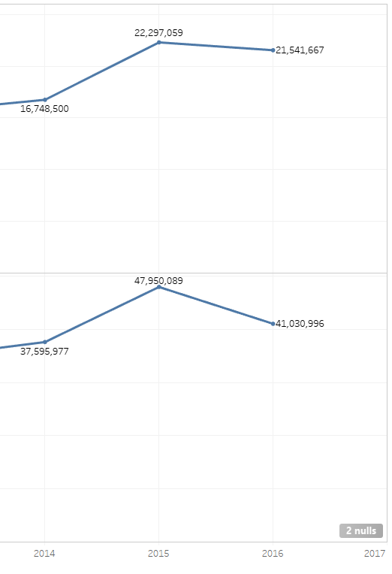
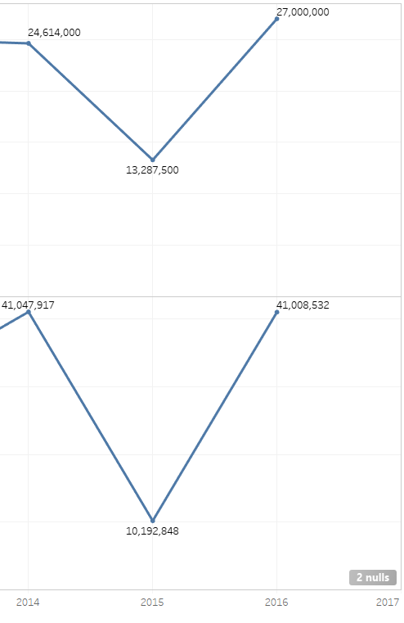
Budget
Gross
action
Adventure
Comedy
Crime
The average profit for an action film is 26M
The average profit for an adventure film is 36M
Comedy averages 21M
Crime averages 9.1M
The number of films produced each year is increasing, so we don't look at the total box office of a film, just the average box office.

Slide 7
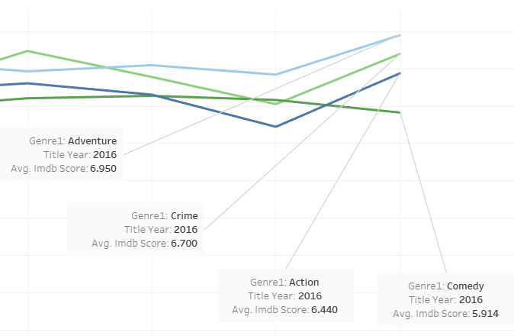
The adventure genre is consistently rated highly, followed by the crime genre, and to a lesser extent by comedy.

Slide 8
Conclusion
Conclusion: The most popular genres of films made in the last few years are action, comedy and opera.
However, the most profitable genres are adventure, action and comedy, with adventure being the most profitable, and the adventure genre is highly rated, so that it reaps critical acclaim and earns money at the same time. So our advice to studios is to invest more in adventure films and less in opera.

