Slide 1
CY376: Network Monitoring, Security and Auditing
Auditing Stored Procedures and Database Objects for Security Weaknesses
Blue Team End-of-Semester Project
Veronica Okyere Index: FCM.41.018.206.23 GitHub: github.com/cy-vokyere3623-hash/CY376-Blue-Team-Stored-Procedure-Audit

Slide 2
1. Problem and Objective
Why this Blue Team project matters
The Problem
Project Objective
• Stored procedures are common in enterprise apps
• They are not automatically safe from abuse
• Risks: SQL injection, privilege escalation, OS commands
• Weak permissions (public EXECUTE) widen the attack surface
• Missing audit leaves little forensic evidence
• Inventory database modules and objects
• Detect dangerous code and permission patterns
• Document findings with severity and evidence
• Remediate weaknesses in a controlled lab
• Re-verify with the same audit scripts
CY376 | Veronica Okyere | FCM.41.018.206.23 | Blue Team
2/12

Slide 3
2. Laboratory Setup
Isolated environment — no production systems
Database Engine
Client Tool
Sample Database
Safety Rule
SQL Server 2022 Express Instance: localhost\SQLEXPRESS Auth: Windows (NOVA\Administrator)
SQL Server Management Studio 21 Used for scripts, results, and screenshot evidence
AdventureWorks2022 Realistic schema for lab procedures and audits
Lab-only vulnerable objects Intentionally created, then remediated and verified
CY376 | Veronica Okyere | FCM.41.018.206.23 | Blue Team
3/12

Slide 4
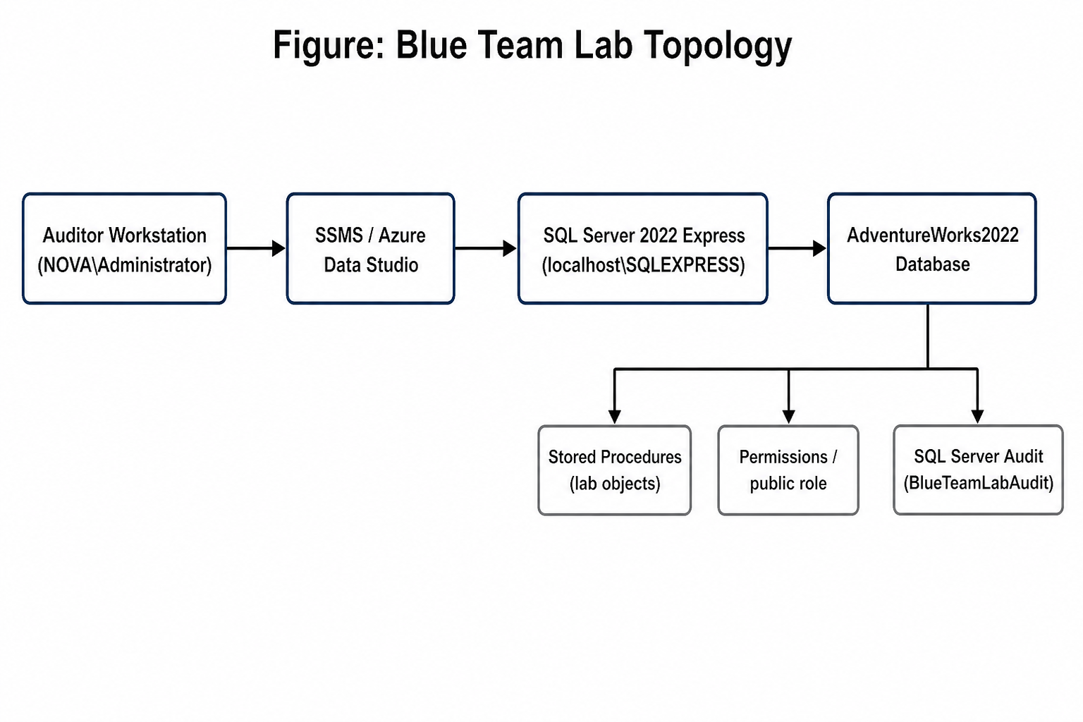
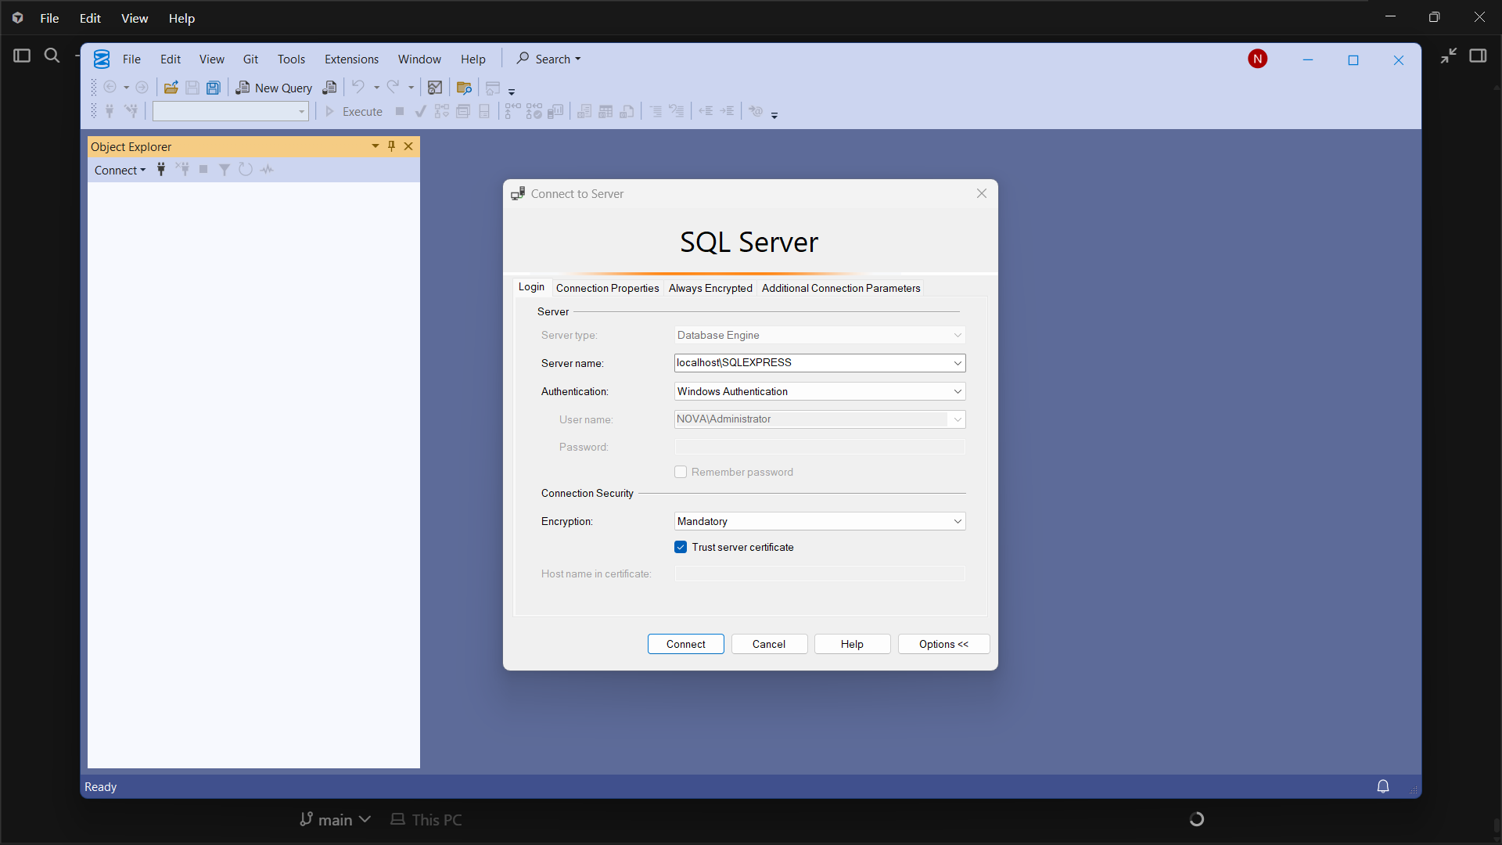
3. Lab Topology and Connection Evidence
How the auditor reached the database
Figure: Lab topology (Auditor → SSMS → SQL Express → AdventureWorks2022)
Figure: SSMS connection to localhost\SQLEXPRESS
CY376 | Veronica Okyere | FCM.41.018.206.23 | Blue Team
4/12

Slide 5
4. Methodology — Blue Team Workflow
Repeatable audit cycle used in the lab
1
2
3
4
5
6
Prepare
Inventory
Detect
Document
Remediate
Verify
Create lab + intentionally weak procedures
01-inventory.sql List modules & EXECUTE AS
02 / 03 / 04 scripts Code, perms, config
Findings F-001–F-006 Severity + evidence
remediate-findings.sql Fix and harden
Re-run 02–05 Prove risks closed
CY376 | Veronica Okyere | FCM.41.018.206.23 | Blue Team
5/12

Slide 6
5. Findings Overview — Six Issues Identified
Summary of audit results
Status: all 6 findings later remediated and re-verified
ID | Severity | Finding | Object / Area | Status
F-001 | Critical | SQL injection via dynamic SQL concatenation | usp_LabSearchProducts_Unsafe | Fixed
F-002 | High | Privilege escalation with EXECUTE AS OWNER | usp_LabGetEmployee_Elevate | Fixed
F-003 | Critical | Dangerous xp_cmdshell wrapper procedure | usp_LabRunCommand_Dangerous | Fixed
F-004 | High | EXECUTE granted to public on lab procedures | usp_Lab* / public role | Fixed
F-005 | Medium | SQL Server Audit not configured initially | Server / database audit | Fixed
F-006 | Low | remote access configuration enabled | sys.configurations | Fixed
CY376 | Veronica Okyere | FCM.41.018.206.23 | Blue Team
6/12

Slide 7
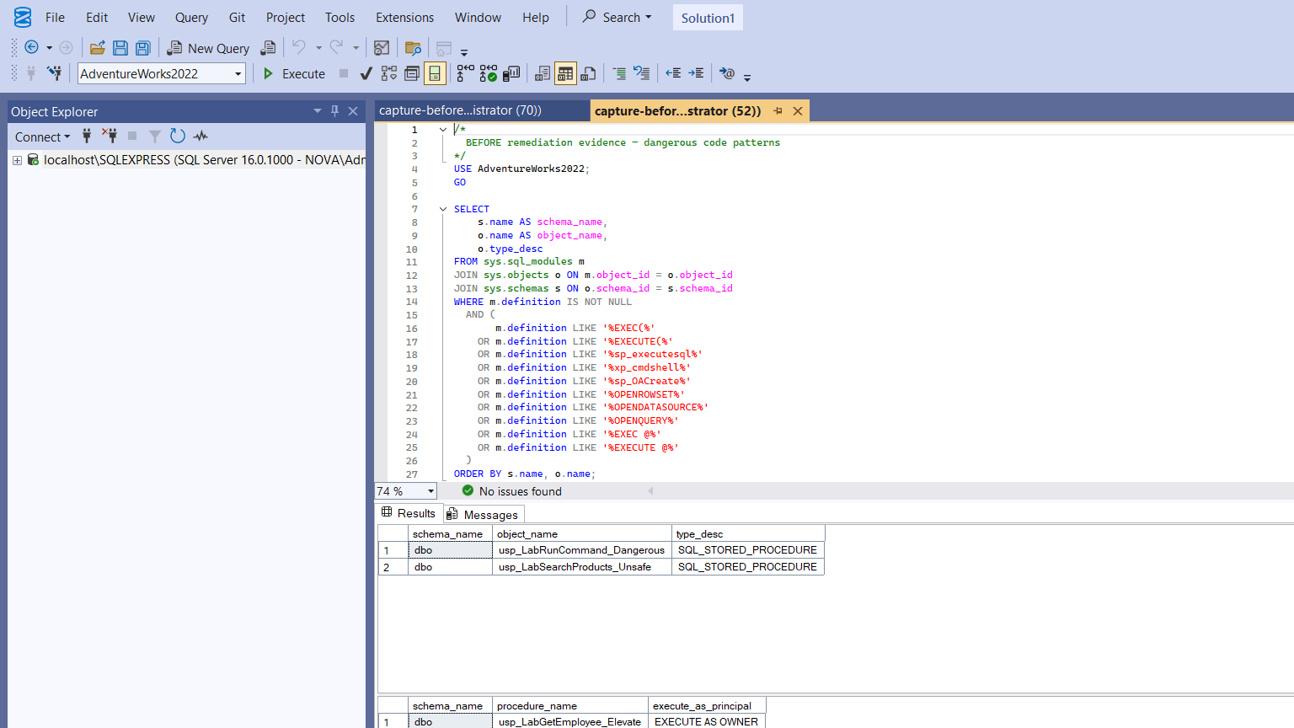
6. Critical Findings — Evidence (Before Remediation)
F-001 SQL injection • F-003 xp_cmdshell wrapper
What this shows
• 02-code-patterns.sql flagged unsafe procs
• usp_LabSearchProducts_Unsafe uses EXEC(@sql)
• usp_LabRunCommand_Dangerous calls xp_cmdshell
• Also found EXECUTE AS OWNER elevation
• Matches OWASP + CIS risk guidance
CY376 | Veronica Okyere | FCM.41.018.206.23 | Blue Team
7/12

Slide 8
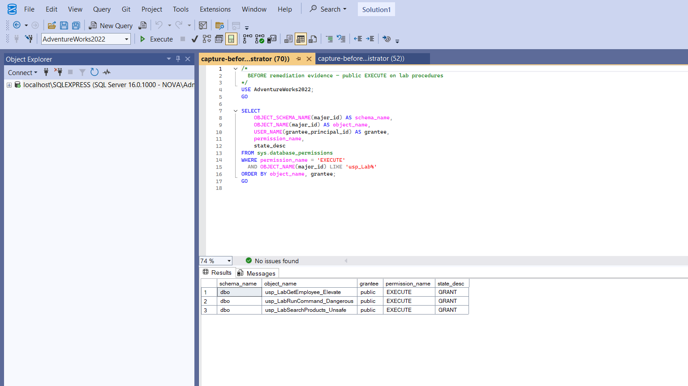
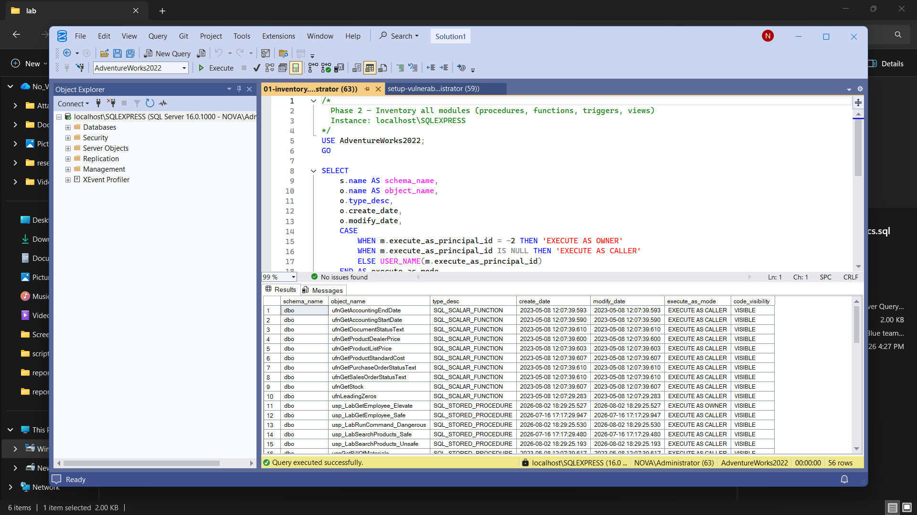
7. High Findings — Elevation and Public EXECUTE
F-002 EXECUTE AS OWNER • F-004 public grants
Left: public has EXECUTE on all three lab procedures | Right: inventory shows EXECUTE AS OWNER on elevate procedure
CY376 | Veronica Okyere | FCM.41.018.206.23 | Blue Team
8/12

Slide 9
8. Audit Gap, Surface Area, and Positive Controls
F-005 missing audit • F-006 remote access • good baselines
Issues found
Already good (before/after)
• F-005: No SQL Server Audit at first check
• Without audit, abuse may leave weak logs
• F-006: remote access was enabled (value_in_use=1)
• Lower severity, still CIS surface-area item
• xp_cmdshell = 0 (disabled)
• Ole Automation Procedures = 0
• clr enabled = 0
• Ad Hoc Distributed Queries = 0
• sa login disabled
CY376 | Veronica Okyere | FCM.41.018.206.23 | Blue Team
9/12

Slide 10
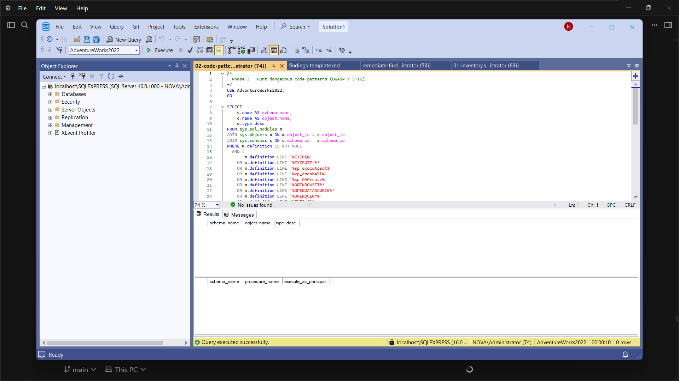
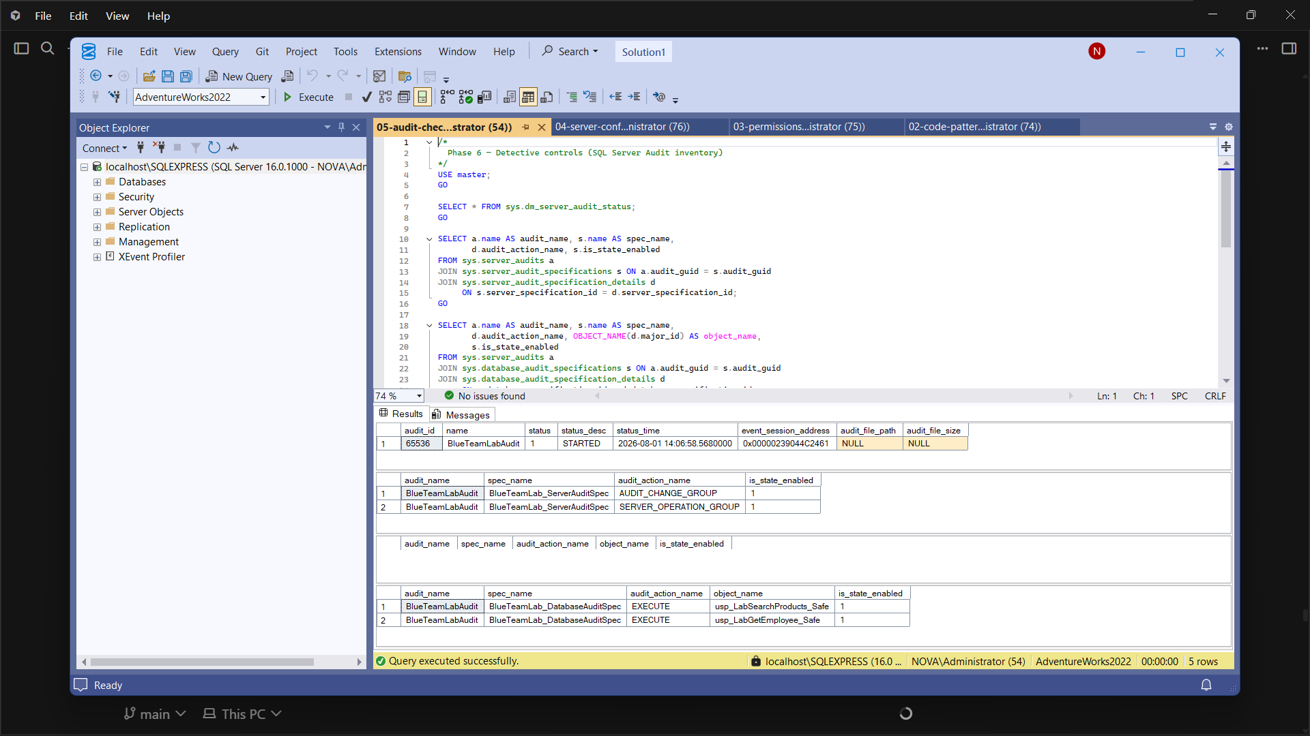
9. Remediation and Verification
Fix → re-run scripts → prove closure
• Dropped unsafe/elevated/dangerous procs; created usp_LabSearchProducts_Safe and usp_LabGetEmployee_Safe
• Revoked public EXECUTE; started BlueTeamLabAudit + server/DB specs; set remote access = 0
• Verification: code-pattern hunt returned 0 rows; audit status = STARTED; config hardened
CY376 | Veronica Okyere | FCM.41.018.206.23 | Blue Team
10/12

Slide 11
10. Recommendations for Similar Environments
Practical blue-team controls
Parameterized SQL
Least Privilege
Never concatenate user input into EXEC; use static SQL or sp_executesql with parameters.
Avoid EXECUTE AS OWNER unless required; never grant sensitive EXECUTE to public.
Surface Area
Detective Controls
Keep xp_cmdshell, OLE Automation, and related features disabled by default.
Enable SQL Server Audit for audit changes, server operations, and sensitive procedure use.
Repeatable Checks
Version Control
Re-run inventory and pattern scripts after schema deployments as a regression control.
Keep audit scripts, findings, and evidence in Git for review and continuity.
CY376 | Veronica Okyere | FCM.41.018.206.23 | Blue Team
11/12

Slide 12
Conclusion
• Completed a full Blue Team audit lifecycle on SQL Server lab objects • Identified 6 findings; all remediated and re-verified with evidence • Deliverables: report, scripts, screenshots, GitHub repository, slides
Thank you — questions welcome Repo: github.com/cy-vokyere3623-hash/CY376-Blue-Team-Stored-Procedure-Audit

