Slide 1
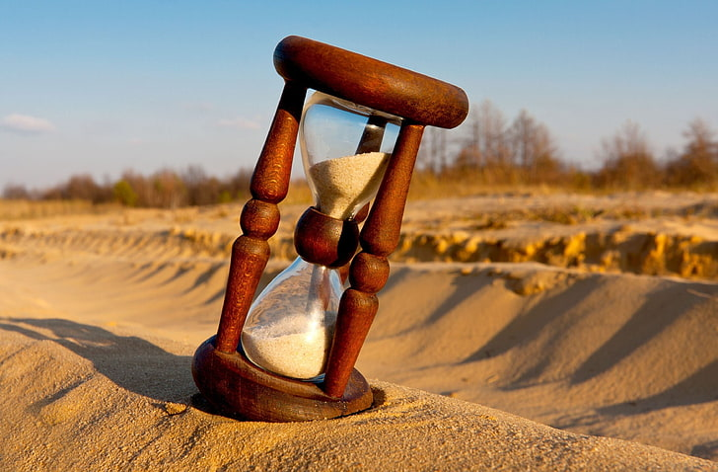
This is
the TIME to
do it.

Slide 2
Why this ?
Because,
Time is the most important as well as useless thing in the world. But if one know when to consider it as important and when to waste it i.e. balancing, will result in becoming a master.

