Slide 1
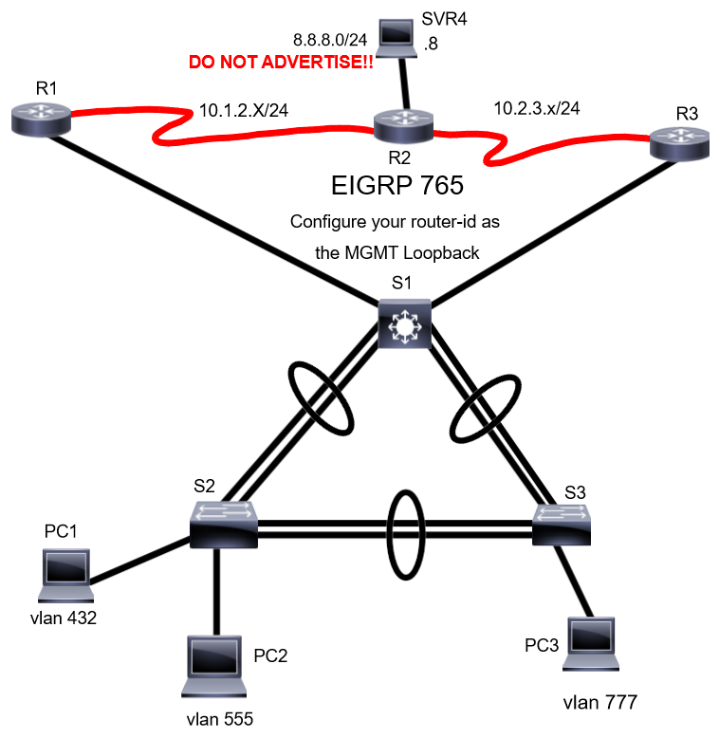
1. Configure base line configuration on all devices
2. Configure IP addresses on all devices for connectivity
-X=Hostname # Example: R1 x=1
3. Configure a FHRP to support failover for VLAN 432, 555, 777.
-R3 is primary for VL432
-R1 is primary for VL555, 777
4. Configure management ip addresses on all switch from the management vlan.
5. Configure Vlans only on S1. Ensure to name according to the above legend.
6. Configure RSTP on all switches. Ensure S1 is the root primary for all vlans.
7. Configure all trunk interfaces to negotiate Operational Trunk Mode.
8. Configure VTP where S1 is the server and all others are clients.
-Version 2, password-WOBC50218, domain
9. Use Loopback Addresses for management on the routers.
10. Configure Link aggregation between all switches
11. Ensure to shutdown and configure UNUSED Vlan for each port.
12. Enable IIS on SVR4 for web service.
13. On all end devices, ensure interfaces when in a up state forward traffic immediately, and ensure that when you hookup a switch that the port will go into errdisable.
14. Configure dynamic routing on routers.
-ensure there is no neighbors forming on LAN interfaces
-On R2, ensure to propagate a default route to R1 & R3.
15. Backup all your configuration to PC1.
Legend
Vlan 432 StrongSide 4.3.2.0/25
Vlan 555 WeakSide 5.5.5.64/29
Vlan 777 IT 7.7.7.128/25
Vlan 222 MGMT 10.222.222.0/29
Vlan 999 UNUSEDPORTS

