Slide 1
Arduino Parts Inventory
Ahmed Al-Taiar

Slide 2
TABLE OF CONTENTS
01
02
03
Technologies
Code Highlights
Demonstration
Explanation of how the website works
Code snippets that implement core aspects
See the website in action

Slide 3
01
Technologies

Slide 4




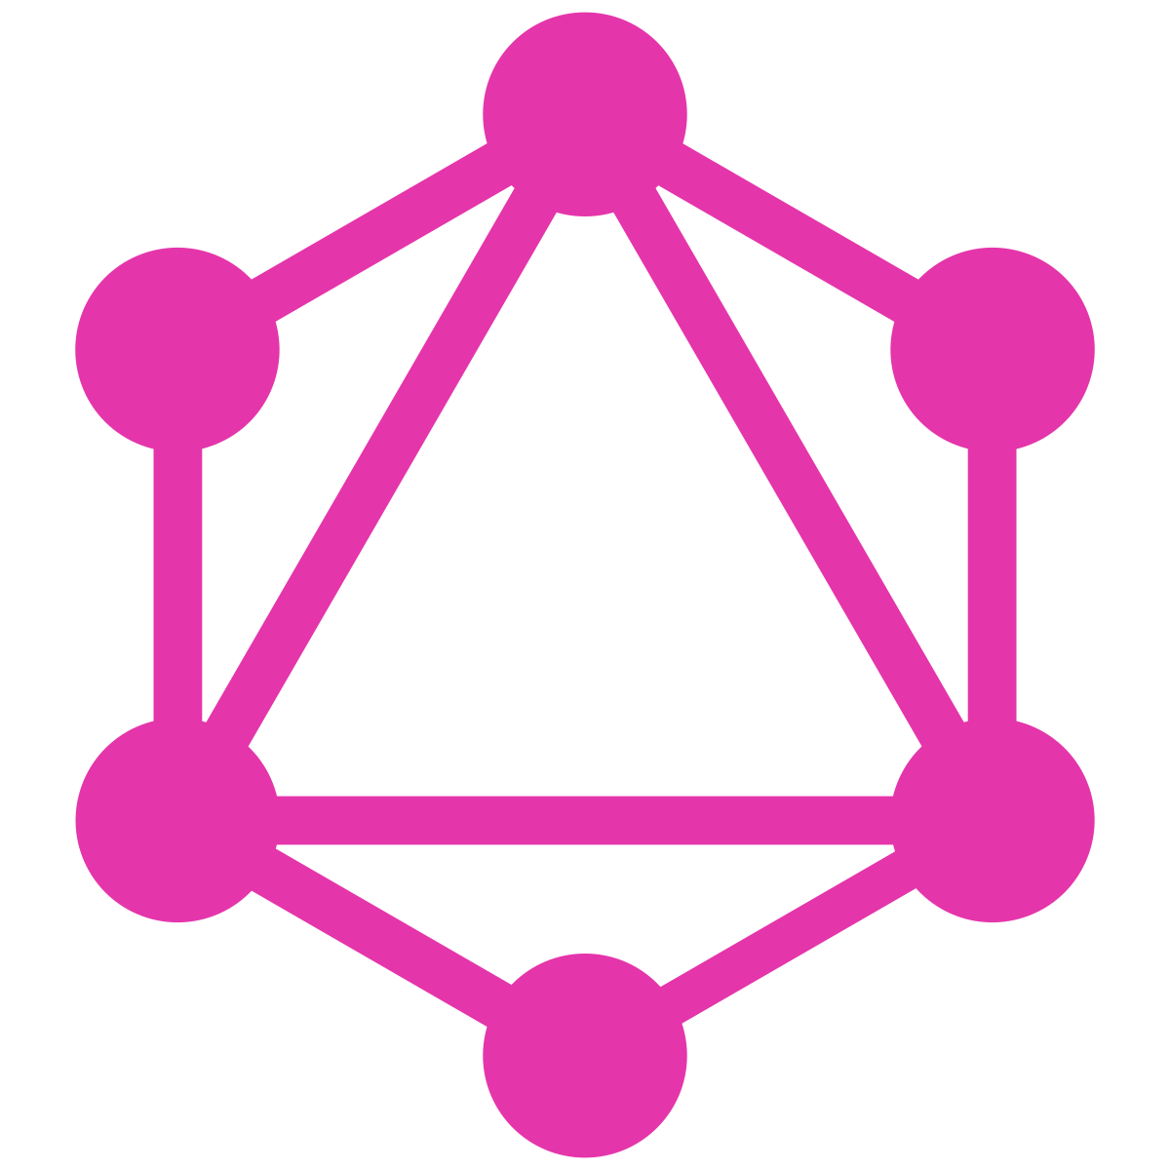

Technologies

Slide 5
02
Code Highlights

Slide 6
Creating a Transaction
export const createTransaction: MutationResolvers['createTransaction'] =
async ({ input }) => {
const basket = input.parts.map((item) => {
const part: Part = JSON.parse(item['part']) as Part
return { part: part.id, quantity: item['quantity'] }
})
for (const item of basket) {
const part = await db.part.findUnique({ where: { id: item.part } })
if (!part) throw new UserInputError(`Part ${item.part} does not exist`)
if (input.type == 'out') {
if (part.availableStock < item.quantity)
throw new UserInputError(
`Cannot take out more than available stock (${part.availableStock} available, ${item.quantity} requested)`
)
await db.part.update({
where: { id: item.part },
data: { availableStock: { decrement: item.quantity } },
})
} else if (input.type == 'in') {
await db.part.update({
where: { id: item.part },
data: { availableStock: { increment: item.quantity } },
})
}
}
return db.transaction.create({
data: input,
})
}

Slide 7
Routes Configuration
import { Router, Route, Set, PrivateSet } from '@redwoodjs/router'
import NavbarLayout from 'src/layouts/NavbarLayout'
import ScaffoldLayout from 'src/layouts/ScaffoldLayout'
import { useAuth } from './auth'
const Routes = () => {
return (
<Router useAuth={useAuth}>
<Route path="/login" page={LoginPage} name="login" />
<Route path="/signup" page={SignupPage} name="signup" />
<Route path="/forgot-password" page={ForgotPasswordPage} name="forgotPassword" />
<Route path="/reset-password" page={ResetPasswordPage} name="resetPassword" />
<PrivateSet unauthenticated="home" roles="admin">
<Set wrap={ScaffoldLayout} title="Parts" titleTo="parts" buttonLabel="New Part" buttonTo="newPart">
<Route path="/admin/parts/new" page={PartNewPartPage} name="newPart" />
<Route path="/admin/parts/{id:Int}/edit" page={PartEditPartPage} name="editPart" />
<Route path="/admin/parts/{id:Int}" page={PartPartPage} name="part" />
<Route path="/admin/parts" page={PartPartsPage} name="parts" />
</Set>
<Set wrap={ScaffoldLayout} title="Transactions" titleTo="adminTransactions">
<Route path="/admin/transactions" page={AdminTransactionsPage} name="adminTransactions" />
</Set>
</PrivateSet>
<Set wrap={NavbarLayout}>
<Route path="/" page={HomePage} name="home" />
<Route path="/part/{id:Int}" page={PartPage} name="partDetails" />
<Route path="/basket" page={BasketPage} name="basket" />
<PrivateSet unauthenticated="login">
<Route path="/transactions" page={TransactionsPage} name="userTransactions" />
</PrivateSet>
</Set>
<Route notfound page={NotFoundPage} />
</Router>
)
}
export default Routes

Slide 8
Add Part to Basket
export const addToBasket = (
part: Part,
quantity: number
): BasketItem[] | string => {
const basket = getBasket()
const existingPartIndex = basket.findIndex((item) => item.part.id == part.id)
if (existingPartIndex !== -1) {
const basketPart = basket[existingPartIndex]
if (basketPart.quantity + quantity <= basketPart.part.availableStock)
basket[existingPartIndex].quantity += quantity
else return `Cannot exceed number of items left (${part.availableStock})`
} else basket.push({ part, quantity })
localStorage.setItem(BASKET_KEY, JSON.stringify(basket))
return basket
}

Slide 9
Catalog Part
const thumbnail = (url: string) => {
if (url.includes('no_image.png')) return url
const parts = url.split('/')
parts.splice(3, 0, 'resize=width:384')
return parts.join('/')
}
const PartsGridUnit = ({ part }: Props) => {
return (
<Link to={routes.partDetails({ id: part.id })}>
<div className="card card-compact w-72 space-y-3 bg-base-100 font-inter shadow-xl transition-all duration-200 hover:-translate-y-2 hover:shadow-2xl sm:w-96">
<figure>
<img
className="h-48 object-cover"
src={thumbnail(part.imageUrl)}
width={384}
height={128}
alt={part.name + ' image'}
/>
</figure>
<div className="card-body">
<h2 className="card-title justify-between">
{part.name}
{part.availableStock == 0 ? (
<div className="badge badge-error">Out of stock</div>
) : (
<div className="badge badge-ghost whitespace-nowrap">
{part.availableStock + ' left'}
</div>
)}
</h2>
<p className="overflow-hidden text-ellipsis whitespace-nowrap">
{part.description}
</p>
<div className="card-actions justify-end">
<button
className={`btn btn-primary ${
part.availableStock == 0 ? 'btn-disabled' : ''
}`}
onClick={(event) => {
event.stopPropagation()
event.preventDefault()
const newBasket = addToBasket(part, 1)
if (typeof newBasket == 'string')
toast.custom((t) => (
<ToastNotification
toast={t}
type="error"
message={newBasket}
/>
))
else
toast.custom((t) => (
<ToastNotification
toast={t}
type="success"
message={`Added 1 ${part.name} to basket`}
/>
))
}}
>
Add to basket
</button>
</div>
</div>
</div>
</Link>
)
}

Slide 10
Transactions List Item
const TransactionListItem = ({
transaction,
returnButton = true,
admin = false,
}: Props) => {
const elapsedTime = dayjs(transaction.date).fromNow()
...
return (
<div className="collapse collapse-arrow max-w-5xl bg-base-200 font-inter">
<input type="checkbox" />
<div className="collapse-title text-xl font-medium">
<div className="items-center justify-between space-x-3 space-y-3 sm:flex sm:space-y-0">
<p className="overflow-hidden text-ellipsis whitespace-nowrap">
{transaction.parts.length} items
</p>
<div className="w-fit flex-col space-x-3">
{admin ? (
<div className="badge badge-primary whitespace-nowrap sm:badge-lg">{`${
(transaction as Transaction).user?.firstName
} ${(transaction as Transaction).user?.lastName}`}</div>
) : (
<></>
)}
<div
className={`badge sm:badge-lg ${
transaction.type == 'out' ? 'badge-error' : 'badge-success'
}`}
>
{transaction.type.replace(
transaction.type[0],
transaction.type[0].toUpperCase()
)}
</div>
<div className="badge whitespace-nowrap bg-base-300 sm:badge-lg">
{elapsedTime.replace(
elapsedTime[0],
elapsedTime[0].toUpperCase()
)}
</div>
</div>
</div>
</div>
<div className="collapse-content space-y-3">
<ul className="mx-4 list-disc space-y-2">
{transaction.parts.map((raw) => {
const part = JSON.parse(raw['part']) as Part
const quantity = raw['quantity']
return (
<li className="list-item" key={part.id}>
<div className="flex justify-between space-x-3">
<p>{part.name}</p>
<div className="badge badge-info">
<p>Quantity: {quantity}</p>
</div>
</div>
</li>
)
})}
</ul>
{transaction.type == 'out' && returnButton ? (
<button
className={`btn btn-primary ${loading ? 'btn-disabled' : ''}`}
disabled={loading}
onClick={() =>
returnTransaction({
variables: { id: transaction.id, userId: currentUser.id },
})
}
>
Return
</button>
) : (
<></>
)}
</div>
</div>
)
}

Slide 11
03
Demonstration

Slide 12
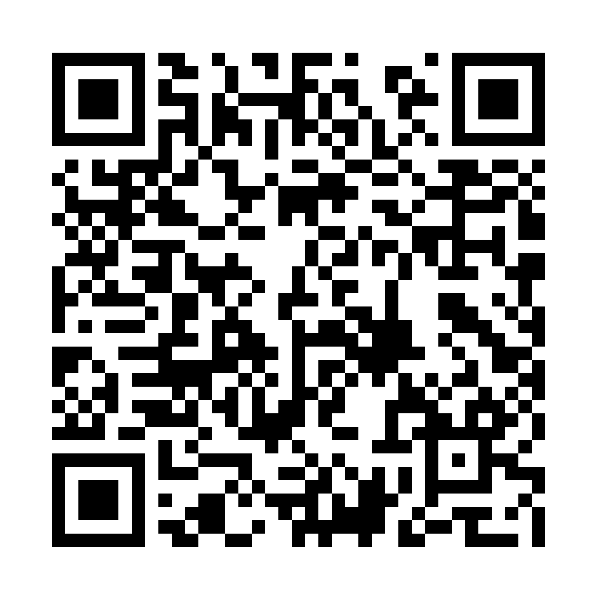
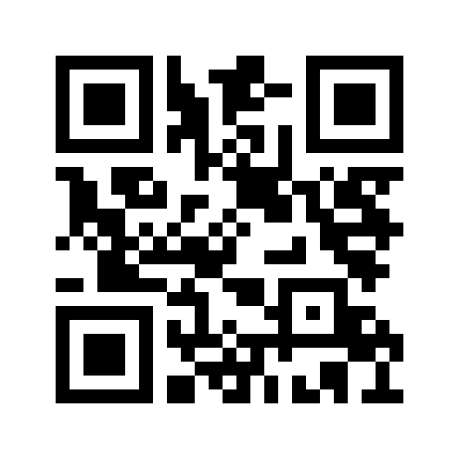
Demonstration
1
2
http://192.168.1.100:8910
SSID: arduinoinventory
PSK: arduinoinventory

Slide 13
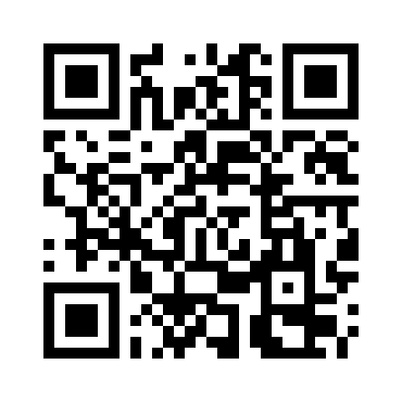
THANK YOU
Full code:

