Slide 1
AI-Powered Data Migration
Turning inconsistent client spreadsheets into clean,
SQL-ready data
MICROSOFT FOUNDRY
AI AGENT
CODE INTERPRETER
AI-Powered Data Migration • Hackathon
1

Slide 2
The Problem
Data migration often begins with spreadsheets that were designed for people—not databases.
Messy Inputs
Manual Cleanup
Database Risk
Misspellings Invalid values Misplaced data Inconsistent formatting
Slow review Repeated decisions Inconsistent corrections Hard to audit
Bad records Import failures Incorrect data types Loss of trust
THE GOAL: TRUSTED DATA
AI-Powered Data Migration • Hackathon
2

Slide 3
The Solution
An AI-assisted pipeline separates data cleaning from database loading.
01 UPLOAD
02 ANALYZE
03 CLEAN
04 REVIEW
05 IMPORT
Excel file
Foundry + Code Interpreter
Apply data rules
Human validation
SQL Server
The original workbook is preserved.
AI performs the repetitive data-quality work.
The workflow can include human approval before a database write.
AI-Powered Data Migration • Hackathon
3

Slide 4
How Microsoft Foundry Fits In
The agent orchestrates the reasoning; Code Interpreter performs the spreadsheet work.
Foundry Agent
Structured Input
Code Interpreter
Defines the cleaning rules,
valid values, confidence requirements, and expected output.
The local app uploads the workbook
passes its runtime file ID as
analysis_file_id.
Python-based analysis
and transformation of the
actual Excel workbook.
NO CHAT ATTACHMENT REQUIRED
AI-Powered Data Migration • Hackathon
4

Slide 5
What the AI Cleans
The agent is instructed to correct high-confidence problems without inventing information.
SPELLING
Jhon → John
VALID VALUES
Californa → California
MISPLACED DATA
Phone number in Email
FORMATTING
Inconsistent capitalization / formats
DATA TYPES
Numeric/text consistency
AI-Powered Data Migration • Hackathon
5

Slide 6
Demo Dataset
A deliberately inconsistent workbook gives the AI real data-quality problems to solve.
100
10
1
CLIENT RECORDS
COLUMNS
SOURCE WORKBOOK
Client ID
First Name
Last Name
Email
Phone
Company
City
State
Industry
Annual Revenue
INTENTIONALLY INCONSISTENT DATA
AI-Powered Data Migration • Hackathon
6

Slide 7
Output: Cleaned Workbook + Audit Trail
The AI creates a new workbook instead of overwriting the source.
Cleaned_Data
Cleaning_Log
SQL-ready dataset • Corrected high-confidence values • Consistent structure • Original valid data preserved
Traceable changes • Original value • Cleaned value • Action and reason • Confidence level
cleaned_client_data.xlsx
AI-Powered Data Migration • Hackathon
7

Slide 8
Current Technical Architecture
Local application + Microsoft Foundry + Code Interpreter.
STREAMLIT
Upload Preview
PYTHON
File handling Orchestration
FOUNDRY
Agent Structured input
CODE INTERPRETER
pandas openpyxl
OUTPUT
Cleaned Excel Cleaning Log
Runtime file IDs keep the workflow dynamic—each upload can be processed by the same agent.
The database layer remains separate so the cleaned result can be validated before import.
AI-Powered Data Migration • Hackathon
8

Slide 9
Why This Approach?
AI handles repetitive work while the application keeps the process controlled.
FASTER
CONSISTENT
TRACEABLE
Reduce manual spreadsheet review.
Apply the same rules repeatedly.
Document what changed and why.
SCALABLE
CONTROLLED
EXPLAINABLE
Reuse the workflow across client files.
Keep database writes outside the AI layer.
Expose cleaning decisions through a log.
AI ASSISTANCE + APPLICATION CONTROL
AI-Powered Data Migration • Hackathon
9

Slide 10
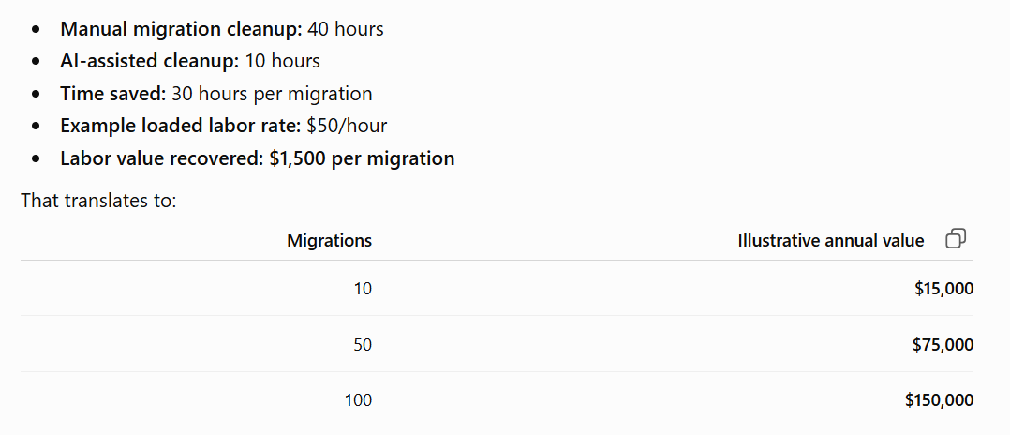

Slide 11
Next Steps
From a working AI cleaning demo to a complete migration workflow.
01
Human review
Accept or reject flagged changes
02
Validation
Check required fields and SQL data types
03
SQL import
Load approved records into SQL Server
04
Audit
Record import results and exceptions
Messy spreadsheet → trusted data → SQL-ready migration
AI-Powered Data Migration • Hackathon
10

