Slide 1

Domain Adaptation approaches for end2end ASR models
presented by
Kwok Chin Yuen
Supervisor
Assoc. Prof. Chng Eng Siong
16 Nov 2023

Slide 2
Outline
Introduction
End-to-end automatic speech recognition (ASR)
ASR Adaptation
Contributions
Layerwise adaptation using automatic selection
TTS synthesized data adaptation
Conclusions & Future Work

Slide 3
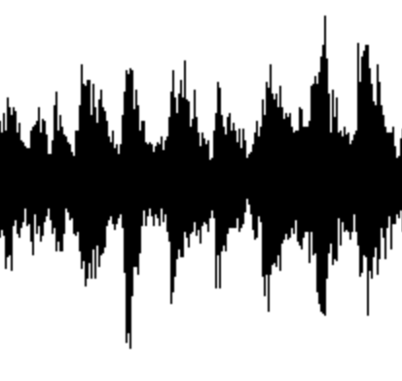
A. Introduction
What is end-to-end automatic speech recognition (ASR)?
ASR: Convert spoken words into written text
End-to-end model ^{[1]}: directly map input acoustic features into output tokens
Lexicon, Language model
Non end-to-end ASR ^{[1]} :
Acoustic model
Phoneme
Likelihood
Decoder
text
audio
End-to-end ASR model ^{[2]} :
Encoder
Decoder
Encoder + Decoder
text
audio
Neural network
[1] Vegesna, Vishnu Vidyadhara Raju, et al. "DNN-HMM acoustic modeling for large vocabulary telugu speech recognition." Mining Intelligence and Knowledge Exploration: 5th International Conference, MIKE 2017, Hyderabad, India, December 13–15, 2017, Proceedings 5. Springer International Publishing, 2017.
[2] Gulati, Anmol, et al. "Conformer: Convolution-augmented transformer for speech recognition." arXiv preprint arXiv:2005.08100 (2020).

Slide 4
A. Introduction
Recent advances of end-to-end ASR
Hidden Markov Models (1980s) Deep Learning model (2010s ~)
Larger model, more training data better performance
Hidden Markov Models [4]
Foundation models [1,2]
Finite State Machine [5]
Deep learning [6]
End-to-end
Non end-to-end
[3]
1982
1992
2002
2012
2022
Model | Model size (param) | Training data size (hours)
OpenAI Whisper (2022) [1] | 1.5 B | 680 K
MetaAI MMS (2023) [2] | 1B | 44.7K
[1] Radford, Alec, et al. "Robust speech recognition via large-scale weak supervision." International Conference on Machine Learning. PMLR, 2023.
[2] Pratap, Vineel, et al. "Scaling speech technology to 1,000+ languages." arXiv preprint arXiv:2305.13516 (2023).
[3] Juang, Biing-Hwang, and Lawrence R. Rabiner. "Automatic speech recognition–a brief history of the technology development." Georgia Institute of Technology. Atlanta Rutgers University and the University of California. Santa Barbara 1 (2005): 67.
[4] Eddy, Sean R. "What is a hidden Markov model?." Nature biotechnology 22.10 (2004): 1315-1316.
[5] Lee, David, and Mihalis Yannakakis. "Principles and methods of testing finite state machines-a survey." Proceedings of the IEEE 84.8 (1996): 1090-1123.
[6] LeCun, Yann, Yoshua Bengio, and Geoffrey Hinton. "Deep learning." nature 521.7553 (2015): 436-444.

Slide 5
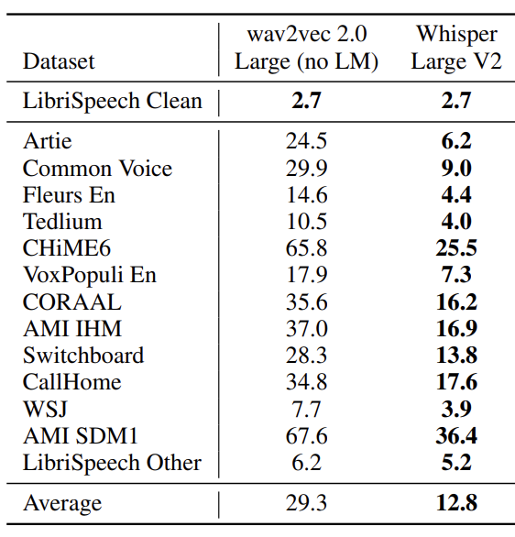
A. Introduction
Is the problem of ASR solved? …No
ASR is not robust performance affected by audio domains
Domains:
Speech Context
Noise
Speaker
Codec
Channel
Recording setup
(word error rate)
(Human ~ 3 -10)
Radford, Alec, et al. "Robust speech recognition via large-scale weak supervision." International Conference on Machine Learning. PMLR, 2023.

Slide 6
A. Introduction
What is ASR adaptation?
Method to enhance ASR performance in specific domain
Update ASR model weights [1]
Update
model
Adapted ASR model
Better
result
Update
model
ASR model
Base ASR model
inference
Feed in while
training model
Feed in while
training model
inference
ASR dataset in
domain A
ASR dataset in
domain B
Test performance
in domain B
Pre-training stage
Adaptation stage
[1] Yao, Kaisheng, et al. "Adaptation of context-dependent deep neural networks for automatic speech recognition." 2012 IEEE Spoken Language Technology Workshop (SLT). IEEE, 2012.

Slide 7
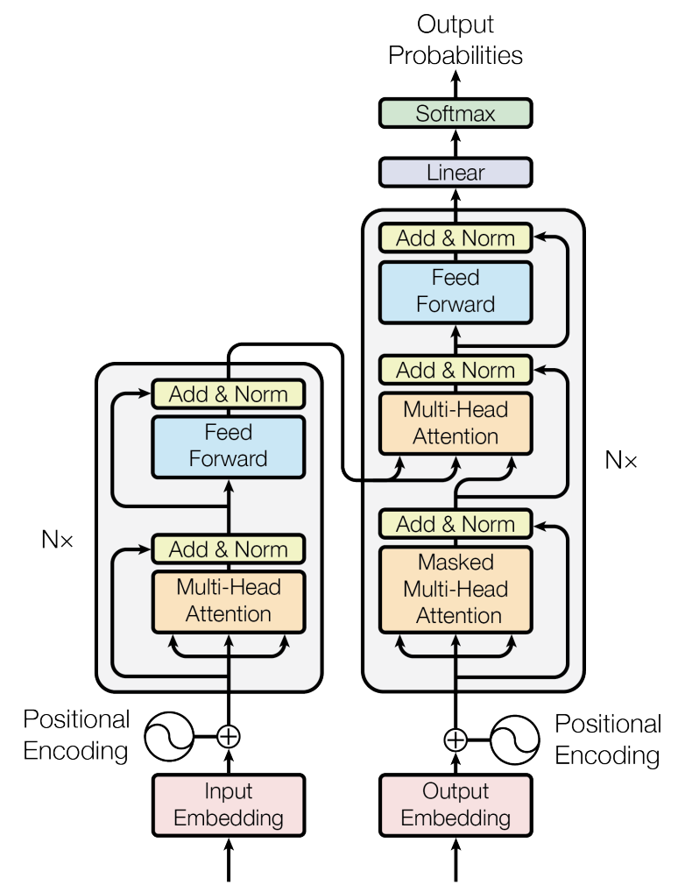



A. Introduction
How does end-to-end model perform ASR?
Transformer [1] Encoder-decoder structure
Encoder Acoustic modelling
Decoder Language modelling
So many components…
Can we adapt model partially?
Probabilities of
next token
acoustic
features
Probability of
correct next token
Training criterion:
n^{th} predicted token
acoustic feature
Prev.
predicted
tokens
audio features
[1] Vaswani, Ashish, et al. "Attention is all you need." Advances in neural information processing systems 30 (2017).

Slide 8

B. Contribution
What is Layerwise adaptation?
Method to adapt only partial model layers [1]
Layer updated
Probabilities of
next token
Probabilities of
next token
Layer freezed
acoustic
features
acoustic
features
…
…
Adapt
last
layer
only
Adapt all
layers
…
…
Prev.
predicted
tokens
Prev.
predicted
tokens
audio features
audio features
[1] Gong, Xun, et al. "Layer-wise fast adaptation for end-to-end multi-accent speech recognition." arXiv preprint arXiv:2204.09883 (2022).

Slide 9
B. Contribution
How to select the layers to adapt for Layerwise Adaptation?
Probabilities of
next token
First few layers
Last few layers
stronger acoustic modelling [1]
acoustic
features
…
stronger language modelling [2]
…
Prev.
predicted
tokens
audio features
[1] Zied Elloumi, Laurent Besacier, Olivier Galibert, and Benjamin Lecou- teux. Analyzing learned representations of a deep asr performance prediction model. arXiv preprint arXiv:1808.08573, 2018.
[2] Kyuhong Shim, Jungwook Choi, and Wonyong Sung. Understanding the role of self attention for efficient speech recognition. In International Conference on Learning Representations, 2021

