Slide 1

Domain Adaptation approaches for end2end ASR models
presented by
Kwok Chin Yuen
Supervisor
Assoc. Prof. Chng Eng Siong
16 Nov 2023

Slide 2
Outline
Introduction
End-to-end automatic speech recognition (ASR)
ASR Adaptation
Contributions
Layerwise adaptation using automatic selection
TTS synthesized data adaptation
Conclusions & Future Work

Slide 3
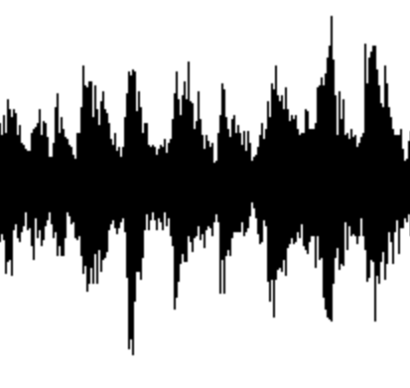
A. Introduction
What is end-to-end automatic speech recognition (ASR)?
ASR: Convert spoken words into written text
End-to-end model ^{[1]}: directly map input acoustic features into output tokens
Lexicon, Language model
Non end-to-end ASR ^{[1]} :
Acoustic model
Phoneme
Likelihood
Decoder
text
audio
End-to-end ASR model ^{[2]} :
Encoder
Decoder
Encoder + Decoder
text
audio
Neural network
[1] Vegesna, Vishnu Vidyadhara Raju, et al. "DNN-HMM acoustic modeling for large vocabulary telugu speech recognition." Mining Intelligence and Knowledge Exploration: 5th International Conference, MIKE 2017, Hyderabad, India, December 13–15, 2017, Proceedings 5. Springer International Publishing, 2017.
[2] Gulati, Anmol, et al. "Conformer: Convolution-augmented transformer for speech recognition." arXiv preprint arXiv:2005.08100 (2020).

Slide 4
A. Introduction
Recent advances of end-to-end ASR
Hidden Markov Models (1980s) Deep Learning model (2010s ~)
Larger model, more training data better performance
Hidden Markov Models [4]
Foundation models [1,2]
Finite State Machine [5]
Deep learning [6]
End-to-end
Non end-to-end
[3]
1982
1992
2002
2012
2022
Model | Model size (param) | Training data size (hours)
OpenAI Whisper (2022) [1] | 1.5 B | 680 K
MetaAI MMS (2023) [2] | 1B | 44.7K
[1] Radford, Alec, et al. "Robust speech recognition via large-scale weak supervision." International Conference on Machine Learning. PMLR, 2023.
[2] Pratap, Vineel, et al. "Scaling speech technology to 1,000+ languages." arXiv preprint arXiv:2305.13516 (2023).
[3] Juang, Biing-Hwang, and Lawrence R. Rabiner. "Automatic speech recognition–a brief history of the technology development." Georgia Institute of Technology. Atlanta Rutgers University and the University of California. Santa Barbara 1 (2005): 67.
[4] Eddy, Sean R. "What is a hidden Markov model?." Nature biotechnology 22.10 (2004): 1315-1316.
[5] Lee, David, and Mihalis Yannakakis. "Principles and methods of testing finite state machines-a survey." Proceedings of the IEEE 84.8 (1996): 1090-1123.
[6] LeCun, Yann, Yoshua Bengio, and Geoffrey Hinton. "Deep learning." nature 521.7553 (2015): 436-444.

Slide 5
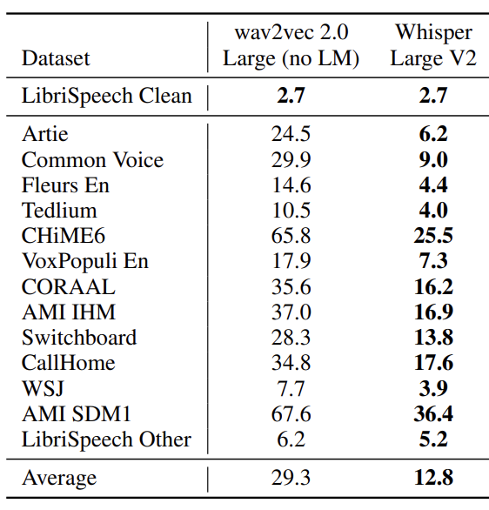
A. Introduction
Is the problem of ASR solved? …No
ASR is not robust performance affected by audio domains
Domains:
Speech Context
Noise
Speaker
Codec
Channel
Recording setup
(word error rate)
(Human ~ 3 -10)
Radford, Alec, et al. "Robust speech recognition via large-scale weak supervision." International Conference on Machine Learning. PMLR, 2023.

Slide 6
A. Introduction
What is ASR adaptation?
Method to enhance ASR performance in specific domain
Update ASR model weights [1]
Update
model
Adapted ASR model
Better
result
Update
model
ASR model
Base ASR model
inference
Feed in while
training model
Feed in while
training model
inference
ASR dataset in
domain A
ASR dataset in
domain B
Test performance
in domain B
Pre-training stage
Adaptation stage
[1] Yao, Kaisheng, et al. "Adaptation of context-dependent deep neural networks for automatic speech recognition." 2012 IEEE Spoken Language Technology Workshop (SLT). IEEE, 2012.

Slide 7
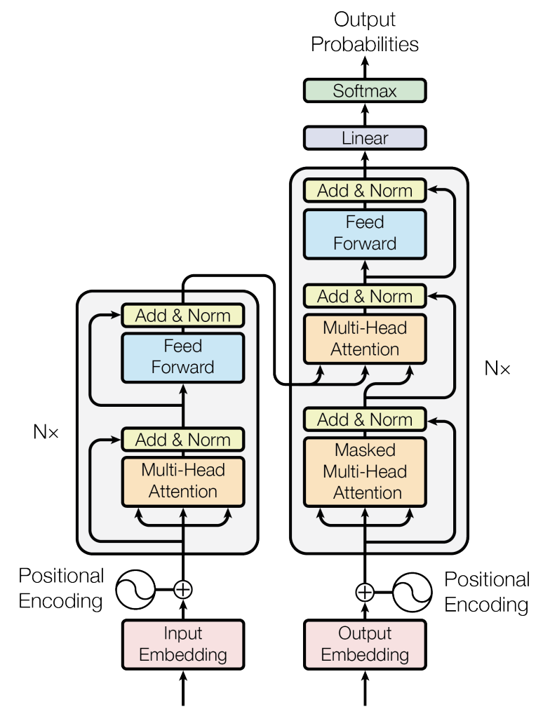



A. Introduction
How does end-to-end model perform ASR?
Transformer [1] Encoder-decoder structure
Encoder Acoustic modelling
Decoder Language modelling
So many components…
Can we adapt model partially?
Probabilities of
next token
acoustic
features
Probability of
correct next token
Training criterion:
n^{th} predicted token
acoustic feature
Prev.
predicted
tokens
audio features
[1] Vaswani, Ashish, et al. "Attention is all you need." Advances in neural information processing systems 30 (2017).

Slide 8

B. Contribution
What is Layerwise adaptation?
Method to adapt only partial model layers [1]
Layer updated
Probabilities of
next token
Probabilities of
next token
Layer freezed
acoustic
features
acoustic
features
…
…
Adapt last
layer
only
Adapt all
layers
…
…
Prev.
predicted
tokens
Prev.
predicted
tokens
audio features
audio features
[1] Gong, Xun, et al. "Layer-wise fast adaptation for end-to-end multi-accent speech recognition." arXiv preprint arXiv:2204.09883 (2022).

Slide 9
B. Contribution
How to select the layers to adapt for Layerwise Adaptation?
Probabilities of
next token
Last few layers
First few layers
stronger language modelling [1]
acoustic
features
…
stronger acoustic modelling [2]
…
Prev.
predicted
tokens
audio features
[1] Kyuhong Shim, Jungwook Choi, and Wonyong Sung. Understanding the role of self attention for efficient speech recognition. In International Conference on Learning Representations, 2021
[2] Zied Elloumi, Laurent Besacier, Olivier Galibert, and Benjamin Lecou- teux. Analyzing learned representations of a deep asr performance prediction model. arXiv preprint arXiv:1808.08573, 2018.

Slide 10
B. Contribution
What is the problem of layer selection for layerwise adaptation?
Require expert knowledge
High computation cost
Examples
Which layer to adapt?
How many layers to adapt?
What task? Adapt to new accent
New Accent Acoustic modelling
First layer better at acoustic [1]
We try to:
Adapt 1 layer
Adapt 2 layers
Best result
…
Adapt N layers
Decision: Adapt first layer
Decision: Adapt 2 layers
[1] Zied Elloumi, Laurent Besacier, Olivier Galibert, and Benjamin Lecou- teux. Analyzing learned representations of a deep asr performance prediction model. arXiv preprint arXiv:1808.08573, 2018.

