Slide 1

Domain Adaptation approaches for end2end ASR models
presented by
Kwok Chin Yuen
Supervisor
Assoc. Prof. Chng Eng Siong
16 Nov 2023

Slide 2
About Me
Name: Kwok Chin Yuen
Status: Third Year Ph.D. candidate
Matriculated on 10-Aug-2021
Year 1 & 2 TAC appraisal passed
CGPA: 4.83
Publications:
C. Y. Kwok, H. Y. Li and E. S. Chng, “ASR Model Adaptation for Rare Words Using Synthetic Data Generated by Multiple Text-To-Speech Systems” 2023 Asia-Pacific Signal and Information Processing Association Annual Summit and Conference (APSIPA ASC). IEEE, 2023.
Notes:
Thi

Slide 3
Outline
Introduction
End-to-end automatic speech recognition (ASR)
ASR Adaptation
Contributions
Layerwise adaptation using automatic layer selection
Multiple TTS synthesized data adaptation
Conclusions & Future Work

Slide 4
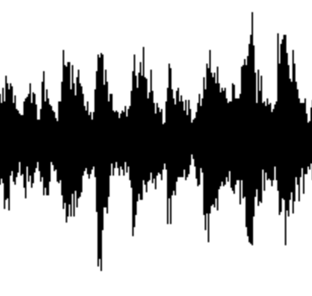
A1. End-to-end automatic speech recognition (ASR)
What is end-to-end automatic speech recognition (ASR)?
ASR: Convert spoken words into written text
End-to-end model ^{[1]}: directly map input acoustic features into output tokens
Lexicon, Language model
Non end-to-end ASR ^{[1]} :
Acoustic model
Phoneme
Likelihood
Decoder
text
audio
End-to-end ASR model ^{[2]} :
Encoder
Decoder
Encoder + Decoder
text
audio
Neural network
[1] Vegesna, Vishnu Vidyadhara Raju, et al. "DNN-HMM acoustic modeling for large vocabulary telugu speech recognition." Mining Intelligence and Knowledge Exploration: 5th International Conference, MIKE 2017, Hyderabad, India, December 13–15, 2017, Proceedings 5. Springer International Publishing, 2017.
[2] Gulati, Anmol, et al. "Conformer: Convolution-augmented transformer for speech recognition." arXiv preprint arXiv:2005.08100 (2020).

Slide 5
A1. End-to-end automatic speech recognition (ASR)
Recent advances of end-to-end ASR
Hidden Markov Models (1980s) Deep Learning model (2010s ~)
Larger model, more training data better performance
Hidden Markov Models [4]
Foundation models [1,2]
Finite State Machine [5]
Deep learning [6]
End-to-end
Non end-to-end
[3]
1982
1992
2002
2012
2022
Model | Model size (param) | Training data size (hours)
OpenAI Whisper (2022) [1] | 1.5 B | 680 K
MetaAI MMS (2023) [2] | 1B | 44.7K
[1] Radford, Alec, et al. "Robust speech recognition via large-scale weak supervision." International Conference on Machine Learning. PMLR, 2023.
[2] Pratap, Vineel, et al. "Scaling speech technology to 1,000+ languages." arXiv preprint arXiv:2305.13516 (2023).
[3] Juang, Biing-Hwang, and Lawrence R. Rabiner. "Automatic speech recognition–a brief history of the technology development." Georgia Institute of Technology. Atlanta Rutgers University and the University of California. Santa Barbara 1 (2005): 67.
[4] Eddy, Sean R. "What is a hidden Markov model?." Nature biotechnology 22.10 (2004): 1315-1316.
[5] Lee, David, and Mihalis Yannakakis. "Principles and methods of testing finite state machines-a survey." Proceedings of the IEEE 84.8 (1996): 1090-1123.
[6] LeCun, Yann, Yoshua Bengio, and Geoffrey Hinton. "Deep learning." nature 521.7553 (2015): 436-444.

Slide 6
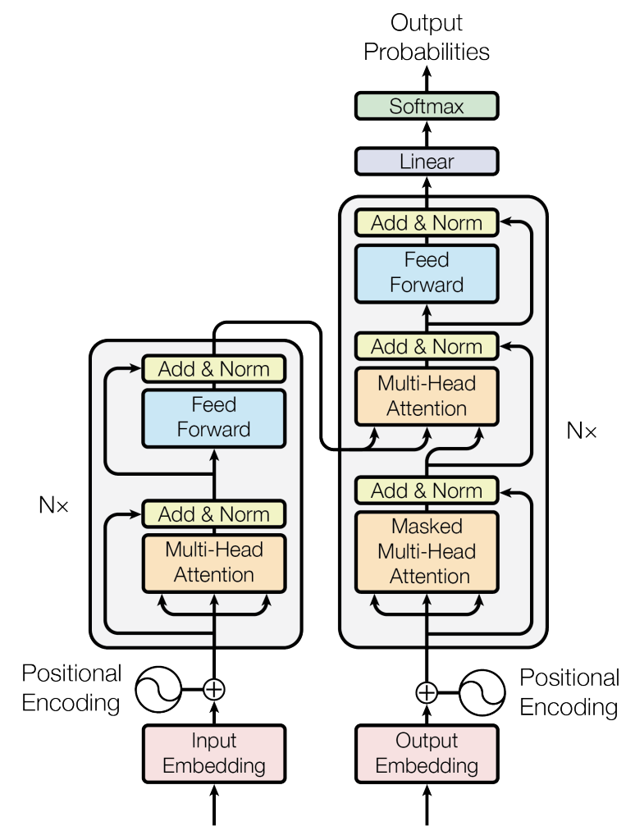



A1. End-to-end automatic speech recognition (ASR)
How is end-to-end ASR model trained?
Transformer [1] Encoder-decoder structure
Encoder Acoustic modelling
Decoder Language modelling
Probabilities of
next token
Evaluation criterion: word error rate (WER)
acoustic
features
Probability of
correct next token
Training criterion:
n^{th} predicted token
acoustic feature
Prev.
predicted
tokens
audio features
[1] Vaswani, Ashish, et al. "Attention is all you need." Advances in neural information processing systems 30 (2017).

Slide 7
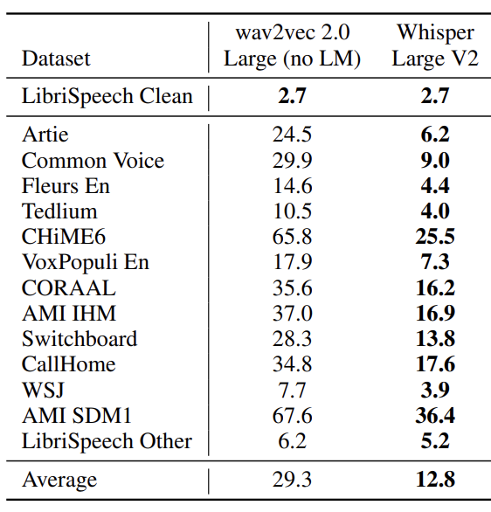
A2. ASR Adaptation
Is the problem of ASR solved? …No
ASR is not robust performance affected by audio domains
Domains:
Speech Context
Noise
Speaker
Codec
Channel
Recording setup
(word error rate)
(Human ~ 3 -10)
Radford, Alec, et al. "Robust speech recognition via large-scale weak supervision." International Conference on Machine Learning. PMLR, 2023.

Slide 8
A2. ASR Adaptation
What is ASR adaptation?
Update model weights [1] -> enhance performance in specific domain
Pre-training stage
Adaptation stage
Domain A WER
Domain B WER
Domain B WER
Finetune on
domain B
Domain A ASR model
Domain A ASR model
Adapted to domain B ASR model
dataset in
domain A
dataset in
domain B
[1] Yao, Kaisheng, et al. "Adaptation of context-dependent deep neural networks for automatic speech recognition." 2012 IEEE Spoken Language Technology Workshop (SLT). IEEE, 2012.

Slide 9
A2. ASR Adaptation
What ASR Adaptation methods are there?
Contributions:
Regularized Adaptation [1,2]
Regularized Adaptation [1,2]
Layerwise adaptation using automatic layer selection
Knowledge Injection [3,4]
ASR Adaptation
Efficient Adaptation [5,6]
Efficient Adaptation [5,6]
TTS synthesized data adaptation
Adaptation for Hybrid/Statistical model [7,8]
[1] Hank Liao. Speaker adaptation of context dependent deep neural networks. In 2013 IEEE International Conference on Acoustics, Speech and Signal Processing, pages 7947–7951. IEEE, 2013
[2] Dong Yu, Kaisheng Yao, Hang Su, Gang Li, and Frank Seide. Kl-divergence regularized deep neural network adaptation for improved large vocabulary speech recognition. In 2013 IEEE International Conference on Acoustics, Speech and Signal Processing, pages 7893–7897. IEEE, 2013
[3] Anjuli Kannan, Arindrima Datta, Tara N Sainath, Eugene Weinstein, Bhuvana Ramabhadran, Yonghui Wu, Ankur Bapna, Zhifeng Chen, and Seungji Lee. Large-scale multilingual speech recognition with a streaming end-to-end model. arXiv preprint arXiv:1909.05330, 2019
[4] George Saon, Hagen Soltau, David Nahamoo, and Michael Picheny. Speaker adaptation of neural network acoustic models using i-vectors. 2013 IEEE Workshop on Automatic Speech Recognition and Understanding, pages 55-59, 2013
[5] Bethan Thomas, Samuel Kessler, and Salah Karout. Efficient adapter transfer of self-supervised speech models for automatic speech recognition. ICASSP 2022 - 2022 IEEE International Conference on Acoustics, Speech and Signal Processing (ICASSP), pages 7102–7106, 2022
[6] Taesup Kim, Inchul Song, and Yoshua Bengio. Dynamic layer normalization for adaptive neural acoustic modeling in speech recognition. In Interspeech, 2017
[7] Chris Leggetter and Philip C. Woodland. Maximum likelihood linear regression for speaker adaptation of continuous density hidden Markov models. Comput. Speech Lang., 9:171–185, 1995.
[8] Yajie Miao, Hao Zhang, and Florian Metze. Towards speaker adaptive training of deep neural network acoustic models. In Interspeech, 2014

Slide 10
Outline
Introduction
End-to-end automatic speech recognition (ASR)
ASR Adaptation
Contributions
Layerwise adaptation using automatic selection
TTS synthesized data adaptation
Conclusions & Future Work

Slide 11

B1. Layerwise adaptation using automatic layer selection
What is layerwise adaptation?
Layer updated
Probabilities of
next token
Probabilities of
next token
Layer freezed
acoustic
features
acoustic
features
…
…
Adapt last
layer only[1]
Adapt all
Layers [2]
…
…
Prev.
predicted
tokens
Prev.
predicted
tokens
audio features
audio features
[1] Gong, Xun, et al. "Layer-wise fast adaptation for end-to-end multi-accent speech recognition." arXiv preprint arXiv:2204.09883 (2022).
[2] Di Gangi, Mattia A., Matteo Negri, and Marco Turchi. "Adapting transformer to end-to-end spoken language translation." Proceedings of INTERSPEECH 2019. International Speech Communication Association (ISCA), 2019. 1133-1137.

Slide 12


B1. Layerwise adaptation using automatic layer selection
Why do we need Layerwise adaptation?
Prevent Catastrophic Forgetting [1]
Prevent Overfitting [2]
Catastrophic Forgetting
Overfitting
train dataset in
domain B
Adaptation stage
validation
Results
in
Loss
Domain A ASR model
Adapted to domain B ASR model
training
Domain A WER
Domain A WER
Epochs
[1] Cuong V Nguyen, Alessandro Achille, Michael Lam, Tal Hassner, Vijay Mahadevan, and Stefano Soatto. Toward understanding catastrophic forgetting in continual learning. arXiv preprint arXiv:1908.01091, 2019
[2] Daniel Bashir, George D Monta ̃nez, Sonia Sehra, Pedro Sandoval Segura, and Julius Lauw. An information-theoretic perspective on overfitting and underfitting. In AI 2020: Advances in Artificial Intelligence: 33rd Australasian Joint Conference, AI 2020, Canberra, ACT, Australia, November 29–30, 2020, Proceedings 33, pages 347–358. Springer, 2020

Slide 13
B1. Layerwise adaptation using automatic layer selection
How to select the layers to adapt for Layerwise Adaptation?
Previous works:
Probabilities of
next token
Last few layers
First few layers
stronger language modelling [1]
acoustic
features
…
stronger acoustic modelling [2]
…
Prev.
predicted
tokens
audio features
[1] Kyuhong Shim, Jungwook Choi, and Wonyong Sung. Understanding the role of self attention for efficient speech recognition. In International Conference on Learning Representations, 2021
[2] Zied Elloumi, Laurent Besacier, Olivier Galibert, and Benjamin Lecou- teux. Analyzing learned representations of a deep asr performance prediction model. arXiv preprint arXiv:1808.08573, 2018.

Slide 14
B1. Layerwise adaptation using automatic layer selection
What is the problem of layer selection for layerwise adaptation?
Require expert knowledge
High computation cost
Examples
Which layer to adapt?
How many layers to adapt?
What task? Adapt to new accent
New Accent Acoustic modelling [1]
First layer better at acoustic [2]
We try to:
Adapt 1 layer
Adapt 2 layers
Best result
…
Adapt N layers
Decision: Adapt first layer
Decision: Adapt 2 layers
[1] Turan, Mehmet Ali Tuğtekin, Emmanuel Vincent, and Denis Jouvet. "Achieving multi-accent ASR via unsupervised acoustic model adaptation." INTERSPEECH 2020. 2020.
[2] Zied Elloumi, Laurent Besacier, Olivier Galibert, and Benjamin Lecou- teux. Analyzing learned representations of a deep asr performance prediction model. arXiv preprint arXiv:1808.08573, 2018.

Slide 15


B1. Layerwise adaptation using automatic layer selection
Automatic layer selection
Consists of 3 stages
3. Perform Early Stopping
1. Estimate Layer performance
2. Record Training dynamics
3. Perform Early Stopping
1. Estimate Layer performance
2. Record Training dynamics
Original loss calculation
New loss calculation
Layer 1
Probabilities of
next token
Cross
entropy
Probabilities of
next token
Layer 2
Layer 3
Compute Loss
acoustic
features
Layer 2 performance no longer improves from epoch 3
acoustic
features
Final loss
Compute Loss
Layer
Performance
metric
…
…
Compute Loss
Freeze / Early stop layer 2
(higher the better)
…
…
Compute Loss
1
2
3
4
5
6
7
Train epochs
Intermediate
layer losses
2. Record Training Dynamics
3. Perform Early Stopping
Prev.
predicted
tokens
Prev.
predicted
tokens
audio features
audio features
.

Slide 16
B1. Layerwise adaptation using automatic layer selection
Automatic layer selection
Experiments on 2 tasks:
Task 1: Reduce overfitting
Task 2: reduce catastrophic forgetting
Automatic layer selection
Experiments on 2 tasks:
Task 1: Reduce overfitting
Task 2: reduce catastrophic forgetting
Overfitting
Catastrophic forgetting
Task 1
Task 2
During
training
During
training
Train set in
domain B
Train set in
domain B
Freeze layer 2
Resume training at checkpoint where layer 2 performs the best
Layer
Performance
metric
Freeze layer 2
Resume training at checkpoint where layer 2 performs the best
Layer
Performance
metric
Train epochs
Domain A ASR model
Train epochs
Domain A ASR model
Validate in domain B
Adapt to domain B
Validate in domain A
Adapt to domain B
.

Slide 17
B1. Layerwise adaptation using automatic layer selection
Benchmark dataset
ASR Corpus | Duration | Type | Language
LibriSpeech-100h [1] | 100h | Clean read | English
AISHELL-1 [2] | 170h | Clean read | Chinese
Datatang-ZH [3] | 7h (test only) | Noisy Spontaneous | Chinese
E.g.
Librispeech: A voice from beyond the world was calling.
AISHELL-1: 对于北京申办冬奥会的最终结果,
Datatang-ZH: 你 个 笨蛋 我 想 听歌。
[1] Panayotov, Vassil, et al. "Librispeech: an asr corpus based on public domain audio books." 2015 IEEE international conference on acoustics, speech and signal processing (ICASSP). IEEE, 2015.
[2] Bu, Hui, et al. "Aishell-1: An open-source mandarin speech corpus and a speech recognition baseline." 2017 20th conference of the oriental chapter of the international coordinating committee on speech databases and speech I/O systems and assessment (O-COCOSDA). IEEE, 2017.
[3] Ltd Beijing DataTang Technology Co. Mandarin conversational speech data from datatang
[4] . Jia Xin Koh, Aqilah Mislan, Kevin Khoo, Brian Ang, Wilson Ang, Charmaine Ng, and YY Tan. Building the singapore english national speech corpus. Malay, 20(25.0):19–3, 2019
.

Slide 18
B1. Layerwise adaptation using automatic layer selection
Task 1: Reduce overfitting
Overfitting
During
training
Train set in
AISHELL-1
layer performance fluctuate/no improvement
Resume training at checkpoint where the layer performs the best
Layer
Performance
metric
Freeze the layer
Whisper
ASR model
Train epochs
Adapt to AISHELL-1
Validate in AISHELL-1
Experiment
Results

Slide 19
B1. Layerwise adaptation using automatic layer selection
Task 2: Reduce catastrophic forgetting
Catastrophic forgetting
Train set in
AISHELL-1
During
training
Layer
Performance
metric
layer performance fluctuate/no improvement
Resume training at checkpoint where the layer performs the best
Freeze the layer
Whisper
ASR model
Train epochs
Adapt to AISHELL-1
Validate in Librispeech-100h
Experiment
Results

Slide 20

B2. Multiple TTS synthesized data adaptation
ASR adaptation dataset: audio-text data pair
Problem: some datasets hard to collect
Example Scenario
What is the cheapest way to Kampong Glam?
Transcribe: What is the cheapest way to Camper Game?
ASR model
No “location name” ASR dataset. How to adapt ASR model?
Insight:
Can we make use of word dictionaries of road names?

Slide 21



B2. Multiple TTS synthesized data adaptation
Goal: Text-only ASR adaptation
Text and audio data available
Text-only data available
ASR model
ASR model
ASR Model Training
ASR Model Training
TTS model
。

Slide 22

B2. Multiple TTS synthesized data adaptation
For better adaptation Larger, more diverse dataset [1,2]
How to generate diverse adaptation data?
I eat
apple
TTS 1
Previous works[3,4]
TTS 1
I eat apple
Our work
TTS 2
[1] Sei Ueno, Masato Mimura, Shinsuke Sakai, and Tatsuya Kawahara. Multi-speaker sequence-to-sequence speech synthesis for data augmentation in acoustic-to-word speech recognition. In ICASSP 2019-2019 IEEE International Conference on Acoustics, Speech and Signal Processing (ICASSP), pages 6161–6165. IEEE, 2019
[2] Chenpeng Du and Kai Yu. Speaker augmentation for low resource speech recognition. In ICASSP 2020-2020 IEEE International Conference on Acoustics, Speech and Signal Processing (ICASSP), pages 7719–7723. IEEE, 2020
[3] Xianrui Zheng, Yulan Liu, Deniz Gunceler, and Daniel Willett. Using synthetic audio to improve the recognition of out-of-vocabulary words in end-to-end asr systems. In ICASSP 2021-2021 IEEE International Conference on Acoustics, Speech and Signal Processing (ICASSP), pages 5674–5678. IEEE, 2021
[4] Masato Mimura, Sei Ueno, Hirofumi Inaguma, Shinsuke Sakai, and Tatsuya Kawahara. Leveraging sequence-to-sequence speech synthesis for enhancing acoustic-to-word speech recognition. In 2018 IEEE Spoken Language Technology Workshop (SLT), pages 477–484. IEEE, 2018

Slide 23
B1. Layerwise adaptation using automatic layer selection
Benchmark dataset
ASR Corpus | Duration | Type | Language
LibriSpeech-100h [1] | 100h | Clean read | English
AISHELL-1 [2] | 170h | Clean read | Chinese
Datatang-ZH [3] | 7h (test only) | Noisy Spontaneous | Chinese
IMDA2-10h [4] | 10h | Clean read Rare word | English
E.g.
Librispeech: A voice from beyond the world was calling.
AISHELL-1: 对于北京申办冬奥会的最终结果,
Datatang-ZH: 你 个 笨蛋 我 想 听歌。
IMDA2-10h: What is the cheapest way to Kampong Glam?
[1] Panayotov, Vassil, et al. "Librispeech: an asr corpus based on public domain audio books." 2015 IEEE international conference on acoustics, speech and signal processing (ICASSP). IEEE, 2015.
[2] Bu, Hui, et al. "Aishell-1: An open-source mandarin speech corpus and a speech recognition baseline." 2017 20th conference of the oriental chapter of the international coordinating committee on speech databases and speech I/O systems and assessment (O-COCOSDA). IEEE, 2017.
[3] Ltd Beijing DataTang Technology Co. Mandarin conversational speech data from datatang
[4] . Jia Xin Koh, Aqilah Mislan, Kevin Khoo, Brian Ang, Wilson Ang, Charmaine Ng, and YY Tan. Building the singapore english national speech corpus. Malay, 20(25.0):19–3, 2019
.

Slide 24
B1. Layerwise adaptation using automatic layer selection
Task 1: Reduce overfitting
Overfitting
Strategy B
During
training
Train set in
AISHELL-1
layer performance fluctuate/no improvement
Resume training at checkpoint where the layer performs the best
Layer
Performance
metric
Freeze the layer
Whisper
ASR model
Train epochs
Adapt to AISHELL-1
Validate in AISHELL-1
Experiment
Results

Slide 25
B1. Layerwise adaptation using automatic layer selection
Task 2: Reduce catastrophic forgetting
Overfitting
Strategy C
Train set in
AISHELL-1
During
training
Layer
Performance
metric
layer performance fluctuate/no improvement
Resume training at checkpoint where the layer performs the best
Freeze the layer
Whisper
ASR model
Train epochs
Adapt to AISHELL-1
Validate in Librispeech-100h
Experiment
Results

Slide 26
B1. Layerwise adaptation using automatic layer selection
Automatic layer selection
3 strategies
Overfitting
Overfitting
Strategy A
Strategy B
After
training
During
training
During
training
Train set in
domain B
Freeze layer 2
Restart training from scratch
Train set in
domain B
Freeze layer 2
Resume training at checkpoint where layer 2 performs the best
Layer
Performance
metric
Layer
Performance
metric
Domain A ASR model
Train epochs
Domain A ASR model
Train epochs
Adapt to domain B
Validate in domain B
Adapt to domain B
Validate in domain B
Catastrophic forgetting
Strategy C
Train set in
domain B
Freeze layer 2
Resume training at checkpoint where layer 2 performs the best
Layer
Performance
metric
.
Domain A ASR model
Train epochs
Adapt to domain B
Validate in domain A

Slide 27

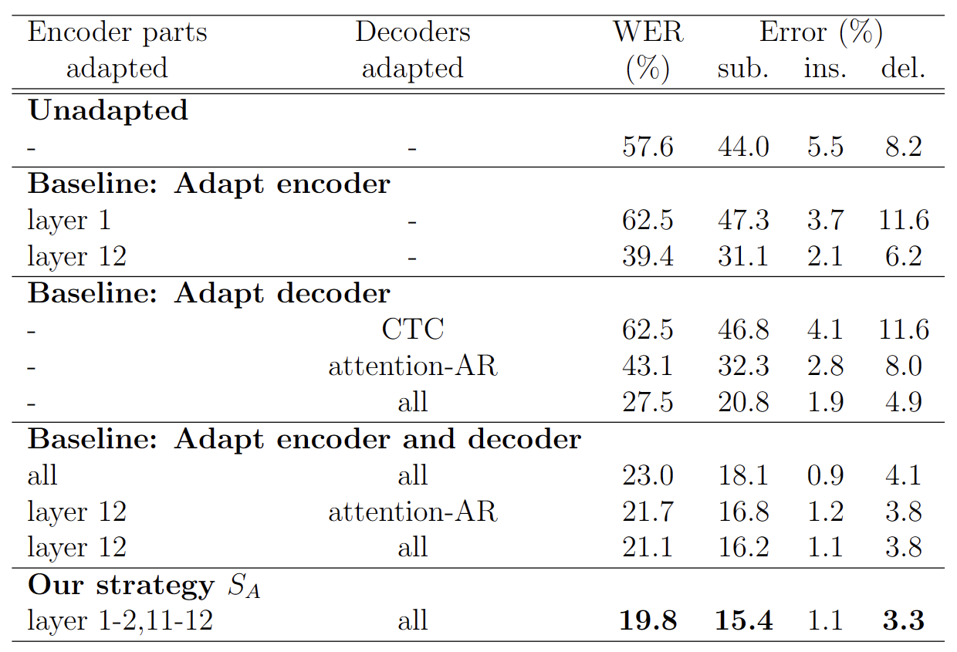
B1. Layerwise adaptation using automatic layer selection
Task 1: Reduce overfitting on low quality data adaption
Overfitting
Strategy A
Train set in
IMDA2
After
training
Layer
Performance
metric
layer performance fluctuate/no improvement
Restart training from scratch
Freeze the layer
Librispeech
ASR model
Train epochs
Adapt to IMDA2
Validate in IMDA2
Experiment
Results

Slide 28

B1. Layerwise adaptation using automatic layer selection
Findings 1. Effectiveness of Strategy A
Adapt our own Librispeech model to IMDA2 domain

Slide 29
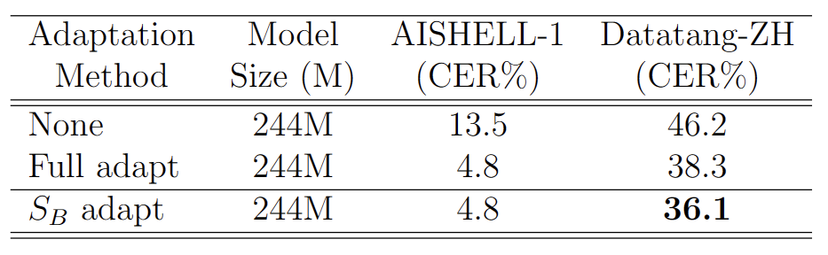
B1. Layerwise adaptation using automatic layer selection
Findings 1. Effectiveness of Strategy B
Adapt OpenAI Whisper to AISHELL-1 domain

Slide 30
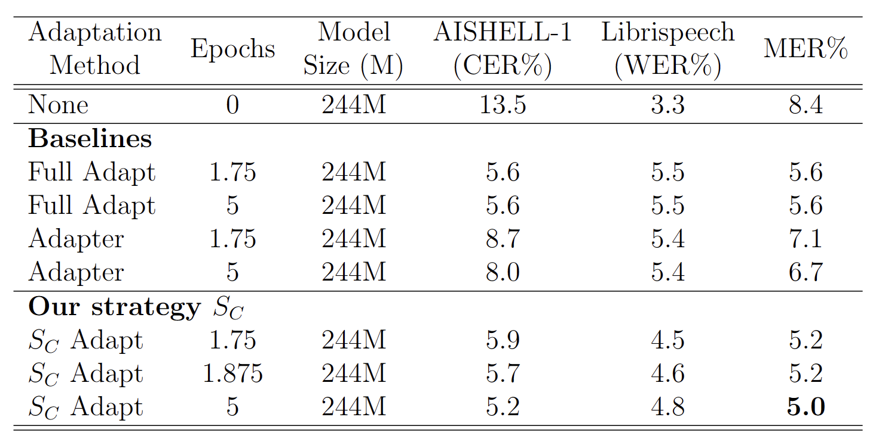
B1. Layerwise adaptation using automatic layer selection
Findings 1. Effectiveness of Strategy C
Adapt OpenAI Whisper to AISHELL-1 domain
Catastrophic forgetting

Slide 31
B1. Layerwise adaptation using automatic layer selection
Automatic layer selection
3 strategies
Overfitting
Strategy B
During
training
Train set in
domain B
Freeze layer 2
Resume training at checkpoint where layer 2 performs the best
Layer
Performance
metric
Domain A ASR model
Train epochs
Adapt to domain B
Validate in domain B
.

Slide 32
B1. Layerwise adaptation using automatic layer selection
Automatic layer selection
3 strategies
Catastrophic forgetting
Strategy C
During
training
Train set in
domain B
Freeze layer 2
Resume training at checkpoint where layer 2 performs the best
Layer
Performance
metric
Domain A ASR model
Train epochs
Adapt to domain B
Validate in domain A
.

Slide 33


B1. Layerwise adaptation using automatic layer selection
Automatic layer selection
Consists of 3 stages
1. Estimate Layer performance
2. Record Training dynamics
3. Perform Early Stopping
Layer 1
Layer 2
Layer 3
Layer 2 performance no longer improves from epoch 3
Layer
Performance
metric
Freeze / Early stop layer 2
(higher the better)
1
2
3
4
5
6
7
Train epochs
2. Record Training Dynamics
3. Perform Early Stopping
.

Slide 34
A2. ASR Adaptation
What is ASR adaptation?
Update model weights [1] -> enhance performance in specific domain
Pre-training stage
Adaptation stage
Adapted ASR model
Update
model
Better Result in domain B
Domain A ASR model
Domain A ASR model
inference
inference
train dataset in
domain A
train dataset in
domain B
Test performance
in domain B
[1] Yao, Kaisheng, et al. "Adaptation of context-dependent deep neural networks for automatic speech recognition." 2012 IEEE Spoken Language Technology Workshop (SLT). IEEE, 2012.

