Slide 1

Domain Adaptation approaches for end2end ASR models
presented by
Kwok Chin Yuen
Supervisor
Assoc. Prof. Chng Eng Siong
16 Nov 2023

Slide 2
Outline
Introduction
What is end-to-end automatic speech recognition (ASR)
What, why and hows of ASR Adaptation
Contributions
TTS synthesized data adaptation
Layerwise adaptation using automatic selection
Conclusions & Future Work

Slide 3
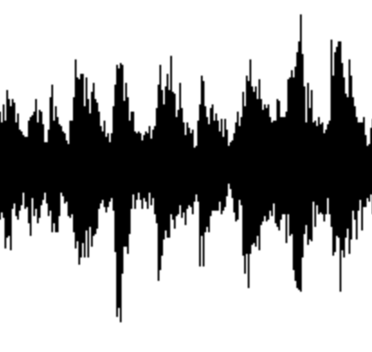
A. Introduction
What is end-to-end automatic speech recognition (ASR)?
ASR: Convert spoken words into written text
End-to-end model ^{[1]}: directly map input acoustic features into output tokens
Lexicon, Language model
Non end-to-end ASR ^{[1]} :
Acoustic model
Phoneme
Likelihood
Decoder
text
audio
End-to-end ASR model ^{[2]} :
End-to-end ASR model ^{[1]}
text
audio
[1] Vegesna, Vishnu Vidyadhara Raju, et al. "DNN-HMM acoustic modeling for large vocabulary telugu speech recognition." Mining Intelligence and Knowledge Exploration: 5th International Conference, MIKE 2017, Hyderabad, India, December 13–15, 2017, Proceedings 5. Springer International Publishing, 2017.
[2] Gulati, Anmol, et al. "Conformer: Convolution-augmented transformer for speech recognition." arXiv preprint arXiv:2005.08100 (2020).

Slide 4


A. Introduction
Recent advances of end-to-end ASR
Statistical model (1952) Deep Learning model (2014 ~)
Larger model, more training data better performance
Whisper ASR (2022):
Model | Model size (param) | Training data size (hours)
OpenAI Whisper | 1.5 B | 680 K
MetaAI MMS | 1B | 44.7K
MMS ASR (2023):
[1] Radford, Alec, et al. "Robust speech recognition via large-scale weak supervision." International Conference on Machine Learning. PMLR, 2023.
[2] Pratap, Vineel, et al. "Scaling speech technology to 1,000+ languages." arXiv preprint arXiv:2305.13516 (2023).

Slide 5
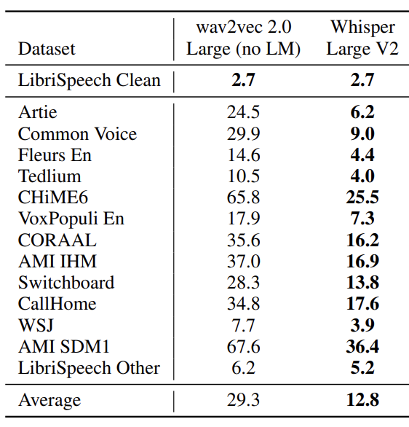
A. Introduction
Is the problem of ASR solved? …No
ASR is not robust performance affected by audio domains
Domains:
Speech Context
Noise
Speaker
Codec
Channel
Recording setup
Radford, Alec, et al. "Robust speech recognition via large-scale weak supervision." International Conference on Machine Learning. PMLR, 2023.

Slide 6
A. Introduction
What is ASR adaptation ?
ASR

Slide 7
C1: Cross Attention with Monotonic Alignment
2.1 Motivation
2.2 Model architecture
2.3 Experiments and results

Slide 8
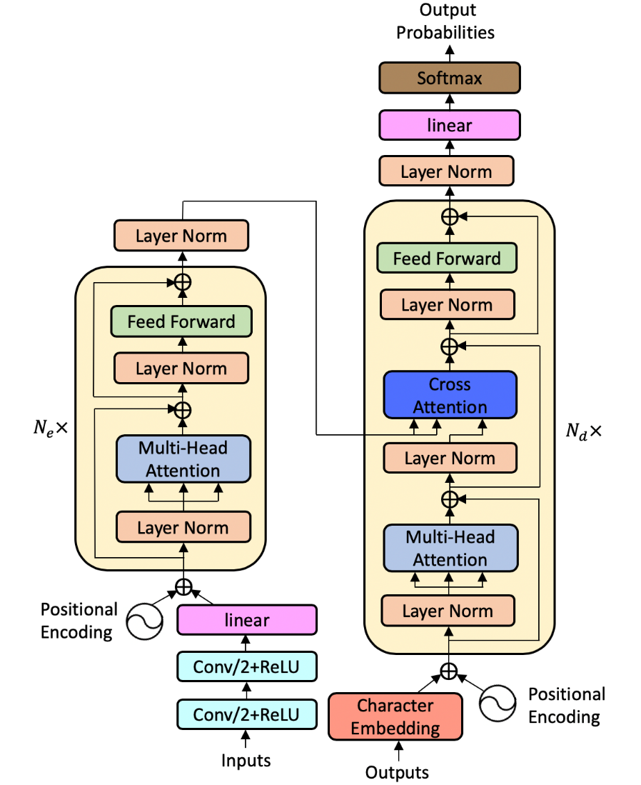
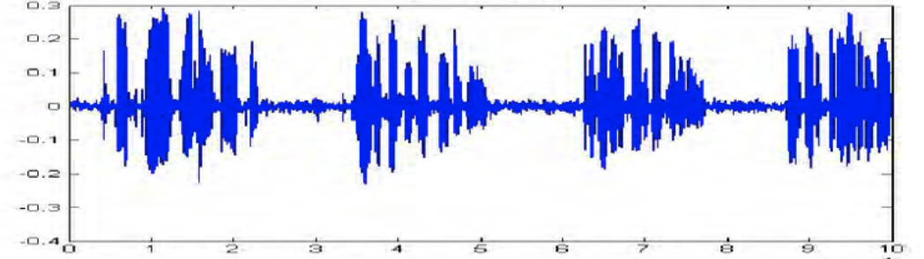
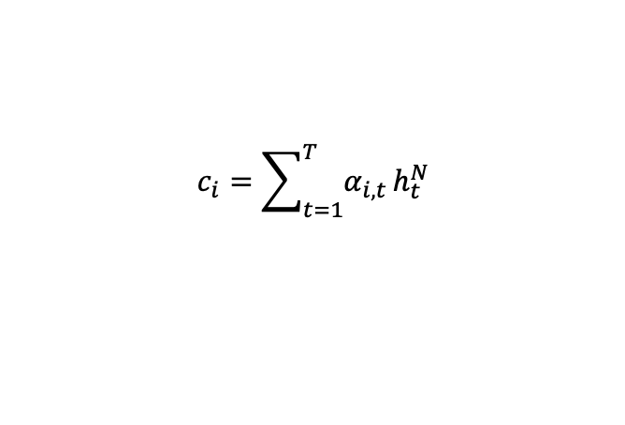
2.1 Motivation
For transformer model
Cross attention disperses the attention distribution over the entire speech input
In speech recognition
The text output and its speech input are monotonically aligned
$$c_{i}=\sum_{t=1}^{T}{α_{i,t}}h_{t}^{N}$$
align
One Two Three Four
One speech and its text transcription example.

Slide 9
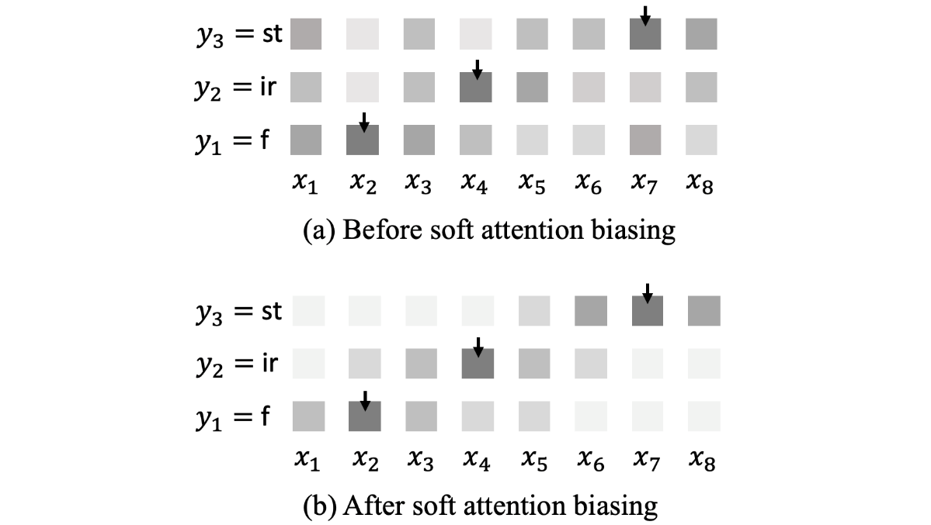
2.2 Model architecture
Cross attention
Alignment
Take the position with the maximum cross attention weight as the input alignment position
Cross attention biasing
Add a Gaussian mask centered at alignment position (soft alignment biasing)

Slide 10
2.2 Model architecture
Cross attention
Look-ahead frames ^{[1]}
Apply cross attention biasing at lower layers of the decoder ^{[2]}
Monotonic alignment regularization
[1] N. Moritz, T. Hori, and J. L. Roux, “Triggered attention for end-to-end speech recognition,” ICASSP 2019.
[2] A. Raganato and J. Tiedemann, “An analysis of encoder representations in transformer-based machine translation,” EMNLP 2018.

Slide 11
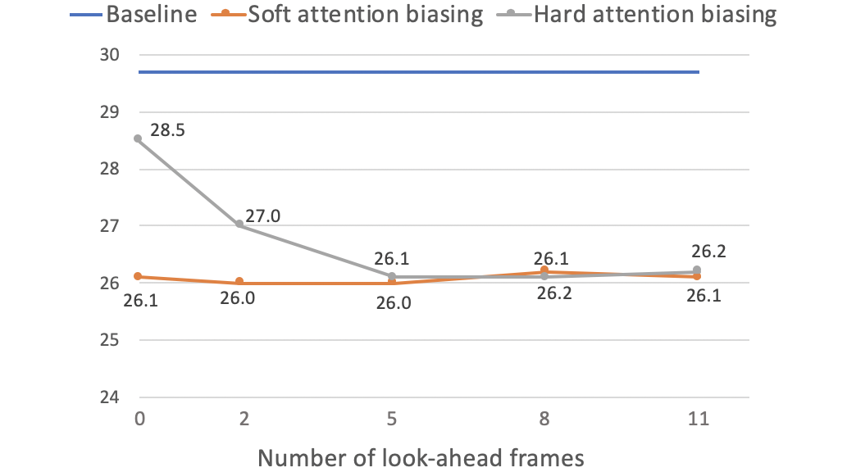
2.3 Experiment
Dataset
Number of look-ahead frames
LibriSpeech ^{[1]} | Length | Baseline WER
Training set | 100 hour | -
Test_clean set | 5.4 hour | 12.0
Test_other set | 5.1 hour | 29.7
Number of look-ahead frames does not affect soft attention biasing
Use 5 look-ahead frames with soft attention biasing
[1] V. Panayotov, G. Chen, D. Povey, and S. Khudanpur, “Librispeech: an ASR corpus based on public domain audio books,” ICASSP 2015.

Slide 12
2.3 Experiment
Number of decoder layers applying cross attention biasing
Cross attention biasing and alignment regularization
Decoder layers applied | Test_clean | Test_other
Baseline | 12.0 | 29.7
Layer 1-3 | 9.4 | 25.9
Layer 4-6 | 9.5 | 26.2
Layer 1-6 | 9.4 | 26.0
Model | Test_clean | Test_other
Baseline | 12.0 | 29.7
Our proposed method | 9.0 | 25.4
w/o look-ahead frames | 9.3 | 25.9
w/o apply on layer 1-3 | 9.4 | 26.0
w/o alignment regularization | 9.4 | 25.9
Hybrid global+local model ^{[1]} | 9.4 | 25.9
[1] M. Xu, D. F. Wong, B. Yang, Y. Zhang, and L. S. Chao, “Leveraging local and global patterns for self-attention networks,” ACL 2019.

Slide 13
C2: Speaker Aware Persistent Memory
3.1 Motivation
3.2 Model architecture
3.3 Experiments and results

Slide 14
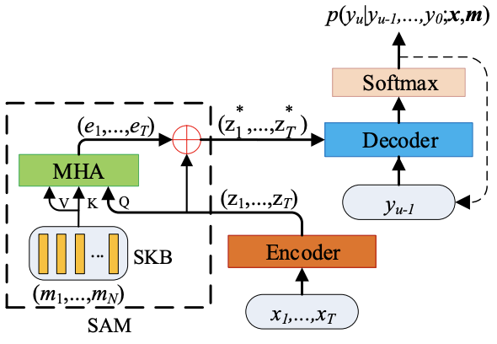

3.1 Motivation
Speaker adaptation
Add a multi-head attention network with speaker i-vectors after encoder ^{[1]}
$(e_{1},…,e_{T})$ are time step independent speaker representation
Double the parameter size of linear transformation in each decoder layer
[1] Z. Fan, J. Li, S. Zhou, and B. Xu, “Speaker-aware speech-transformer,” ASRU 2019.

Slide 15
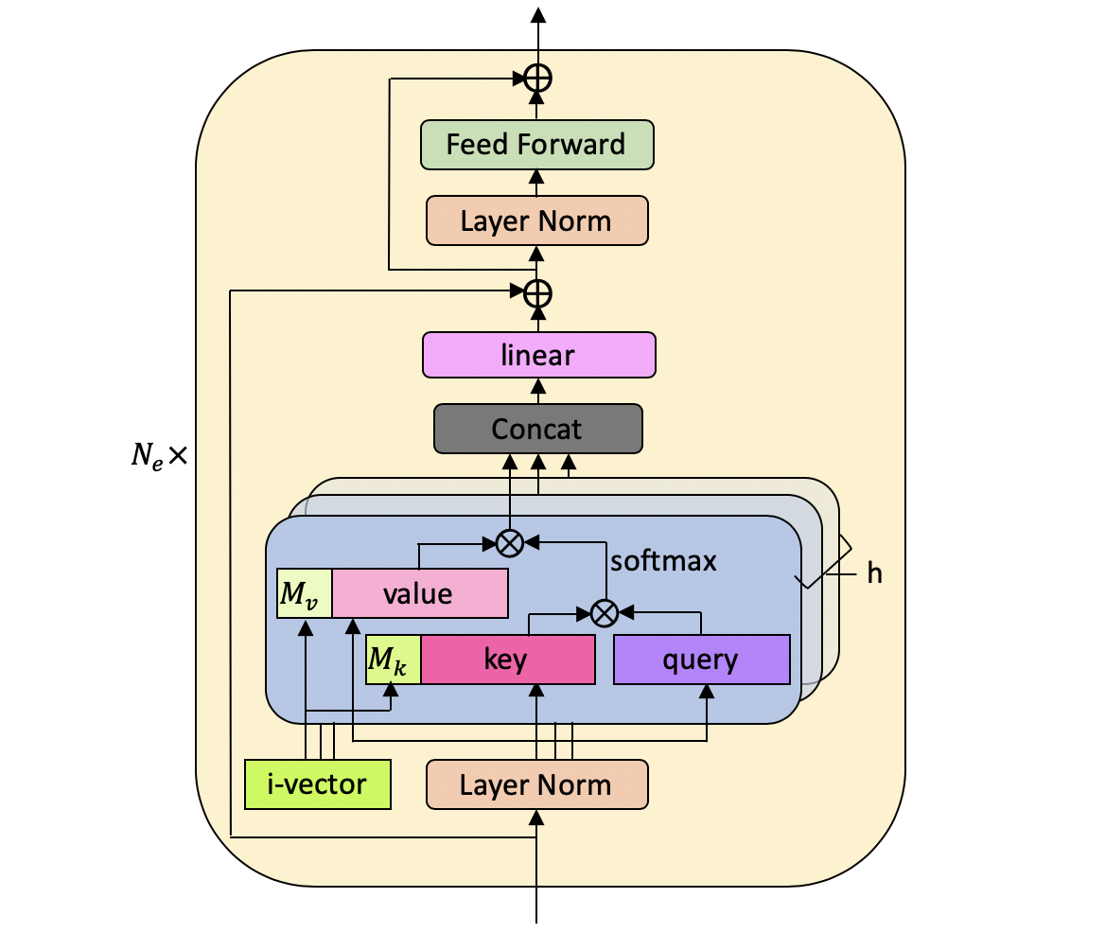
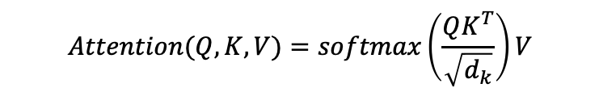

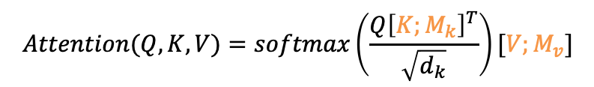
3.2 Model architecture
Speaker space
$N$ randomly sampled speaker i-vectors
$$m_{1},…,m_{N}∈ℝ^{d}$$
$$Attention(Q,K,V)=softmax\left(\frac{QK^{T}}{\sqrt{d_{k}}}\right)V$$
$$Attention(Q,K,V)=softmax\left(\frac{Q{\left[K;M_{k}\right]}^{T}}{\sqrt{d_{k}}}\right)[V;M_{v}]$$
encoder

Slide 16
3.3 Experiment
Dataset
LibriSpeech ^{[1]}
Training set | 100h (251 speakers)
Test_clean set | 5.4h (20 males, 20 females)
Test_other set | 5.1h (16 males, 17 females)
Switchboard ^{[2]}
Training set | 300h (4804 speakers)
SWBDset | 2.1h (40 speakers)
CallHome set | 1.6h (40 speakers)
AISHELL-1 ^{[3]}
Training set | 150h (340 speakers)
Test set | 5h (13 males, 7 females)
[1] V. Panayotov, G. Chen, D. Povey, and S. Khudanpur, “Librispeech: an ASR corpus based on public domain audio books,” ICASSP 2015.
[2] J. J. Godfrey, E. C. Holliman, and J. McDaniel, “SWITCHBOARD: telephone speech corpus for research and de- velopment,” ICASSP 1992.
[3] H. Bu, J. Du, X. Na, B. Wu, and H. Zheng, “AISHELL-1: An open-source mandarin speech corpus and a speech recognition baseline,” in 2017 20th O-COCOSDA. IEEE, 2017.

Slide 17
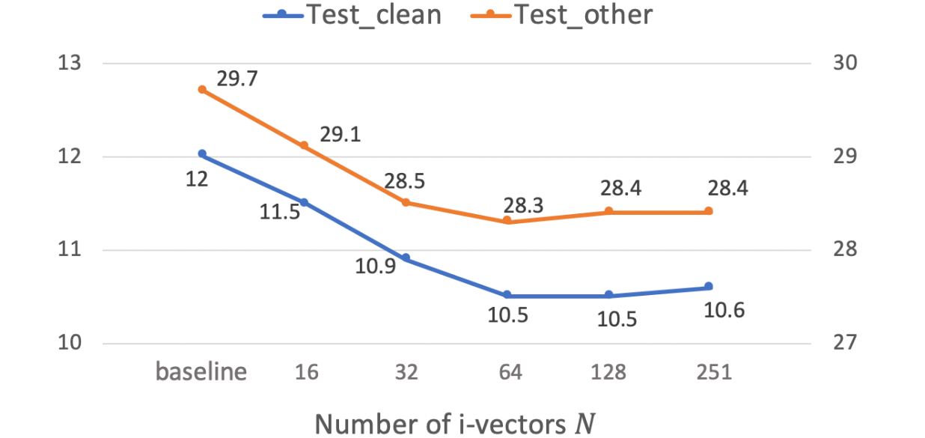
3.3 Experiment
Number of speaker i-vectors
Number of layers applied with speaker aware persistent memory
Performance improve from 16 to 64 i-vectors
After 64 i-vectors, increasing the number does not improve further
Encoder layers applied | Test_clean | Test_other
Baseline | 12.0 | 29.7
Lower half (1-6) | 11.2 | 28.6
Higher half (7-12) | 10.9 | 28.1
All (1-12) | 10.5 | 28.3
Applying on higher layers obtains better performance

Slide 18
3.3 Experiment
Comparison with other models
Model | Switchboard
 | SWBD | CallHome |  | All
Baseline | 8.8 | 18.0 |  | 13.4
Attn based ^{[1]} | - | - |  | 15.5
BLHUC ^{[2]} | 12.8 | 22.9 |  | -
PM ^{[3]} | 8.8 | 17.5 |  | 13.2
Our work | 8.2 | 16.0 |  | 12.1
Model | AISHELL-1
 | Dev |  | Test
Baseline | 6.4 |  | 7.3
SAST ^{[4]} | 7.6 |  | 7.8
PM ^{[3]} | 6.3 |  | 7.1
Our work | 5.9 |  | 6.4
Model | LibriSpeech
 | Test_clean |  | Test_other
Baseline | 12.0 |  | 29.7
SAST ^{[4]} | 11.4 |  | 28.4
PM ^{[3]} | 11.3 |  | 28.9
Our work | 10.5 |  | 28.3
Switchboard – 9.7% relative improvement
AISHELL-1 – 7.8%-12.3% relative improvement
LibriSpeech – 4.7%-12.5% relative improvement
[1] J. Pan, et al, “Online speaker adaptation for LVCSR based on attention mechanism,” APSIPA ASC, 2018. .
[2] X. Xie, et al, “BLHUC: Bayesian learning of hidden unit contributions for deep neural network speaker adaptation,” ICASSP 2019.
[3] Z. You, et al, “DFSMN-SAN with persistent memory model for automatic speech recognition,” arXiv preprint arXiv:1910.13282, 2019.
[4] Z. Fan, et al, “Speaker-aware speech-transformer,” ASRU 2019.

Slide 19
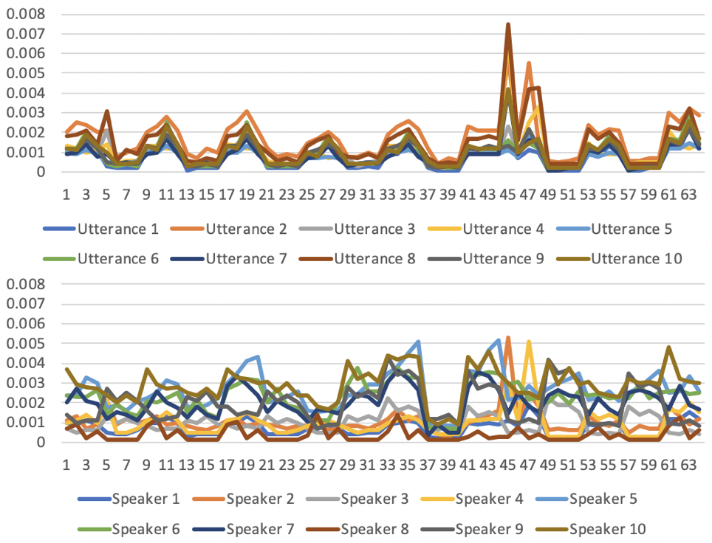
3.3 Experiment
Persistent memory analysis
Attention scores of ten utterances from one speaker is similar
Attention scores of ten utterances from ten speakers are different

Slide 20
4 Conclusions & Future work
Contribution 1:
An effective cross attention biasing method for monotonic alignment between text and speech
Contribution 2:
Speaker aware persistent memory model for speaker adaptation

Slide 21
4 Conclusions & Future work
Extension of contribution 1:
Integration with a more effective encoder network
Global misalignment regularization
Extension of contribution 2:
Speaker i-vector clustering
Include i-vector generation as a full end-to-end model
Speaker diarization
Replace i-vector with channel / background noise – environment identification / noise adaptation
Future work 3:
Robustness towards other factors (domain, language model, channel etc.)
Future work 4:
Unsupervised adaptation (speaker adaptation without i-vector)
Future work 5:
Multilingual ASR, use pretrained mBART model for decoder

Slide 22
Thank you very much!

