Slide 1

Domain Adaptation approaches for end2end ASR models
presented by
Kwok Chin Yuen
Supervisor
Assoc. Prof. Chng Eng Siong
16 Nov 2023

Slide 2
About Me
Name: Kwok Chin Yuen
Status: Third Year Ph.D. candidate
Matriculated on 10-Aug-2021
Year 1 & 2 TAC appraisal passed
CGPA: 4.83
Publications:
C. Y. Kwok, H. Y. Li and E. S. Chng, “ASR Model Adaptation for Rare Words Using Synthetic Data Generated by Multiple Text-To-Speech Systems” 2023 Asia-Pacific Signal and Information Processing Association Annual Summit and Conference (APSIPA ASC). IEEE, 2023.

Slide 3
Outline
Introduction
End-to-end automatic speech recognition (ASR)
ASR Adaptation
Contributions
Layerwise adaptation using automatic layer selection
Multiple TTS synthesized data adaptation
Conclusions & Future Work

Slide 4
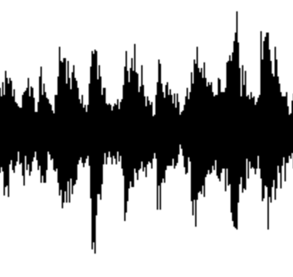
A1. End-to-end automatic speech recognition (ASR)
What is end-to-end automatic speech recognition (ASR)?
ASR: Convert spoken words into written text
End-to-end model ^{[1]}: directly map input acoustic features into output tokens
Lexicon, Language model
Non end-to-end ASR ^{[1]} :
Acoustic model
Phoneme
Likelihood
Decoder
text
audio
End-to-end ASR model ^{[2]} :
Encoder
Decoder
Encoder + Decoder
text
audio
Neural network
[1] Vegesna, Vishnu Vidyadhara Raju, et al. "DNN-HMM acoustic modeling for large vocabulary telugu speech recognition." Mining Intelligence and Knowledge Exploration: 5th International Conference, MIKE 2017, Hyderabad, India, December 13–15, 2017, Proceedings 5. Springer International Publishing, 2017.
[2] Gulati, Anmol, et al. "Conformer: Convolution-augmented transformer for speech recognition." arXiv preprint arXiv:2005.08100 (2020).

Slide 5
A1. End-to-end automatic speech recognition (ASR)
Recent advances of end-to-end ASR
Hidden Markov Models (1980s) Deep Learning model (2010s ~)
Larger model, more training data better performance
Hidden Markov Models [4]
Foundation models [1,2]
Finite State Machine [5]
Deep learning [6]
End-to-end
Non end-to-end
[3]
1982
1992
2002
2012
2022
Model | Model size (param) | Training data size (hours)
OpenAI Whisper (2022) [1] | 1.5 B | 680 K
MetaAI MMS (2023) [2] | 1B | 44.7K
[1] Radford, Alec, et al. "Robust speech recognition via large-scale weak supervision." International Conference on Machine Learning. PMLR, 2023.
[2] Pratap, Vineel, et al. "Scaling speech technology to 1,000+ languages." arXiv preprint arXiv:2305.13516 (2023).
[3] Juang, Biing-Hwang, and Lawrence R. Rabiner. "Automatic speech recognition–a brief history of the technology development." Georgia Institute of Technology. Atlanta Rutgers University and the University of California. Santa Barbara 1 (2005): 67.
[4] Eddy, Sean R. "What is a hidden Markov model?." Nature biotechnology 22.10 (2004): 1315-1316.
[5] Lee, David, and Mihalis Yannakakis. "Principles and methods of testing finite state machines-a survey." Proceedings of the IEEE 84.8 (1996): 1090-1123.
[6] LeCun, Yann, Yoshua Bengio, and Geoffrey Hinton. "Deep learning." nature 521.7553 (2015): 436-444.

Slide 6
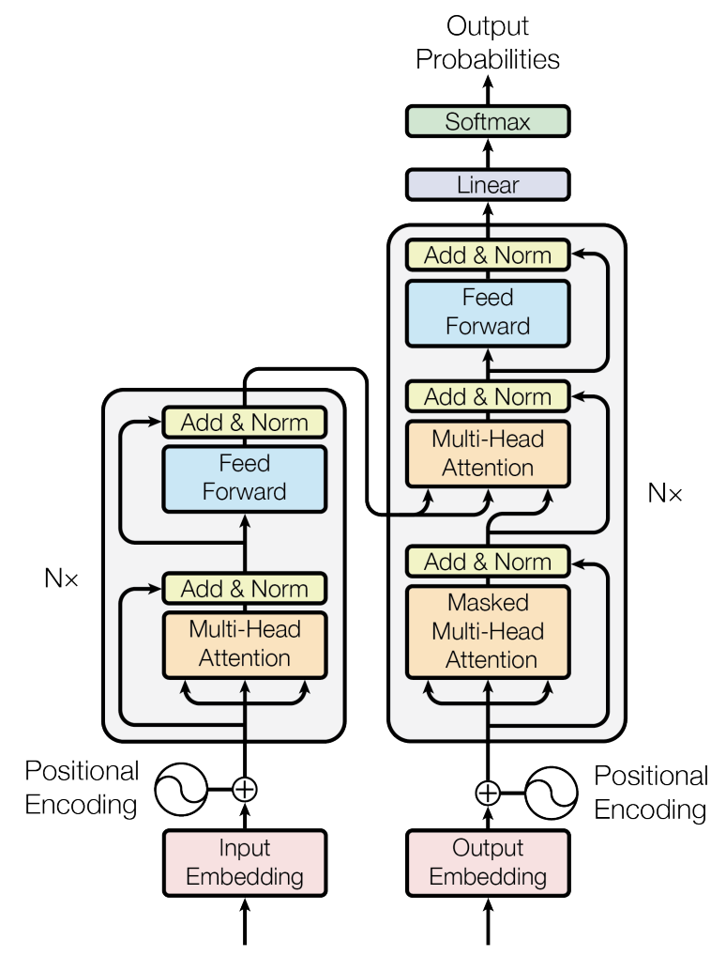



A1. End-to-end automatic speech recognition (ASR)
How is end-to-end ASR model trained?
Transformer [1] Encoder-decoder structure
Encoder Acoustic modelling
Decoder Language modelling
Probabilities of
next token
Evaluation criterion: word error rate (WER)
encoder
embeddings
Probability of
correct next token
Training criterion:
n^{th} predicted token
encoder embedding
Prev.
predicted
tokens
audio features
[1] Vaswani, Ashish, et al. "Attention is all you need." Advances in neural information processing systems 30 (2017).
Notes:
Decoder will perform autoregressive decoder

Slide 7
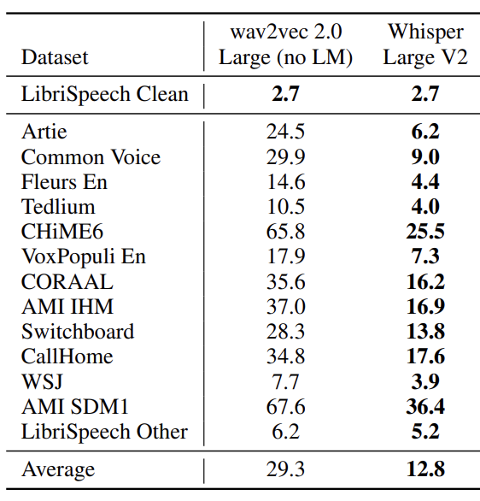
A2. ASR Adaptation
Is the problem of ASR solved? …No
ASR is not robust performance affected by audio domains
Domains:
Speech Context
Noise
Speaker
Codec
Channel
Recording setup
(word error rate)
(Human ~ 3 -10)
Radford, Alec, et al. "Robust speech recognition via large-scale weak supervision." International Conference on Machine Learning. PMLR, 2023.
Notes:
Previously mentioned: more data, larger model -> better performance

Slide 8
A2. ASR Adaptation
What is ASR adaptation?
Update model weights [1] -> enhance performance in specific domain
Pre-training stage
Adaptation stage
Domain A WER
Domain B WER
Domain B WER
Adapt on
domain B
Domain A ASR model
Domain A ASR model
Adapted to domain B ASR model
dataset in
domain A
dataset in
domain B
[1] Yao, Kaisheng, et al. "Adaptation of context-dependent deep neural networks for automatic speech recognition." 2012 IEEE Spoken Language Technology Workshop (SLT). IEEE, 2012.

Slide 9
A2. ASR Adaptation
What ASR Adaptation methods are there?
Contributions:
Regularized Adaptation [1,2]
Regularized Adaptation [1,2]
Layerwise adaptation using automatic layer selection
Knowledge Injection [3,4]
ASR Adaptation
Efficient Adaptation [5,6]
Efficient Adaptation [5,6]
TTS synthesized data adaptation
Adaptation for Hybrid/Statistical model [7,8]
[1] Hank Liao. Speaker adaptation of context dependent deep neural networks. In 2013 IEEE International Conference on Acoustics, Speech and Signal Processing, pages 7947–7951. IEEE, 2013
[2] Dong Yu, Kaisheng Yao, Hang Su, Gang Li, and Frank Seide. Kl-divergence regularized deep neural network adaptation for improved large vocabulary speech recognition. In 2013 IEEE International Conference on Acoustics, Speech and Signal Processing, pages 7893–7897. IEEE, 2013
[3] Anjuli Kannan, Arindrima Datta, Tara N Sainath, Eugene Weinstein, Bhuvana Ramabhadran, Yonghui Wu, Ankur Bapna, Zhifeng Chen, and Seungji Lee. Large-scale multilingual speech recognition with a streaming end-to-end model. arXiv preprint arXiv:1909.05330, 2019
[4] George Saon, Hagen Soltau, David Nahamoo, and Michael Picheny. Speaker adaptation of neural network acoustic models using i-vectors. 2013 IEEE Workshop on Automatic Speech Recognition and Understanding, pages 55-59, 2013
[5] Bethan Thomas, Samuel Kessler, and Salah Karout. Efficient adapter transfer of self-supervised speech models for automatic speech recognition. ICASSP 2022 - 2022 IEEE International Conference on Acoustics, Speech and Signal Processing (ICASSP), pages 7102–7106, 2022
[6] Taesup Kim, Inchul Song, and Yoshua Bengio. Dynamic layer normalization for adaptive neural acoustic modeling in speech recognition. In Interspeech, 2017
[7] Chris Leggetter and Philip C. Woodland. Maximum likelihood linear regression for speaker adaptation of continuous density hidden Markov models. Comput. Speech Lang., 9:171–185, 1995.
[8] Yajie Miao, Hao Zhang, and Florian Metze. Towards speaker adaptive training of deep neural network acoustic models. In Interspeech, 2014
Notes:
Reduce overfitting and catastrophic forgetting. E.g. Including L2 penalty into training loss
Provide additional information besides audio. E.g. provide speaker information besides audio
Adapt ASR model under various resource constraints. E.g. adapt partial model weights to reduce training computation cost
E.g. Maximum Likelihood Linear Regression

Slide 10
Outline
Introduction
End-to-end automatic speech recognition (ASR)
ASR Adaptation
Contributions
Layerwise adaptation using automatic selection
TTS synthesized data adaptation
Conclusions & Future Work

Slide 11

B1. Layerwise adaptation using automatic layer selection
What is layerwise adaptation?
Layer updated
Probabilities of
next token
Probabilities of
next token
Layer freezed
Encoder
embeddings
Encoder
embeddings
…
…
Adapt last
layer only[1]
Adapt all
Layers [2]
…
…
Prev.
predicted
tokens
Prev.
predicted
tokens
audio features
audio features
[1] Gong, Xun, et al. "Layer-wise fast adaptation for end-to-end multi-accent speech recognition." arXiv preprint arXiv:2204.09883 (2022).
[2] Di Gangi, Mattia A., Matteo Negri, and Marco Turchi. "Adapting transformer to end-to-end spoken language translation." Proceedings of INTERSPEECH 2019. International Speech Communication Association (ISCA), 2019. 1133-1137.
Notes:
Basically is if you have a lot of fine tune data - you can update all layers
But if you have only a little - then update of layers should be selective

Slide 12


B1. Layerwise adaptation using automatic layer selection
Why do we need Layerwise adaptation?
Prevent Overfitting [1]
Prevent Catastrophic Forgetting [2]
Overfitting
Catastrophic Forgetting
Inconsistent performance
Adaptation stage
train dataset in
domain B
validation
Loss
Results
in
Domain A ASR model
Adapted to domain B ASR model
training
Domain A WER
Domain A WER
Epochs
[1] Daniel Bashir, George D Monta ̃nez, Sonia Sehra, Pedro Sandoval Segura, and Julius Lauw. An information-theoretic perspective on overfitting and underfitting. In AI 2020: Advances in Artificial Intelligence: 33rd Australasian Joint Conference, AI 2020, Canberra, ACT, Australia, November 29–30, 2020, Proceedings 33, pages 347–358. Springer, 2020
[2] Cuong V Nguyen, Alessandro Achille, Michael Lam, Tal Hassner, Vijay Mahadevan, and Stefano Soatto. Toward understanding catastrophic forgetting in continual learning. arXiv preprint arXiv:1908.01091, 2019
Notes:
Performance gap between model training and validation increases. This is undesirable as we want model training and validation performance to be consistent.

Slide 13
B1. Layerwise adaptation using automatic layer selection
Research problem: How to select the layers to adapt?
Depends on the task
E.g. Language or Accent domain adaptation?
Previous works:
Probabilities of
next token
acoustic
features
Last few layers [3]
First few layers [4]
stronger language modelling [1]
…
…
stronger acoustic modelling [2]
Prev.
predicted
tokens
audio features
[1] Kyuhong Shim, Jungwook Choi, and Wonyong Sung. Understanding the role of self attention for efficient speech recognition. In International Conference on Learning Representations, 2021
[2] Zied Elloumi, Laurent Besacier, Olivier Galibert, and Benjamin Lecou- teux. Analyzing learned representations of a deep asr performance prediction model. arXiv preprint arXiv:1808.08573, 2018.
[3] Xinwei Li, Yue Pan, Matthew Gibson, and Puming Zhan. Dnn online adaptation for automatic speech recognition. In Konferenz Elektronische Sprachsignalverarbeitung, pages 46–53. TUDpress, Dresden, 2018
[4] Prashanth Gurunath Shivakumar and Panayiotis Georgiou. Transfer learning from adult to children for speech recognition: Evaluation, analysis and recommendations. Computer speech & language, 63:101077, 2020

Slide 14
B1. Layerwise adaptation using automatic layer selection
What is the problem of layer selection for layerwise adaptation?
Require expert knowledge
High computation cost
To decide
To decide
Examples
Which layer to adapt?
How many layers to adapt?
What task? Adapt to new accent
New Accent Acoustic modelling [1]
First layer better at acoustic [2]
We try to:
Adapt 1 layer
Adapt 2 layers
Best result
…
Adapt N layers
Decision: Adapt first layer
Decision: Adapt 2 layers
[1] Turan, Mehmet Ali Tuğtekin, Emmanuel Vincent, and Denis Jouvet. "Achieving multi-accent ASR via unsupervised acoustic model adaptation." INTERSPEECH 2020. 2020.
[2] Zied Elloumi, Laurent Besacier, Olivier Galibert, and Benjamin Lecou- teux. Analyzing learned representations of a deep asr performance prediction model. arXiv preprint arXiv:1808.08573, 2018.
Notes:
Brute force search of all combinations of layers conducted, and it was found…
high computation cost because its np complete to search and optimise different combinations of layers

Slide 15
B1. Layerwise adaptation using automatic layer selection
Baselines:
How does previous works solve catastrophic forgetting?
Parameter regularization: Elastic weight consolidation (EWC) [1]
Rehearsal strategy: Replay samples and minimize logits L2 distance [2]
Modular based: Use task specific model components [3]
How does previous works solve overfitting?
Adapt small amount of model weights: Adapter [4]
Dropout [5]
Label smoothing [6]
[1] Kirkpatrick, James, et al. "Overcoming catastrophic forgetting in neural networks." Proceedings of the national academy of sciences 114.13 (2017): 3521-3526.
[2] Buzzega, Pietro, et al. "Dark experience for general continual learning: a strong, simple baseline." Advances in neural information processing systems 33 (2020): 15920-15930.
[3] Ostapenko, Oleksiy, et al. "Continual learning via local module composition." Advances in Neural Information Processing Systems 34 (2021): 30298-30312.
[4] He, Ruidan, et al. "On the effectiveness of adapter-based tuning for pretrained language model adaptation." arXiv preprint arXiv:2106.03164 (2021).
[5] Srivastava, Nitish, et al. "Dropout: a simple way to prevent neural networks from overfitting." The journal of machine learning research 15.1 (2014): 1929-1958.
[6] Müller, Rafael, Simon Kornblith, and Geoffrey E. Hinton. "When does label smoothing help?." Advances in neural information processing systems 32 (2019).

Slide 17
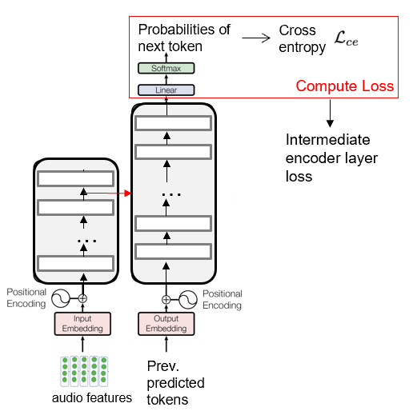

B1. Layerwise adaptation using automatic layer selection
Automatic layer selection for Transformers
Consists of 3 stages
1. Estimate Layer performance
2. Record Layer Performance
3. Perform Early Stopping
1 way to estimate layer performance Layer loss
Original loss calculation
New loss calculation
Original loss calculation
Probabilities of
next token
Probabilities of
next token
Probabilities of
next token
Cross
entropy
Compute Loss
acoustic
features
acoustic
features
acoustic
features
Compute Loss
Final loss
Compute Loss
…
…
…
…
…
Compute Loss
…
Intermediate
Decoder layer losses
Prev.
predicted
tokens
Prev.
predicted
tokens
Prev.
predicted
tokens
audio features
audio features
audio features
.

Slide 18


B1. Layerwise adaptation using automatic layer selection
Automatic layer selection for Transformers
Consists of 3 stages
1. Estimate Layer performance
2. Record Layer Performance
3. Perform Early Stopping
Layer performance = - Layer Loss
Layer 1
New loss calculation
Layer 2
Probabilities of
next token
Layer
Validation set
Performance
Metric
Layer 3
…
acoustic
features
(higher the better)
Compute Loss
…
Compute Loss
…
Compute Loss
1
2
3
4
5
6
7
Train epochs
Intermediate
layer losses
Prev.
predicted
tokens
2. Record Layer Performance
audio features
.

Slide 19
B1. Layerwise adaptation using automatic layer selection
Automatic layer selection for Transformers
Consists of 3 stages
1. Estimate Layer performance
2. Record Layer Performance
3. Perform Early Stopping
Layer 1
Layer 2
Layer 2 performance no longer improves from epoch 3
Layer
Validation set
Performance
Metric
Layer 3
…
(higher the better)
Sign of overfitting / forgetting
Freeze / Early stop layer 2
1
2
3
4
5
6
7
Train epochs
3. Perform Early Stopping
2. Record Layer Performance
.
Notes:
Layer selection criterion: Track Individual layer loss during adaptation to determine when does overfitting and catastrophic forgetting occur

Slide 20
B1. Layerwise adaptation using automatic layer selection
Benchmark dataset
Each dataset split to train + validation + test set (except Datang-ZH)
ASR Corpus | Duration | Type | Language
LibriSpeech-100h [1] | 100h | Clean read | English
AISHELL-1 [2] | 170h | Clean read | Chinese
Datatang-ZH [3] | 7h (test only) | Noisy Spontaneous | Chinese
Example transcription:
Librispeech: A voice from beyond the world was calling.
AISHELL-1: 对于北京申办冬奥会的最终结果,
Datatang-ZH: 你 个 笨蛋 我 想 听歌。
[1] Panayotov, Vassil, et al. "Librispeech: an asr corpus based on public domain audio books." 2015 IEEE international conference on acoustics, speech and signal processing (ICASSP). IEEE, 2015.
[2] Bu, Hui, et al. "Aishell-1: An open-source mandarin speech corpus and a speech recognition baseline." 2017 20th conference of the oriental chapter of the international coordinating committee on speech databases and speech I/O systems and assessment (O-COCOSDA). IEEE, 2017.
[3] Ltd Beijing DataTang Technology Co. Mandarin conversational speech data from datatang
.

Slide 21
B1. Layerwise adaptation using automatic layer selection
Experiment setups
1) Pretrained model: Whisper
English WER good
Chinese WER bad
2) Adapt to AISHELL-1 (Chinese)
Chinese WER
But 2 negative effects
Overfitting
Forgetting
Overfit to AISHELL-1 (Chinese)
Other Chinese result suboptimal
Forget English domain
Librispeech (English) result suboptimal
Evaluate Task 1: Reduce overfitting
Evaluate Task 2: Reduce forgetting
Test in Datatang-ZH (Chinese)
Test in Librispeech (English)
If Overfit solved,
Datatang-ZH (Chinese) WER
If forgetting solved,
Librispeech (English) WER
Notes:
Shift domain to Chinese
May not generalize well to other Chinese dataset

Slide 22
B1. Layerwise adaptation using automatic layer selection
Task 1: Reduce overfitting
No improvement. Stop training to prevent Overfitting
During
training
AISHELL-1
Dataset
layer performance fluctuate/no improvement
Resume training at checkpoint where the layer performs the best
Layer
Performance
metric
Freeze the layer
Whisper
ASR model
Train epochs
Adapt to AISHELL-1
train set (Chinese)
Validate in AISHELL-1
Validation set (Chinese)
Experiment
Results
Notes:
The more we train, the more we overfit

Slide 23
B1. Layerwise adaptation using automatic layer selection
Task 2: Reduce catastrophic forgetting
Catastrophic forgetting
During
training
AISHELL-1
Dataset
layer performance fluctuate/no improvement
Resume training at checkpoint where the layer performs the best
Freeze the layer
Layer
Performance
metric
Whisper
ASR model
Train epochs
Adapt to AISHELL-1
train set (Chinese)
Validate in Librispeech-100h
Validation set (English)
Validation set data size very small = 5 audio samples
Experiment
Results
Notes:
Typically, we use 5% of corpus to form validation set. To demonstrate the effectiveness of our method -> only use 5 audio samples <0.01% of corpus
forgets English domain knowledge

Slide 24


B2. Multiple TTS synthesized data adaptation
Scope: ASR adaptation for rare words [1,2,3]
Rare words: words rarely/never seen in ASR dataset
Hard to find rare word ASR dataset
Hard to train/adapt model to rare words
rare word
Example Scenario
(My name is Mac Ardle.)
ASR model
Transcribe as: My name is make other.
Poor result, need adaptation
Idea:
Hard to find dataset, cannot adapt
Use name dictionary (text-only data) to adapt ASR model?
[1] C. Peyser, S. Mavandadi, T. N. Sainath, J. Apfel, R. Pang, and S. Kumar, “Improving tail performance of a deliberation e2e asr model using a large text corpus,” arXiv preprint arXiv:2008.10491, 2020.
[2] Jain, Mahaveer, et al. "Contextual RNN-T for open domain ASR." arXiv preprint arXiv:2006.03411 (2020).
[3] Huang, Rongqing, et al. "Class LM and word mapping for contextual biasing in end-to-end ASR." arXiv preprint arXiv:2007.05609 (2020).
Notes:
It is hard to find rare word ASR dataset. If we cannot find the dataset, then we cannot adapt the ASR model

Slide 25



B2. Multiple TTS synthesized data adaptation
How to perform ASR adaptation with supervised learning?
Supervised learning
ASR Model
encoder
decoder
HYP
encoder embeddings
REF
During training
paired
。

Slide 26

B2. Multiple TTS synthesized data adaptation
What is text-only adaptation?
Adapt ASR model to new language domain using text-only data
What type of text-only Adaptation methods are there?
Type 2: Text-to-encoder [1,2]
Type 1: TTS synthesized data adaptation [1,2]
encoder
Text-to-encoder training
paired
Learn to predict
Text-to-encoder
Text-only data available
ASR Model
ASR Model
ASR Model
encoder
encoder
decoder
encoder
decoder
decoder
HYP
encoder embeddings
REF
encoder embeddings
encoder embeddings
missing
During training
During training
During training
Text-to-encoder
TTS model
Fake encoder
embeddings
Text in new language domain
[1] Tomoki Hayashi, Shinji Watanabe, Yu Zhang, Tomoki Toda, Takaaki Hori, Ram ́on Fern ́andez Astudillo, and K. Takeda. Back-translation-style data augmentation for end-to-end asr. 2018 IEEE Spoken Language Technology Workshop (SLT), pages 426–433, 2018. URL https://api.semanticscholar.org/CorpusID:51879045.
[2] Takaaki Hori, Ram ́on Fern ́andez Astudillo, Tomoki Hayashi, Yu Zhang, Shinji Watanabe, and Jonathan Le Roux. Cycle-consistency training for end-to-end speech recognition. ICASSP 2019 - 2019 IEEE International Conference on Acoustics, Speech and Signal Processing (ICASSP), pages 6271–6275, 2018. URL https://api.semanticscholar.org/CorpusID:53219757.
[1] Xianrui Zheng, Yulan Liu, Deniz Gunceler, and Daniel Willett. Using synthetic audio to improve the recognition of out-of-vocabulary words in end-to-end asr systems. In ICASSP 2021-2021 IEEE International Conference on Acoustics, Speech and Signal Processing (ICASSP), pages 5674–5678. IEEE, 2021
[2] Masato Mimura, Sei Ueno, Hirofumi Inaguma, Shinsuke Sakai, and Tatsuya Kawahara. Leveraging sequence-to-sequence speech synthesis for enhancing acoustic-to-word speech recognition. In 2018 IEEE Spoken Language Technology Workshop (SLT), pages 477–484. IEEE, 2018

Slide 27

B2. Multiple TTS synthesized data adaptation
What type of text-only Adaptation methods are there?
4 types
Type 4: Decoder pretraining [1]
Type 3: LM fusion [1,2]
Stage 1: Pretrain LM
Stage 2: Train ASR model
Stage 1:Train external LM
ASR Model
train
train
LM
External LM
LM as decoder
Text in
new language domain
encoder
ASR Model
ASR Model
encoder
encoder
LM as decoder
decoder
Encoder embeddings
Encoder embeddings
Biasing
Stage 3: During Inference
Stage 2: During Inference
External LM
Given text-audio samples at test time
Given text-audio samples at test time
[1] Le, Duc, et al. "Contextualized streaming end-to-end speech recognition with trie-based deep biasing and shallow fusion." arXiv preprint arXiv:2104.02194 (2021)
[2] Le, Duc, et al. "Deep shallow fusion for RNN-T personalization." 2021 IEEE Spoken Language Technology Workshop (SLT). IEEE, 2021..
[1] Gao, Changfeng, et al. "Pre-training transformer decoder for end-to-end asr model with unpaired text data." ICASSP 2021-2021 IEEE International Conference on Acoustics, Speech and Signal Processing (ICASSP). IEEE, 2021.

Slide 28


B2. Multiple TTS synthesized data adaptation
Our approach: TTS synthesized data adaptation
For better adaptation Larger, more diverse dataset [1,2]
Research problem: How to generate diverse adaptation data?
Previous works [3,4]
Random speaker
I eat
apple
TTS 1
Random speaker
Sample random speaker embedding
More diverse TTS output data
Our work
TTS 1
Random speaker
I eat apple
TTS 2
Random speaker
[1] Sei Ueno, Masato Mimura, Shinsuke Sakai, and Tatsuya Kawahara. Multi-speaker sequence-to-sequence speech synthesis for data augmentation in acoustic-to-word speech recognition. In ICASSP 2019-2019 IEEE International Conference on Acoustics, Speech and Signal Processing (ICASSP), pages 6161–6165. IEEE, 2019
[2] Chenpeng Du and Kai Yu. Speaker aug[3] Xianrui Zheng, Yulan Liu, Deniz Gunceler, and Daniel Willett. Using synthetic audio to improve the recognition of out-of-vocabulary words in end-to-end asr systems. In ICASSP 2021-2021 IEEE International Conference on Acoustics, Speech and Signal Processing (ICASSP), pages 5674–5678. IEEE, 2021
[3] X. Zheng, Y. Liu, D. Gunceler, and D. Willett, “Using synthetic audio to improve the recognition of out-of-vocabulary words in end-to-end asr systems,” in ICASSP 2021-2021 IEEE International Conference on Acoustics, Speech and Signal Processing (ICASSP), IEEE, 2021, pp. 5674–5678.
[4] M. Mimura, S. Ueno, H. Inaguma, S. Sakai, and T. Kawahara, “Leveraging sequence-to-sequence speech synthesis for enhancing acoustic-to-word speech recognition,” in 2018 IEEE Spoken Language Technology Workshop (SLT), IEEE, 2018, pp. 477–484.
Notes:
different tts may benefit variability in generated speech data

Slide 29
B2. Multiple TTS synthesized data adaptation
Experiment Setup
Benchmark Dataset
ASR Corpus | Duration | Type | Language | # Sentences in train set
IMDA2-10h [1] | 10h | Clean read Rare word | English
13K
13K
E.g.
IMDA2-10h: What is the cheapest way to Kampong Glam?
TTS systems
TTS systems | Trained on | # Train set speaker | End-to-end
VITS [2] | VCTK [4] |  | Yes
TransformerTTS [3] | VCTK [4] |  | No
108
108
108
108
[1] . Jia Xin Koh, Aqilah Mislan, Kevin Khoo, Brian Ang, Wilson Ang, Charmaine Ng, and YY Tan. Building the singapore english national speech corpus. Malay, 20(25.0):19–3, 2019
[2] J. Kim, J. Kong, and J. Son, “Conditional variational autoencoder with adversarial learning for end-to-end text-to-speech,” in International Conference on Machine Learning, PMLR, 2021, pp. 5530–5540.
[3] N. Li, S. Liu, Y. Liu, S. Zhao, and M. Liu, “Neural speech synthesis with transformer network,” in Proceedings of the AAAI conference on artificial intelligence, vol. 33, 2019, pp. 6706–6713.
[4] C. Veaux, J. Yamagishi, K. MacDonald, et al., “Cstrvctk corpus: English multi-speaker corpus for cstr voice cloning toolkit,” University of Edinburgh. The Centre for Speech Technology Research (CSTR), 2017

Slide 30

B2. Multiple TTS synthesized data adaptation
Experiment Setup
Simulate text-only adaption use IMDA2-10h
TTS synthesize voice from 108 random speakers (SPKs)
13K sentences
Ways to create TTS synthesized audio dataset
For each sentence from 13K sentences
TransformerTTS
OR VITS
Random SPK
Single TTS
(TransformerTTS OR VITS)
Sample random speaker embedding
Random SPK
Same Dataset Size
For each sentence from 13K sentences
Transformer
TTS
Random SPK
Multiple TTS
(Transformer TTS + VITS)
Sample random speaker embedding
VITS
Random SPK
.

Slide 31
B2. Multiple TTS synthesized data adaptation
Experiment results
TTS synthesized audio
Dataset
Librispeech
ASR model
Adapt to TTS synthesized audio dataset
Upper bound
Baselines
Our method
IMDA2
Multiple TTS helps provide variability to speaker speech and lead to better adaptation result

Slide 32
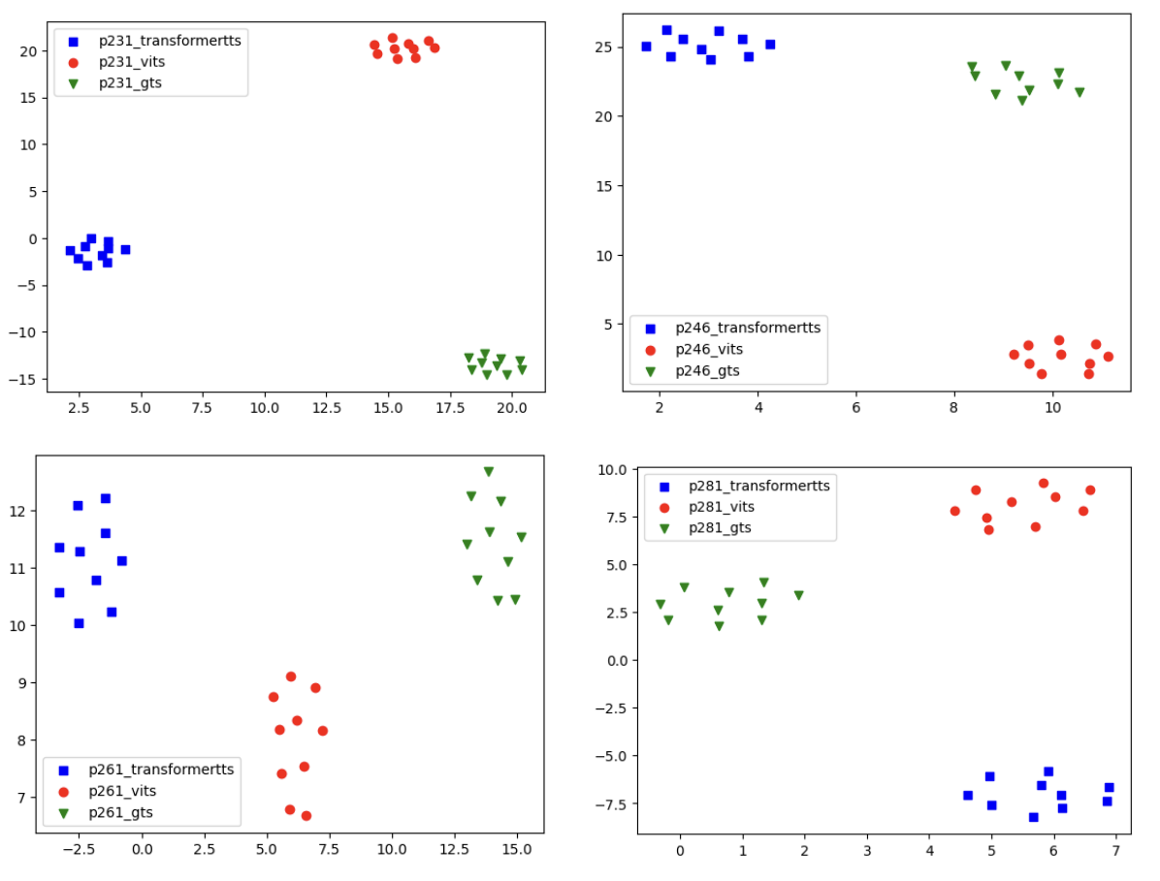
B2. Multiple TTS synthesized data adaptation
Analysis: Different TTS output different SPK embedding for the same SPK
UMAP plot [1] of speaker (SPK) embeddings
[1] L. McInnes, J. Healy, and J. Melville, “Umap: Uniform manifold approximation and projection for dimension reduction,” arXiv preprint arXiv:1802.03426, 2018.

Slide 33
Outline
Introduction
End-to-end automatic speech recognition (ASR)
ASR Adaptation
Contributions
Layerwise adaptation using automatic layer selection
Multiple TTS synthesized data adaptation
Conclusions & Future Work

Slide 34
C. Conclusions & Future Work
Conclusion:
Contribution 1 (Layerwise adaptation using automatic layer selection):
Introduced Layerwise freezing based on Layer performance estimation
Layer performance good indicators of overfitting and forgetting
Training dynamics of layer performance freeze/early stop layer
Improved adaptation result over full adaptation baseline
Contribution 2 (Multiple TTS synthesized data adaptation):
Explore multiple TTS data synthesis
Our method using Multiple TTS helps provide variability to speaker speech
Improved adaptation result over single TTS

Slide 35
C. Conclusions & Future Work
Future Work:
Extension of contribution 1 (Layerwise adaptation using automatic layer selection):
Currently: Automatic layer selection for early stopping/freezing
Automatic layer selection for adapter insertion
Extension of contribution 2 (Multiple TTS synthesized data adaptation):
Currently: Adapt ASR model using TTS output audio
Adapt ASR model using TTS intermediate representation
New Future Approach 1: LLM ASR adaptation
New Future Approach 2: Rare words adaptation via context biasing

Slide 36

Probabilities of
next token
Cross
entropy
Compute Loss
Intermediate encoder layer loss
…
…
Prev.
predicted
tokens
audio features

Slide 37
B2. Multiple TTS synthesized data adaptation
How to perform ASR adaptation normally?
If text-audio pair is available
ASR Model
encoder
decoder
Encoder embeddings
During training
paired
。

Slide 38
B2. Multiple TTS synthesized data adaptation
What type of text-only Adaptation methods are there?
4 types
Text-only data available
ASR Model
encoder
decoder
Acoustic features
missing
During training
。

Slide 39
B2. Multiple TTS synthesized data adaptation
What text-only Adaptation methods are there?
TTS synthesized data adaptation [1,2]
ASR Model
encoder
decoder
Acoustic features
During training
TTS model
[1] Xianrui Zheng, Yulan Liu, Deniz Gunceler, and Daniel Willett. Using synthetic audio to improve the recognition of out-of-vocabulary words in end-to-end asr systems. In ICASSP 2021-2021 IEEE International Conference on Acoustics, Speech and Signal Processing (ICASSP), pages 5674–5678. IEEE, 2021
[2] Masato Mimura, Sei Ueno, Hirofumi Inaguma, Shinsuke Sakai, and Tatsuya Kawahara. Leveraging sequence-to-sequence speech synthesis for enhancing acoustic-to-word speech recognition. In 2018 IEEE Spoken Language Technology Workshop (SLT), pages 477–484. IEEE, 2018

Slide 40
B2. Multiple TTS synthesized data adaptation
What text-only Adaptation methods are there?
Text-to-encoder [1,2]
ASR Model
encoder
decoder
Acoustic features
During training
Text-to-encoder
Fake acoustic representations
[1] Tomoki Hayashi, Shinji Watanabe, Yu Zhang, Tomoki Toda, Takaaki Hori, Ram ́on Fern ́andez Astudillo, and K. Takeda. Back-translation-style data augmentation for end-to-end asr. 2018 IEEE Spoken Language Technology Workshop (SLT), pages 426–433, 2018. URL https://api.semanticscholar.org/CorpusID:51879045.
[2] Takaaki Hori, Ram ́on Fern ́andez Astudillo, Tomoki Hayashi, Yu Zhang, Shinji Watanabe, and Jonathan Le Roux. Cycle-consistency training for end-to-end speech recognition. ICASSP 2019 - 2019 IEEE International Conference on Acoustics, Speech and Signal Processing (ICASSP), pages 6271–6275, 2018. URL https://api.semanticscholar.org/CorpusID:53219757.

Slide 41
B2. Multiple TTS synthesized data adaptation
What is the problem of text-only adaptation?
LM fusion [1,2]
Stage 1:Train external LM
train
External LM
ASR Model
encoder
decoder
Acoustic features
Biasing
Stage 2: During Inference
External LM
Given text-audio samples at test time
[7] Le, Duc, et al. "Contextualized streaming end-to-end speech recognition with trie-based deep biasing and shallow fusion." arXiv preprint arXiv:2104.02194 (2021)
[8] Le, Duc, et al. "Deep shallow fusion for RNN-T personalization." 2021 IEEE Spoken Language Technology Workshop (SLT). IEEE, 2021..

Slide 42
B2. Multiple TTS synthesized data adaptation
What is the problem of text-only adaptation?
Decoder pretraining [1,2]
Stage 1: Pretrain biased decoder
train
Biased
decoder
ASR Model
encoder
Biased
decoder
Acoustic features
Stage 2: During Inference
Given text-audio samples at test time
[1] Xun Gong, Wei Wang, Hang Shao, Xie Chen, and Yanmin Qian. Factorized aed: Factorized attention-based encoder-decoder for text-only domain adaptive asr. ICASSP 2023 - 2023 IEEE International Conference on Acoustics, Speech and Signal Processing (ICASSP), 2023. URL https://api.semanticscholar.org/CorpusID:258529852.
[2] Tomoki Hayashi, Shinji Watanabe, Yu Zhang, Tomoki Toda, Takaaki Hori, Ram ́on Fern ́andez Astudillo, and K. Takeda. Back-translation-style data augmentation for end-to-end asr. 2018 IEEE Spoken Language Technology Workshop (SLT), pages 426–433, 2018. URL https://api.semanticscholar.org/CorpusID:51879045.

Slide 43
B2. Multiple TTS synthesized data adaptation
What is the problem of text-only adaptation?
4 types
Type 3: LM fusion [1,2]
Stage 1:Train external LM
train
External LM
ASR Model
encoder
decoder
Acoustic features
Biasing
Stage 2: During Inference
External LM
Given text-audio samples at test time
[7] Le, Duc, et al. "Contextualized streaming end-to-end speech recognition with trie-based deep biasing and shallow fusion." arXiv preprint arXiv:2104.02194 (2021)
[8] Le, Duc, et al. "Deep shallow fusion for RNN-T personalization." 2021 IEEE Spoken Language Technology Workshop (SLT). IEEE, 2021..

Slide 44
B2. Multiple TTS synthesized data adaptation
What is the problem of text-only adaptation?
Decoder pretraining [1,2]
Stage 1: Pretrain biased decoder
train
Biased
decoder
ASR Model
encoder
Biased
decoder
Acoustic features
Stage 2: During Inference
Given text-audio samples at test time
[1] Xun Gong, Wei Wang, Hang Shao, Xie Chen, and Yanmin Qian. Factorized aed: Factorized attention-based encoder-decoder for text-only domain adaptive asr. ICASSP 2023 - 2023 IEEE International Conference on Acoustics, Speech and Signal Processing (ICASSP), 2023. URL https://api.semanticscholar.org/CorpusID:258529852.
[2] Tomoki Hayashi, Shinji Watanabe, Yu Zhang, Tomoki Toda, Takaaki Hori, Ram ́on Fern ́andez Astudillo, and K. Takeda. Back-translation-style data augmentation for end-to-end asr. 2018 IEEE Spoken Language Technology Workshop (SLT), pages 426–433, 2018. URL https://api.semanticscholar.org/CorpusID:51879045.

Slide 45
B2. Multiple TTS synthesized data adaptation
What text-only Adaptation methods are there?
Text-to-encoder [1,2]
TTS data synthesized adaptation [3,4]
TTS data synthesized adaptation [3,4]
Our contribution
Text-only Adaptation
Decoder pretraining [5,6]
LM Fusion [7,8]
[1] Tomoki Hayashi, Shinji Watanabe, Yu Zhang, Tomoki Toda, Takaaki Hori, Ram ́on Fern ́andez Astudillo, and K. Takeda. Back-translation-style data augmentation for end-to-end asr. 2018 IEEE Spoken Language Technology Workshop (SLT), pages 426–433, 2018. URL https://api.semanticscholar.org/CorpusID:51879045.
[2] Takaaki Hori, Ram ́on Fern ́andez Astudillo, Tomoki Hayashi, Yu Zhang, Shinji Watanabe, and Jonathan Le Roux. Cycle-consistency training for end-to-end speech recognition. ICASSP 2019 - 2019 IEEE International Conference on Acoustics, Speech and Signal Processing (ICASSP), pages 6271–6275, 2018. URL https://api.semanticscholar.org/CorpusID:53219757.
[3] Xianrui Zheng, Yulan Liu, Deniz Gunceler, and Daniel Willett. Using synthetic audio to improve the recognition of out-of-vocabulary words in end-to-end asr systems. In ICASSP 2021-2021 IEEE International Conference on Acoustics, Speech and Signal Processing (ICASSP), pages 5674–5678. IEEE, 2021
[4] Masato Mimura, Sei Ueno, Hirofumi Inaguma, Shinsuke Sakai, and Tatsuya Kawahara. Leveraging sequence-to-sequence speech synthesis for enhancing acoustic-to-word speech recognition. In 2018 IEEE Spoken Language Technology Workshop (SLT), pages 477–484. IEEE, 2018
[5] Xun Gong, Wei Wang, Hang Shao, Xie Chen, and Yanmin Qian. Factorized aed: Factorized attention-based encoder-decoder for text-only domain adaptive asr. ICASSP 2023 - 2023 IEEE International Conference on Acoustics, Speech and Signal Processing (ICASSP), 2023. URL https://api.semanticscholar.org/CorpusID:258529852.
[6] Tomoki Hayashi, Shinji Watanabe, Yu Zhang, Tomoki Toda, Takaaki Hori, Ram ́on Fern ́andez Astudillo, and K. Takeda. Back-translation-style data augmentation for end-to-end asr. 2018 IEEE Spoken Language Technology Workshop (SLT), pages 426–433, 2018. URL https://api.semanticscholar.org/CorpusID:51879045.
[7] Le, Duc, et al. "Contextualized streaming end-to-end speech recognition with trie-based deep biasing and shallow fusion." arXiv preprint arXiv:2104.02194 (2021)
[8] Le, Duc, et al. "Deep shallow fusion for RNN-T personalization." 2021 IEEE Spoken Language Technology Workshop (SLT). IEEE, 2021..

Slide 46

B2. Multiple TTS synthesized data adaptation
How to adapt with text-only?
Text-to-encoder [1]
LM Fusion [2]
orange
orange
Real acoustic representations
Fake acoustic representations
Decoder
External LM
Decoder
Audio encoder
I like
Audio encoder
I like
Text-to-encoder
I like orange and apple.
Audio
Transformer architecture
Training stage only
Inference stage only
[1] Tomoki Hayashi, Shinji Watanabe, Yu Zhang, Tomoki Toda, Takaaki Hori, Ram ́on Fern ́andez Astudillo, and K. Takeda. Back-translation-style data augmentation for end-to-end asr. 2018 IEEE Spoken Language Technology Workshop (SLT), pages 426–433, 2018. URL https://api.semanticscholar.org/CorpusID:51879045.
[2] Le, Duc, et al. "Contextualized streaming end-to-end speech recognition with trie-based deep biasing and shallow fusion." arXiv preprint arXiv:2104.02194 (2021).

Slide 47
B1. Layerwise adaptation using automatic layer selection
Automatic layer selection for Transformers
Consists of 3 stages
3. Perform Early Stopping
1. Estimate Layer performance
2. Record Training dynamics
3. Perform Early Stopping
1. Estimate Layer performance
2. Record Training dynamics
Original loss calculation
New loss calculation
Probabilities of
next token
Cross
entropy
Probabilities of
next token
Layer
Performance
metric
Layer 1
Layer 2
Compute Loss
Layer 3
acoustic
features
(higher the better)
Layer 2 performance no longer improves from epoch 3
acoustic
features
Final loss
Compute Loss
1
2
3
4
5
6
7
Train epochs
…
…
Compute Loss
Layer
Performance
metric
…
…
Compute Loss
Freeze / Early stop layer 2
(higher the better)
1
2
3
4
5
6
7
Intermediate
layer losses
Train epochs
2. Record Training Dynamics
3. Perform Early Stopping
Prev.
predicted
tokens
Prev.
predicted
tokens
audio features
audio features
.
Notes:
Details of the implementation will be discussed in the experiment section

Slide 48
B1. Layerwise adaptation using automatic layer selection
Automatic layer selection
Experiments on 2 tasks:
Task 1: Reduce overfitting
Task 2: reduce catastrophic forgetting
Automatic layer selection
Experiments on 2 tasks:
Task 1: Reduce overfitting
Task 2: reduce catastrophic forgetting
Overfitting
Catastrophic forgetting
Task 1
Task 2
Train set in
domain B
Train set in
domain B
Freeze layer 2
Resume training at checkpoint where layer 2 performs the best
Layer
Performance
metric
Freeze layer 2
Resume training at checkpoint where layer 2 performs the best
Layer
Performance
metric
Train epochs
Domain A ASR model
Train epochs
Domain A ASR model
Validate in domain B
Adapt to domain B
Validate in domain A
Adapt to domain B
.

Slide 49
B1. Layerwise adaptation using automatic layer selection
Benchmark dataset
ASR Corpus | Duration | Type | Language
LibriSpeech-100h [1] | 100h | Clean read | English
AISHELL-1 [2] | 170h | Clean read | Chinese
Datatang-ZH [3] | 7h (test only) | Noisy Spontaneous | Chinese
IMDA2-10h [4] | 10h | Clean read Rare word | English
E.g.
Librispeech: A voice from beyond the world was calling.
AISHELL-1: 对于北京申办冬奥会的最终结果,
Datatang-ZH: 你 个 笨蛋 我 想 听歌。
IMDA2-10h: What is the cheapest way to Kampong Glam?
[1] Panayotov, Vassil, et al. "Librispeech: an asr corpus based on public domain audio books." 2015 IEEE international conference on acoustics, speech and signal processing (ICASSP). IEEE, 2015.
[2] Bu, Hui, et al. "Aishell-1: An open-source mandarin speech corpus and a speech recognition baseline." 2017 20th conference of the oriental chapter of the international coordinating committee on speech databases and speech I/O systems and assessment (O-COCOSDA). IEEE, 2017.
[3] Ltd Beijing DataTang Technology Co. Mandarin conversational speech data from datatang
[4] . Jia Xin Koh, Aqilah Mislan, Kevin Khoo, Brian Ang, Wilson Ang, Charmaine Ng, and YY Tan. Building the singapore english national speech corpus. Malay, 20(25.0):19–3, 2019
.

Slide 50
B1. Layerwise adaptation using automatic layer selection
Task 1: Reduce overfitting
Overfitting
Strategy B
During
training
Train set in
AISHELL-1
layer performance fluctuate/no improvement
Resume training at checkpoint where the layer performs the best
Layer
Performance
metric
Freeze the layer
Whisper
ASR model
Train epochs
Adapt to AISHELL-1
Validate in AISHELL-1
Experiment
Results

Slide 51
B1. Layerwise adaptation using automatic layer selection
Task 2: Reduce catastrophic forgetting
Overfitting
Strategy C
Train set in
AISHELL-1
During
training
Layer
Performance
metric
layer performance fluctuate/no improvement
Resume training at checkpoint where the layer performs the best
Freeze the layer
Whisper
ASR model
Train epochs
Adapt to AISHELL-1
Validate in Librispeech-100h
Experiment
Results

Slide 52
B1. Layerwise adaptation using automatic layer selection
Automatic layer selection
3 strategies
Overfitting
Overfitting
Strategy A
Strategy B
After
training
During
training
During
training
Train set in
domain B
Freeze layer 2
Restart training from scratch
Train set in
domain B
Freeze layer 2
Resume training at checkpoint where layer 2 performs the best
Layer
Performance
metric
Layer
Performance
metric
Domain A ASR model
Train epochs
Domain A ASR model
Train epochs
Adapt to domain B
Validate in domain B
Adapt to domain B
Validate in domain B
Catastrophic forgetting
Strategy C
Train set in
domain B
Freeze layer 2
Resume training at checkpoint where layer 2 performs the best
Layer
Performance
metric
.
Domain A ASR model
Train epochs
Adapt to domain B
Validate in domain A

Slide 53

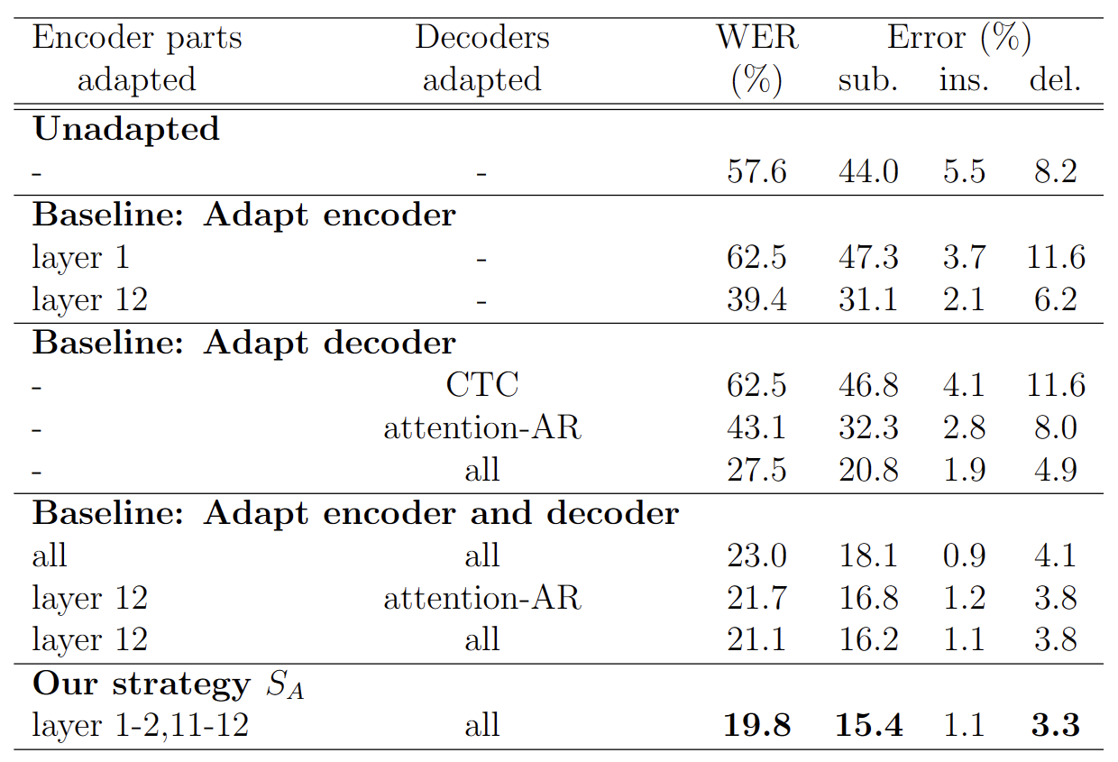
B1. Layerwise adaptation using automatic layer selection
Task 1: Reduce overfitting on low quality data adaption
Overfitting
Strategy A
Train set in
IMDA2
After
training
Layer
Performance
metric
layer performance fluctuate/no improvement
Restart training from scratch
Freeze the layer
Librispeech
ASR model
Train epochs
Adapt to IMDA2
Validate in IMDA2
Experiment
Results

Slide 54

B1. Layerwise adaptation using automatic layer selection
Findings 1. Effectiveness of Strategy A
Adapt our own Librispeech model to IMDA2 domain

Slide 55
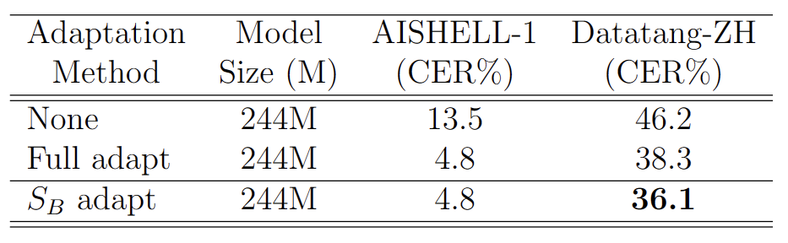
B1. Layerwise adaptation using automatic layer selection
Findings 1. Effectiveness of Strategy B
Adapt OpenAI Whisper to AISHELL-1 domain

Slide 56
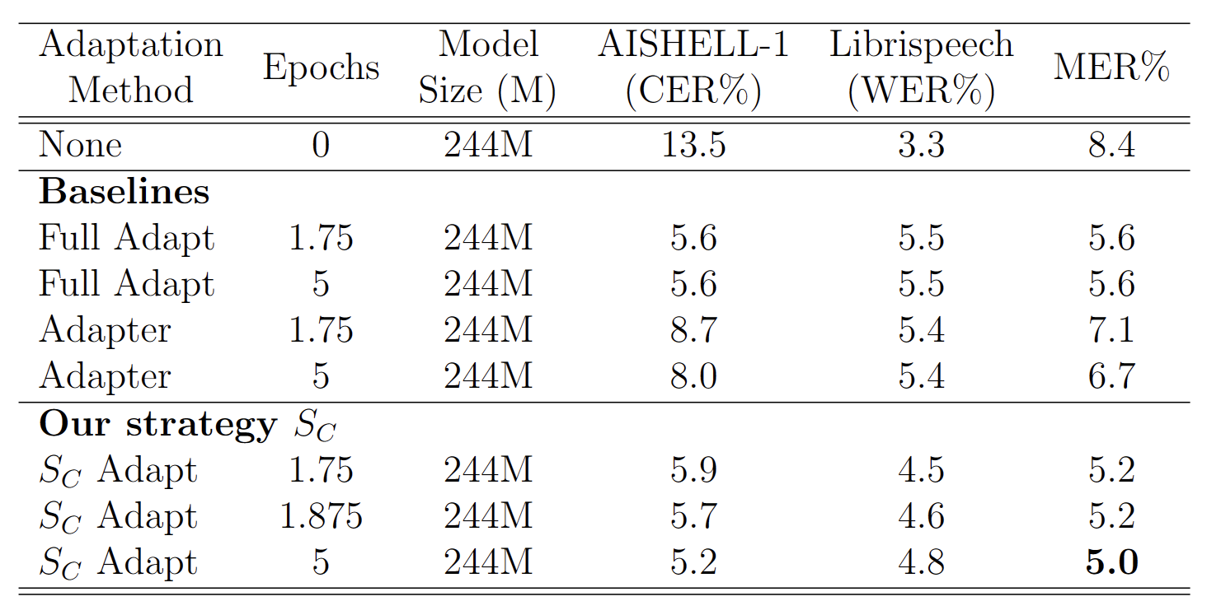
B1. Layerwise adaptation using automatic layer selection
Findings 1. Effectiveness of Strategy C
Adapt OpenAI Whisper to AISHELL-1 domain
Catastrophic forgetting

Slide 57
B1. Layerwise adaptation using automatic layer selection
Automatic layer selection
3 strategies
Overfitting
Strategy B
During
training
Train set in
domain B
Freeze layer 2
Resume training at checkpoint where layer 2 performs the best
Layer
Performance
metric
Domain A ASR model
Train epochs
Adapt to domain B
Validate in domain B
.

Slide 58
B1. Layerwise adaptation using automatic layer selection
Automatic layer selection
3 strategies
Catastrophic forgetting
Strategy C
During
training
Train set in
domain B
Freeze layer 2
Resume training at checkpoint where layer 2 performs the best
Layer
Performance
metric
Domain A ASR model
Train epochs
Adapt to domain B
Validate in domain A
.

Slide 59


B1. Layerwise adaptation using automatic layer selection
Automatic layer selection
Consists of 3 stages
1. Estimate Layer performance
2. Record Training dynamics
3. Perform Early Stopping
Layer 1
Layer 2
Layer 3
Layer 2 performance no longer improves from epoch 3
Layer
Performance
metric
Freeze / Early stop layer 2
(higher the better)
1
2
3
4
5
6
7
Train epochs
2. Record Training Dynamics
3. Perform Early Stopping
.

Slide 60
A2. ASR Adaptation
What is ASR adaptation?
Update model weights [1] -> enhance performance in specific domain
Pre-training stage
Adaptation stage
Adapted ASR model
Update
model
Better Result in domain B
Domain A ASR model
Domain A ASR model
inference
inference
train dataset in
domain A
train dataset in
domain B
Test performance
in domain B
[1] Yao, Kaisheng, et al. "Adaptation of context-dependent deep neural networks for automatic speech recognition." 2012 IEEE Spoken Language Technology Workshop (SLT). IEEE, 2012.

