Slide 1
Tutorial: How to prepare writing plan for PhD thesis
PhD candidate year 4: Kwok Chin Yuen
Supervisor: Chng Eng Siong

Slide 2
A. Sections
Your writing plan should be organized into sections:
Sections to write:
Introduction
Literature Review
Subtopic 1
Subtopic 2
Conclusion and future work

Slide 3
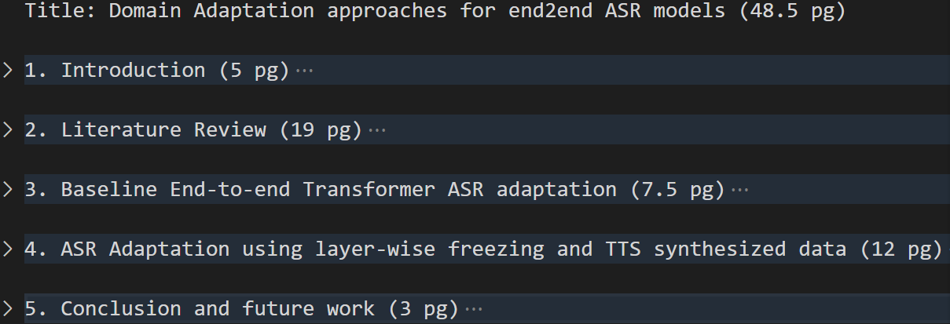
A. Example 1
(This is example for QE. Thesis should be longer like 120 pages)

Slide 4
B. Write up a list of questions
For each section, write a list of questions that you aim to answer for the section:
Write the questions in a cascaded format
From section to subsection
From subsection to sub-subsection
Don’t cascade too much
Indicate the number of pages to write for each question / section
The questions should flow logically

Slide 5
B. Tips in writing questions
To write a section about topic A, always start with:
What is topic A
Why is topic A important
For Lit review, focus on Comparison (Which is better, Why this is better)
For methodology, focus on How (how is this done?)

Slide 6
B1. Questions for Introduction Section
Things to consider:
Subsections to write:
Background
Motivation
Contribution
Report Outline
Background
Prior knowledge about the topic
The broadest overview of the topic

Slide 7
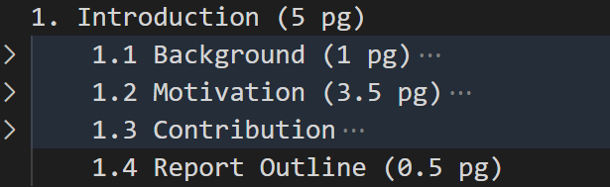
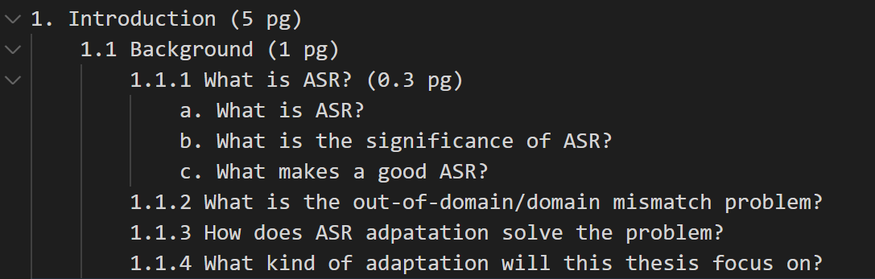
B1. Example 1

Slide 8
B1. Questions for Introduction Section
Things to consider:
Motivation
Problem -> limit scope
Technical gap
How other works solve it
Good story telling: 3 little pigs
Contribution
How we solve it

Slide 9
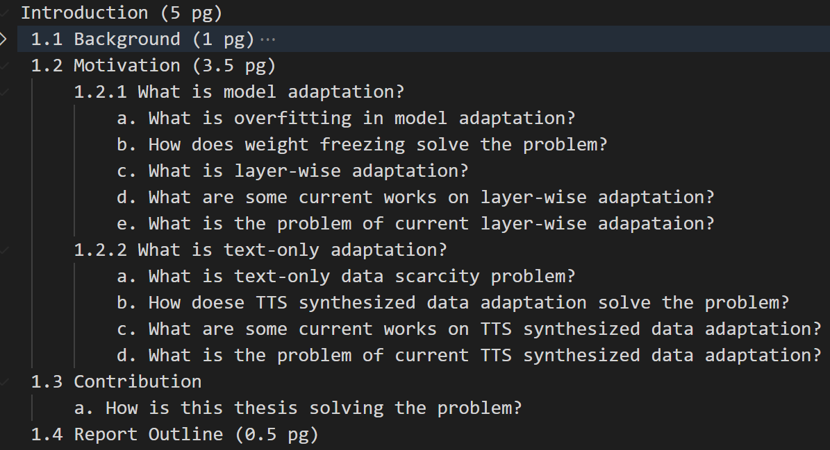
D1. Example2

Slide 10
B2. Questions for Literature Review
Things to consider:
Write overview for each concept in the title
Example: Domain Adaptation approaches for end2end ASR models
Subsections to write:
Overview
Overview 1
Overview 2
Summary
Ask questions more on How and Why, not what
Example: Why do we need domain adaptation?
Give whole taxonomy, then focus on parts that the proposed method is under
Example: proposed method = layer adaptation, falls under = regularized adaptation

Slide 11
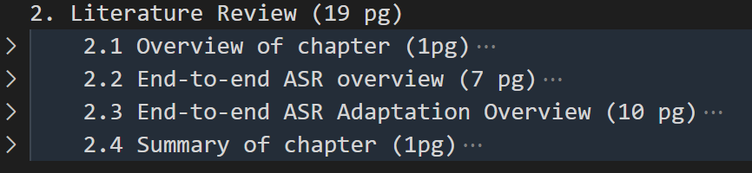
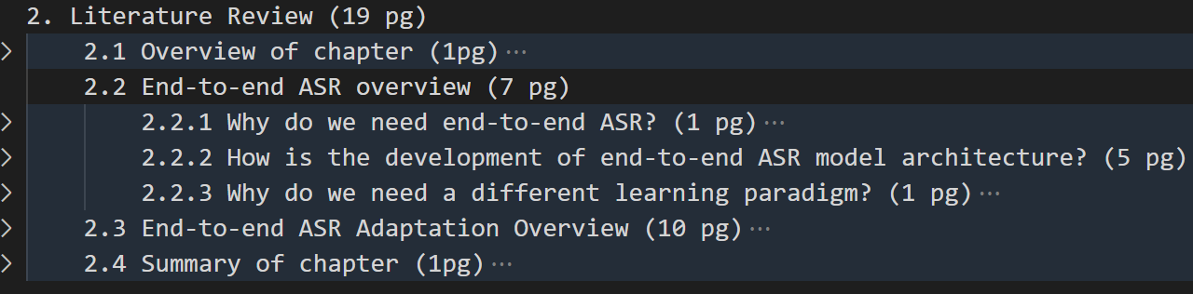
B2. Example

Slide 12
B3. Questions for Methods Section
Things to consider:
Subsections to write:
Overview of chapter
Corpus and metric
Baseline 1
Baseline 2
Summary of chapter
For corpus, give list of available corpus, and explain why you choose certain corpus in experiments
In proposed method subsection, there should be related work
This related work has smaller, more specific scope than Literature Review
Example:
Proposed method: layerwise adaptation
Literature Review: Regularized adaptation. Includes layerwise adaptation, instance weighting
Proposed method - related work: different kinds of layerwise adaptation

Slide 13
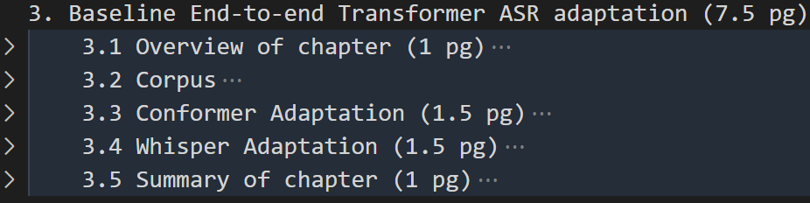
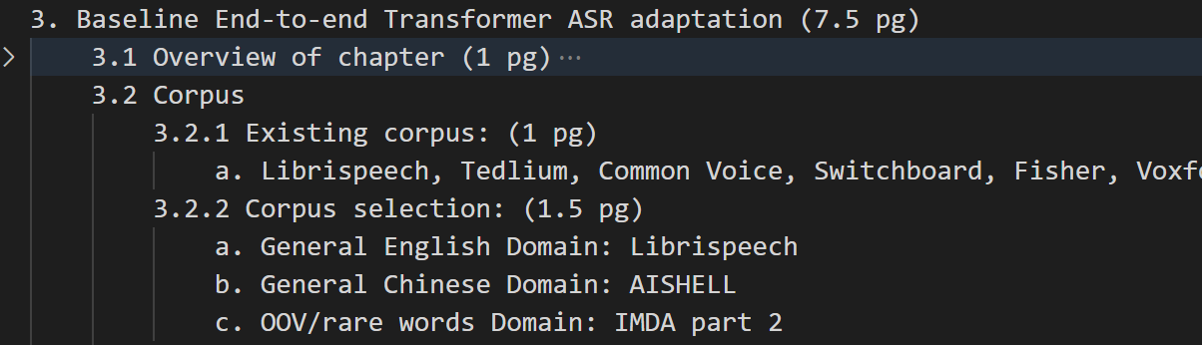
B3. Example

Slide 14
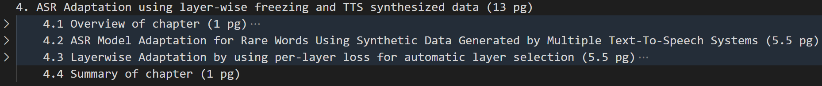
B3. Example

Slide 15
C. Supporting papers
If your chapter comes from your published papers, make sure to show that in the writing plan like
Chapter 3 uses paper A,B,C
Chapter 4 uses paper D,E

